Slide 1
Bradley Nickell Director of Transmission Planning
Incorporation of Water in Transmission Planning
April 2, 2013

Slide 2
RTEP Update Today’s Discussion
WECC Background
Transmission Expansion Planning
Incorporation of Water Information

Slide 3
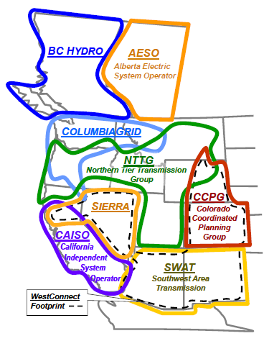
CALIF
CaISO and
California
Transmission
Planning
Group

Slide 4
The Future of Electric Transmission in the West Western Interconnection Facts
The Western Interconnection includes two Canadian provinces, a portion of Baja California Norte, Mexico, and all or part of the 14 Western states
~78 million people
~229 GW of Generation
~122 Thousand miles of Transmission lines
Notes:
~77 M people
~ 20% of the net energy to load in NERC
~1.2M square miles = roughly ½ the size of the U.S.
About WECC
Compliance monitoring
Monitor compliance by users, owners and operators of the bulk power system in the United States
Compliance enforcement
Violation mitigation and settlement negotiation
Standards development
Forum and support for the development of NERC and WECC Reliability Standards Reliability coordination
Operate two Reliability Coordination Offices located in Vancouver, Washington and Loveland, Colorado that provide situational awareness and real-time supervision of the entire Western Interconnection
Operator training
Provide training sessions for operators, schedulers and dispatchers
WREGIS
Hosts the Western Renewable Energy Generation Information System, which creates and tracks renewable energy certificates
Loads and Resources Assessments
Perform annual assessment of 10-year loads and resources
Provide information to NERC for summer and winter assessments of the reliability and adequacy of the bulk electric system
Market-Operations interface
Ensure that competitive power markets do not negatively impact reliability
Transmission Expansion Planning
Management of a comprehensive planning database
Coordination of subregional planning processes
Analyses and modeling
Reliability studies
System modeling and studies performed under a variety of scenarios to set operating policies and limits

Slide 5
Transmission Expansion Planning History of Interconnection-wide planning in the West
Planning cooperation among Western Interconnection entities
Create economic planning data sets
Perform interconnection-wide transmission expansion studies
Process consistent with applicable FERC Order 890 planning principles
Governed by the WECC Transmission Expansion Planning Policy Committee (TEPPC)
Notes:
2000-01 – California Energy Crisis
2002-05 – SSG-WI
Seams Steering Group – Western Interconnection
2005 – TEPPC created by WECC
Took over work being performed by SSG-WI
2010 – DOE Grant to TEPPC
Expand scope of Interconnection-wide planning
TEPPC created in 2005 to continue the work started under SSG-WI.

Slide 6
Transmission Expansion Planning What are we planning for?
Identify future infrastructure needs to
Serve the expected load reliably
Meet public policy directives
Minimize cost and environmental impact
Accomplished by
Maintaining a database of planning data and models
Facilitating an Interconnection-wide planning process
Performing economic analysis
Preparing Interconnection-wide transmission plans
Notes:
Multi-function objective
Not a crystal ball. Rather, an understanding of the regional impacts of state- and provincial-centered decisions

Slide 7
Transmission Expansion Planning Organizational Framework
Notes:
Close coordination between WECC and WGA/WIEB
Expand the breadth and depth of WECC’s existing Regional Transmission Planning process (TEPPC)
$14.5M DOE grant
Deliverables (2011)
10-Year Plan
Acquire new planning tools
Create educational materials
Deliverables (2013)
10- and 20-Year Plans

Slide 8
TEPPC Stakeholders What do they value?
TEPPC’s diverse stakeholders value different products and processes
Data – Tools – Models
Transmission Planners and Developers
Generation Planners and Developers
States and Provinces
Environmental groups
Analysis – Results – Plans
States and Provinces
Environmental groups
Advocacy Groups
All Value the Information Sharing

Slide 9
TEPPC Products – Analysis 2022 expected generation resource mix
~60% use water for cooling
Notes:
CO2 = 359 Metric tons
Variable Cost = 14,851

Slide 10
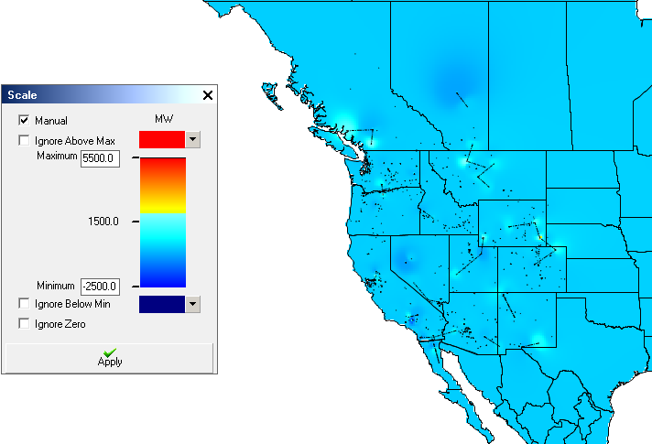
TEPPC Products – Tools and Models Long-term Planning Tool
Capital Expansion model that co-optimizes generation and transmission expansion
Considers policy, cost, and environmental factors

Slide 11
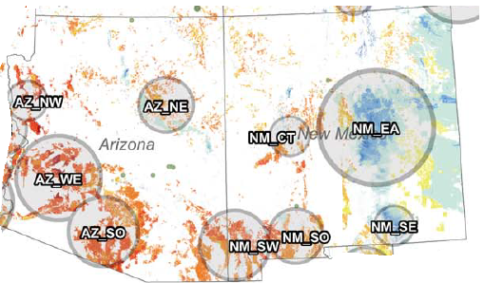
TEPPC Products – Data Generation Resource Availability
+767
+ 18
+ 1318
+ 1
+ 166
+ 92
+ 1360
+ 599
+ 38
Wind Solar PV Solar Thermal Small Hydro Geothermal Biomass RPS
Source: Map excerpt - WREZ Phase I report, Numbers – WECC

Slide 12
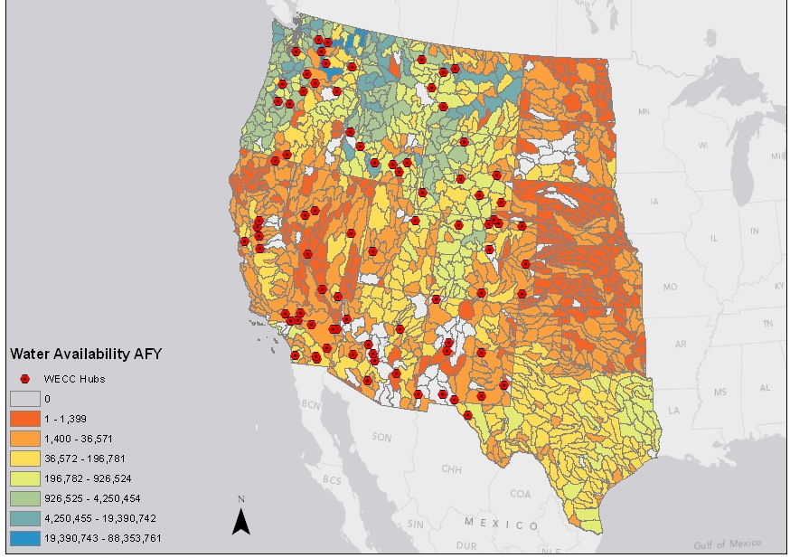
TEPPC Products – Data Water Availability for Future Generation
Source: Sandia National Laboratory, Resource Constraint and Cost Maps for WECC 20-yr Planning
Notes:
Use of “hubs” as a proxy tool to represent locations of WREZ zones and TEPPC load areas where new regional backbone transmission may need to be built.
Water availability incorporated into the Long-term Planning tool.

Slide 13
TEPPC Products – Data Generation Heat Rates
Combined Cycle Heat Rate Comparison for Wet and Dry Cooling
Source | Location | Wet Cooling (Btu/kWh) | Dry Cooling (Btu/kWh) | Penalty (Btu/kWh)
APS | AZ | 6,473 | 7,311 | 838
Avista | NW | 6,722 | 6,856 | 134
Pacificorp | UT | 6,885 | 6,963 | 78
Xcel | CO | 6,947 | 7,143 | 196
CEC | CA (Desert) | 6,596 | 6,795 | 199
CEC | CA (Coast) | 6,573 | 6.596 | 23
Source: E3 Cost and Performance Review of Generation Technologies, Recommendations for WECC.

Slide 14
Source: Sandia National Laboratory, Resource Constraint and Cost Maps for WECC 20-yr Planning

Slide 15
2013 Interconnection-wide Plan Plan Organization
Plan Summary
Background and Context
Data and Assumptions
10-Year Horizon
20-Year Horizon
Tools and Models
WECC Path Reports
Appendices
Sections are layered from broad to detailed
Notes:
Transmission Plan will be over 1000 pages, plus 700+ page appendix
Background and Context – 50 pages
Plan Summary – 100 pages
Data and Assumptions – 150 pages
Tools and Models – 150 pages
10-Year Study Report – 250 pages
20-Year Study Report – 200 pages
WECC Path Report – 250 pages
Appendices – 700+ pages
Plan layered into modules – Broad to detailed
Three printed brochures – Executive Summary, Plan Summary, Policy-makers’ Guide

Slide 16
Opportunities
Water usage in Production Cost Modeling
Water cost
Additional comparisons
Drought
Water withdraw and consumption

Slide 17
Questions
?
Brad Nickell
Director of Transmission Planning
Western Electricity Coordinating Council 155 North 400 West, Suite 200
Salt Lake City, Utah 84103
bnickell@wecc.biz

