Slide 1

A Hydrologist national perspective on the Energy-Water Nexus
Eric J. Evenson
US Geological Survey
Notes:
1
Work toward a common quality standard for data

Slide 2
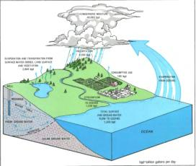
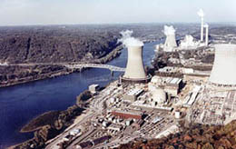
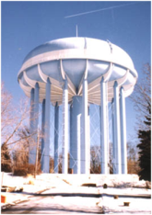
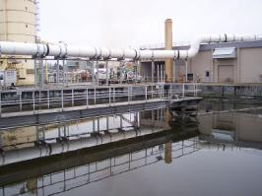
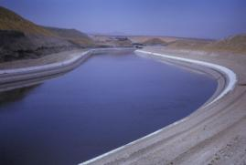
Energy Water Nexus
Notes:
2
Work toward a common quality standard for data

Slide 3
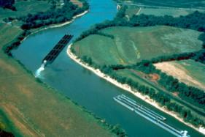

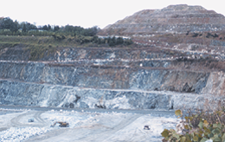
Energy Water Nexus
Notes:
3
Work toward a common quality standard for data

Slide 4

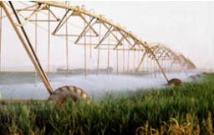
Energy Water
Nexus
Food
Notes:
4
Work toward a common quality standard for data

Slide 5

Energy Water
Nexus
Food
We need better understanding of the fluxes of materials between these processes and markets to adequately manage these resources
Notes:
5
Work toward a common quality standard for data

Slide 6
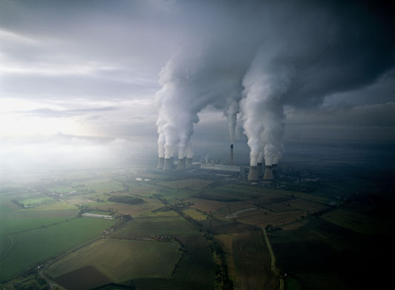
Estimating Thermoelectric
Water Use
Eric J. Evenson
April 2, 2013
Notes:
6
Work toward a common quality standard for data

Slide 7
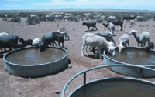
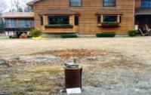




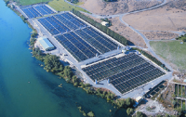


Water withdrawals by category
Livestock
Self-Supplied Domestic
Public Supply
Thermoelectric Power
Less than 1 percent
1 percent
11 percent
49 percent
1 percent
2 percent
4 percent
31 percent
Mining
Aquaculture
Self-Supplied Industrial
Irrigation

Slide 8
GAO Report 10-23, 2009
ENERGY-WATER NEXUS
Improvements to Federal Water Use Data Would Increase Understanding of Trends in Power Plant Water Use
Full report and current status of response to recommendations: http://www.gao.gov/products/GAO-10-23
Notes:
Issues:
8

Slide 9
GAO recommendations directly involving USGS:
EIA and USGS should develop a process involving identified stakeholders constituencies to improve data collection and dissemination
USGS resume publication of thermoelectric water consumption
USGS disseminate available information on use of alternative water sources
Notes:
Issues:
9

Slide 10


USGS and EIA working together
U.S. Department of the Interior
U.S. Department of Energy

Slide 11
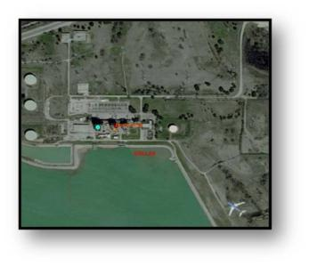
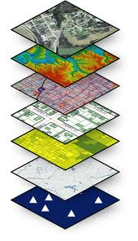

Investigate Various GIS Techniques
Definition Query
Multipoint Layer
Mean center point
Reference layers
Verify or Rectify Point
Notes:
The method for verifying and rectifying the points is as follows.
Step 1 From spreadsheet, divide records into 6 layers by agency
Step 2. Definition query by EIA plant code isolates that plant code only
Step 3. Merge 6 layers into one coverage for the one plant code.
Step 4. By plant code, GIS routine creates mean center layer
Step 5. Zoom to spatial extent of points including mean central point.
Step 6. Apply reference layers to help locate plants
Step 7. Include HSIP layer for verification.
Step 8. Verify or rectify point location.
Step 9. Move point to plant location.
Investigate various GIS techniques to verify and rectify the location of selected set of power plant locations
A definition query creates a subset of points from the database for an individual power plant.

Slide 12
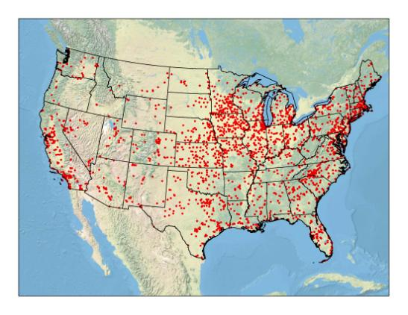
Results
First comprehensive location data on all plants in a GIS format
Excludes industrial and commercial

Slide 13
Assembling the Data to Model Thermoelectric Water Use
Categorization based on
plant size
fuel type
plant configuration
cooling equipment
climatic data
to create groups of plants whose water use and consumptive use can be modeled based upon the heat budget of the plant.
Notes:
Issues:
13

Slide 14
COOLING TYPES
Once through
Closed cycle – Wet tower
Closed cycle – Pond
Notes:
Issues:
14

Slide 15
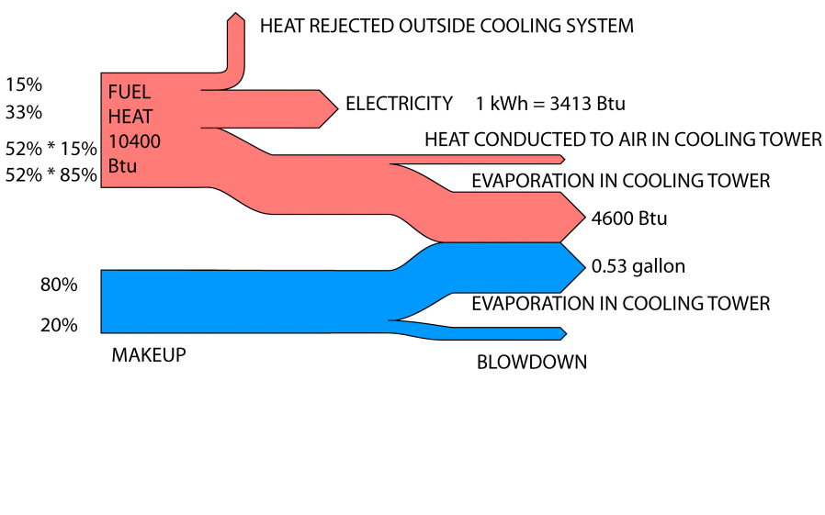
WITHDRAWAL - TOWER
WITHDRAWAL
Notes:
15
That corresponds to an exact amount of water evaporating. So this is very similar to what was happening in the block diagram I showed you before. Withdrawal – consumption – return flow to the environment.
These are hot summer conditions – a cooler wet bulb temperature would lower evaporation percentage.

Slide 16
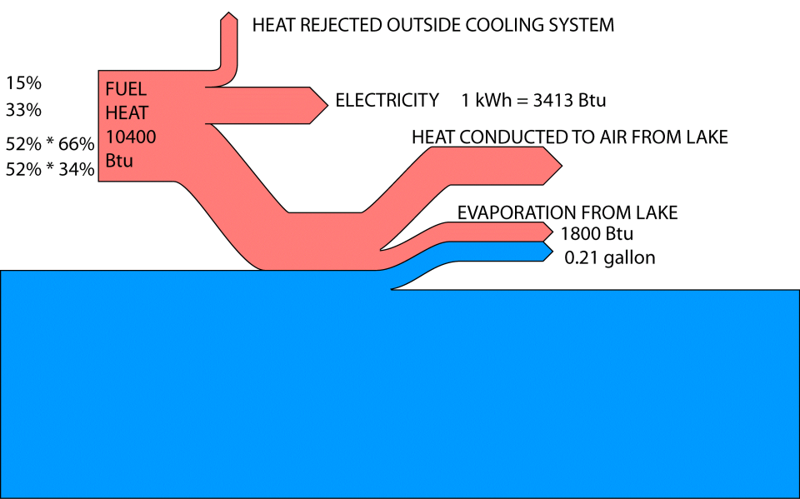
Notes:
16
If we had no cooling tower, and we had a nice cold lake to dump our heat into, much more heat would be conducted into the air, and much less would be evaporated. On the other hand, If this lake were very warm due to a heat wave and drought, the evaporation would be almost as much as in the previous slide.
Temperature sensitivity is strong – this is winter – warm lake 60% evap, cooling pond 75% evap
This is a simplistic model, but it has about the right sensitivity to environmental conditions. Utilities have access to much more precise proprietary models.
My position is that this is a water “use” even though it happens outside the plant. Some in the USGS might disagree. In any case, it happens.

Slide 17
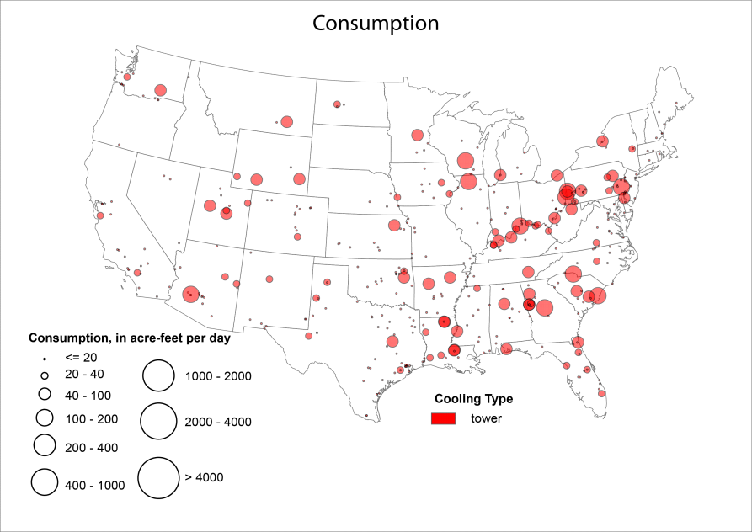
QUESTIONS ?
Notes:
Issue
Understand the in-plant water management factors that determine how water flow is reported for a power plant
How is water withdrawal determined
How is return flow determined
Example of the worst case scenario--TX
17

Slide 18
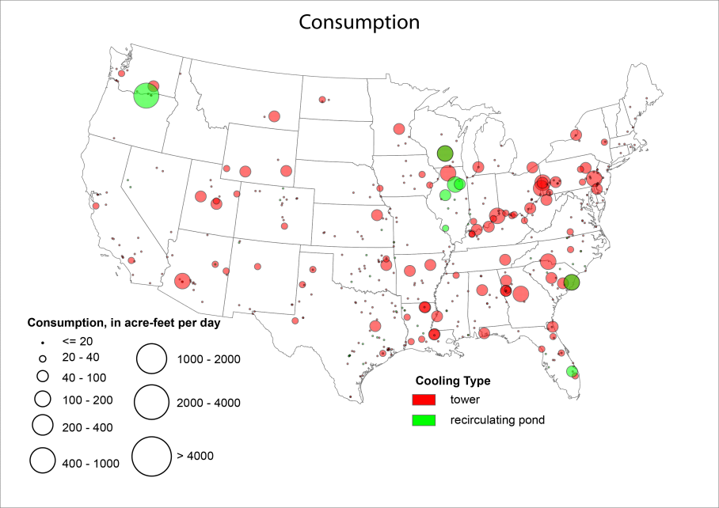
QUESTIONS ?
Notes:
Issue
Understand the in-plant water management factors that determine how water flow is reported for a power plant
How is water withdrawal determined
How is return flow determined
Example of the worst case scenario--TX
18

Slide 19
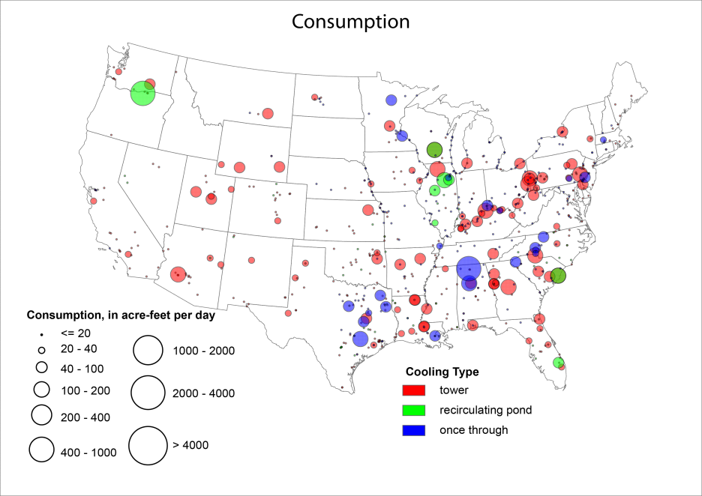
QUESTIONS ?
Notes:
Issue
Understand the in-plant water management factors that determine how water flow is reported for a power plant
How is water withdrawal determined
How is return flow determined
Example of the worst case scenario--TX
19

Slide 20
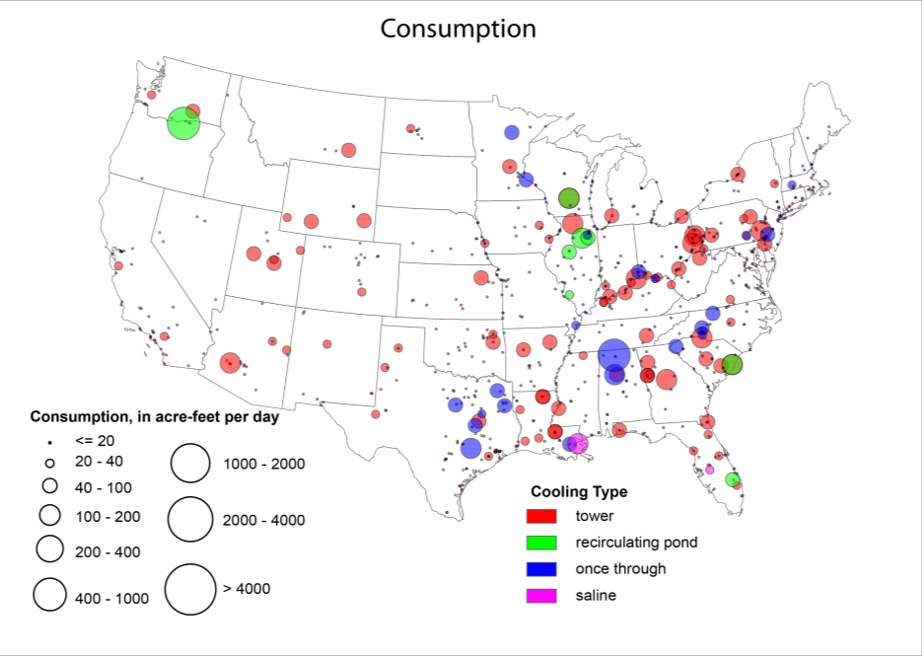
QUESTIONS ?
Notes:
Issue
Understand the in-plant water management factors that determine how water flow is reported for a power plant
How is water withdrawal determined
How is return flow determined
Example of the worst case scenario--TX
20

Slide 21
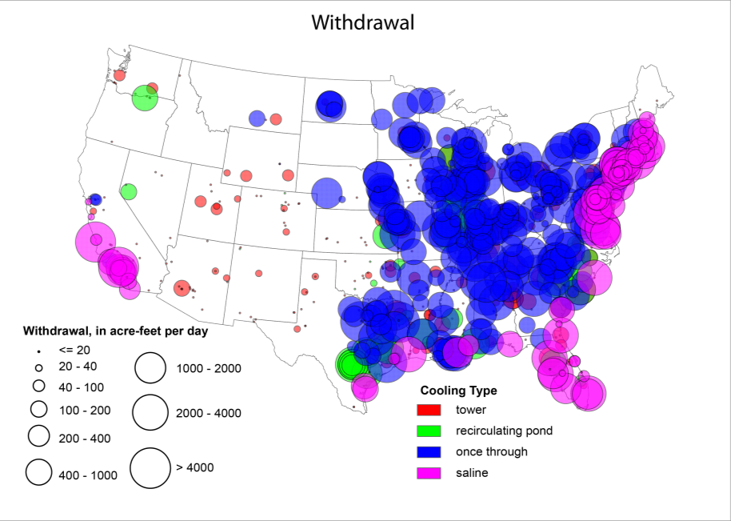
QUESTIONS ?
Notes:
Issue
Understand the in-plant water management factors that determine how water flow is reported for a power plant
How is water withdrawal determined
How is return flow determined
Example of the worst case scenario--TX
21

Slide 22
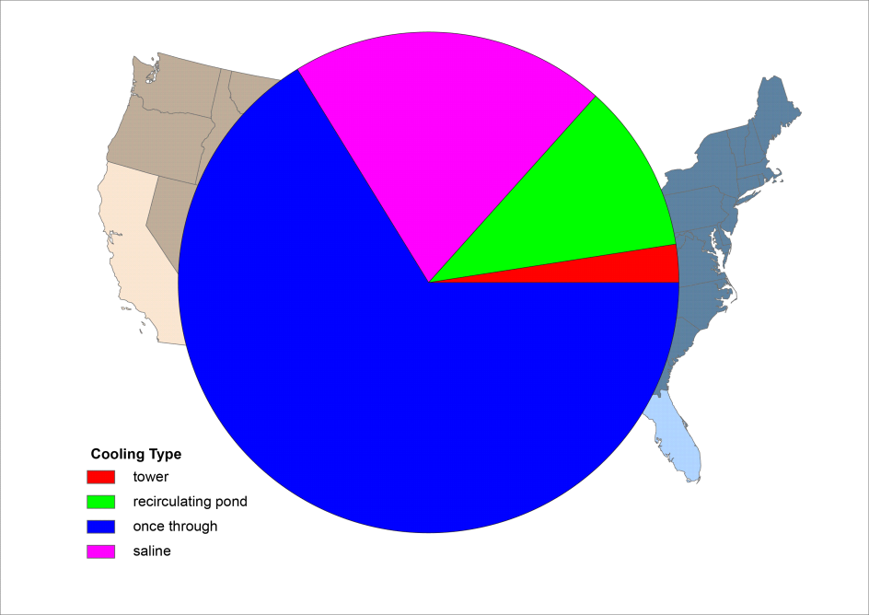
CONUS Withdrawal
QUESTIONS ?
Notes:
Issue
Understand the in-plant water management factors that determine how water flow is reported for a power plant
How is water withdrawal determined
How is return flow determined
Example of the worst case scenario--TX
22

Slide 23
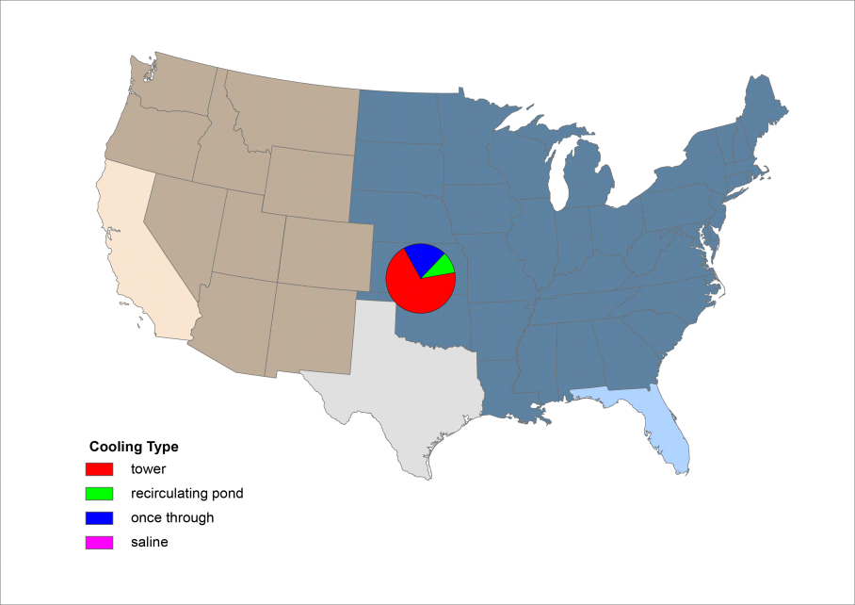
CONUS Consumption
QUESTIONS ?
Notes:
Issue
Understand the in-plant water management factors that determine how water flow is reported for a power plant
How is water withdrawal determined
How is return flow determined
Example of the worst case scenario--TX
23

Slide 24

CONUS Withdrawal and Consumption
QUESTIONS ?
Notes:
Issue
Understand the in-plant water management factors that determine how water flow is reported for a power plant
How is water withdrawal determined
How is return flow determined
Example of the worst case scenario--TX
24

Slide 25
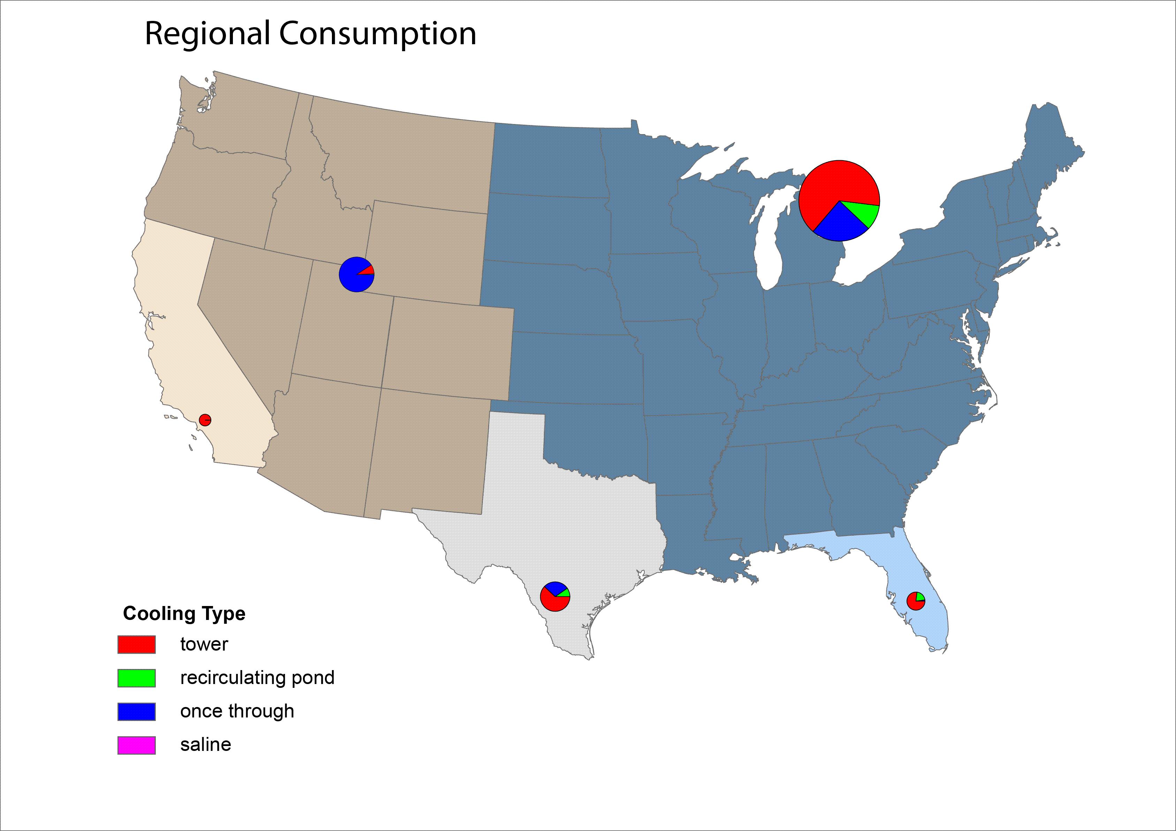
QUESTIONS ?
Notes:
Issue
Understand the in-plant water management factors that determine how water flow is reported for a power plant
How is water withdrawal determined
How is return flow determined
Example of the worst case scenario--TX
25

Slide 26
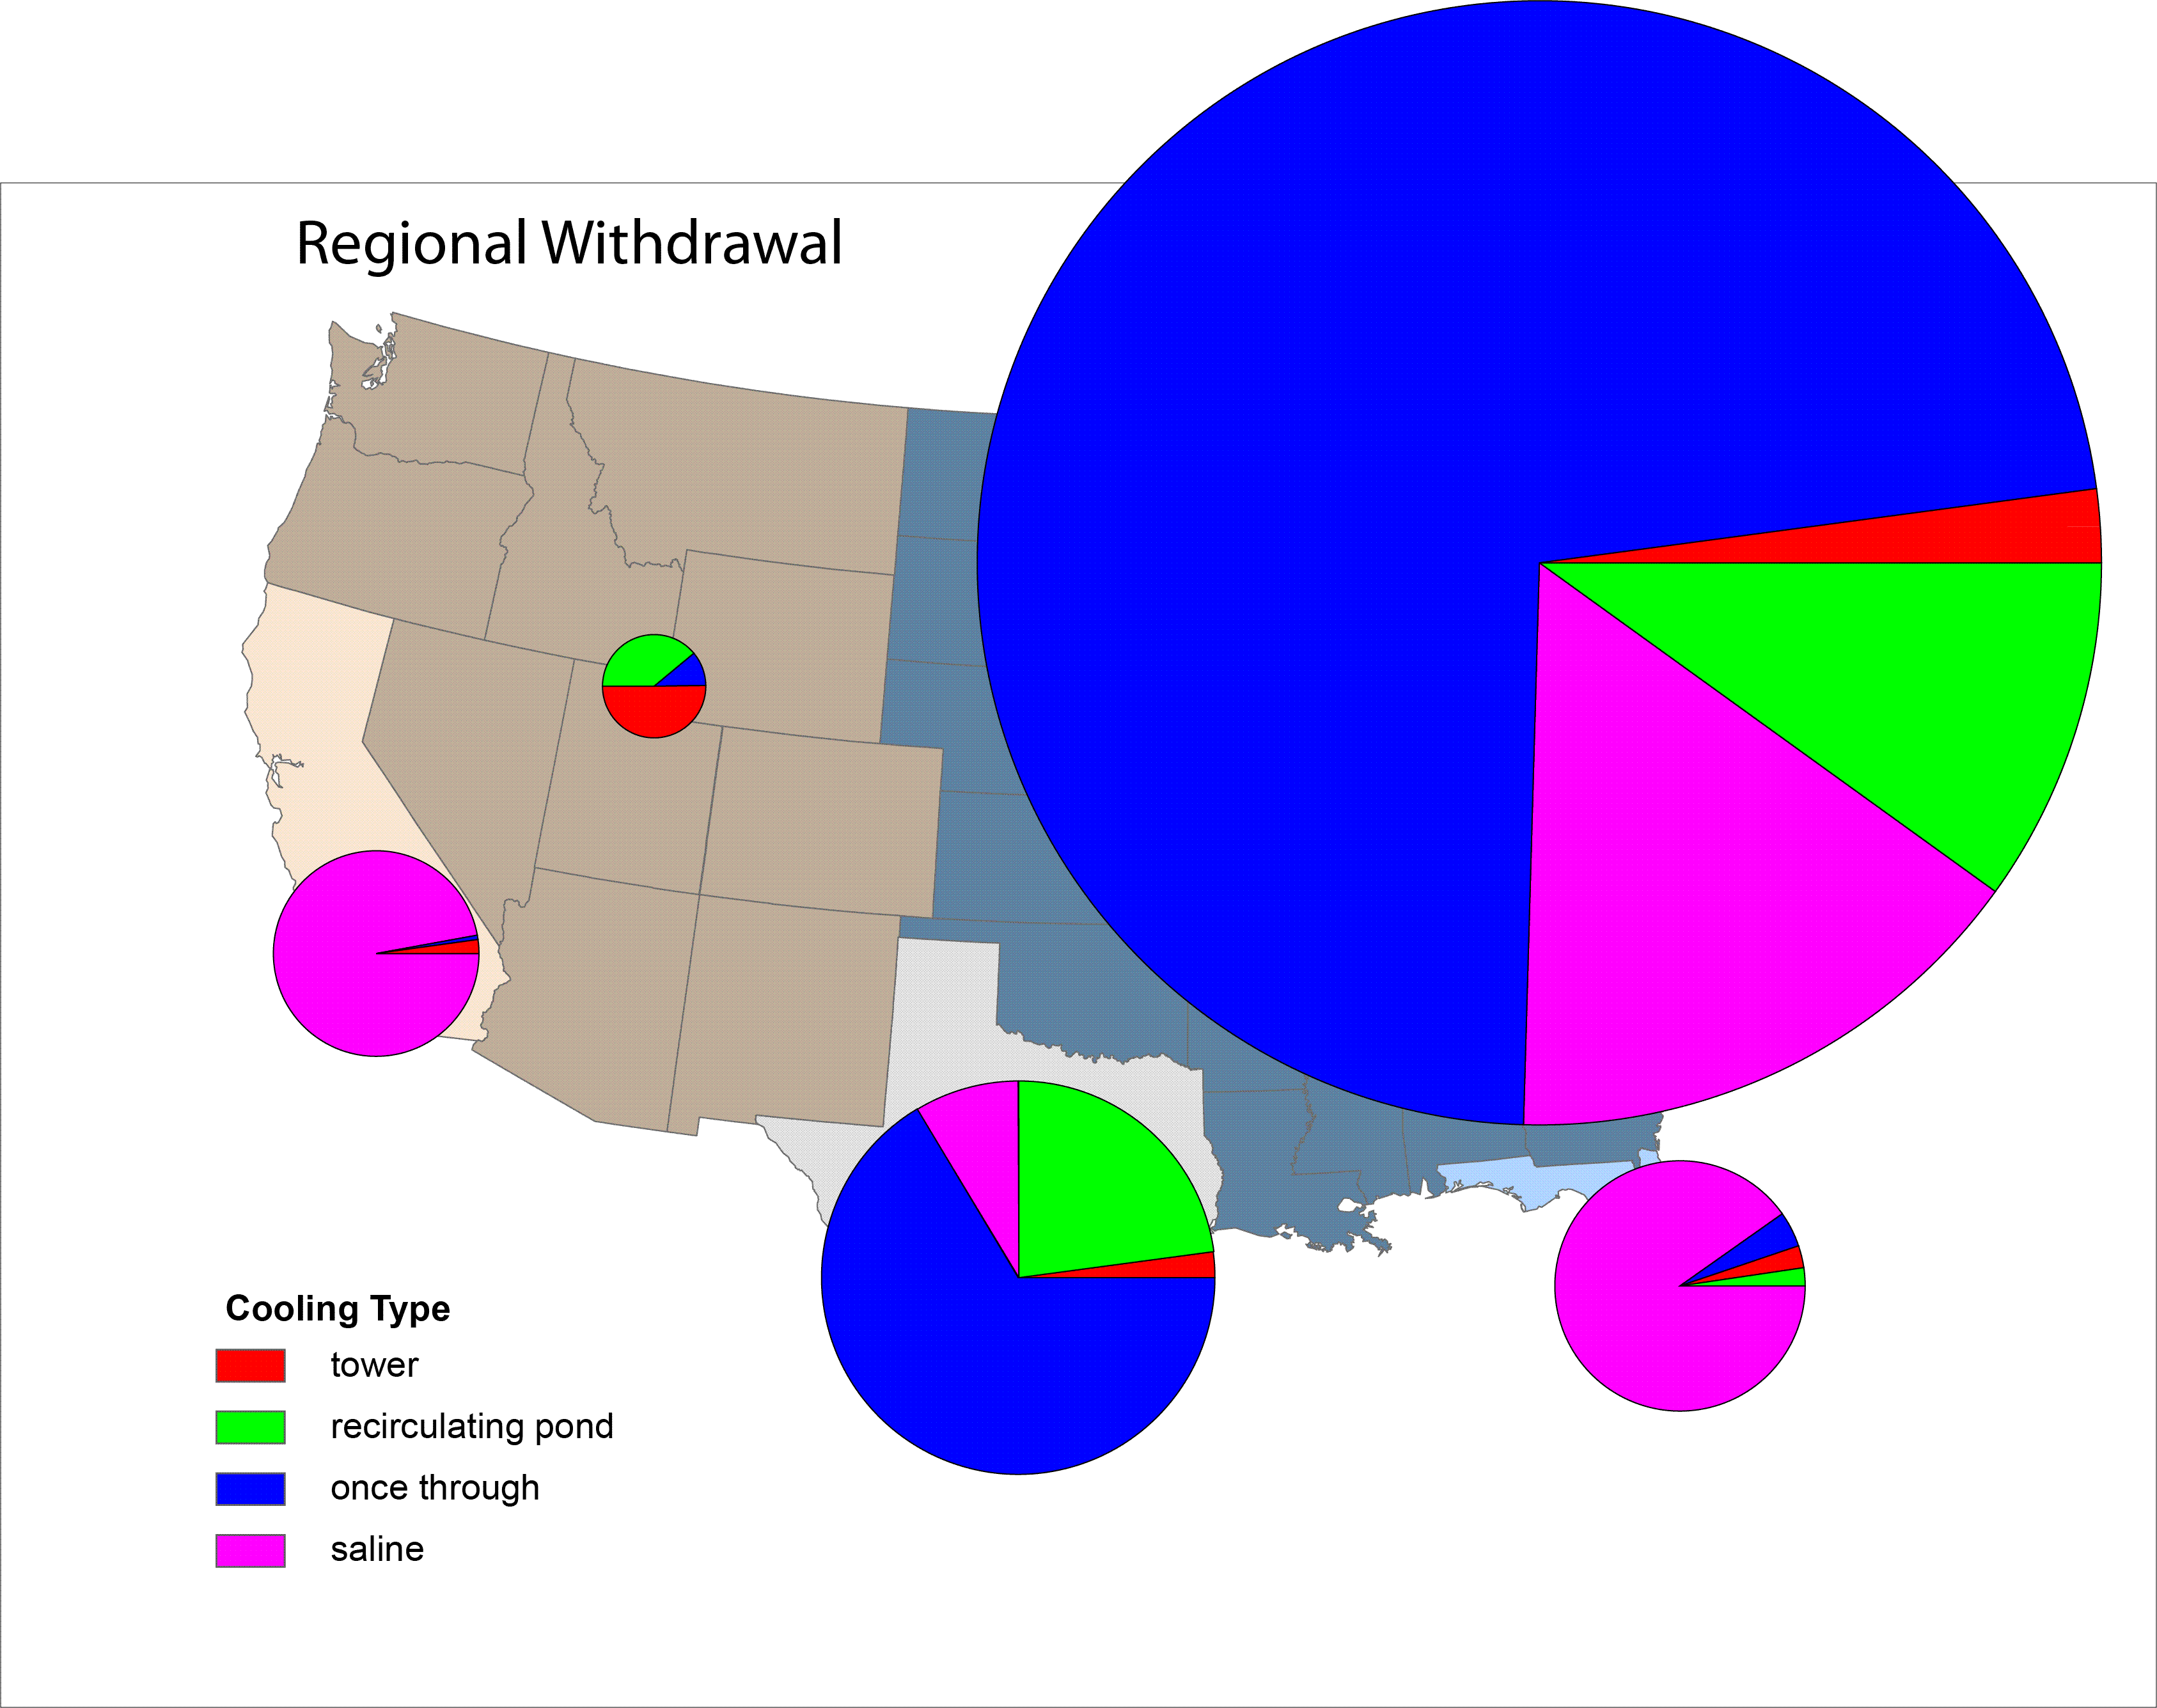
QUESTIONS ?
Notes:
Issue
Understand the in-plant water management factors that determine how water flow is reported for a power plant
How is water withdrawal determined
How is return flow determined
Example of the worst case scenario--TX
26

Slide 27
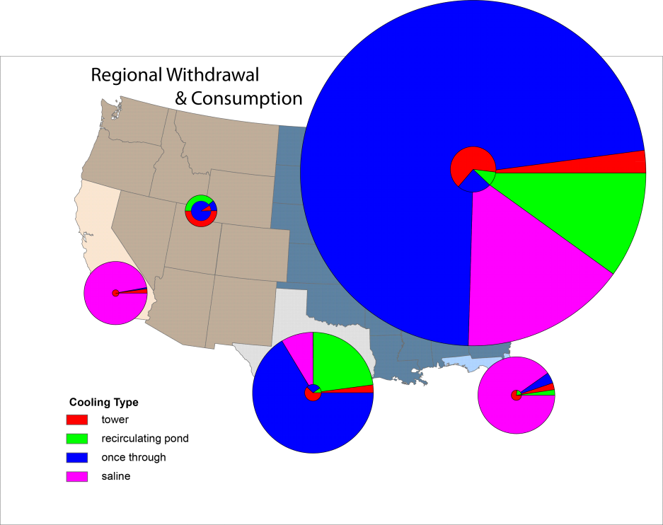
QUESTIONS ?
Notes:
Issue
Understand the in-plant water management factors that determine how water flow is reported for a power plant
How is water withdrawal determined
How is return flow determined
Example of the worst case scenario--TX
27

Slide 28

Eric J Evenson
Water Census Coordinator
U.S. Geological Survey
810 Bear Tavern Road, Suite 206
Trenton, New Jersey 08628
609-771-3904 eevenson@usgs.gov
U.S. Department of the Interior
U.S. Geological Survey

