Slide 1
Innovative Technology Development for Fresh Water Conservation in Power Sector
Jessica Shi, Ph.D.
Sr. Project Manager and Technical Lead of Technology Innovation Water Conservation Program
Sean Bushart, Ph.D.
Sr. Program Manager
WSWC-WGA Energy-Water Workshop
Denver, CO
April 2, 2013

Slide 2

Outline
Overview of EPRI and EPRI’s Technology Innovation Water Conservation Program
Examples of Technologies under Development in EPRI’s Water Innovation Program
Next Steps: 2013 Joint EPRI-NSF Solicitation

Slide 3
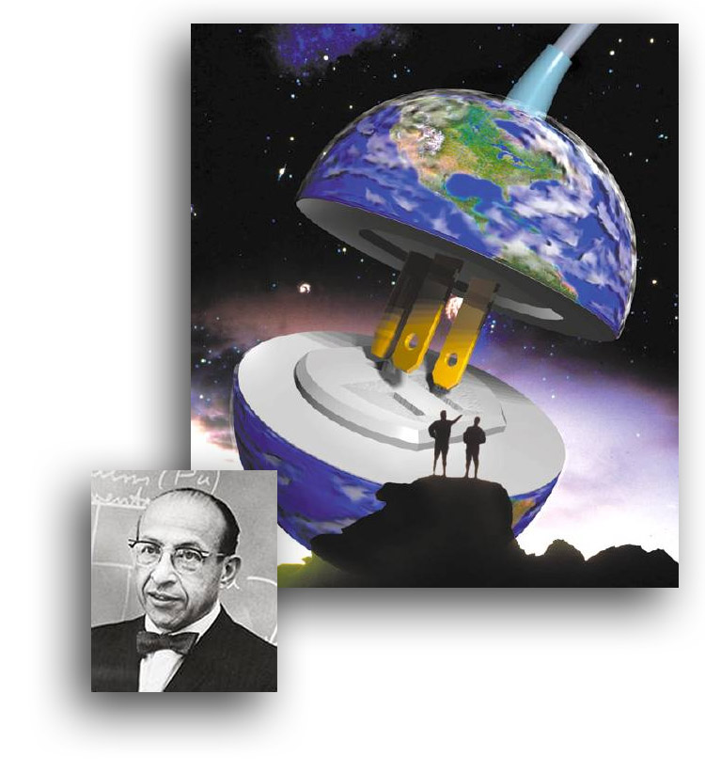
About EPRI
Founded in 1972
Independent, nonprofit center for public interest energy and environmental research (~$381 m funding in 2012)
Collaborative resource for the electricity sector
  450+ funders in more than 40 countries
  More than 90% of the electricity in the United States generated by EPRI members
  More than 15% of EPRI funding from international members
Major offices in Palo Alto, CA; Charlotte, NC; Knoxville, TN
  Laboratories in Knoxville,
  Charlotte, and Lenox, MA
Chauncey Starr
EPRI Founder
Notes:
3

Slide 4
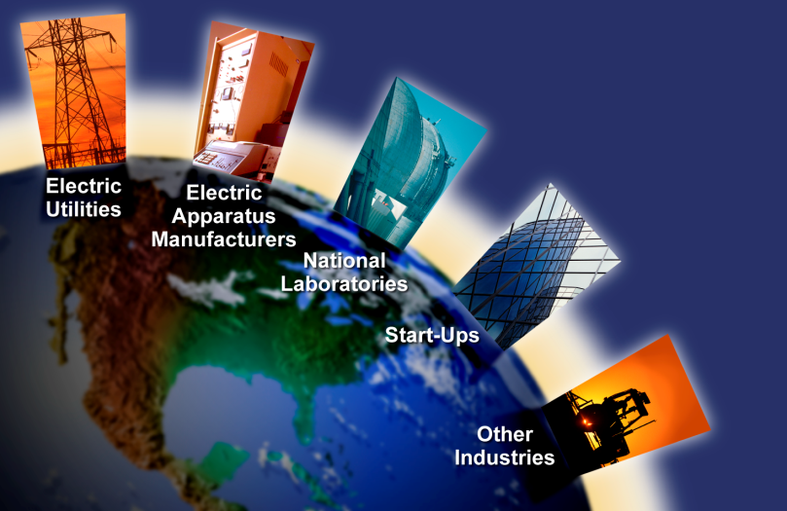
TI Water Conservation Program
Overview and Objective
Initiated in early 2011
Collaborated by all EPRI Sectors (Environment, Nuclear, Generation, and Power Distribution Unit)
Collected 114 proposals and several white papers through two rounds of global solicitations
Objective
Seek and develop “out of the box”, game changing, early stage, and high risk cooling and water treatment ideas and technologies with high potential for water consumption reduction.

Slide 5
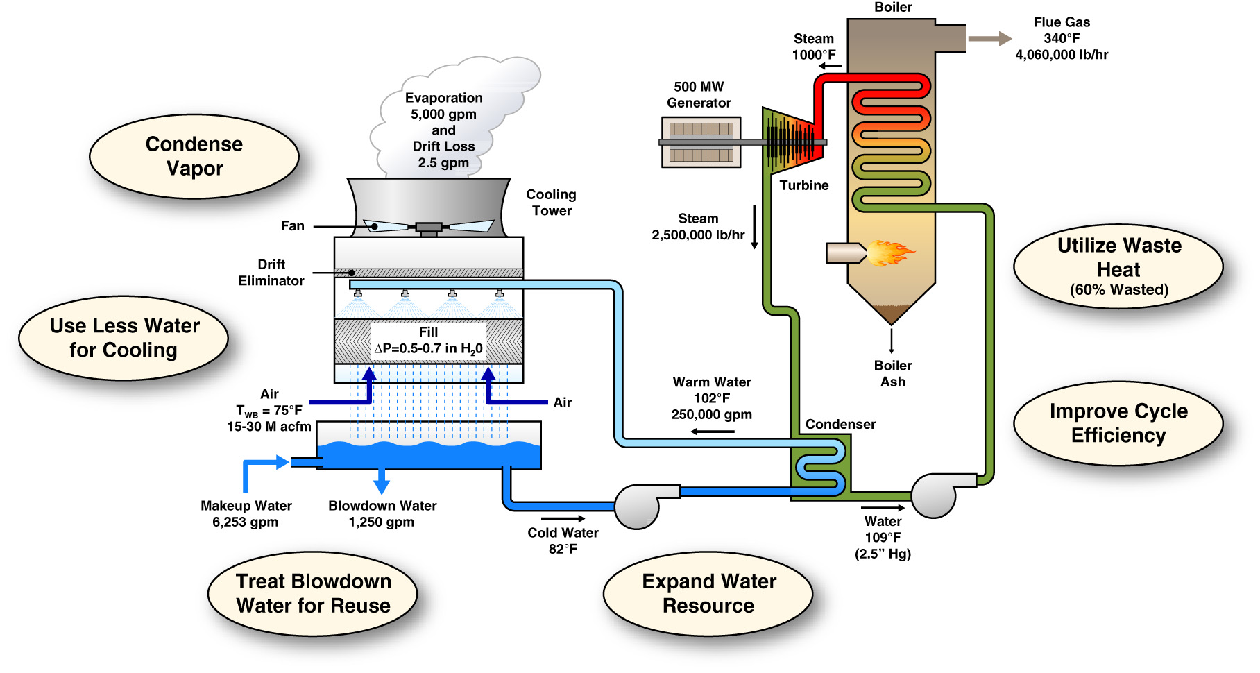
Opportunities for Power Plant Fresh Water Use Reduction
Innovation Priorities: Advancing cooling technologies, and applying novel water
treatment and waste heat concepts to improve efficiency and reduce water use
Notes:
example is for coal plant -water savings from cooling also applicable to nuclear and other thermoelectric technologies
Water savings in gpm – benchmark- ~1 Olympic size pool of water lost per hour

Slide 6
Effect of Reducing Condensing Temperature on Steam Turbine Rankine Cycle Efficiency
3
Coal-Fired Power Plant
a
T-S Diagram for Pure Water
2
Nuclear Power Plant
1
4
Potential for 5% (1st Order Estimate) more power production or $11M more annual income ($0.05/kWh) for a 500 MW power plant due to reduced steam condensing temperature from 50 °C to 35 °C.
.

Slide 7
Project 1: Waste Heat/Solar Driven Green Adsorption Chillers for Steam Condensation (Collaboration with Allcomp)
Schematic Illustration of a Typical Adsorption Chiller
Key Potential Benefits
Dry cooling system
  Near Zero water use and consumption
Reduced condensation temperature
  As low as 35 °C
  Potential for annual power production increase by up to 5%
Full power production even on the hottest days compared to air cooled condensers.
Air
Air-Cooled Condenser
Air
Hot Air
Adsorption Chamber
Desorption Chamber
Steam
Evaporator
Refrigerant
Water
Phase 1 Project Update (EPRI Patent Pending)
Developed several power plant system level approaches to utilize waste heat or solar heat for desorption
Performed system integration energy and mass flow balance analysis for a 500 MW coal-fired power plant
Performed technical and economic feasibility study
Finalizing final report.

Slide 8
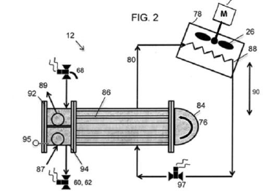
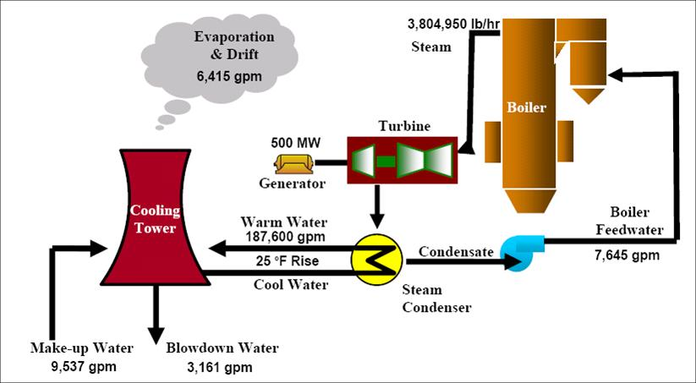
Project 2:Thermosyphon Cooler Technology (Collaboration with Johnson Controls)
Project Update
Performed a thorough feasibility evaluation of a hybrid, wet/dry heat rejection system comprising recently developed, patent pending, thermosyphon coolers (TSC).
Made comparisons in multiple climatic locations, to standard cooling tower systems, all dry systems using ACC’s, hybrid systems using parallel ACC’s, and air coolers replacing the thermosyphon coolers.
Determined the most effective means to configure and apply the thermosyphon coolers.
Completed final project review on March 5th.
Key Potential Benefits
  Potential annual water savings up to 75%
  Compared to ACC, full plant output is available on the hottest days
Ease of retrofitting
No increase in surface area exposed to primary steam
Reduced operating concerns in sub freezing weather
Broad application for both new and existing cooling systems for fossil and nuclear plants)

Slide 9

Power Plant Heat Rejection System Incorporating Thermosyphon Cooler (TSC) Technology*
Plume
Animation Slide
TSC Condenser
Refrigerant Condensate
Refrigerant Vapor
Reduced Water Treatment Chemicals
97.5F
Refrigerant
Liquid Head
TSC Evaporator
Wet Cooling Tower
110F
TSC Loop Pump
On
97.5F
Generator
Make UP
300 gal/ MWH
Steam Turbine
70F
Mild Weather Day
Wet Cooling Tower Handles 50% of the Heat Load
TSC Handles 50% of the Heat Load
85F
110F
Boiler
Steam Surface Condenser
175 gal/MWH Blowdown
No Blowdown
75 gal/MWH Blowdown
85F
Outside
Temp
Steam Condensate Pump
Condenser Loop Pump
* Patent Pending

Slide 10
Project 3 : Advanced M-Cycle Dew Point Cooling Tower Fill (Collaboration with Gas Technology Institute)
Project Scope
Develop an advanced fill
Perform CFD and other types of energy, mass, and momentum balance modeling
Evaluate performance and annual water savings for several typical climates using simulation models
Perform prototype testing in lab cooling towers
Perform technical and economic feasibility evaluation
Key Potential Benefits
Potential for less cooling water consumption by up to 20%
Lower cooling tower exit water temperature resulting in increased power production
Ease of retrofitting
Broad applications

Slide 11
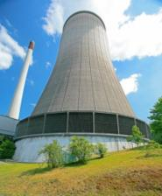
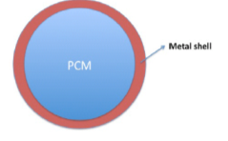
Project 4: Heat Absorption Nanoparticles in Coolant (Collaboration with Argonne National Laboratory)
Phase Change Material (PCM) Core/Ceramic Shell Nano-particles added into the coolant.
Project Scope
Develop multi-functional nanoparticles with ceramic shells and phase change material cores
Measure nano-fluid thermo-physical properties
Perform prototype testing in scaled down water cooled condenser and cooling tower systems
Assess potential environmental impacts due to nanoparticle loss to ambient air and water source.
Perform technical and economic feasibility evaluation
Evaporation & Drift
Shell
Warm Water
PCM
Cooling Tower
Steam Condenser
Make-up Water
Cool Water
Blowdown
  Key Potential Benefits
  Up to 20% less evaporative loss potential
  Less drift loss
  Enhanced thermo-physical properties of coolant
  Inexpensive materials
Ease of retrofitting
Broad applications (hybrid/new/existing cooling systems)
Notes:
Melt as it is heated up in the condenser
Re-solidified as it is cooled in the cooling tower

Slide 12
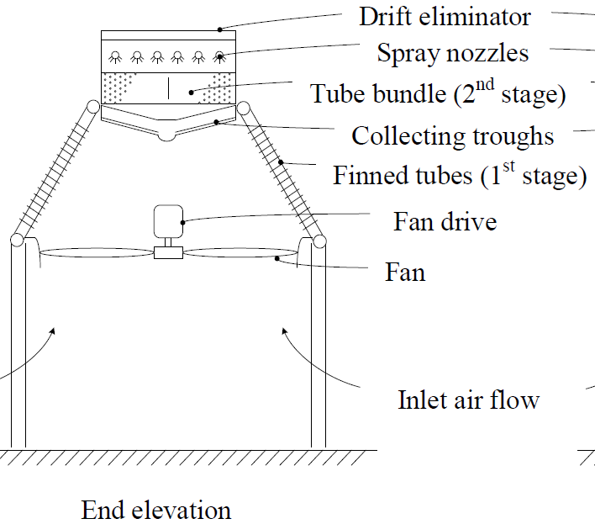
Potential Project 1: Hybrid dry/wet cooling to enhance air cooled condensers (Collaboration with University of Stellenbosch in S. Africa)
Dry/Wet Cooling Addition
Key Potential Benefits
Up to 10% more power production on the hottest days than air cooled condensers
90% less makeup water use than wet cooling tower systems
Up to 50% less water use than currently used dry cooling with the aid of adiabatic water spray precooling for incoming air
Project Scope
Further develop the design concept
Perform detailed modeling and experimental investigation for various options
Perform technical and economic feasibility study
Notes:
To mitigate power production penalty issue or to reduce steam condensation temperature on hot summer days, water spray cooled steam bundle is added at the top of the air cooled condenser. The water will be collected at the dephlegmator or collecting troughs below the tube bundle. On cold days, the steam bundle will be cooled by air.
The proposed concept has low additional capital and operational costs when compared to a dry system and requires
less water than alternative dry/wet systems to achieve higher power production on hot days.
An analysis will be conducted to determine the optimum configuration and operating
characteristics of the hybrid dephlegmator. Thermal-flow performance tests will be carried
out on the various components of the dephlegmator, including the tube bundle, deluge water
spray distribution nozzles, water collection troughs and a combination of these components.
The objective of these tests will be to compare the results with analytically predicted values
and to generate additional information with which a practical full-scale hybrid (dry/wet)
dephlegmator can ultimately be designed.

Slide 13
Potential Project 2: Reverse Osmosis Membrane Self Cleaning by Adaptive Flow Reversal (Collaboration with UCLA)
Key Potential Benefits
Prevent scaling on membranes
  Prolong membrane lifetime
Reduce/Eliminate certain chemical pretreatment requirements (20% cost savings)
Enable cooling tower blowdown water recovery by up to 85% (Equivalent of 20% makeup water reduction)
Normal Feed Flow Mode
Reversed Feed Flow Mode
Mineral scaling mitigation via automated switching of feed flow direction, triggered by online Membrane Monitor (MeMo)
Project Scope
Further develop the framework for process operation and flow control
Further develop and demonstrate a real-time/online membrane mineral scale detection monitor (MeMo) and integration with feed flow reversal control
Perform technical and economic feasibility study
Notes:
NF/RO self cleaning technology to prevent fouling
The proposed project addresses the power sector needs for innovative approaches to water
use reduction through the development and evaluation of a novel self-adaptive NF/RO treatment
for enabling cooling tower blowdown water reuse. The application of membrane technology for
desalting cooling tower blowdown water for on-site reuse (including cooling water make-up) is
confronted by the crippling limitation of membrane mineral scaling. Scaling leads to permeate
flux decline, limits recovery and increases water treatment maintenance costs. In this regard, the
proposed disruptive technology averts membrane mineral scaling, while eliminating or reducing
antiscalant chemical use, by operating (cross flow) NF/RO desalination elements in a cyclic
mode of “Feed Flow Reversal” (FFR). Robust FFR operation will be achieved through triggering
of FFR by real-time membrane fouling detection using a unique and field proven UCLA
Membrane Monitor (MeMo). In this manner, periodic switching of the flow direction (in the
membrane module) disrupts and reverses the concentration polarization profile (in the RO feed
channel) such that scale removal is achieved. Filtration and desalination of blowdown water by
integrated UF/RO operation in FFR mode will achieve a target level of recovery of 75-85%
without any or with minimal antiscalant use, thereby expanding the options toward zero level
discharge, given the reduction in generated concentrate. The overall approach will be developed
focusing on establishing a comprehensive framework for optimal and robust RO-FFR operation.
Achieving the above goal will be facilitated by enhanced real-time MeMo capability for
detection of membrane fouling, including gypsum, calcium carbonate, silica, and biofoulants.
The MeMo membrane fouling detection system will be integrated with a pilot scale RO system (3-5 GPM feed capacity) that will be developed specifically for FFR operation. The MeMo-
RO/FFR operation will be evaluated using feed water representing a range of blowdown water
compositions as well as directly at the UCLA Cogeneration plant. It is estimated that
implementation of self-adaptive FFR-MeMo technology can reduce RO/NF operational cost by
about 20%, while prolonging RO/NF membrane lifetime, reducing the volume of blowdown
water discharge, and thus lowering cooling water makeup needs.

Slide 14
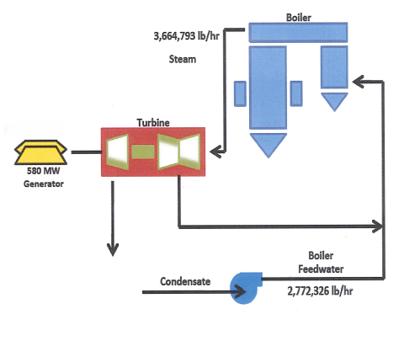
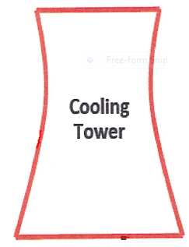
Potential Project 3: Integration of cooling system with membrane distillation aided by degraded water source (Collaboration with A3E and Sandia National Lab)
Key Potential Benefits
Membrane distillation technology utilizes
  Waste heat from condenser hot coolant
  Cooling system as a water treatment plant
Reduced fresh water makeup by up to 50% - 100%
Potential to eliminate cooling tower for dry cooling
Hot Water 102° F
Additional Makeup Water if Needed
Blowdown Water
Degraded Water
80° F
Condenser
Distilled Makeup Water
65° F
60° F
Heat Exchanger
Distilled Water
75° F
Membrane Distillation System
Project Scope
Further develop and assess system integration strategy
Perform technical and economic feasibility study
Notes:
Reduced heat load/evaporation loss of cooling tower by up to 50% - 100% (potential for dry cooling)

Slide 15
Potential Project 4: Carbon Nanotube Immobilized Membrane (CNIM) Distillation (Collaboration with New Jersey Institute of Technology)
Key Potential Benefits
Compared to top commercial MD technologies
  Up to 10 times more vapor flux due to CNTs
  Reduced cost of utilizing alternative water sources
Enabling technology for A3E concept to eliminate the cooling tower and turn the cooling system into a water treatment plant for other use
Mechanisms of MD in the presence of CNTs
Project Scope
Develop carbon nanotube (CNT) technology for membrane fabrication
Further develop and test CNIMs for membrane distillation (MD)
Develop and optimize MD integration strategies/process for water recovering
Perform technical and economic feasibility of the process
Notes:
First is optimizing the membrane synthesis. We will try different types and fictionalization of carbon nanotubes, different types of nanotubes.
The second would be to try different processes such as using vacuum, air or water to recover water from salt water. There are many parameters at play, and optimization of all these.
Compared to Reverse Osmosis:
Waste heat driven
Reduced cost and energy consumption of water treatment
Ability to handle higher % of salt
Less stringent pretreatment demands
Less fouling and ~ 2X longer lifetime

Slide 16
Possible NSF-EPRI Joint Solicitation on Advancing Water Conservation Cooling Technologies
Potential Funding Level:
  $300 k to $700 k for an up to a three year project
Funding Approach
  Coordinated but independent funding
    NSF awards grants.
    EPRI contracts.
  Joint funding for most proposals
  Independent funding for a few proposals if needed
Joint Workshop held in Nov. during ASME International Congress Conference in Houston, TX
  High impact cooling research directions defined to build foundation for the join solicitation
  13 speakers from both power industry and academia
  More than 100 attendees
Established Memorandum of Understanding between NSF and EPRI
Finalizing solicitation and getting final approval

Slide 17
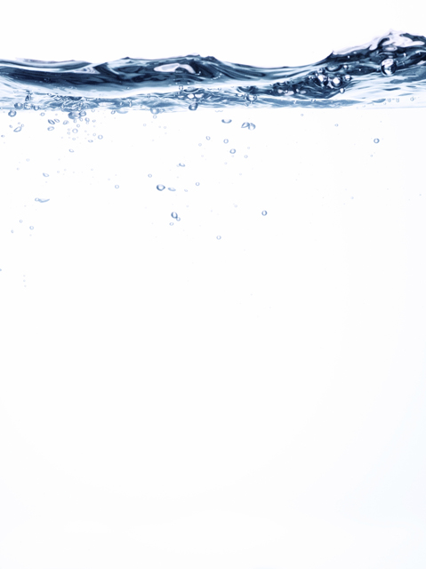
EPRI Water Innovation Program: Progress Summary
Progress Since 2011 Program Initialization
Received 114 proposals from Request for Information Solicitations.
Funded eight projects including three new exploratory type projects in 2012
Funding four or more projects on water treatment and cooling in 2013
Published four reports
Co-hosted joint workshop and finalizing 2013 joint solicitation with the National Science Foundation.

Slide 18
Together…Shaping the Future of Electricity
Thank You!
Please feel free to contact us:
Jessica Shi at JShi@epri.com
General Questions: Vivian Li at VLi@epri.com

