Slide 1
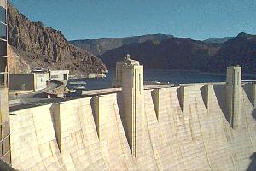
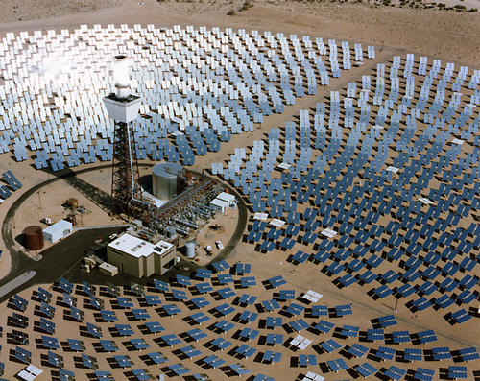
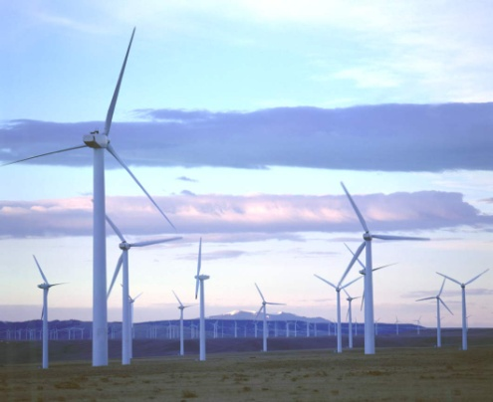
Energy and Water in the Texas and Western Interconnections
WSWC/WGA Energy-Water Workshop
Denver, CO
April 2, 2013

Slide 2






Technical Support Team
Sandia National Laboratories
  Vincent Tidwell
  Barbie Moreland
  Howard Passell
  Katie Zemlick
  Barry Roberts
Argonne National Laboratory
  John Gasper
  Eugene Yan
  Chris Harto
Electric Power Research Institute
  Robert Goldstein
National Renewable Energy Laboratory
  Jordan Macknick
  Kathleen Hallett
Idaho National Laboratory
  Gerald Sehlke
  Dan Jensen
  Chris Forsgren
Pacific Northwest National Laboratory
  Mark Wigmosta
  Ruby Leung
University of Texas
  Michael Webber
  Carey King

Slide 3




Integrated Planning
Transmission
Planning
Water
Management
Energy
Security

Slide 4
Energy and Water in the Western and Texas Interconnections
Reduce the water footprint of electric power production in western United States:
  Develop tools for a quantitative assessment of the energy-water nexus,
  Engage stakeholders across the energy-water spectrum, and
  Evaluate water implications of alternative interconnection-wide transmission expansion scenarios.

Slide 5
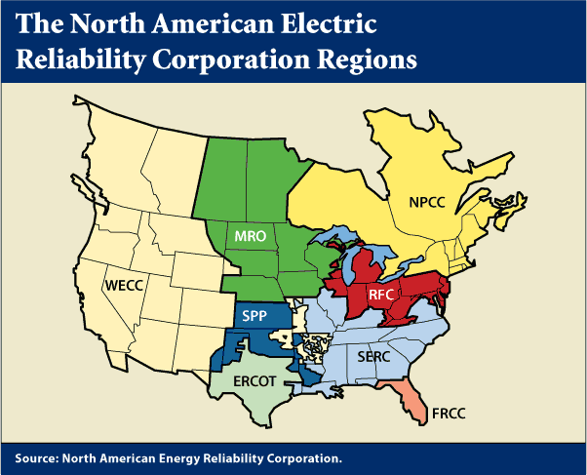
Transmission Planning
WECC and ERCOT are conducting long-range transmission planning (20 yrs.)
  Siting of new power plants
  New transmission capacity

Slide 6
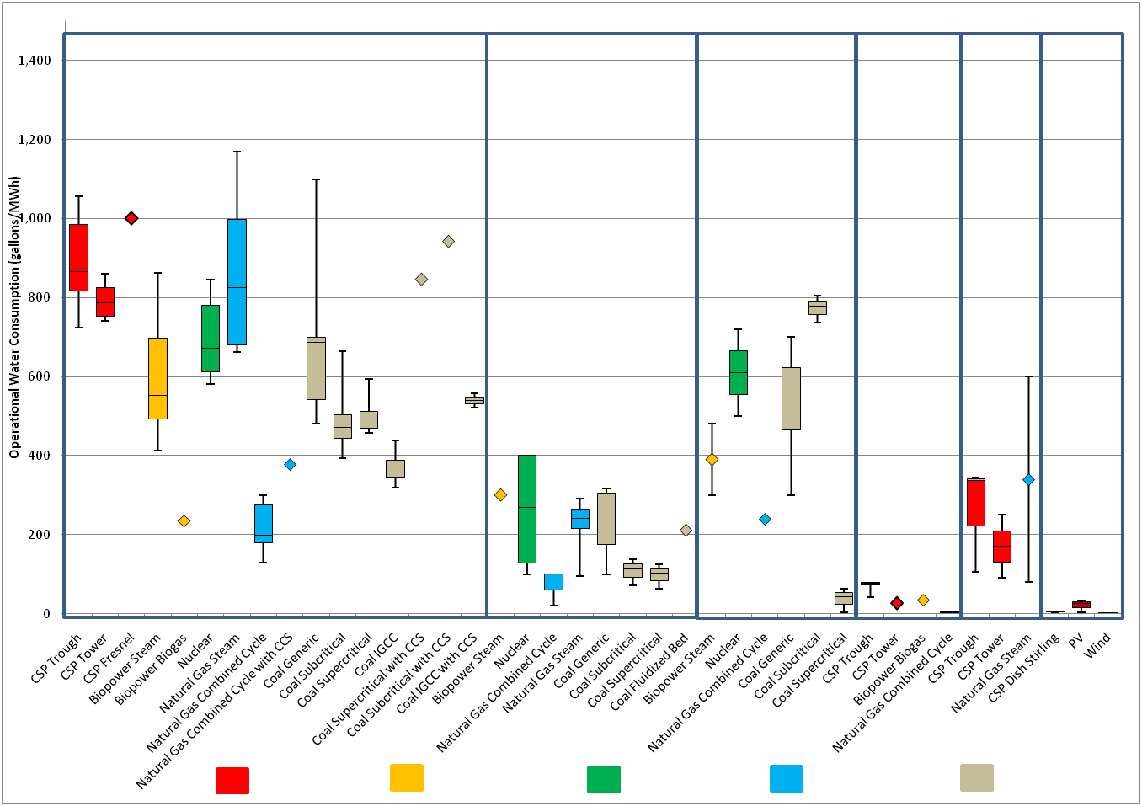
Operational water consumption factors for electricity generating technologies
Caption or heading (if you have one)
Recirculating Cooling
Once-through Cooling
Pond Cooling
Dry Cooling
Hybrid Cooling
No Cooling Required
(insert really cool image/supergraphic from your work)
Operational water consumption (Gal/MWh)
CSP and PV
Biopower
Nuclear
Natural Gas
Coal
Source: Macknick et al. 2011

Slide 7
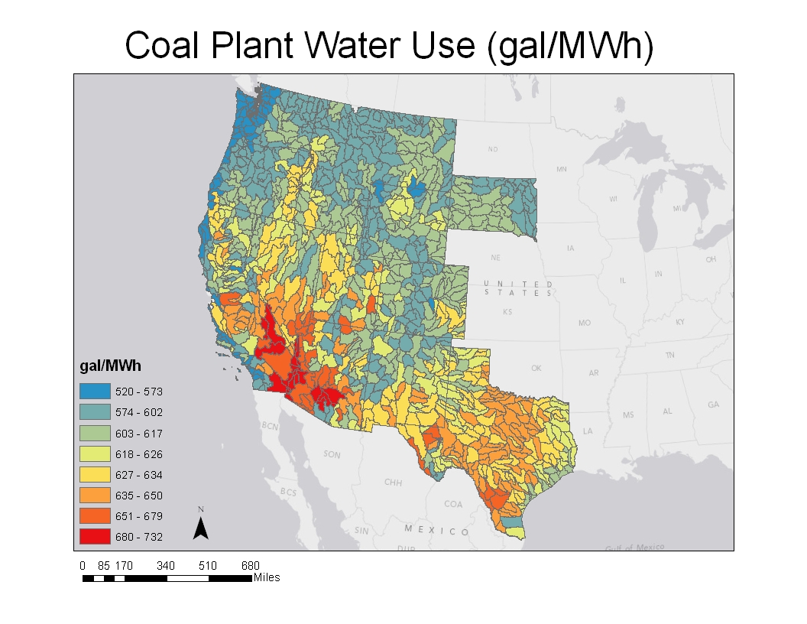
NREL 2012

Slide 8
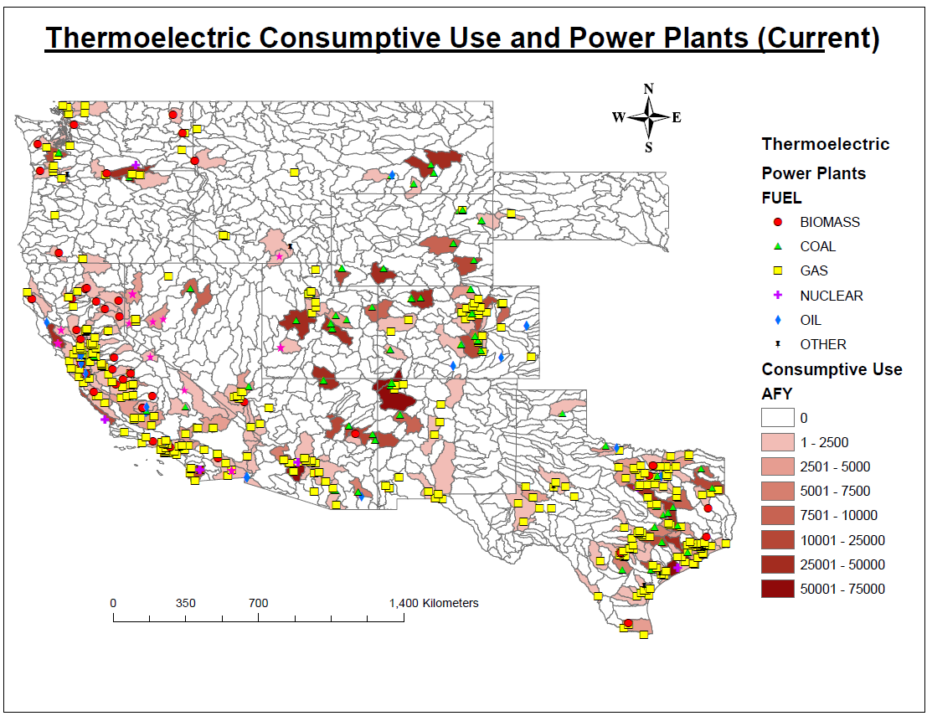
Notes:
Plants that show no water use are combustion turbine plants, which use no water.

Slide 9
CLIMATE Variability Impacts on Electricity Generation
Evaluate impacts of future (2030s) climate variability, drought scenarios, and water demand
Potential reduction or curtailment of power generation
  Low lake levels
  Thermal effluent limitations

Slide 10
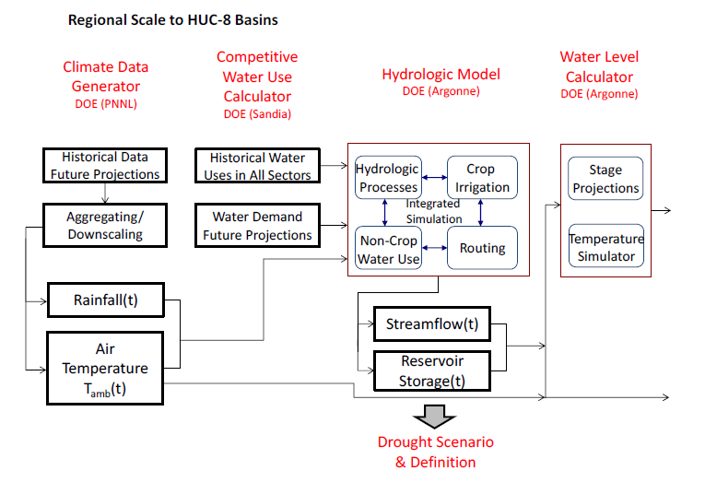
Methods of Analysis (1)
Notes:
Composite figure: circles are average of 11 drought year; color are less than 5 percentile, color line is 2007, shaded area is drought year, water year start from oct..
Characteristics:
1. Deficit: precip-winter, snowmelt-spring, soil moisture, runoff – summer
2. temp.
Annual: 0.3-0.8 C elevated from normal year
Summer and fall: 0.5-1 elevated from normal
Increased trend in recent year: 2007 drought -- ~2 C elevated from normal
2. Chance or global warming trend
Recent drought in 2001-2008 in Colorado basin: it is 60% probability for 100 year based historical measurements.

Slide 11
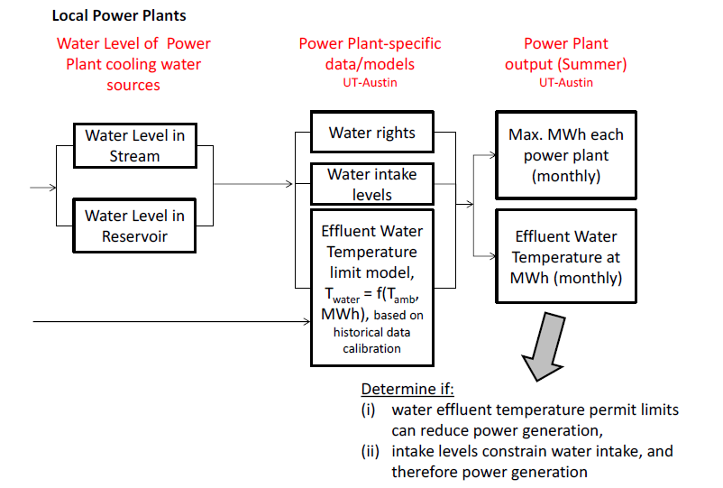
Methods of Analysis (2)

Slide 12
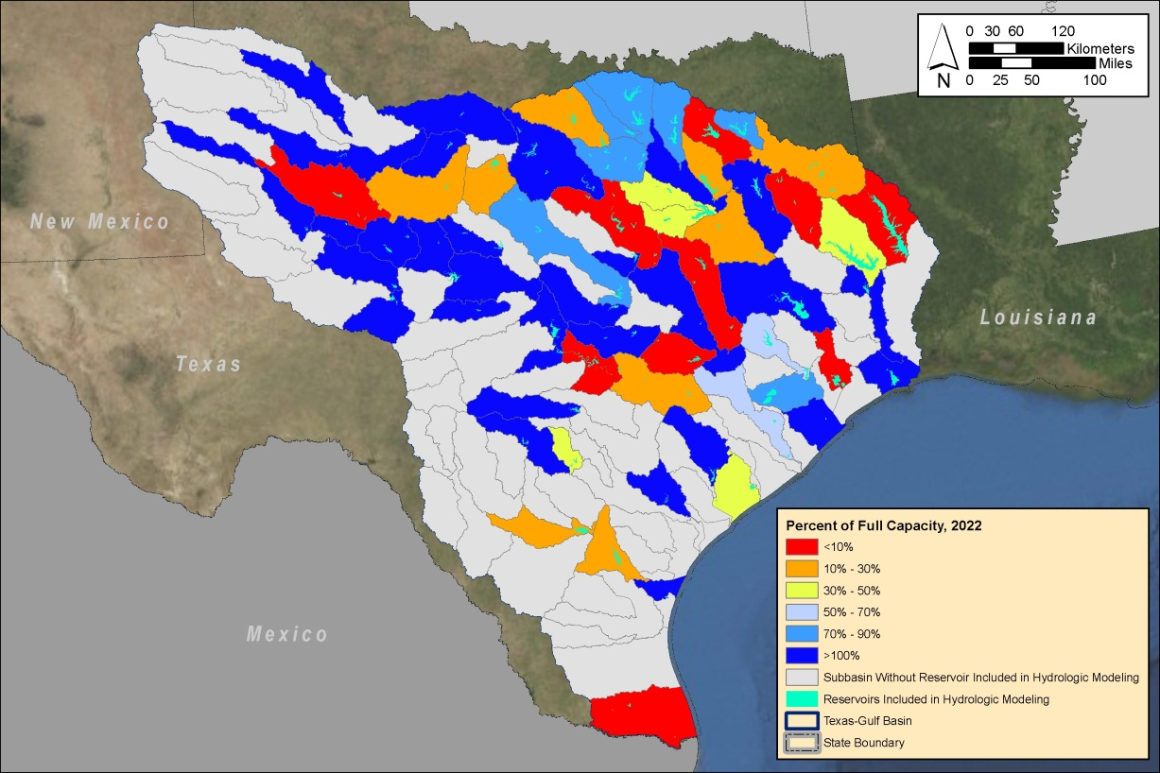
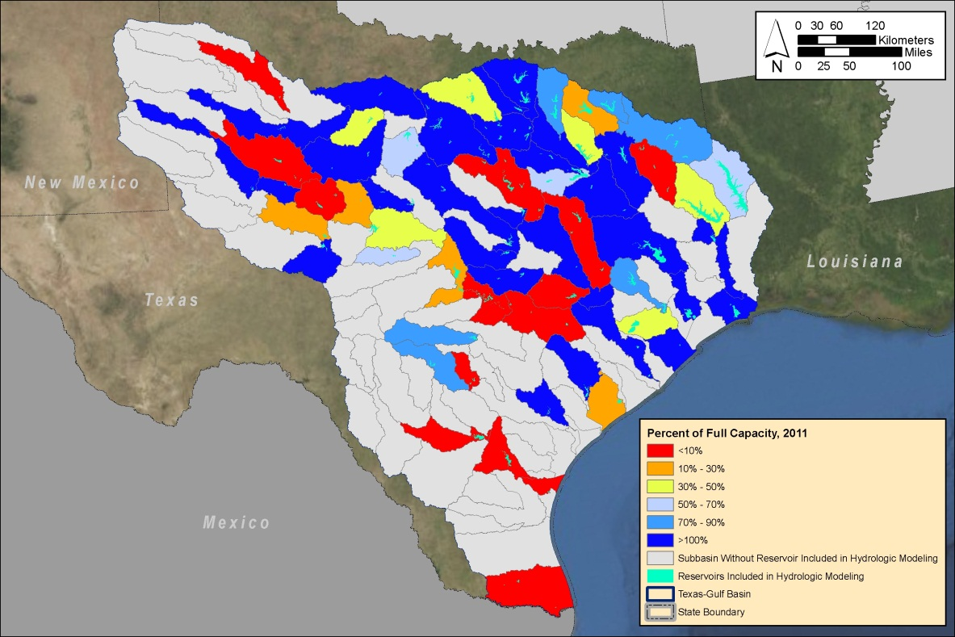
Hydrologic Modeling Results – Single-Year Drought
Projected Reservoir Capacity in HUC-8 Basins

Slide 13
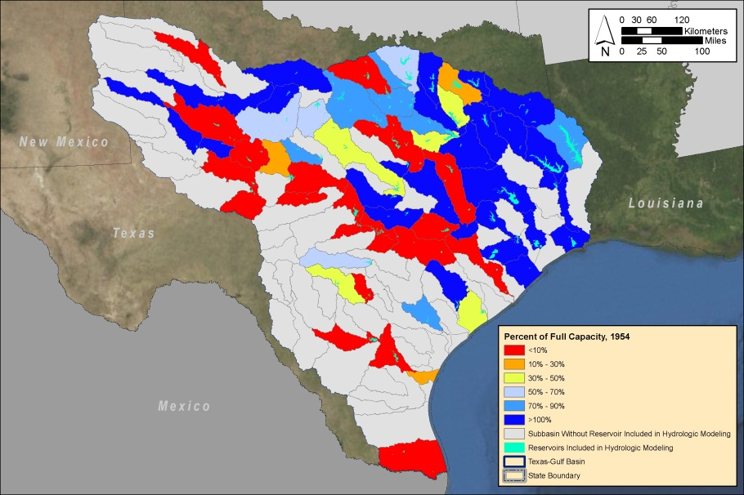
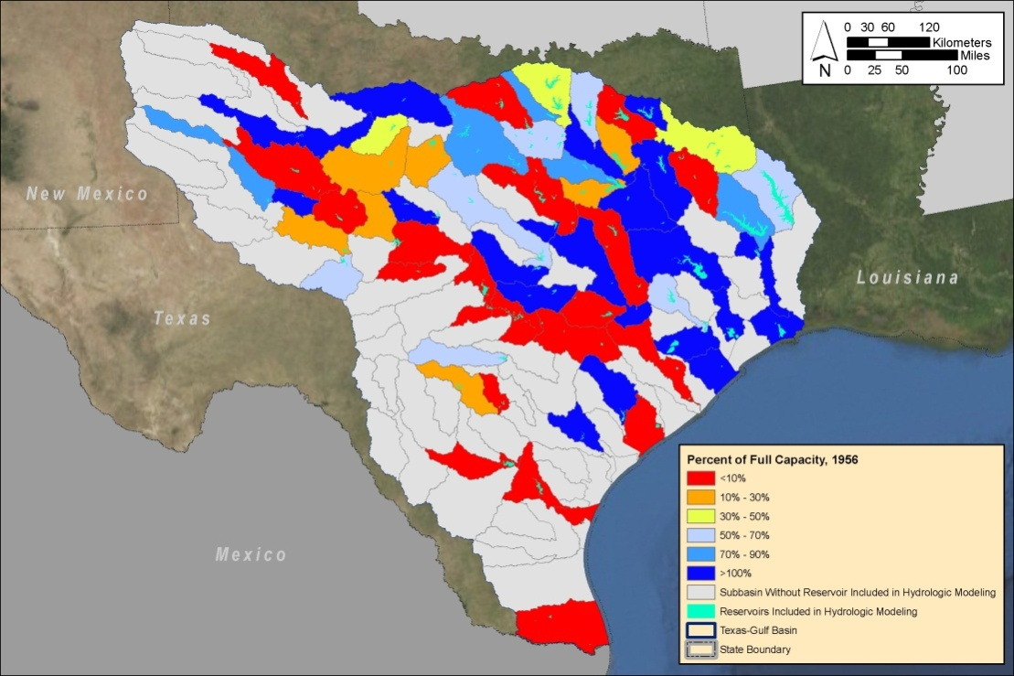
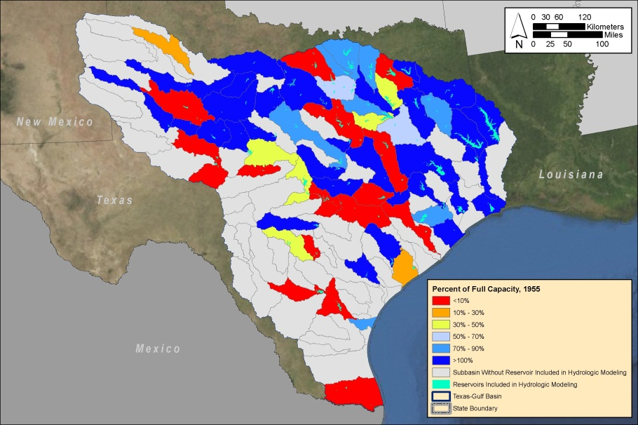
Hydrologic Modeling Results – Multiple-Year Drought
Projected reservoir storage in HUC-8 basins under 1950-1957 drought scenario
1954
1956
1955

Slide 14
Operations near thermal limit

Slide 15
Operations near thermal limit in future summers

Slide 16
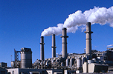
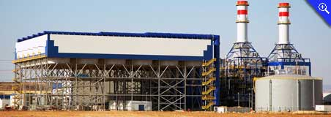
Power Plant Siting Decisions
West-wide objectives
  Minimize cost
  Maximize reliability
  Maximize transmission capacity utilization
  Limit exposure to policy change
  Minimize stress over water
Power plant siting criteria
  Fuel type
  Cooling type
  Capacity
  Location
  Water source

Slide 17
Key Water Sources
  Potable Water
    Unappropriated surface water
    Unappropriated groundwater
    Appropriated water (rights transfers)
  Non-Potable Water
    Municipal/Industrial wastewater
    Shallow brackish water
Relative Availability and Cost

Slide 18
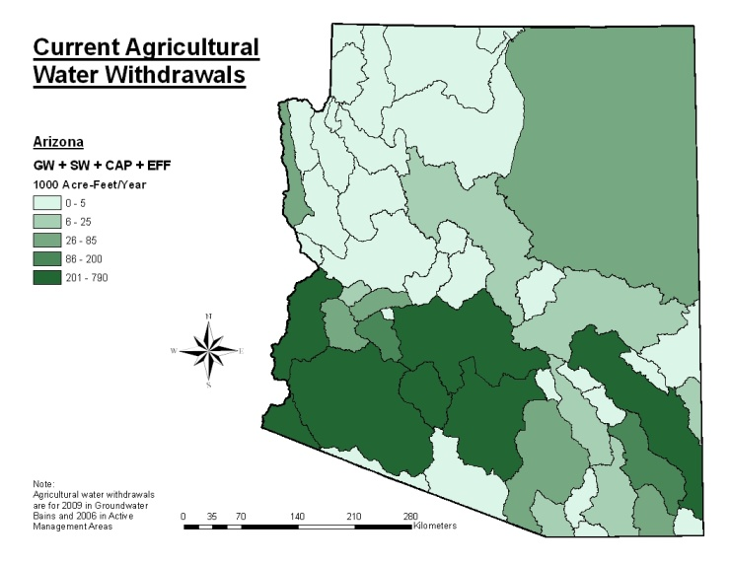
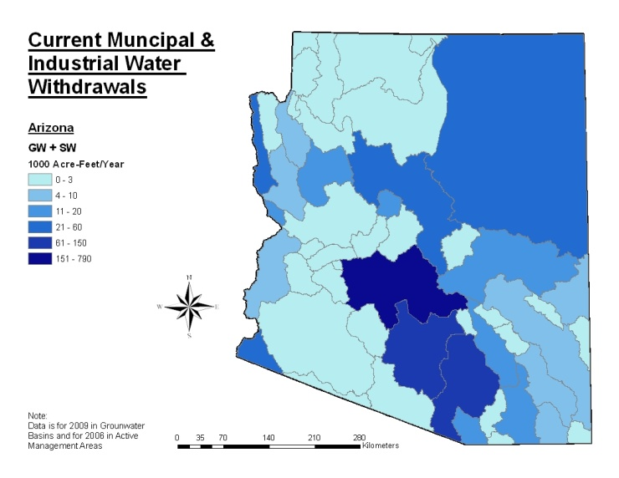
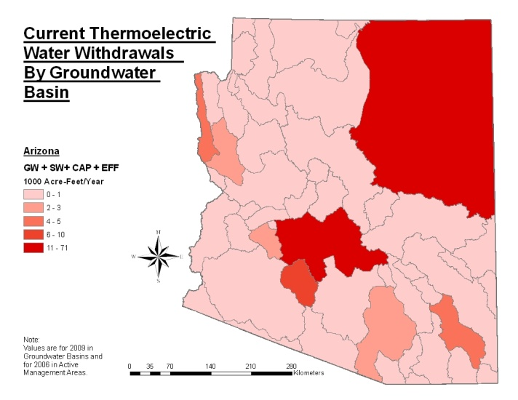
Water Availability Indicators: Demand
Focus on withdrawals
Estimate consumption from withdrawals
Disaggregate by:
  8-digit watershed
  Sector
    M&I
    Agriculture
    Evaporative
    Instream
  Water source

Slide 19
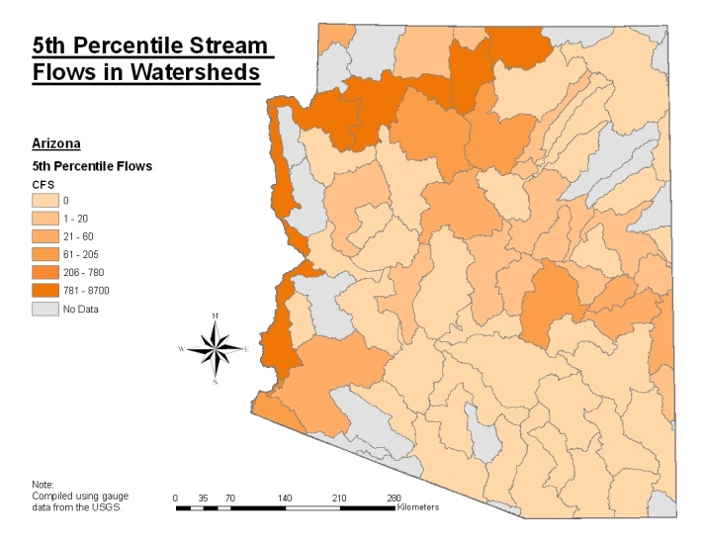
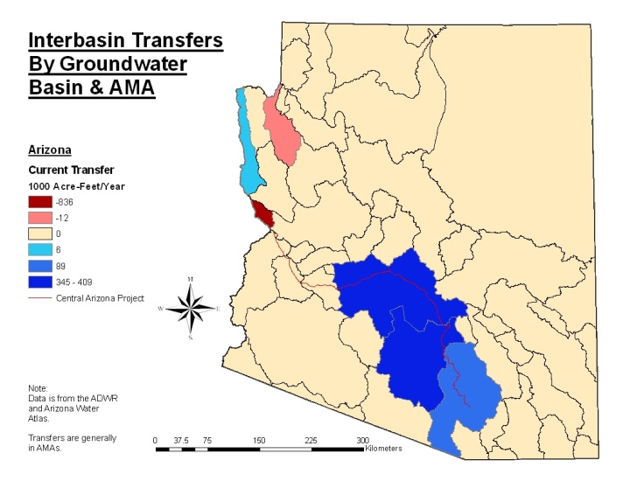
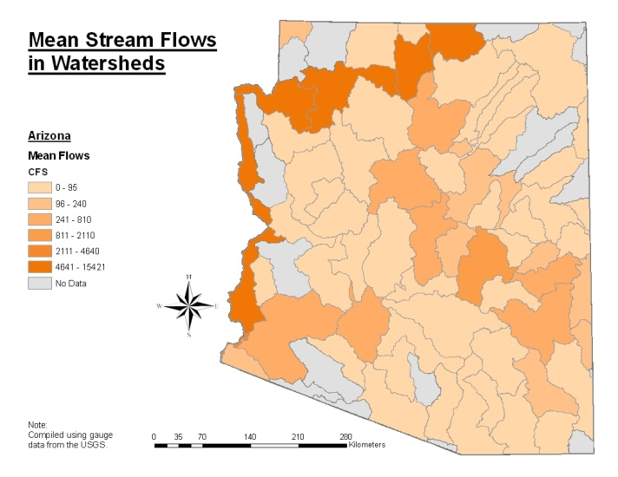
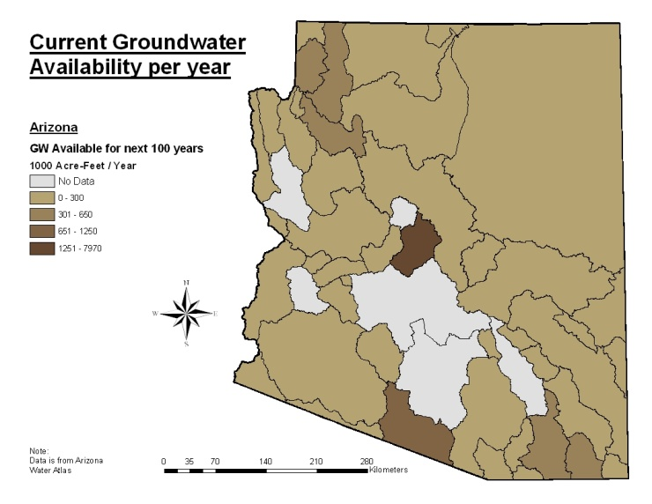
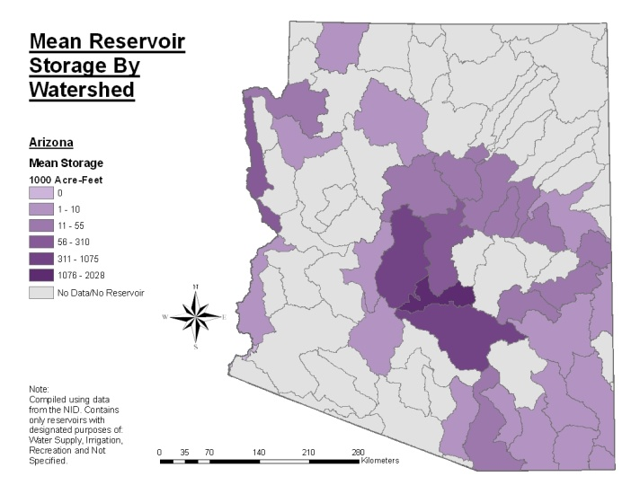
Water Availability Indicators: Supply
Mean Gauged Streamflow
Interbasin Transfers
Annual Low Flow
Groundwater Depletion
Reservoir Storage

Slide 20
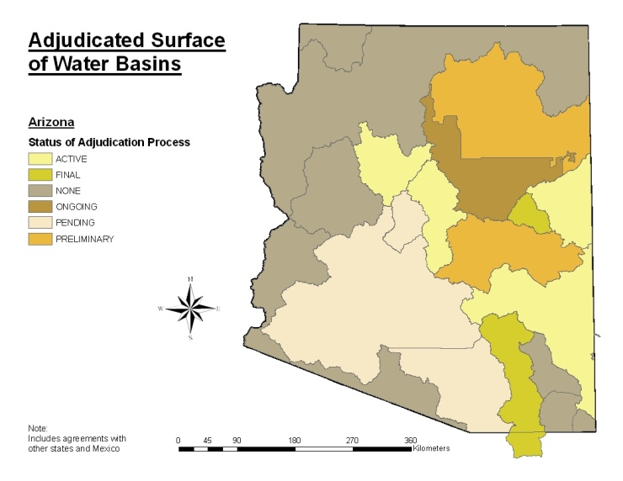
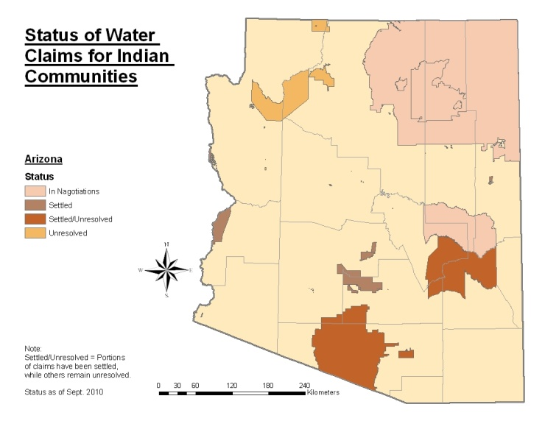
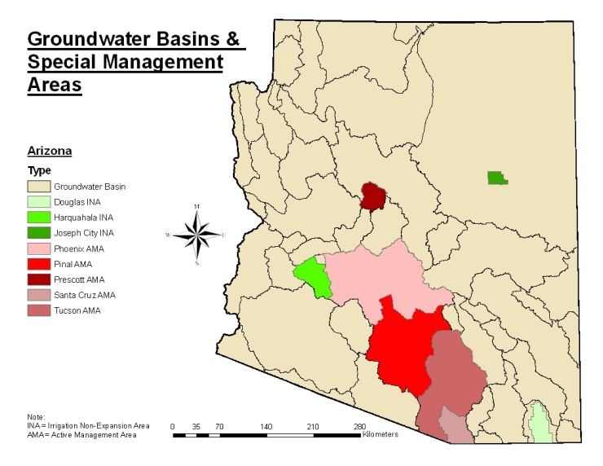
Water Availability Indicators:
Institutional Factors
Unappropriated Water
Adjudication Status
Indian Water
Administrative Control Areas

Slide 21
Metric Development
Data on “available water” are rare
As such, metrics were estimated from available information
Assisted by volunteer team from WSWC
  Bret Bruce (USGS)
  Dan Hardin (TX)
  Sara Larsen (WSWC)
  Dave Mitamura (TX)
  Andy Moore (CO)
  Ken Stahr (OR)
  Todd Stonely (UT)
  Steve Wolff (WY)
  Dwane Young (WSWC)

Slide 22
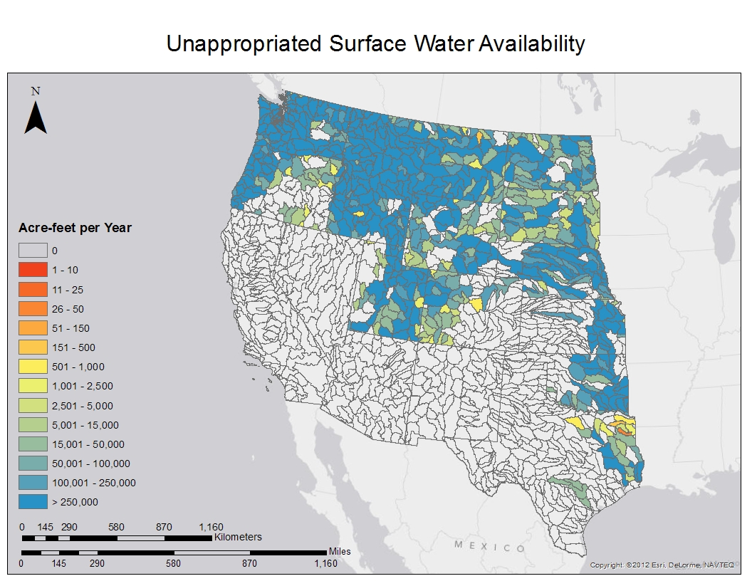

Slide 23
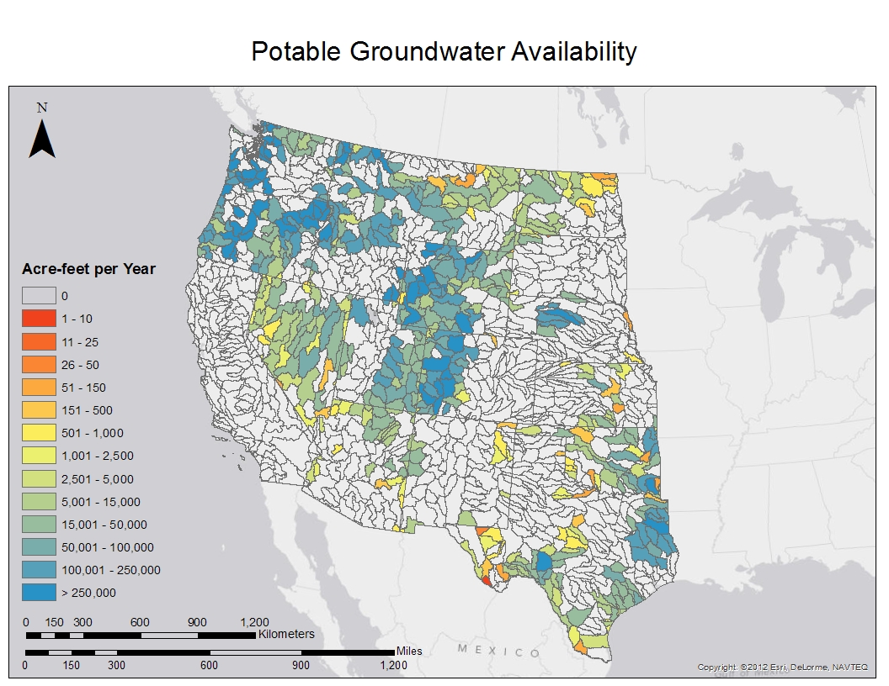

Slide 24
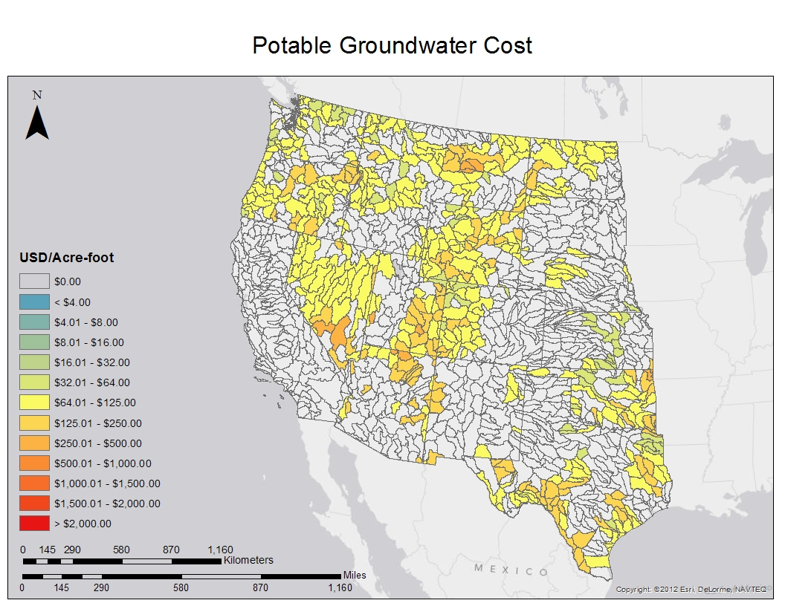

Slide 25
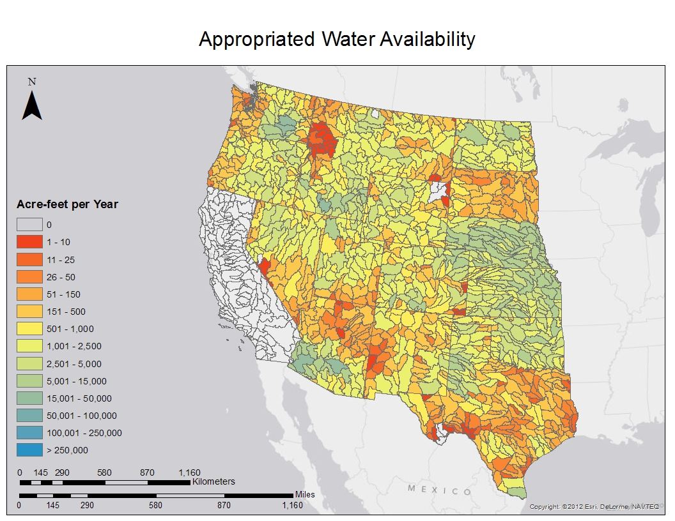

Slide 26
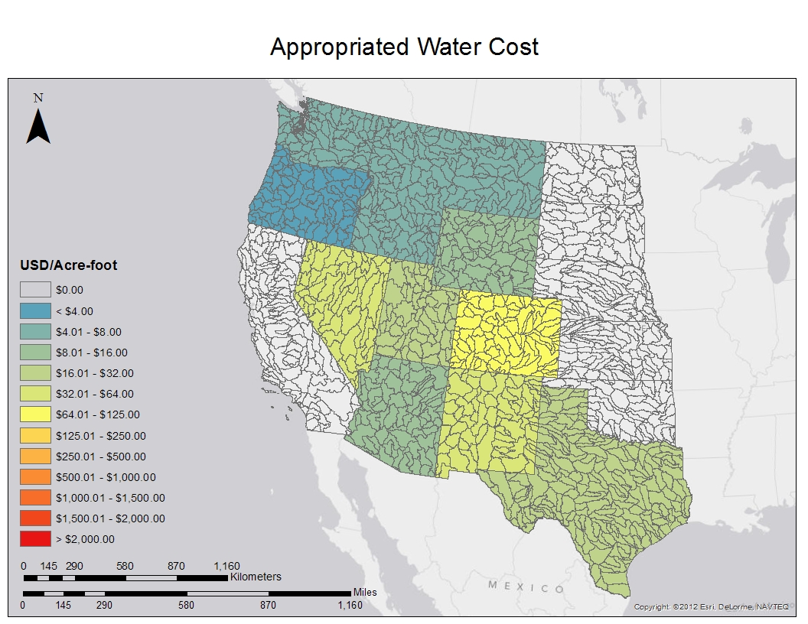
Appropriated Water Cost

Slide 27
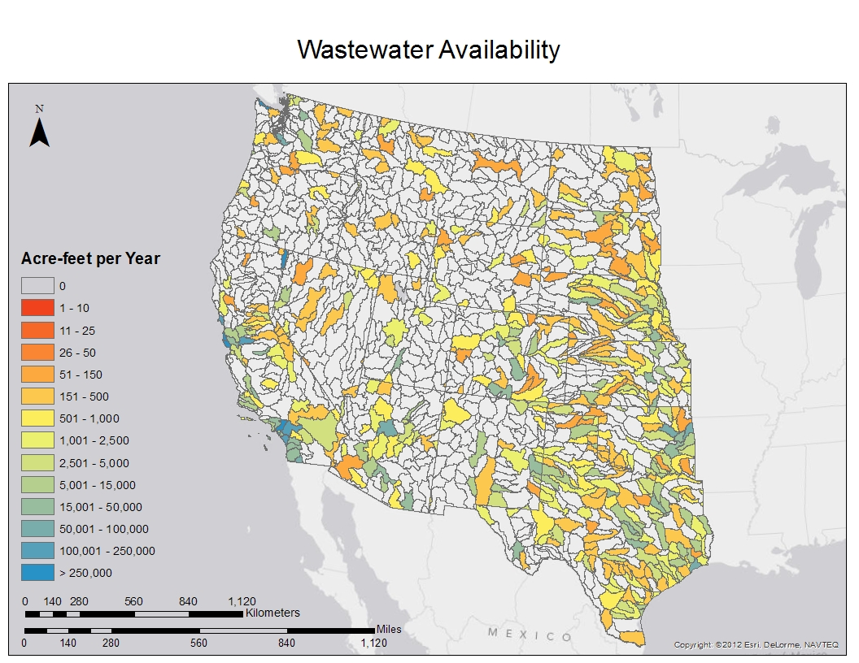

Slide 28
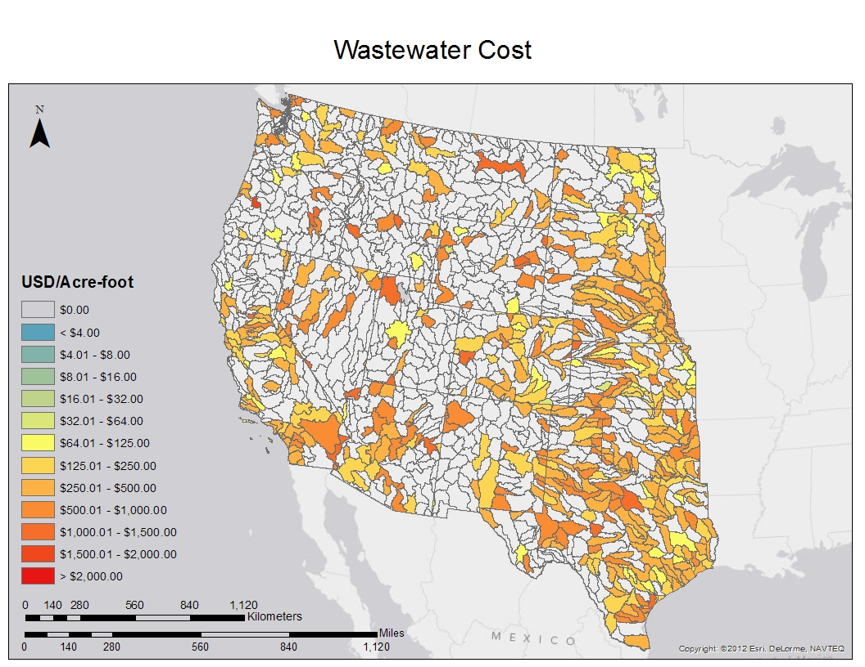
Notes:
Municipal water runs about $1000/af ($2.85-$5.50/1000 gallons).

Slide 29
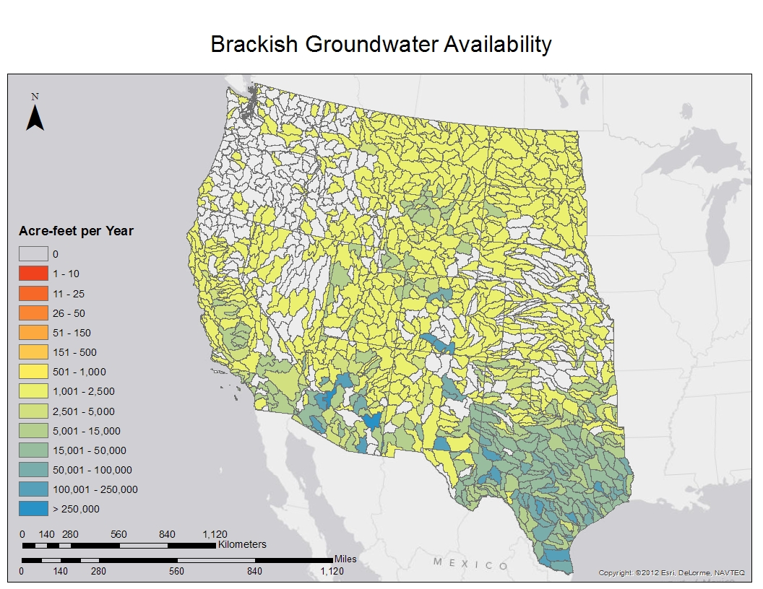

Slide 30
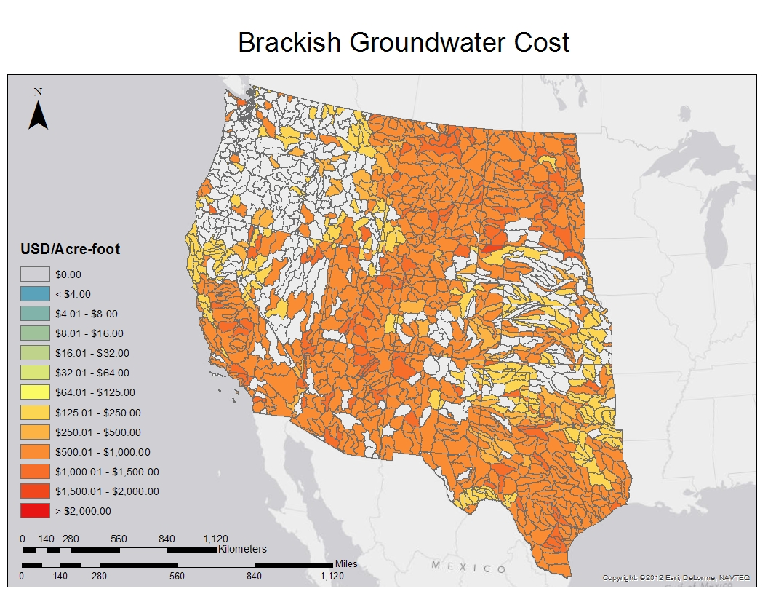

Slide 31
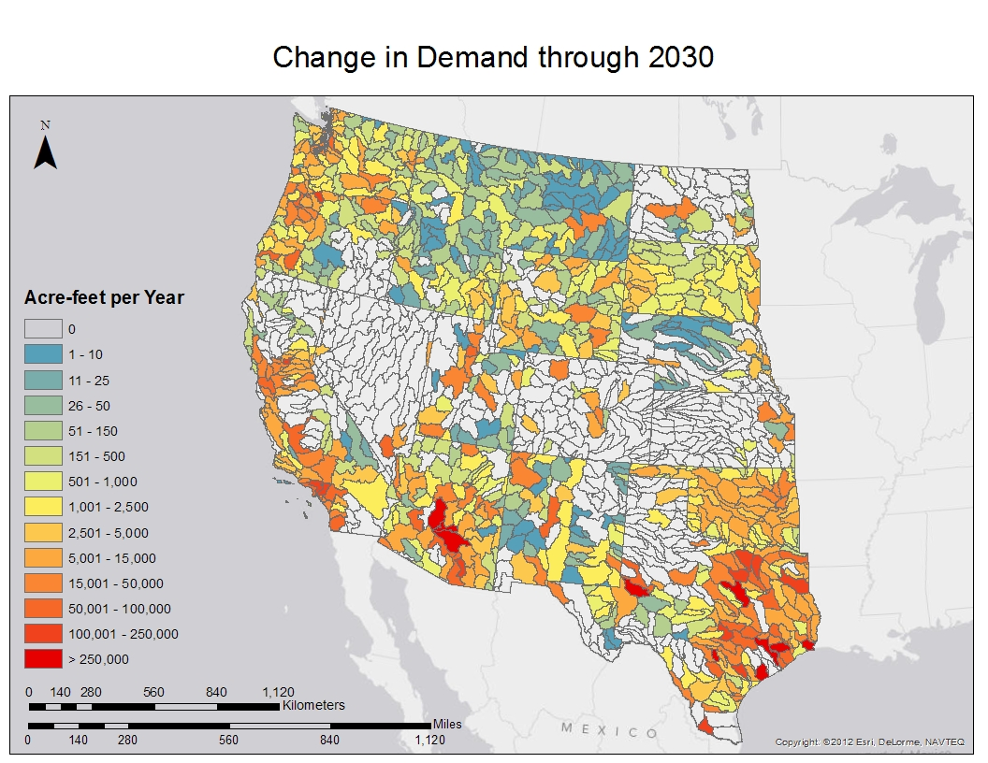

Slide 32
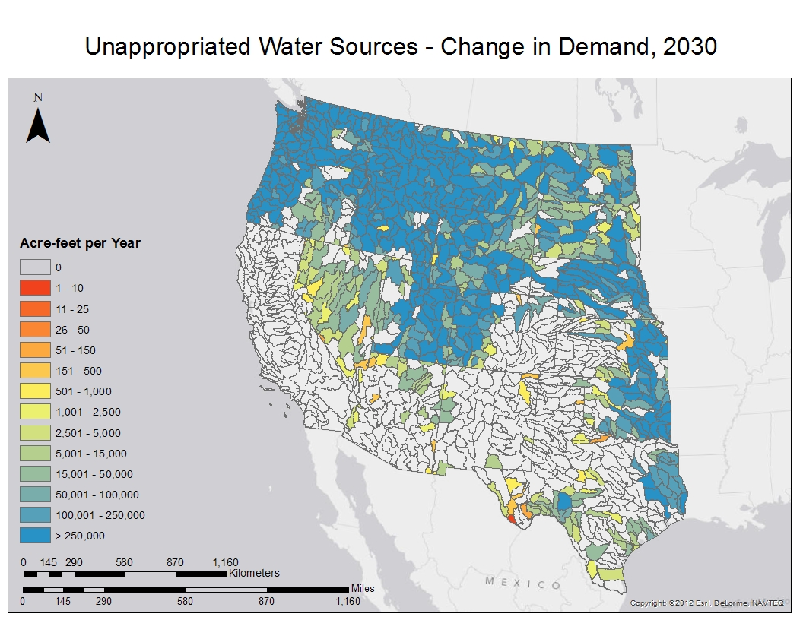
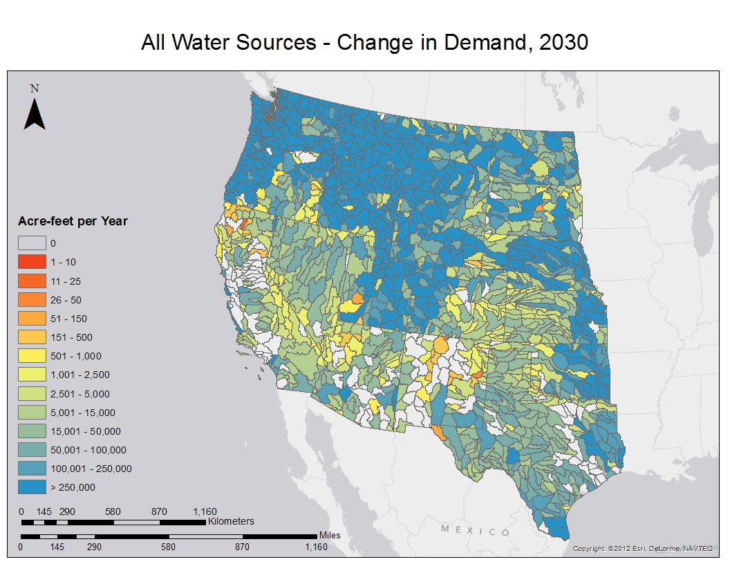
Water for Development

Slide 33
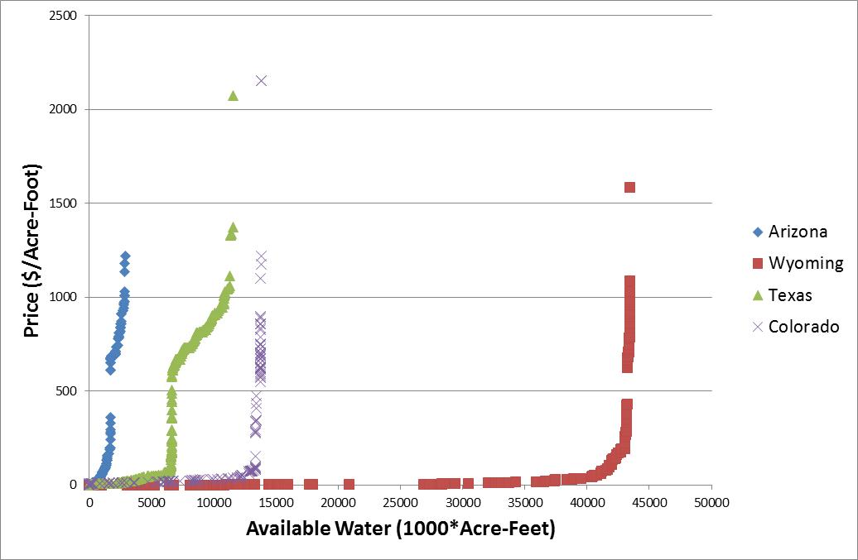
State-Level Supply Curves

Slide 34
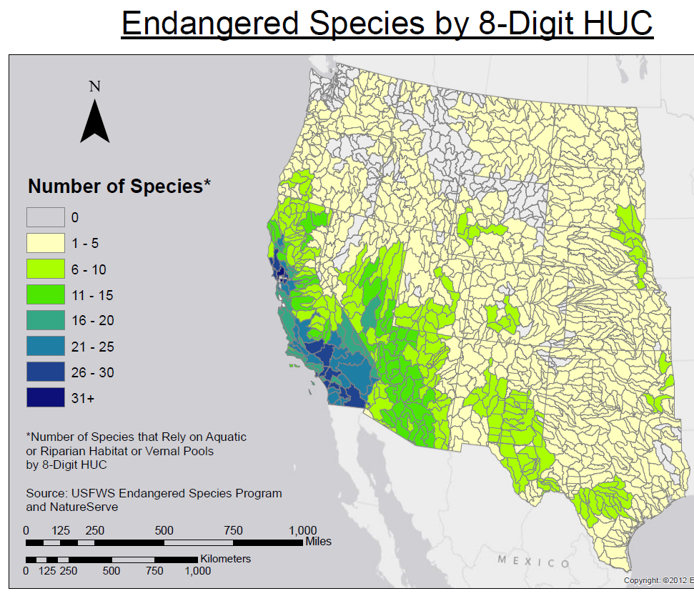

Slide 35
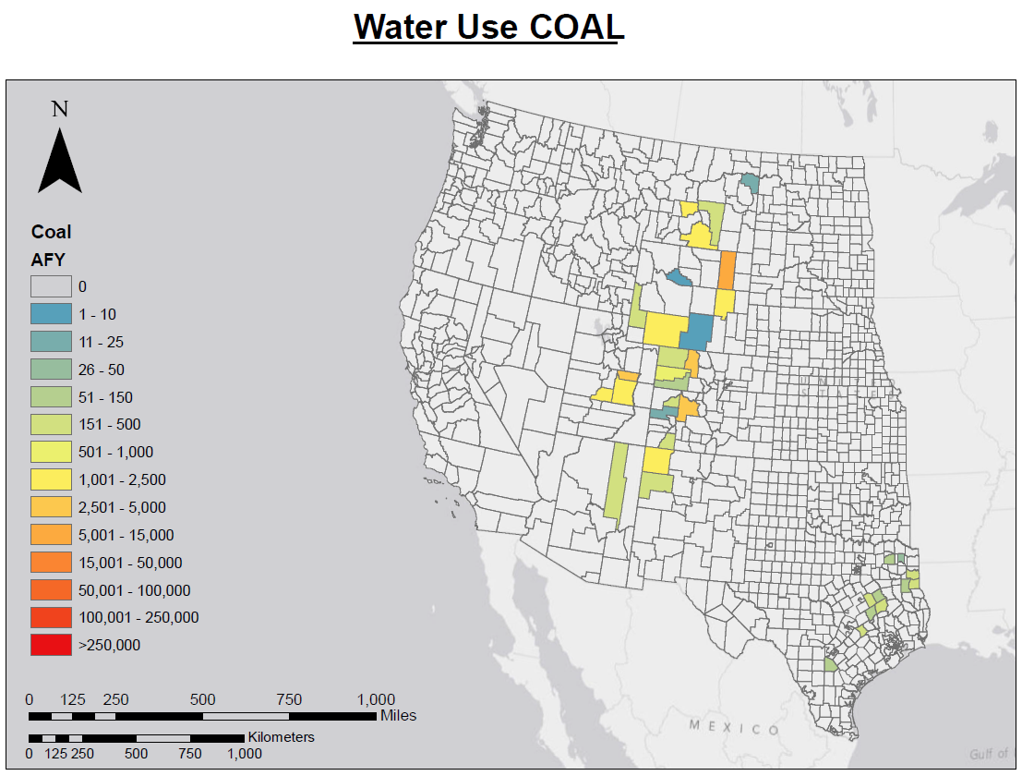
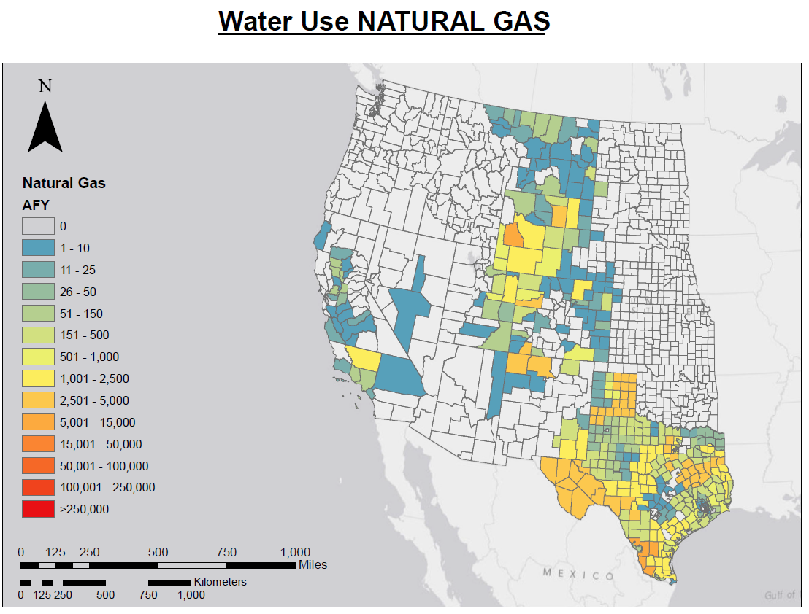
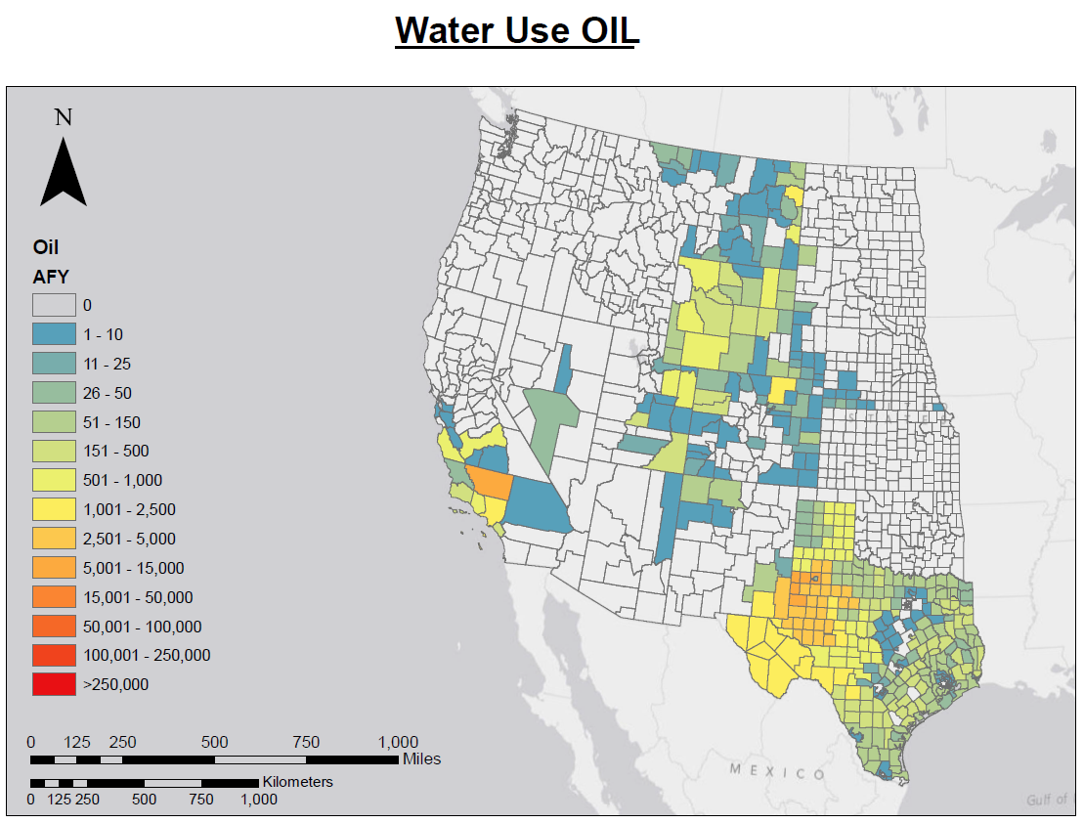
Water for Fuel Extraction

Slide 36
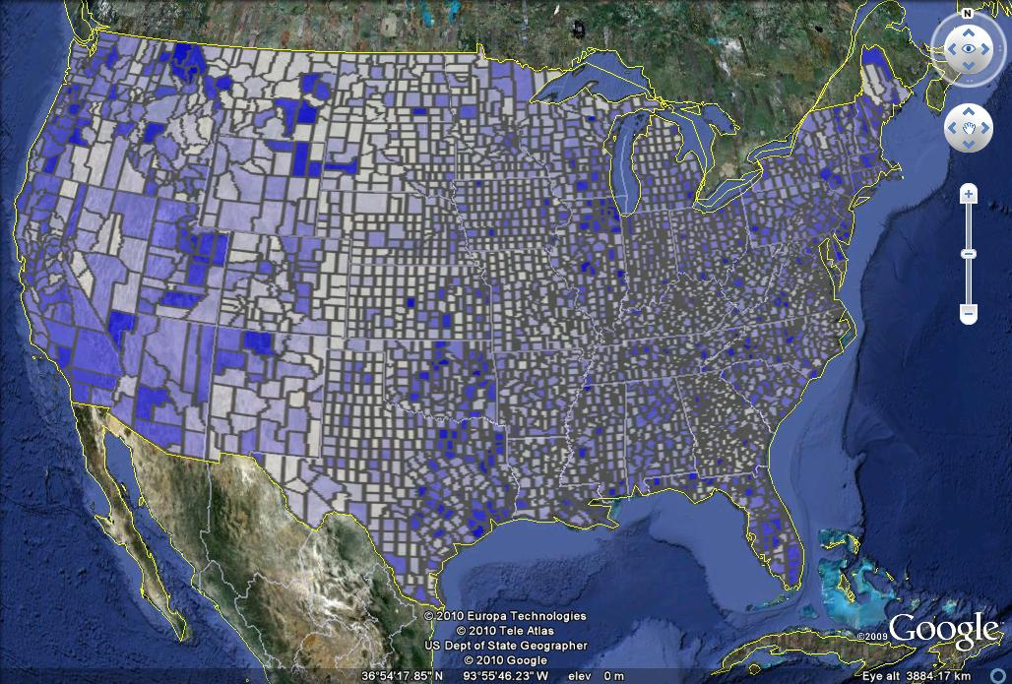

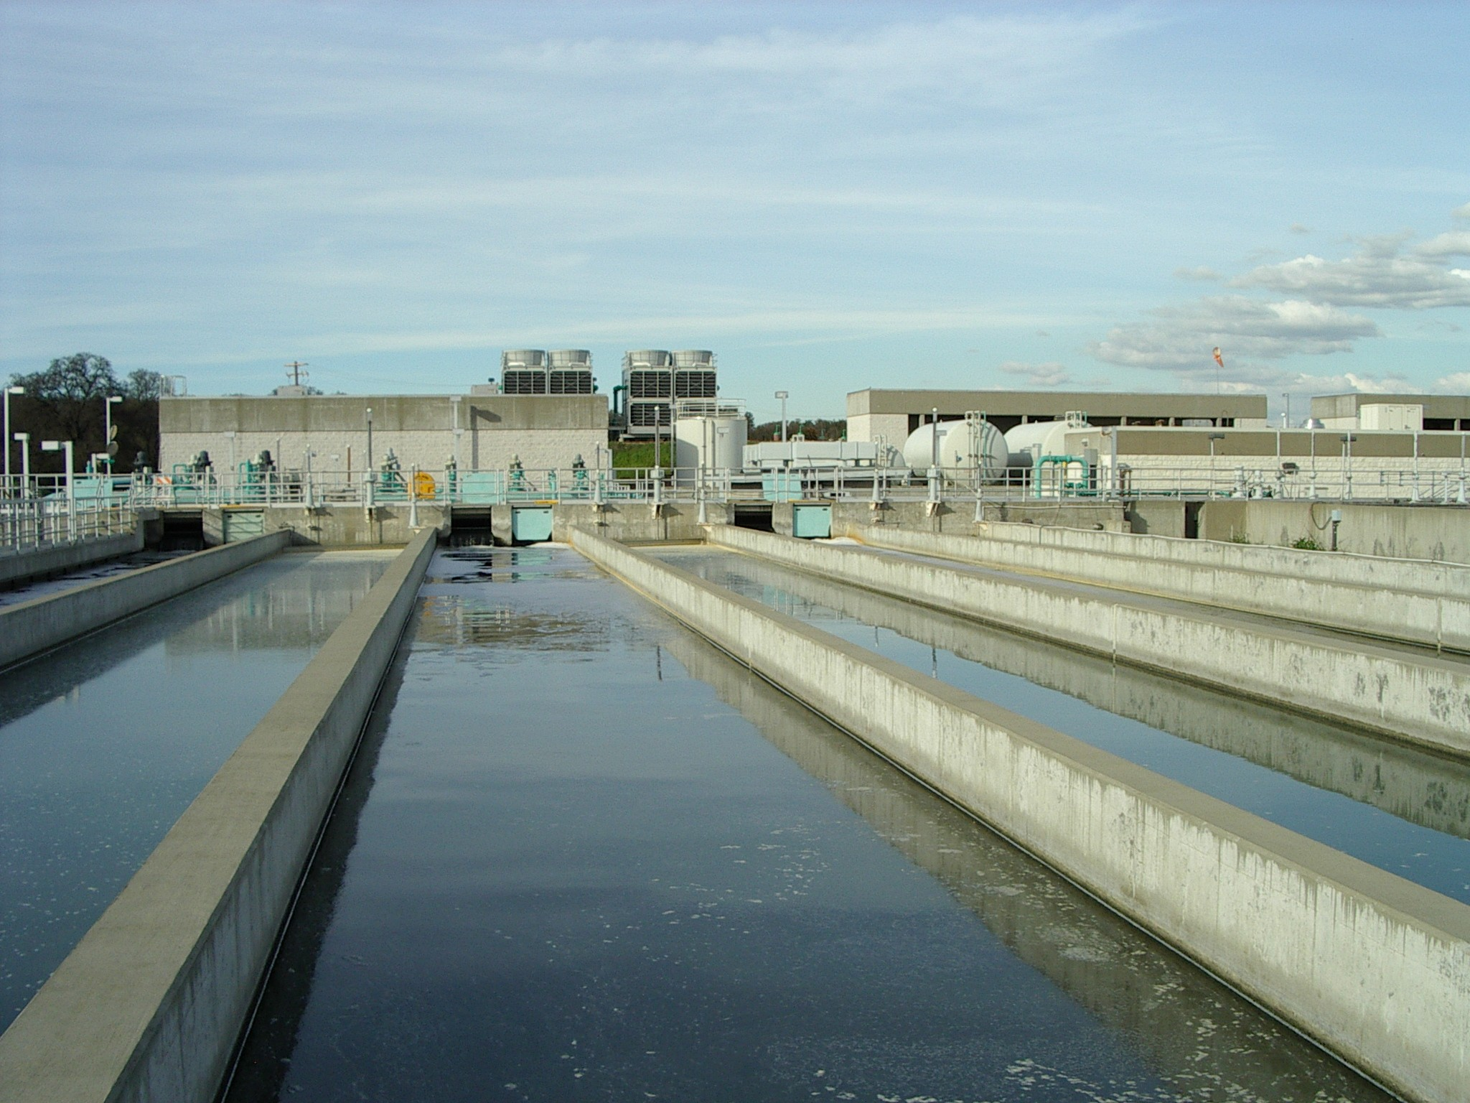
Energy for Water Calculator
Update Energy for Water Model
Energy for Large Projects
Energy for Agriculture

Slide 37
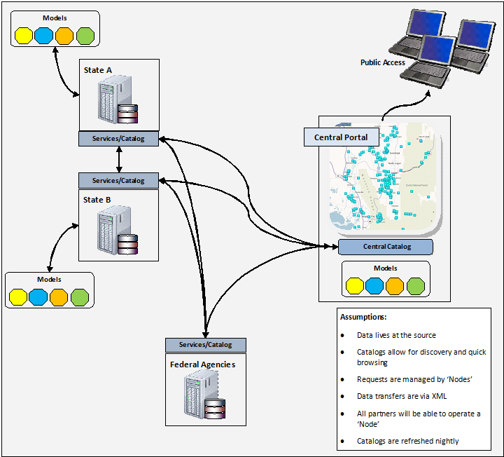
Water Use Data Exchange (WaDE)
Use Web Services to transfer data
Data Stay at the Source (i.e. the states)
Provide transparent link between state data and integrated water metrics
  Link to metadata
  Changes in state data are automatically reflected in metrics

Slide 38
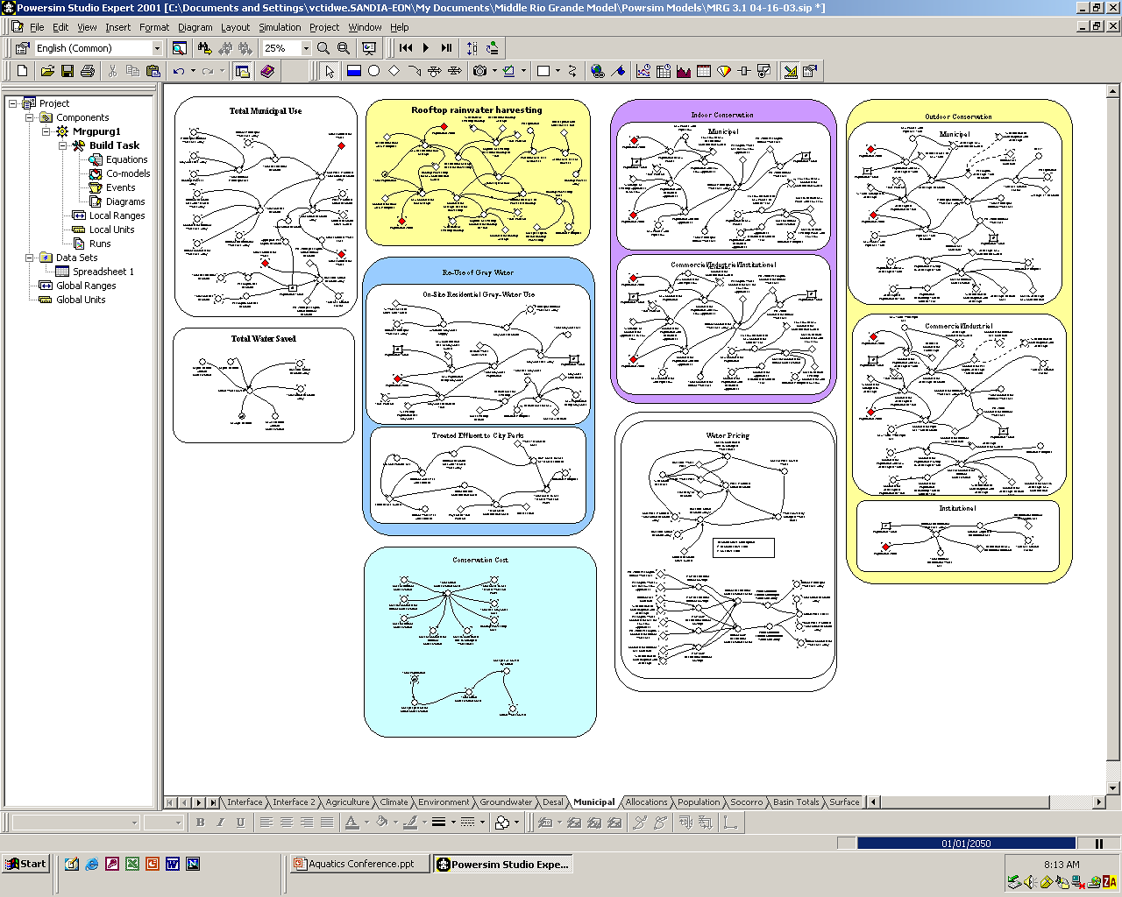
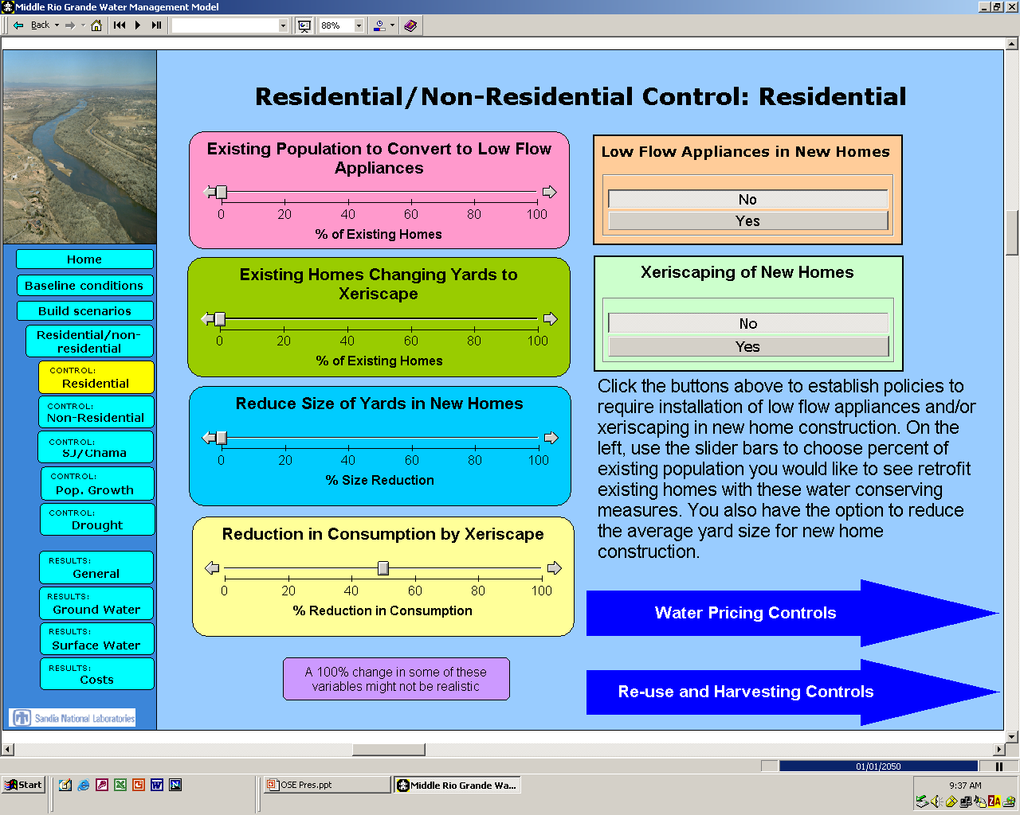
Vincent Tidwell
vctidwe@sandia.gov
(505)844-6025
http://energy.sandia.gov/

