Slide 1
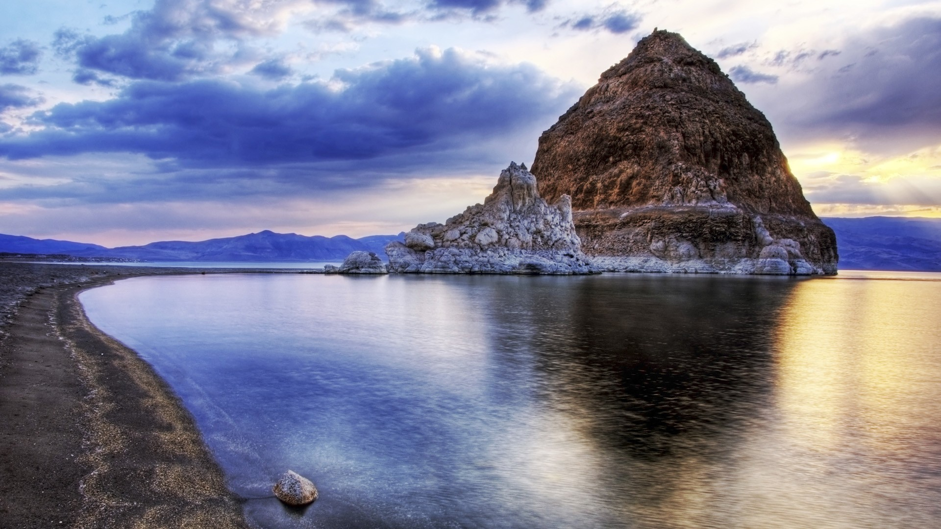
Jason King, P.E.
State Engineer
WSWC/NARF Symposium on the Settlement of Indian Reserved Water Right Claims
August 25-27, 2015
Pyramid Lake Paiute Tribe’s Water Rights Settlement
PL 101-618

Slide 2
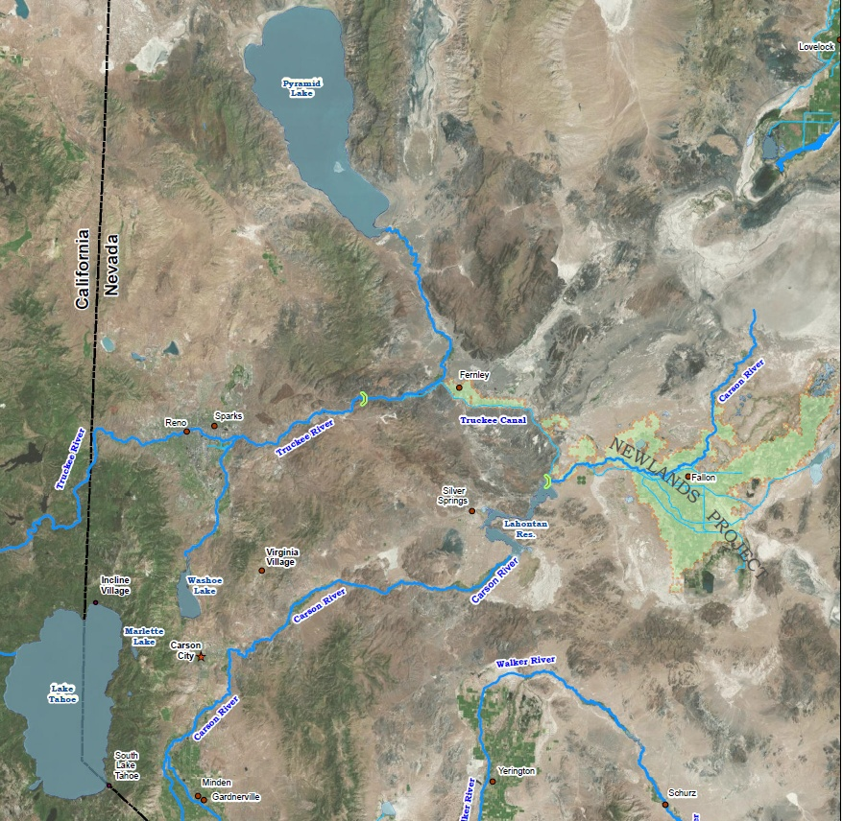

Slide 3
California Conservation Commission - 1913
“ …the waters of Lake Tahoe are too valuable an asset, from every point of view, to permit them to be diverted, without established limit, into any other state…The Commission, therefore recommends as strongly as it can, that this State bring suit, before the Supreme Court of the United States, against the State of Nevada to have the waters of Lake Tahoe equitably apportioned to and between the two states…”

Slide 4
Competing Demands
Use in the Lake Tahoe Basin – Nevada and California
Pyramid Lake and it’s fisheries
Hydropower along the Truckee River
Reno/Sparks Metropolitan Area M&I
Truckee Meadows Irrigation
Fernley Area, M&I and Irrigation
Lower Carson (Newlands Project)
Fallon Paiute-Shoshone Tribe

Slide 5
Truckee River Key Dates
1902 Federal Reclamation Act is passed
1913 U.S. v Orr Ditch Water Co. begins
1915 Truckee River General Electric Decree is issued
1935 Truckee River Agreement is signed
1944 Orr Ditch Decree is issued
1955 Interstate Compact Authorized by Congress
States approved in 1970 and 1971 but never ratified by Congress
1990 Public Law 101-618 enacted

Slide 6
Pyramid Lake/Truckee-Carson Water Rights Settlement Act PL 101-618
Seven Elements
Resolve interstate allocations for the Truckee River, Carson River and Lake Tahoe Basin between the states of Nevada and California (Sec 204)
Improve management and efficiency of the Newlands Project (Sec 209)
Promote the enhancement and recovery of endangered and threatened fish species in the Truckee River (Sec 207)
Protect wetlands in Lahontan Valley (Sec 206)
Negotiate an operating agreement for the Truckee River (TROA) (Sec 205)
Establish a settlement fund for the Pyramid Lake Paiute Tribe (Sec 208)
Establish a settlement fund for the Fallon Paiute-Shoshone Tribe
(Sec 102)

Slide 7
Pyramid Lake/Truckee-Carson Water Rights Settlement Act
Carson River Interstate Allocation
Alpine Decree affirmed as the allocation
Truckee River
32,000 acre-feet to California
Balance to Nevada (~550,000 acre-feet based on average flow)
Lake Tahoe Basin
34,000 acre-feet total available water from all sources
23,000 acre-feet to California (2/3)
11,000 acre-feet to Nevada (1/3)

Slide 8
Pyramid Lake/Truckee-Carson Water Rights Settlement Act
Truckee River Operating Agreement (TROA)
Five Mandatory Signatory Parties
Pyramid Lake Paiute Tribe
Nevada
California
United States
Truckee Meadows Water Authority (Successor to
Sierra Pacific Power Company)

Slide 9
Pyramid Lake/Truckee-Carson Water Rights Settlement Act
TROA includes provisions and procedures that:
Protects existing water rights
Increases the operational flexibility and efficiency of certain reservoirs in the Lake Tahoe and Truckee River basins
Provides additional drought protection by storing water in existing reservoirs for future Municipal & Industrial demands in the Truckee Meadows for the Cities of Reno and Sparks

Slide 10
Pyramid Lake/Truckee-Carson Water Rights Settlement Act
TROA includes provisions and procedures that:
Increases recreational opportunities in the federal reservoirs; improves stream flows and fish habitat throughout the Truckee River basin; and enhances spawning flows in the lower Truckee River for the benefit of Pyramid Lake.
Improves water quality in the Truckee River, and
Resolves existing and potential issues and conflicts resulting in an orderly and stable administration of the water supplies.

Slide 11
Pyramid Lake/Truckee-Carson Water Rights Settlement Act
TROA’s Significant Procedural Steps:
The Truckee River Decree had to be changed to allow changes in Floriston Rates (previously established flow rate benchmarks) to promote credit storage in upstream reservoirs
Change permits needed to be granted to allow direct diversion Truckee River rights to be stored in upstream reservoirs located in California
The Pyramid Lake Paiute Tribes (PLPT) claim to all the unappropriated water of the Truckee River had to be confirmed, thereby declaring the Truckee River fully appropriated.
The PLPT’s unappropriated rights were allowed to be administered by the Federal Water Master, not the Nevada State Engineer.
Environmental evaluation
TROA had to be promulgated as a federal regulation

Slide 12
Pyramid Lake/Truckee-Carson Water Rights Settlement Act
TROA Status:
Agreement approved in June 2008
Final implementation dependent on a number of contingencies being met.
Last week, final purchase of water in support of the Water Quality Settlement Agreement between Reno, Sparks and Washoe County and the PLPT was secured.
TROA implemented this year? Early 2016?

Slide 13
Pyramid Lake/Truckee-Carson Water Rights Settlement Act
TROA Administration:
Administered by the Federal Water Master
Coordinating Committee
One representative from each signatory party.
Review and discuss implementation, scheduling, forecasting and coordination in the operation of the Truckee River reservoirs.
Dispute Resolution
Truckee River Special Hearing Officer
Appealable to the Orr Ditch Court

Slide 14
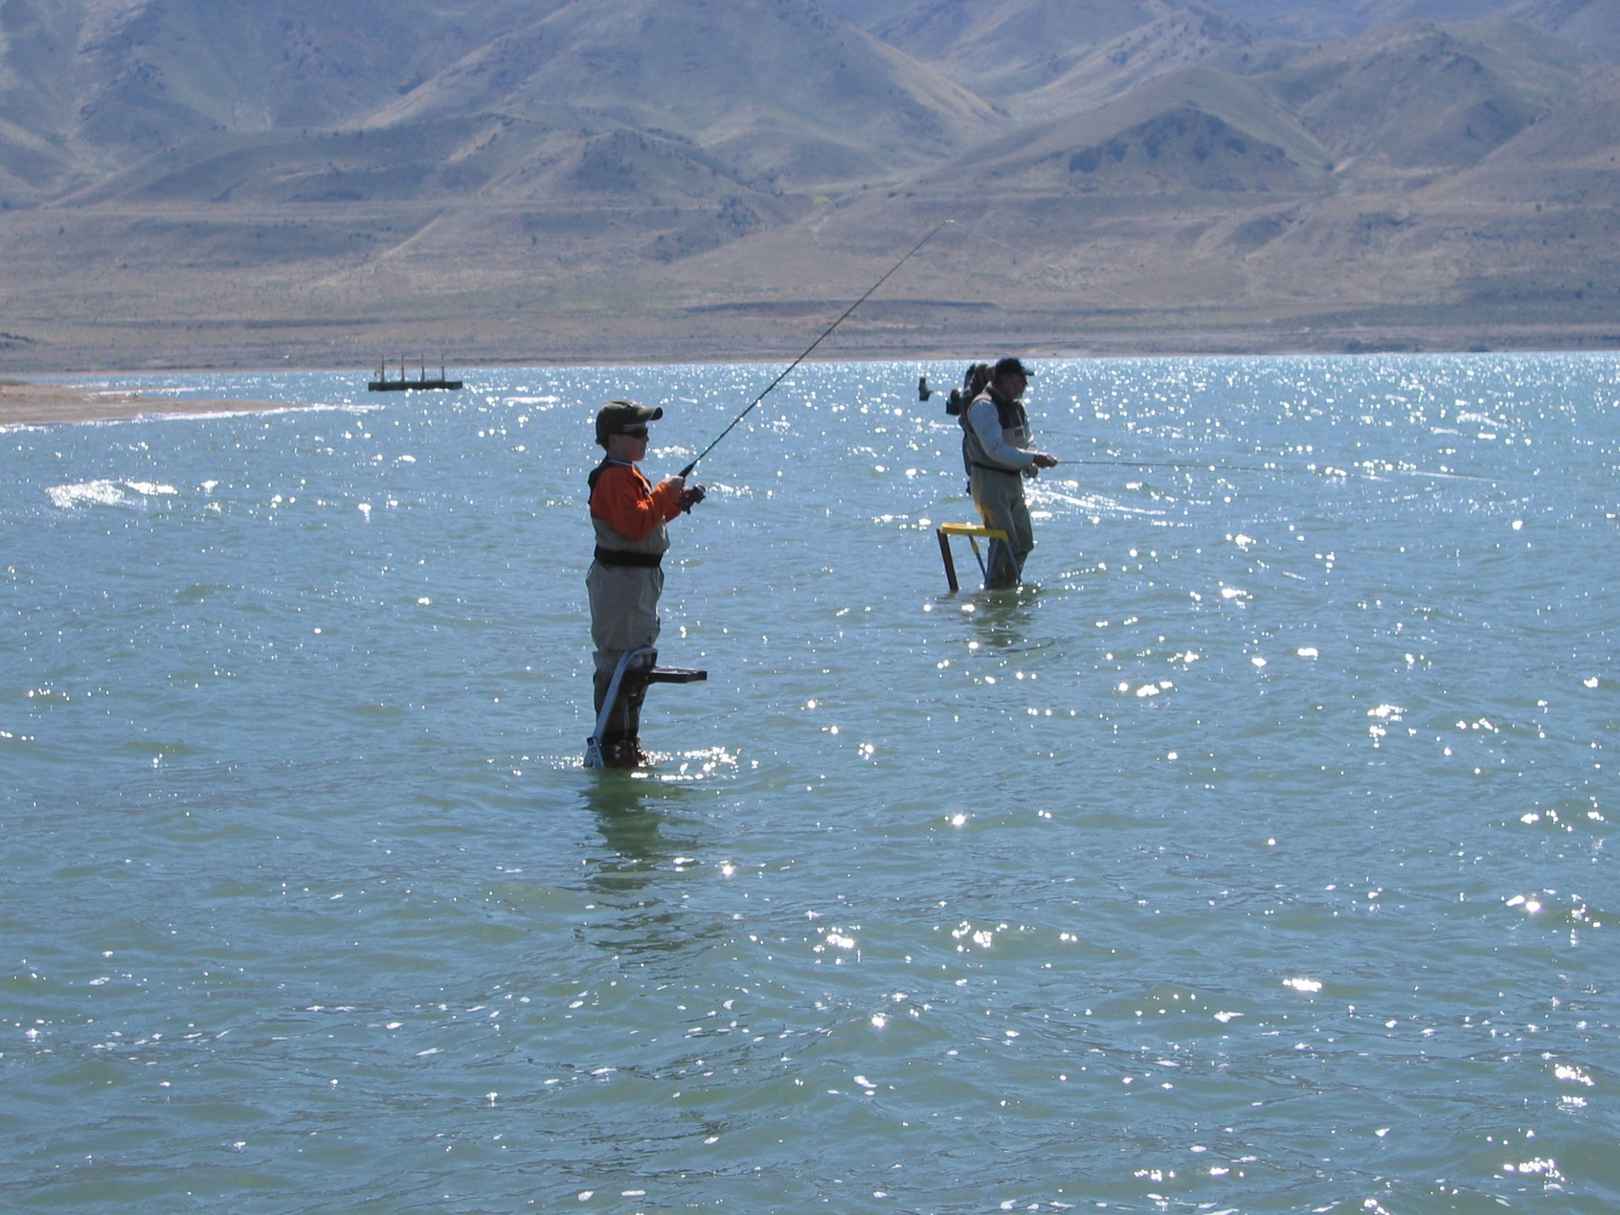
Questions?

