Slide 1
Tule River Indian Tribe Water Settlement - Response to Administration Settlement Policy
Wednesday, August 26, 2015
Kenneth McDarment
Vice Chairman, Tule River Tribe

Slide 2
Creation of the Tule River Reservation
1854
Tejon Reservation was established by the U.S. at the southern end of the San Joaquin Valley, near Ft. Tejon. The reservation was occupied by Yokuts Indians.
1856
The original Tule River Indian Reservation was established north of the Tejon Reservation.

Slide 3
Original Tule River Indian Reservation
The original Reservation included 2,240 acres of prime San Joaquin Valley farmland located in Tulare County, California.
The location of this original Reservation was selected by the federal government to provide the Tribe with a permanent homeland.
It was known as the “Madden Farm.”

Slide 5
Indian Removal from the Madden Farm
1873
President Grant establishes 48,000 acre Tule River Reservation.
Later that year, Grant doubled the Reservation’s size to 91,837 acres because of poor agricultural lands.
Only a very small portion of the new Reservation land was suitable for agricultural development!
A conflict arose because the Indians refused to abandon their crops at the Madden Farm for the lands of the new reservation.

Slide 6
Tule River Reservation
1876
As a result of the conflict, the Yokut and Tejon Indians on the Madden Farm were forcefully and violently removed to the new reservation.
1878
Four landowners in the expanded Reservation complained to the United States about the loss of “their” land.
President Hayes issued a third Executive Order that reduced the size of the Reservation back to its approximately original size.
Notes:
In 1878, President Rutherford B. Hayes reduced the Reservation to its original size.

Slide 8
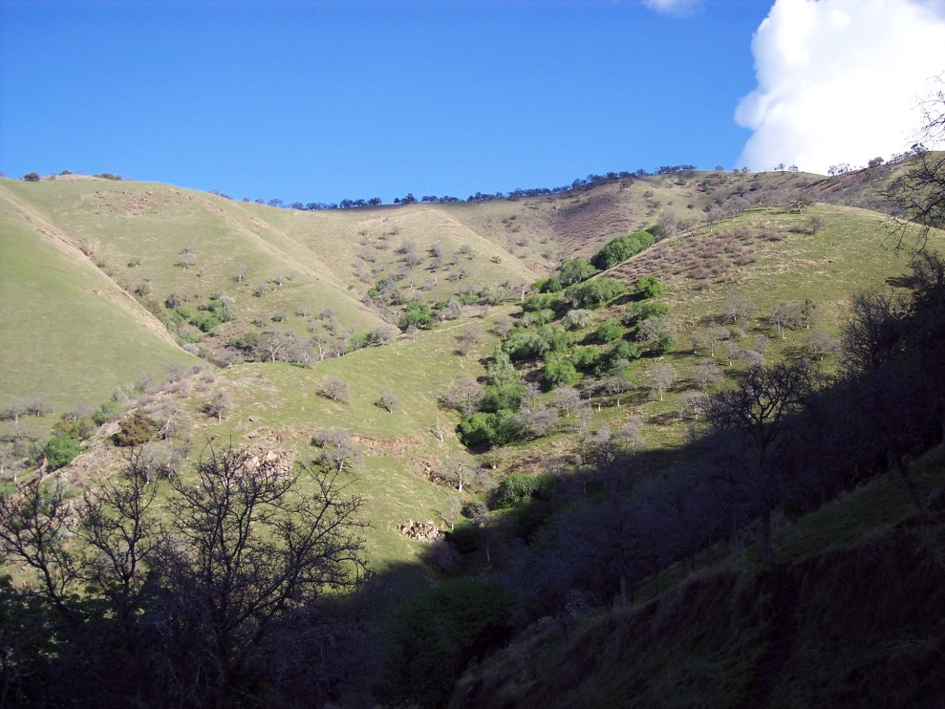
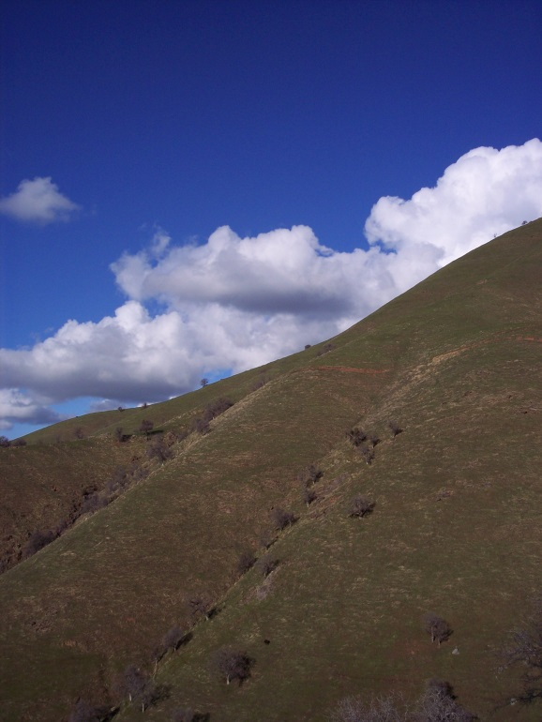
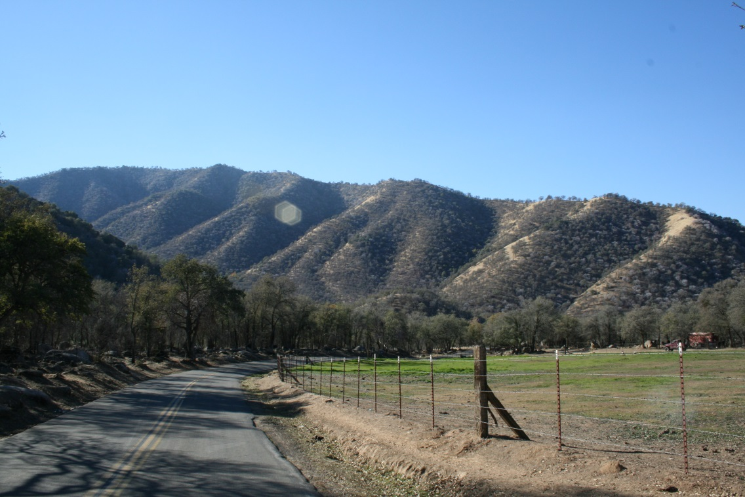
Views of the Reservation

Slide 9
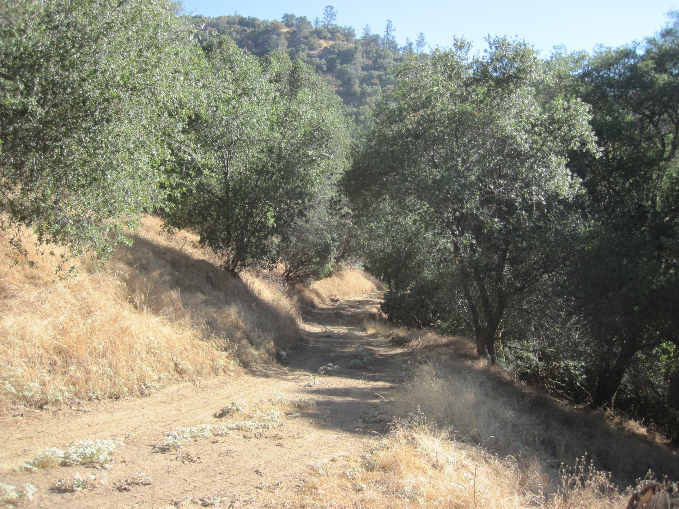

Slide 10
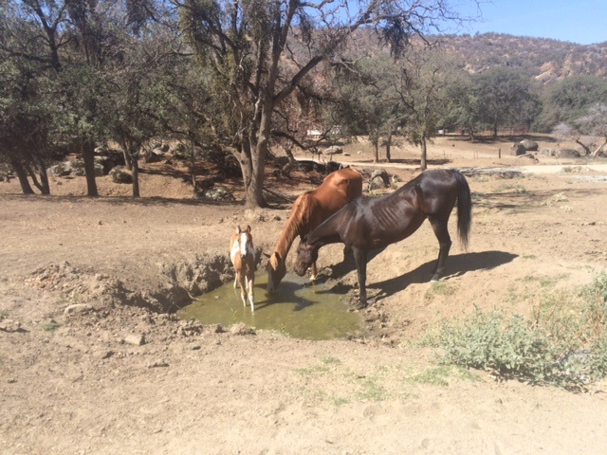

Slide 11
The Current Drought Situation Faced by the Tule River Tribe
Like the rest of California, Tule River has faced drought for many of the past years.
Unlike the rest of California, Tule River has been consistently running out of water every summer.

Slide 14
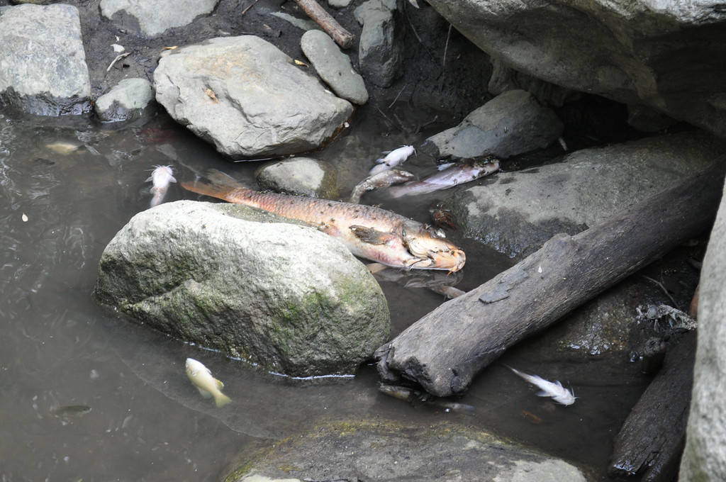

Slide 17
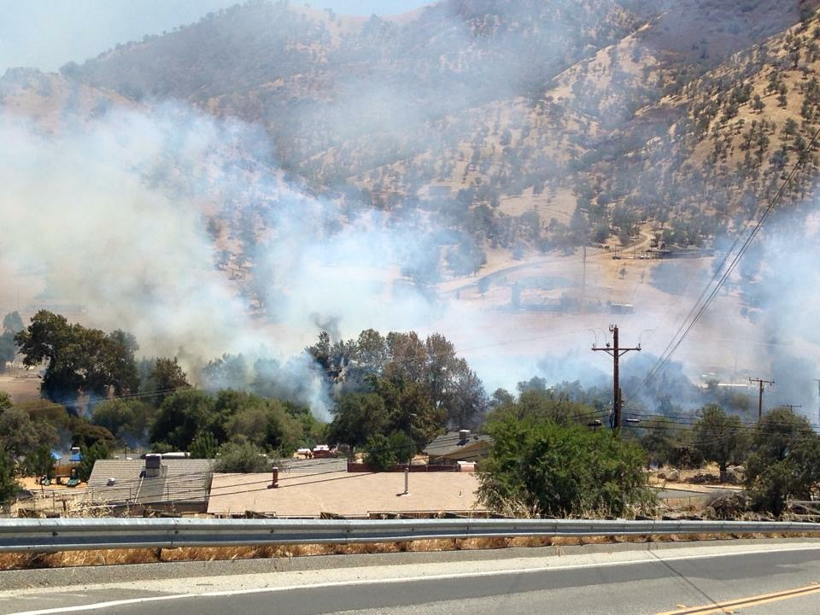

Slide 18
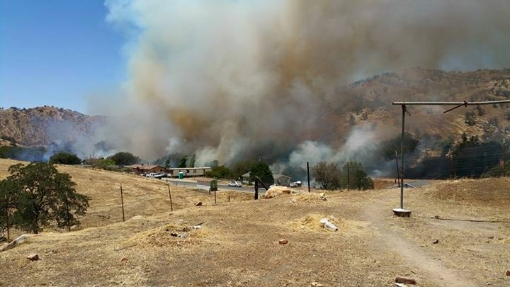

Slide 19
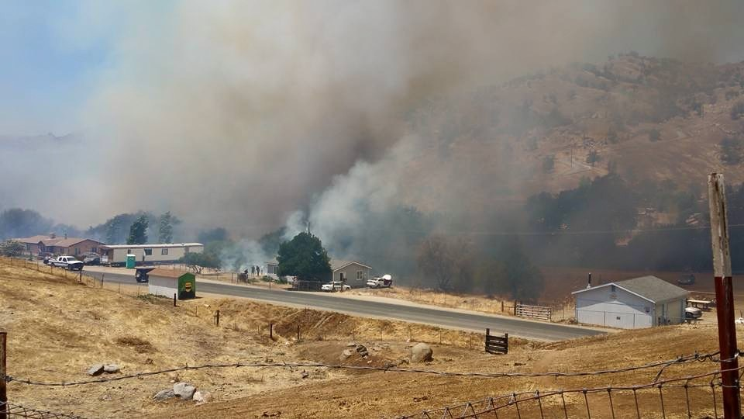

Slide 20
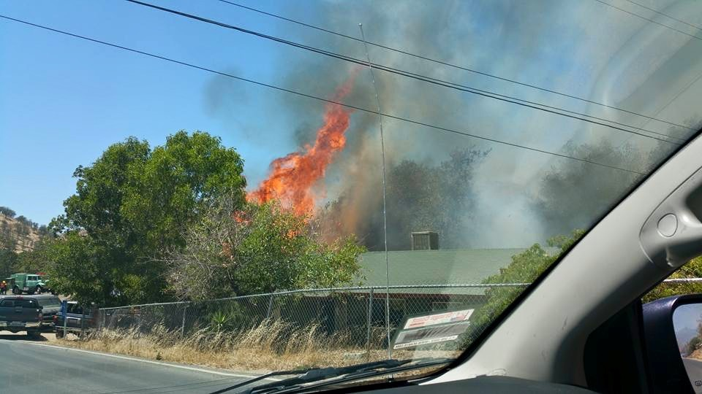

Slide 21
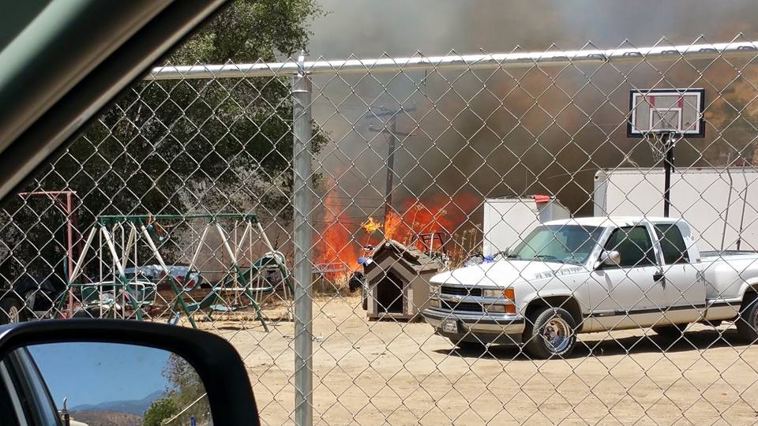

Slide 22
Contemporary Efforts and Settlement Discussions
1971 – Tribe started work to establish their water rights.
Former Chairman Alec Garfield made many trips to Washington, D.C. to get the attention of Federal and Congressional officials concerning the water plight of the Tribe.

Slide 23
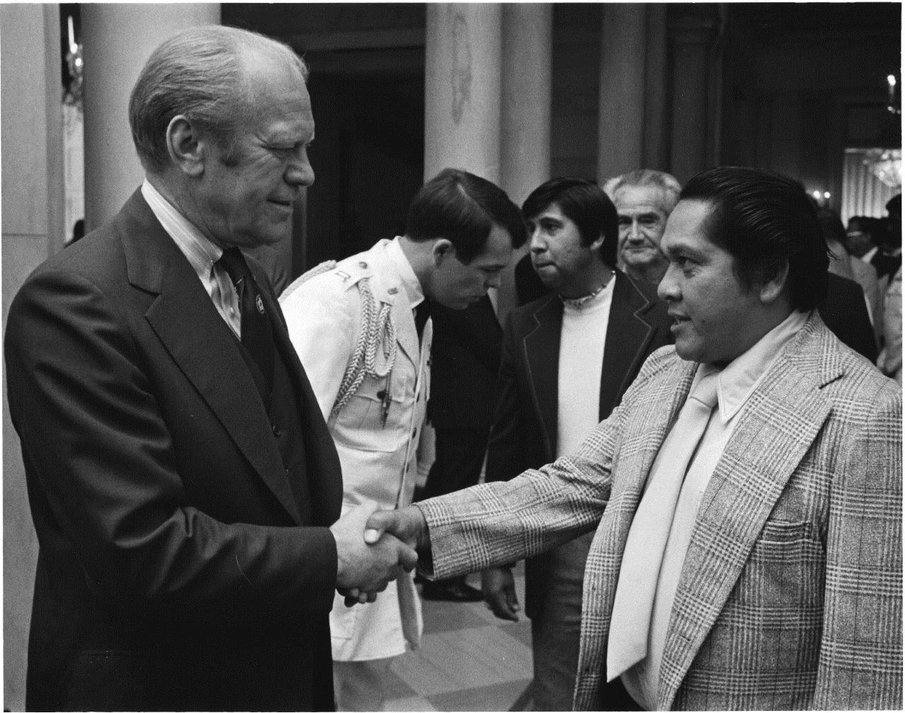

Slide 24
Contemporary Efforts and Settlement Discussions
1998 - Negotiations begin
2007 - Settlement Agreement is reached regarding the Tribe’s water rights and a water storage project.
2007-present – Many more studies undertaken including a new round of alternatives analysis to negotiate with the United States.
Total spent by the Tribe on studies using grants and its own money 1995 to date = at least $769,000.

Slide 25
2007 Settlement Agreement
Agreement is between the Tule River Indian Tribe, the Tule River Association, and the South Tule Independent Ditch Company.
These two entities represent a majority of the water users, of the South Fork Tule River
Agreement recognizes the Tribe’s right to water in the amount of 5,828 acre feet per year and the right to construct a reservoir on its Reservation.

Slide 26
2007 Settlement Agreement
Tribe’s future water demand in 2112 = 7,103 acre feet per year.
To meet the demand, the 2007 Agreement calls for a dam project in conjunction with other infrastructure.
Dam will impound a 5,000 acre-foot reservoir.
Preferred location is the Lower Bear Creek site on the South Fork Tule River.

Slide 27
Lower Bear Creek (before drought)

Slide 28
Inability to Garner US Support
Despite participating extensively in the negotiations and helping to draft the 2007 Settlement Agreement, the United States does not support the Agreement -- says it is too costly.
United States effectively reorganizes the Federal Negotiation Team in 2014, putting a Bureau of Reclamation technical expert in the lead.
United States goes back to the drawing board to study any and all alternatives – Tribe participates.
No signal from Interior that it will support final alternative selected or any indication of what it will support.

Slide 29
Frustration with Settlement Policy and Practice
Tribe spent extensive time after the 2007 Agreement analyzing the envisioned storage project.
Despite this lengthy process, the U.S. starts over from scratch to re-evaluate alternatives, many of which had already been studied.
Because we now have to look at other alternatives, the 2007 Settlement Agreement may have to be re-negotiated, which could threaten an overall Agreement.
Re-negotiation could force Tule to expend more money up front to even get to settlement, e.g. purchasing non-Indian property or other expenses.

Slide 30
Frustration with Settlement Policy and Practice
Current settlement process is very inefficient.
Negotiation should only occur once, not multiple times.
Federal Negotiation Teams need more authority delegated from Interior Working Group.
There is a lack of resources for the U.S. and for the Tribes.
The Tule River Tribe had to pay for a large portion of the analysis.
The current practice is slow to respond and seemingly only does so when there is an emergency.

Slide 31
Frustration with Settlement Policy and Practice
Delays increase the cost of water infrastructure, thereby making the settlement unpopular politically, thereby creating more delay and cost – a death vortex for tribes.
Tule River has agreeable downstream users, so it should not be so delayed and time consuming.
This undercuts the purpose of settlement;
Process very confusing and costly to all parties;
Difficult to maintain support of other negotiating parties when the process is so slow and convoluted.

Slide 32
QUESTIONS?

Slide 33
THANK YOU

