Slide 1

Gathering Background Information and the Role of Technicians in Negotiations
Doug Oellermann, P.E.

Slide 2
POLICY AND POLITICS
Settlements-Core Technical Foundation
Each Settlement Unique
  Tribal right
  State needs
  Federal position
Policy Makers persuade Politicians
Technical Experts persuade Policy Makers

Slide 3
IMPORTANCE OF TECHNICAL ANALYSIS
Interview for Staff Engineer-Montana Reserved Water Rights Compact Commission
Montana Negotiating Fort Peck Compact
Question-How to Determine Reasonableness of Proposed Settlement?
Answer-Develop Sample Projects to Determine Benefits & Costs
RWRCC Hired me

Slide 4
TYPICAL DATA NEEDS
Soils
  Source: Natural Resources Cons. Service (NRCS), State Soil Scientists
  Purpose: Identify Arable & Irrigable Soils for New Irrigation Projects
Hydrology (Surface Water)
  Source: U.S. Geological Survey (USGS), State Engineer’s Offices
  Purpose: Identify Water Availability

Slide 5
TYPICAL DATA NEEDS
Hydrology (Ground Water)
  Source: USGS, State Offices
  Purpose: Determine Ground Water Availability
Climate Information
  Source: National Weather Service
  Purpose: Determine Irrigation Requirements
Irrigated Lands
  Source: Aerial Photos, State & National Inventories, Water Rights Filings
  Purpose: Quantify current and historic uses

Slide 6
TYPICAL DATA NEEDS
Instream Flows
  Source: Fish & Wildlife Service, State Agencies
  Purpose: Identify Desirable Instream Flows for Fisheries & Other Purposes
Engineering Criteria
  Source: Engineers, Standard References
  Purpose: Determine Irrigation Requirements, Design Mitigation Facilities

Slide 7
TECHNICAL NEGOTIATIONS
Negotiators ask Tech Experts to resolve technical issues
Experts gather data, Meet to Review and agree
Modeling ideally a joint effort- Agreed-upon model and parameters
Experts Report Back to Negotiators

Slide 8
CASE STUDIES-MONTANA
Fort Peck Reservation-1985 (Date of Enactment by State of Montana)
  Missouri River & Tributaries
Northern Cheyenne Reservation-1991
  Tongue River & Rosebud Creek
Crow Reservation-1999
  Bighorn & Little Bighorn Rivers, Pryor Creek
Fort Belknap Reservation-2001
  Milk River, Peoples Creek & tributaries
Blackfeet Reservation-2009
  St. Mary’s, Milk & Marias Rivers

Slide 9
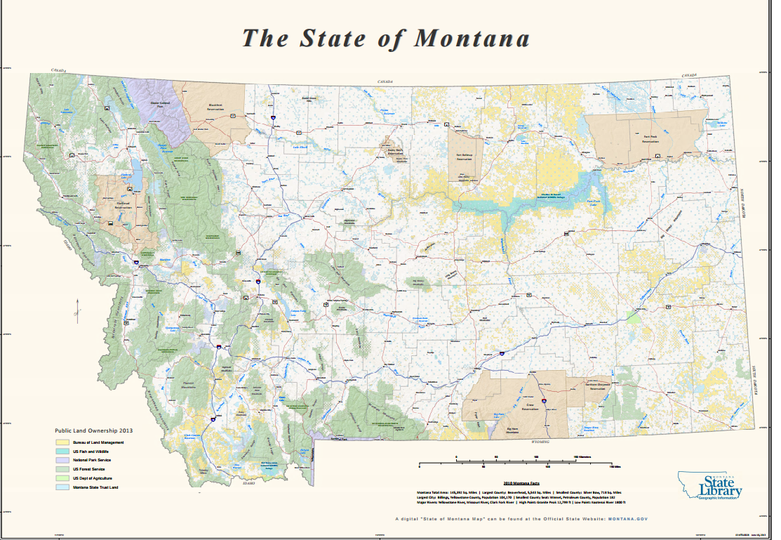

Slide 11
FORT PECK RESERVATION
Water Supply-U.S. Geological Survey
Irrigable Soils-NRCS
Diversion Requirement-National Weather Service
Existing Irrigation-Aerial photos, Water Resources Surveys, Water Right Filings, Field Visits
Instream Flows-U.S. Geological Survey
Benefit/Cost Review-Reclamation Cost Indexes, Extension Service Farm Budgets
No Hydrological Modeling

Slide 13
NORTHERN CHEYENNE RESERVATION
Water Supply-U.S. Geological Survey, Dept of Natural Resources & Conservation
Tongue River Model-Joint through Contractor
Existing Irrigation-Aerial Photos, Water Resources Surveys, Water Right Filings, Field Visits

Slide 15
CROW RESERVATION
Shared Shortages-Tribe & State
Existing Irrigation-Aerial Photos, Water Resources Surveys, Water Right Filings, Field Visits
Instream Flow-Big Horn River-U.S. Geological Survey, Yellowstone River Compact

Slide 17
FORT BELKNAP RESERVATION
Winter’s Right-125 cfs on Milk River
New Irrigation-NRCS Soils, Water Supply Model, Weather Data, Engineering
Existing & Historical Tributary Irrigation-Aerial Photos, Water Resources Surveys, Field Visits
Non-Indian Peoples Creek Irrigation-Aerial Photos, Water Resources Surveys, Water Right Filings, Field Visits
Infrastructure-Peoples Creek Dam-Geotechnical-Reclamation, Engineering
Boundary Waters Treaty Considerations
Milk River Model-Joint Model

Slide 19
BLACKFEET RESERVATION
St. Mary River-Water Rights filing
St. Mary/Milk model-U.S. Geological Survey, Boundary Waters Treaty
Badger/Birch Creek Model-U.S. Geological Survey, Irrigation District Records
New Irrigation-NRCS Soils, Badger/Birch Model, Weather Data, Engineering
Existing Irrigation-Aerial Photos, Water Resources Survey, Water Right Filings, Field Visits
Instream Flows-Fish & Wildlife Service

Slide 20
QUESTIONS?
Contact Information:
Doug Oellermann
doellermann@usbr.gov
(202) 513-0560

