Slide 1
Pyramid Lake Paiute Tribe Water Rights Settlement
Presented by:
Terri Edwards, Area Manager
Lahontan Basin Area Office
August 26, 2015

Slide 2
Discussion Topics
Lessons Learned
Settlement Agreement is Voluminous
Truckee River Operating Agreement
Future – TROA Implementation

Slide 3
Voluminousness: PL 101-618
WINNEMUCCA LAKE (dry)
§205 TROA
§207 Cui-ui/LCT Recovery
§208 Settlement Funds
PYRAMID LAKE
CALIFORNIA
NEVADA
Nixon
§ 204 Interstate Allocation
§205 TROA
Stillwater NWR
§205 TROA
Derby
Dam
STAMPEDE
Reno/Sparks
Fernley
Fallon
INDEPENDENCE
BOCA
TRUCKEE
RIVER
Newlands
Project
PROSSER
Truckee
MARTIS
LAHONTAN
CARSON
LAKE
DONNER
Carson
City
Tahoe City
§§101-107 Fallon Tribes
§206 Wetlands Water Purchase
§209 Newlands Project
CARSON
RIVER
LAKE TAHOE
Notes:
Describe map
Section 204 – Interstate Allocation – compliance, transfers, determination of the allocation, etc.
Section 205 – Truckee River water supply management through negotiation of an operating agreement and use of Truckee River reservoirs
Section 206 – Wetlands Protection – purchasing water rights for Lahontan Valley wetlands, expansion of the Stillwater Wildlife Refuge, establishment of Lahontan Valley and Pyramid Lake Fish and Wildlife Fund, 2 title transfers in Lahontan Valley, use of Navy Water from Lahontan Valley
Section 207 – Cui-ui and LCT Recovery and Enhancement Program – revise, update, implement recovery plans, Truckee River rehabilitation on the Reservation, acquisition of water rights, use of Stampede and Prosser reservoirs for conservation of the Pyramid Lake fishery
Section 208 – Pyramid Lake Fisheries and Development Funds –
Section 209 – Newland Project Improvement – expanded purposes, compliance with OCAP, efficiency study, water bank, recreation study, effluent reuse study, repayment cancellation incentives for TCID
Section 210 – Operating agreement contingent of settlement of litigation, management of Anaho Island, management of bed and banks of Truckee River within Reservation boundaries, management of hunting, fishing, boating on the Reservation, and non-waiver, non-abrogation clauses, appropriations authorized to be appropriated for implementation (none appropriated)
Settlement Agreement is voluminous. It appears to try to provide something for everyone. Some of those provisions may conflict with each other. Not a single agency implementing. Three bureaus within the Department of the Interior with sometimes conflicting missions. Actually tried adding a 4th entity – Truckee Carson Coordination Office – independent from all the other bureaus. Disbanded in 1998.
Could you have a more focused and succinct Settlement Agreement?
Maybe not. Most of the issues had to be addressed as one settlement. Lesson - Just expect it to take a long time. The topic is so vitally critical to everyone, it will take a long time.

Slide 4
Truckee River Operating Agreement (TROA) Section 205(a) Negotiated Agreement
Intended to improve flexibility and efficiency of Truckee River operations
Mandatory signatories:
Pyramid Lake Paiute Tribe
Department of the Interior
State of California
State of Nevada
Truckee Meadows Water Authority
Notes:
TROA is a major component of the Settlement Agreement
5 mandatory signatories and 17 non mandatory signatories

Slide 5
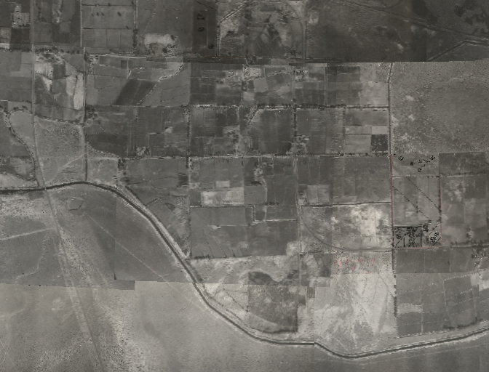
Fernley, NV 1948: Truckee Basin Operations under 1935 Truckee River Agreement
Truckee Canal
Notes:
Current operations based on 1935 Truckee River Agreement. World has changed since then: Slides show changes from 1948 to 2008.
Point out farm fields, housing , Truckee Canal
Current Operations:
1915 General Electric Decree - Floriston Rate Regime
1935 Truckee River Agreement - Modified Floriston Rates
1944 Orr Ditch Decree – Nevada Water Rights

Slide 6
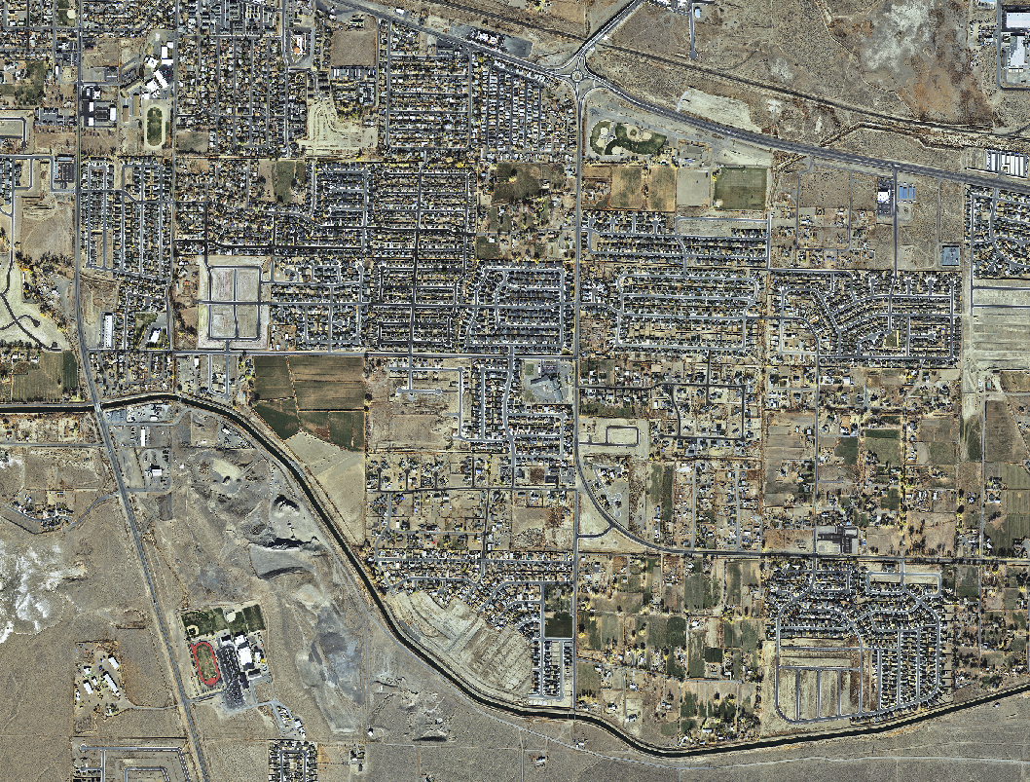
Truckee Basin changes: Fernley, NV 2008
Truckee Canal
Notes:
… And 2008.
Point out almost no farming.

Slide 7
Truckee River Operating Agreement
Implementation of TROA Will:
Increase M&I drought supply
Enhance habitat for T&E fish species
Enhance river flow and water quality
Enhance reservoir recreation
Coordinate river and reservoir management
Implement interstate allocation
Notes:
That was the reason for TROA. With more urbanization along the Truckee River, how can you meet the needs of everyone? TROA attempts to do that.

Slide 8
Truckee River Operating Agreement
Actions Required
Prior to settlement:
EIS/EIR
Storage contract
Tribal referendum
Fully appropriate Truckee River
Prior to implementation:
Promulgation as Federal Rule
Modifications to decrees
Water rights changes
Changes in point of diversion and re-diversion, place of use and purpose of use
Dismissal of lawsuits
Notes:
TROA is complex and required consensus negotiation
Consensus – I can live with that. But parties at odds for the last 50 to 100 years when 101-618 passed.
At times may have tried to over think and cover all the what if scenarios.
Took 3 EISs. Parties were in a hurry to get it done. Started EISs before negotiations were complete and had to start a new EIS – twice.
Took 18 years to negotiate. Was signed almost 8 years ago in September 2008. Has not yet been implemented. However, all the pieces are now in place for dismissal of the final lawsuits.
26 years needed to implement the Settlement Agreement – is that normal?
Can see the complexities just in the actions that were required prior to signing TROA and the actions required prior to implementing TROA.
Good side:
Modeling tools necessary to implement TROA are also complex
Team of water master, Reclamation, Tribe, and TMWA technical reps that work together and do a step-by-step review of the model as it is developed. This resulted in good final product, prevent failure of final implementation
Will also serve as a model for operating in the future – all parties sitting down together to agree on operations.

Slide 9
How will TROA be implemented?
TROA Administrator
RiverWare model developed by Water Master in collaboration with others
Database
Accounting
Forecasting
Operations
Parties schedule own water, Administrator coordinates operations

Slide 10
PLPT water scheduling
Water rights:
Orr Ditch Decree
Fish Water and Fish Credit Water
Water Quality Credit Water in cooperation with Reno/Sparks/Washoe County
TROA Holdbacks and Exchanges to maximize benefits
Pyramid Lake fishery
Irrigation
M&I
Water quality
Cottonwood recruitment
Notes:
This is an example of one entity’s involvement in TROA and scheduling their water.
Shows what the entities involved in TROA had to overcome to get to this point.

Slide 11
Possible Challenges
Legal opposition
It’s a complex agreement
Continual improvement of tools/models
Possible conflicts in scheduling water
Notes:
Ongoing litigation related to TROA
Complex – owners scheduling water requires a learning curve
Will require continuous improvement – will require funding/staffing from all parties.
Leads to possible future conflict, but TROA has a process to handle – and in the long run, may reduce conflict because of team scheduling. Parties must sit down together to manage the Truckee River.

Slide 12
Questions?

Slide 13
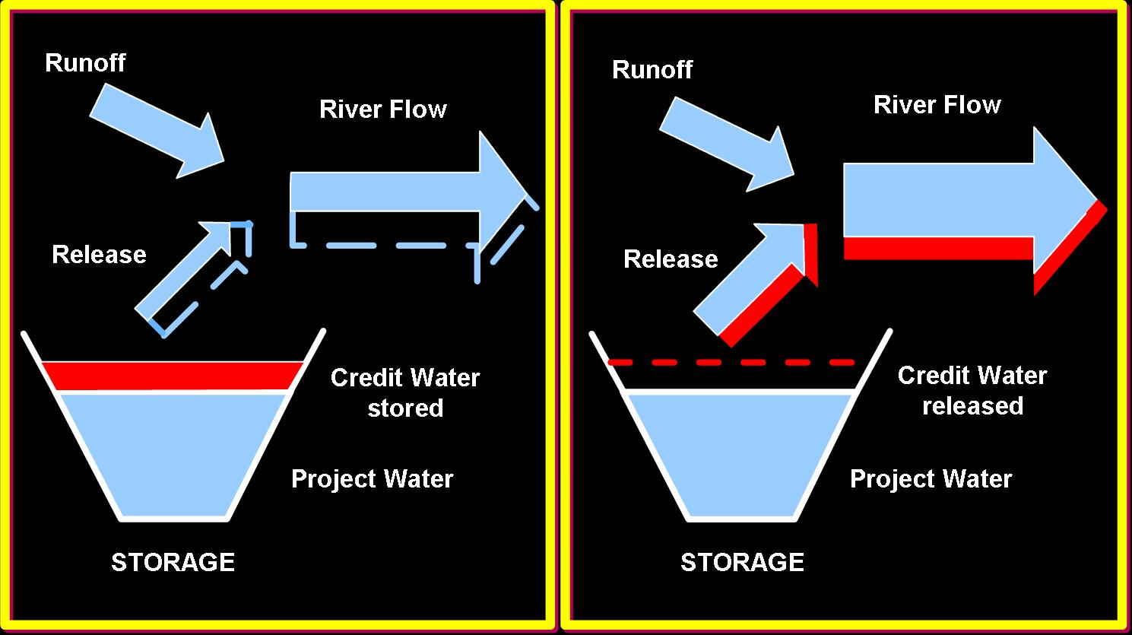
Generalized river operations with TROA

