Slide 1
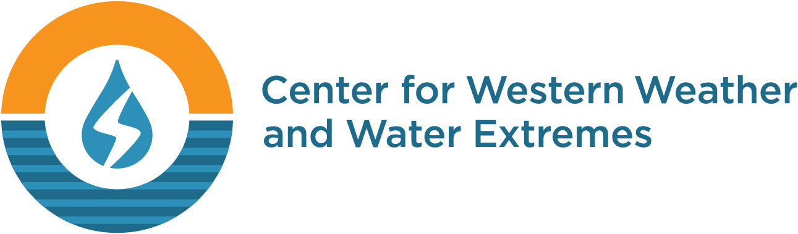

Advancing Seasonal Prediction for
Water Resources
Knowledge Gaps and Research Opportunities
F. Martin Ralph, Ph.D.
Scripps Institution of Oceanography, UCSD
NOAA and Western States Water Council – Workshop
Salt Lake City, Utah
21 October 2015

Slide 2
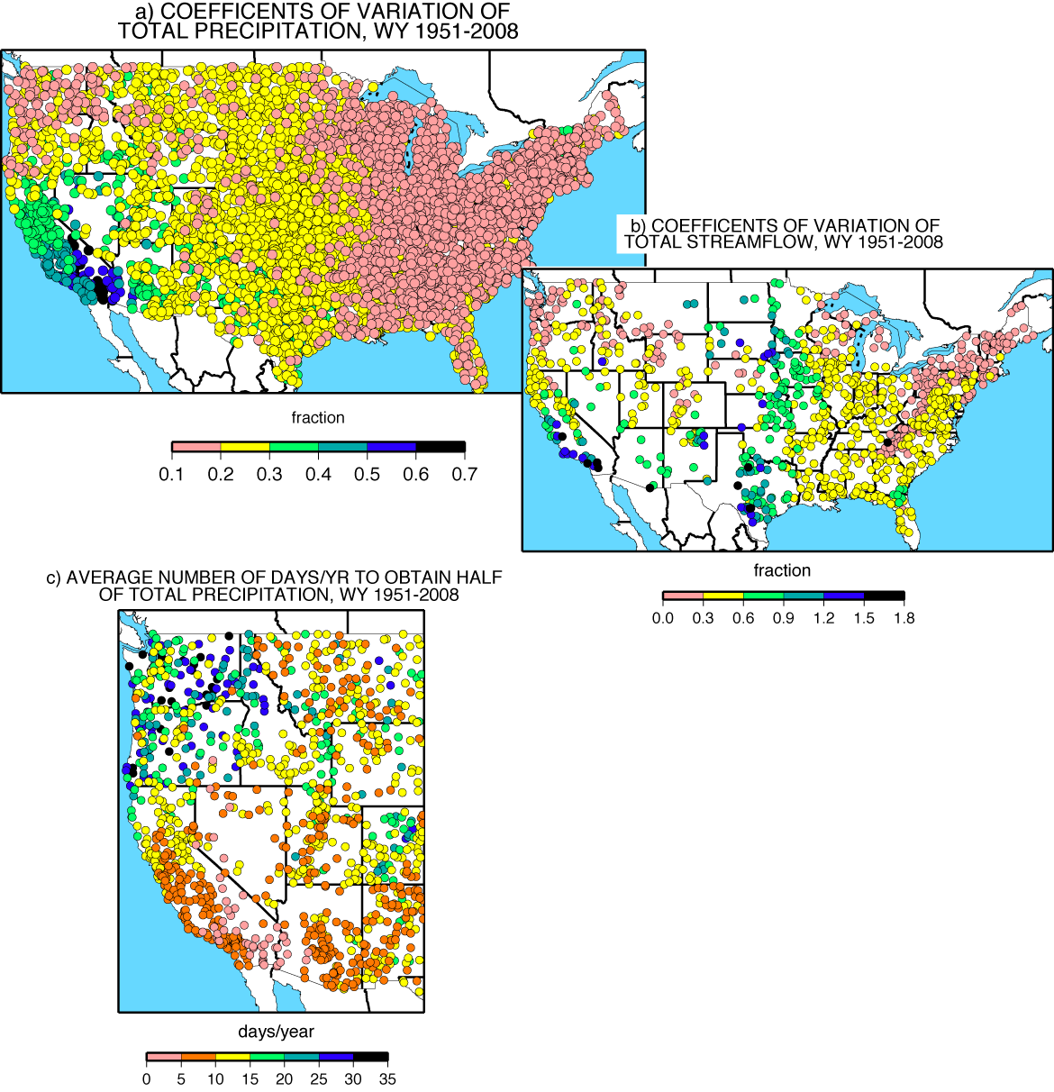
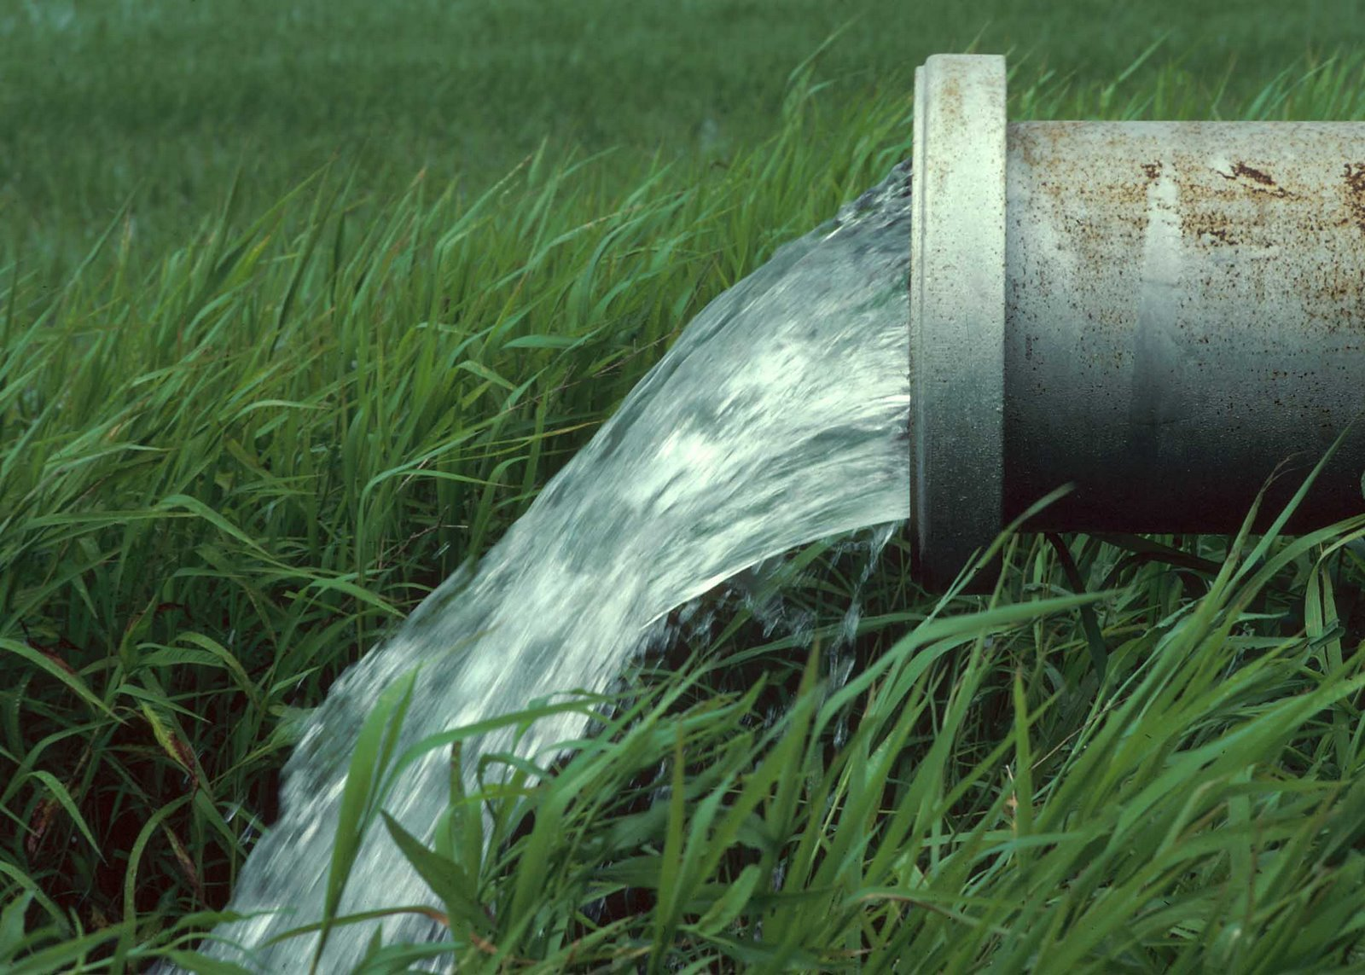
WESTERN U.S. ANNUAL PRECIPITATION IS 2-3 TIMES MORE VARIABLE THAN EASTERN U.S.
Dettinger et al. 2011, Water

Slide 3
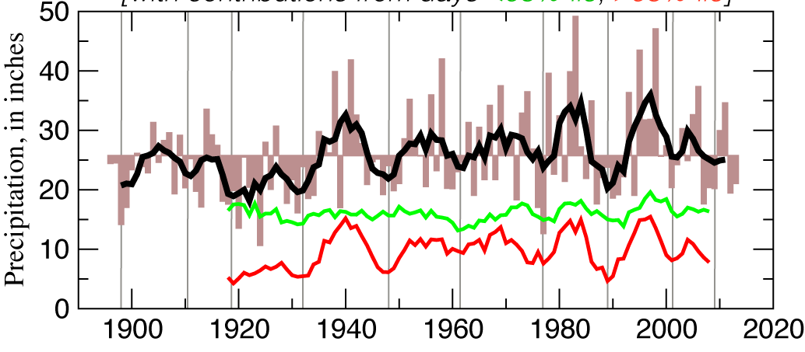

Atmospheric Rivers and the Need for Seasonal Outlooks by F.M. Ralph Scripps May 2015
A few large storms (or their absence)
Account for a disproportionate amount of California’s precipitation variability
Water year precipitation, Delta catchment
with contributions from days <95%-ile, >95%-ile
Dettinger and Cayan 2014, San Francisco Estuary and Watershed Science
Notes:
Use Verdana for all copy

Slide 4
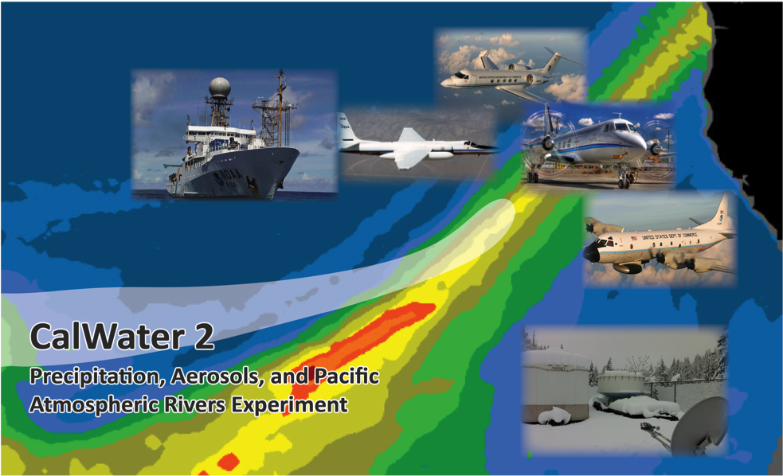




F. Martin Ralph, K. Prather, D. Cayan (Co-Leads)
UC San Diego/Scripps Institution of Oceanography
Key Agencies
NOAA, DOE, NSF, CA DWR, NASA, ONR

Slide 5
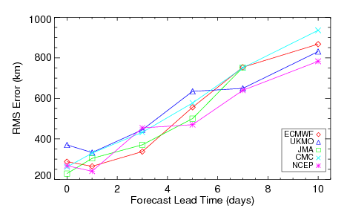
AR Landfall Position Forecast Errors
While overall occurrence well forecast out to 10 days, landfall is less well predicted and the location is subject to significant errors, especially at longer lead times
RMS Error in Forecast AR Landfall Location
Errors in location increase to over 800 km at 10-day lead
Errors in 3-5 day forecasts comparable with current hurricane track errors
Model resolution a key factor
500 km forecast error at 5-day lead time
From Wick et al., 2013 (Weather and Forecasting)
Models provide useful heads-up for AR impact and IWV content, but location highly uncertain
Location uncertainty highlights limitations in ability to predict extreme precipitation and flooding
Improvements in predictions clearly desirable

Slide 6
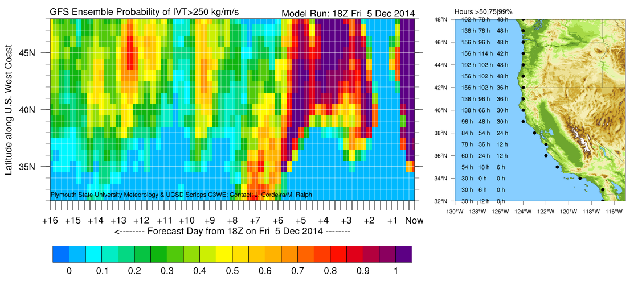
Example of a new AR Forecast Tool: Dec 2014
From J. Cordeira of Plymouth State Univ. and Scripps/CW3E
Available real-time at cw3e.ucsd.edu
NOAA’s
AR predicted to make landfall 5-7 days ahead

Slide 7
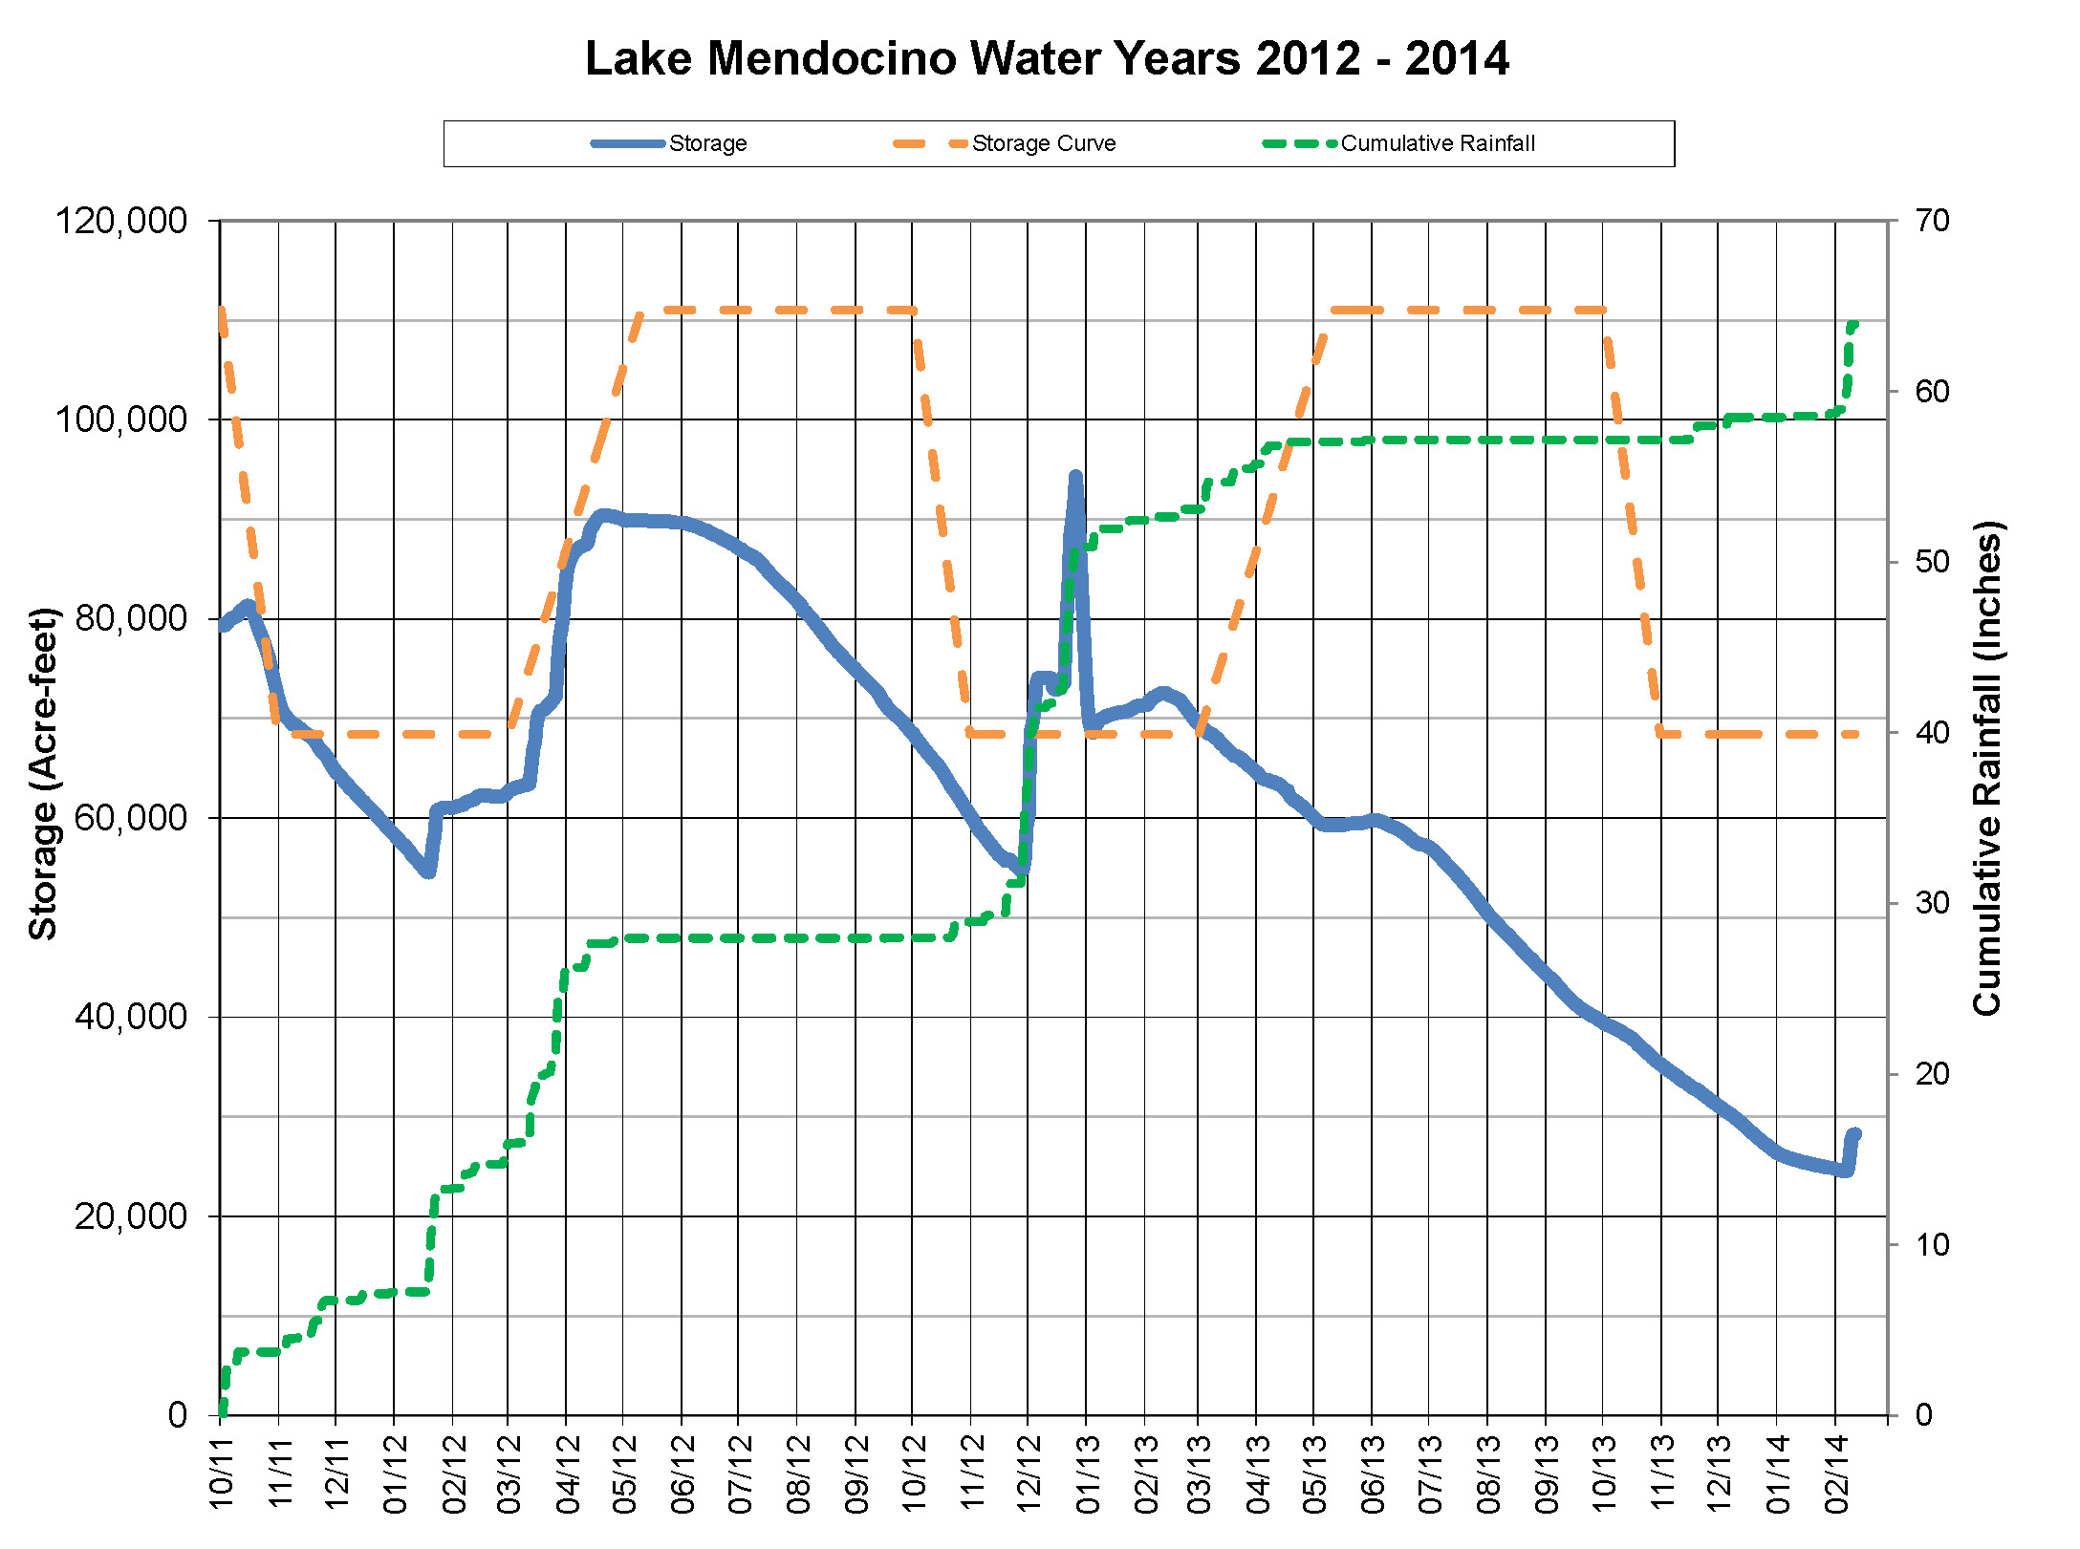
Lake Mendocino FIRO Viability Assessment – A Collaborative Effort
Coalition of federal, state, & regional agencies comprised of scientists & water managers
Co-Chaired by J. Jasperse (SCWA) and M. Ralph (Scripps/CW3E)
Steering Committee:
Federal: NOAA (OAR, NWS, NMFS), USGS, Army Corps of Engineers, & Bureau of Reclamation
State: CA Dept. of Water Resources & Scripps Center for Western Weather & Water Extremes
Regional: Sonoma County Water Agency
NOAA Habitat Blueprint, Integrated Water Resource Sciences & Services
Atm. River Events
Reservoir Storage Curve
Atm. River Events
Can we save some of this water?
WY 2013 Rainfall
WY 2012 Rainfall
Atmospheric River Events

Slide 8
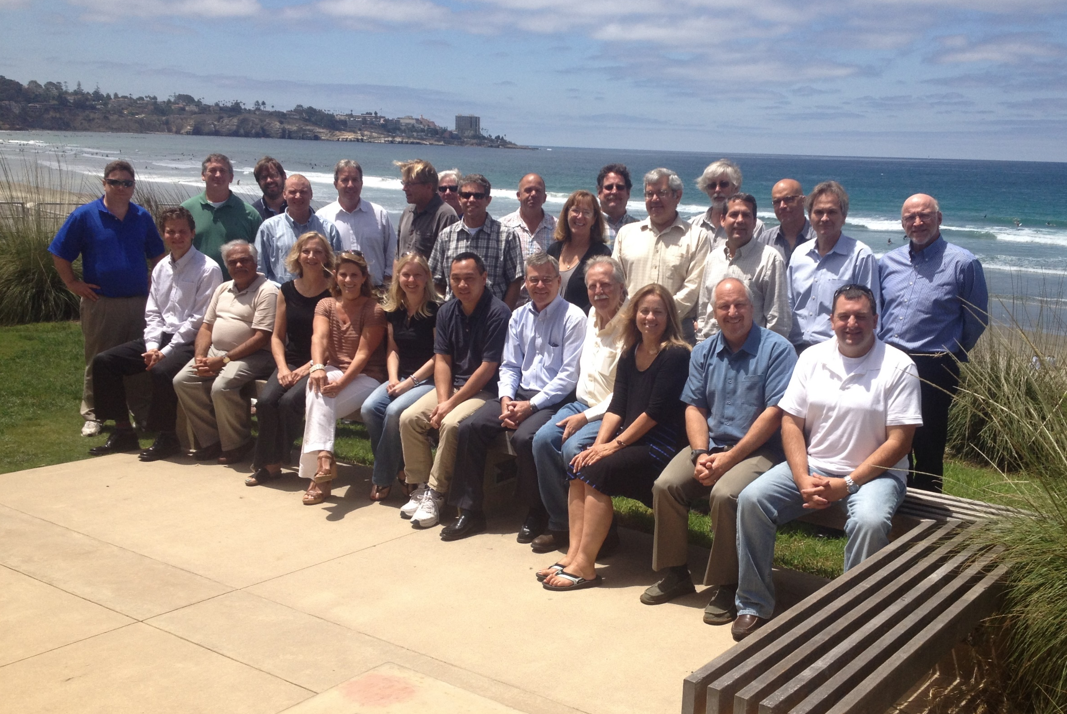
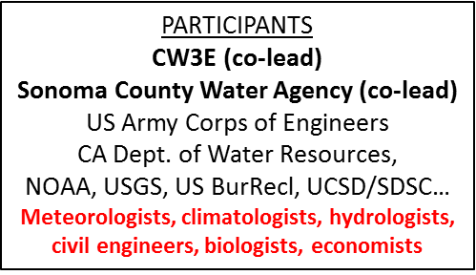
Forecast-Informed Reservoir Operations (FIRO) for Lake Mendocino
Feasibility Assessment Planning Workshop
11
12
13
15
1
2
3
4
5
6
7
8
9
16
17
10
14
19
27
28
18
20
21
22
23
24
25
26
4-7 August 2014
Scripps Seaside Forum
UCSD/Scripps Institution of Oceanography
(Sponsored by – SCWA and CW3E)

Slide 9
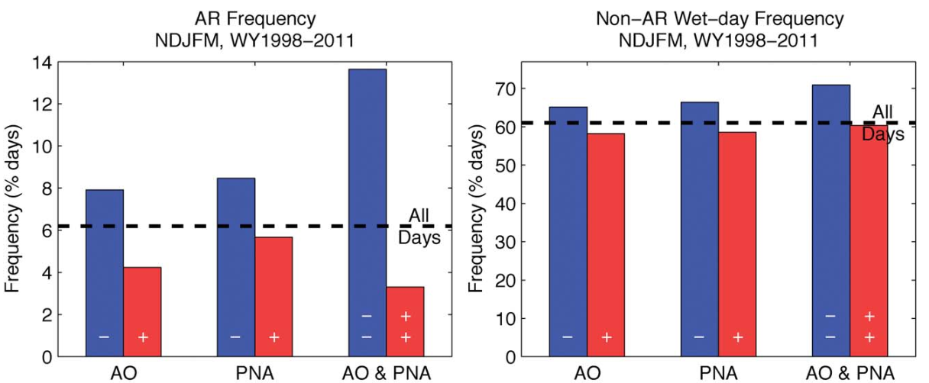
The 2010/2011 snow season in California’s Sierra Nevada:
Role of atmospheric rivers and modes of large-scale variability
Guan, B., N.P. Molotch, D. E. Waliser, E. Fetzer and P.J. Neiman
Water Resources Research (2013)
Arctic Oscillation (negative , i.e., southward cold-air outbreaks) combined with
Pacific North American “teleconnections” pattern (negative, southern storm track)
Favors Atmospheric river conditions striking the Sierra and causing precipitation
Notes:
Use Verdana for all copy

Slide 10
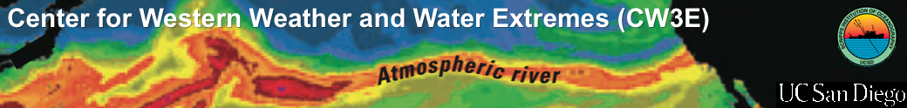
  Application of AR Detection Scheme to Reanalysis Output
Annual number of days with
landfalling ARs along California coast
Percent of total precipitation
associated with nearby
landfalling AR
Gershunov, Shulgina, Ralph
Scripps/CW3E

Slide 11
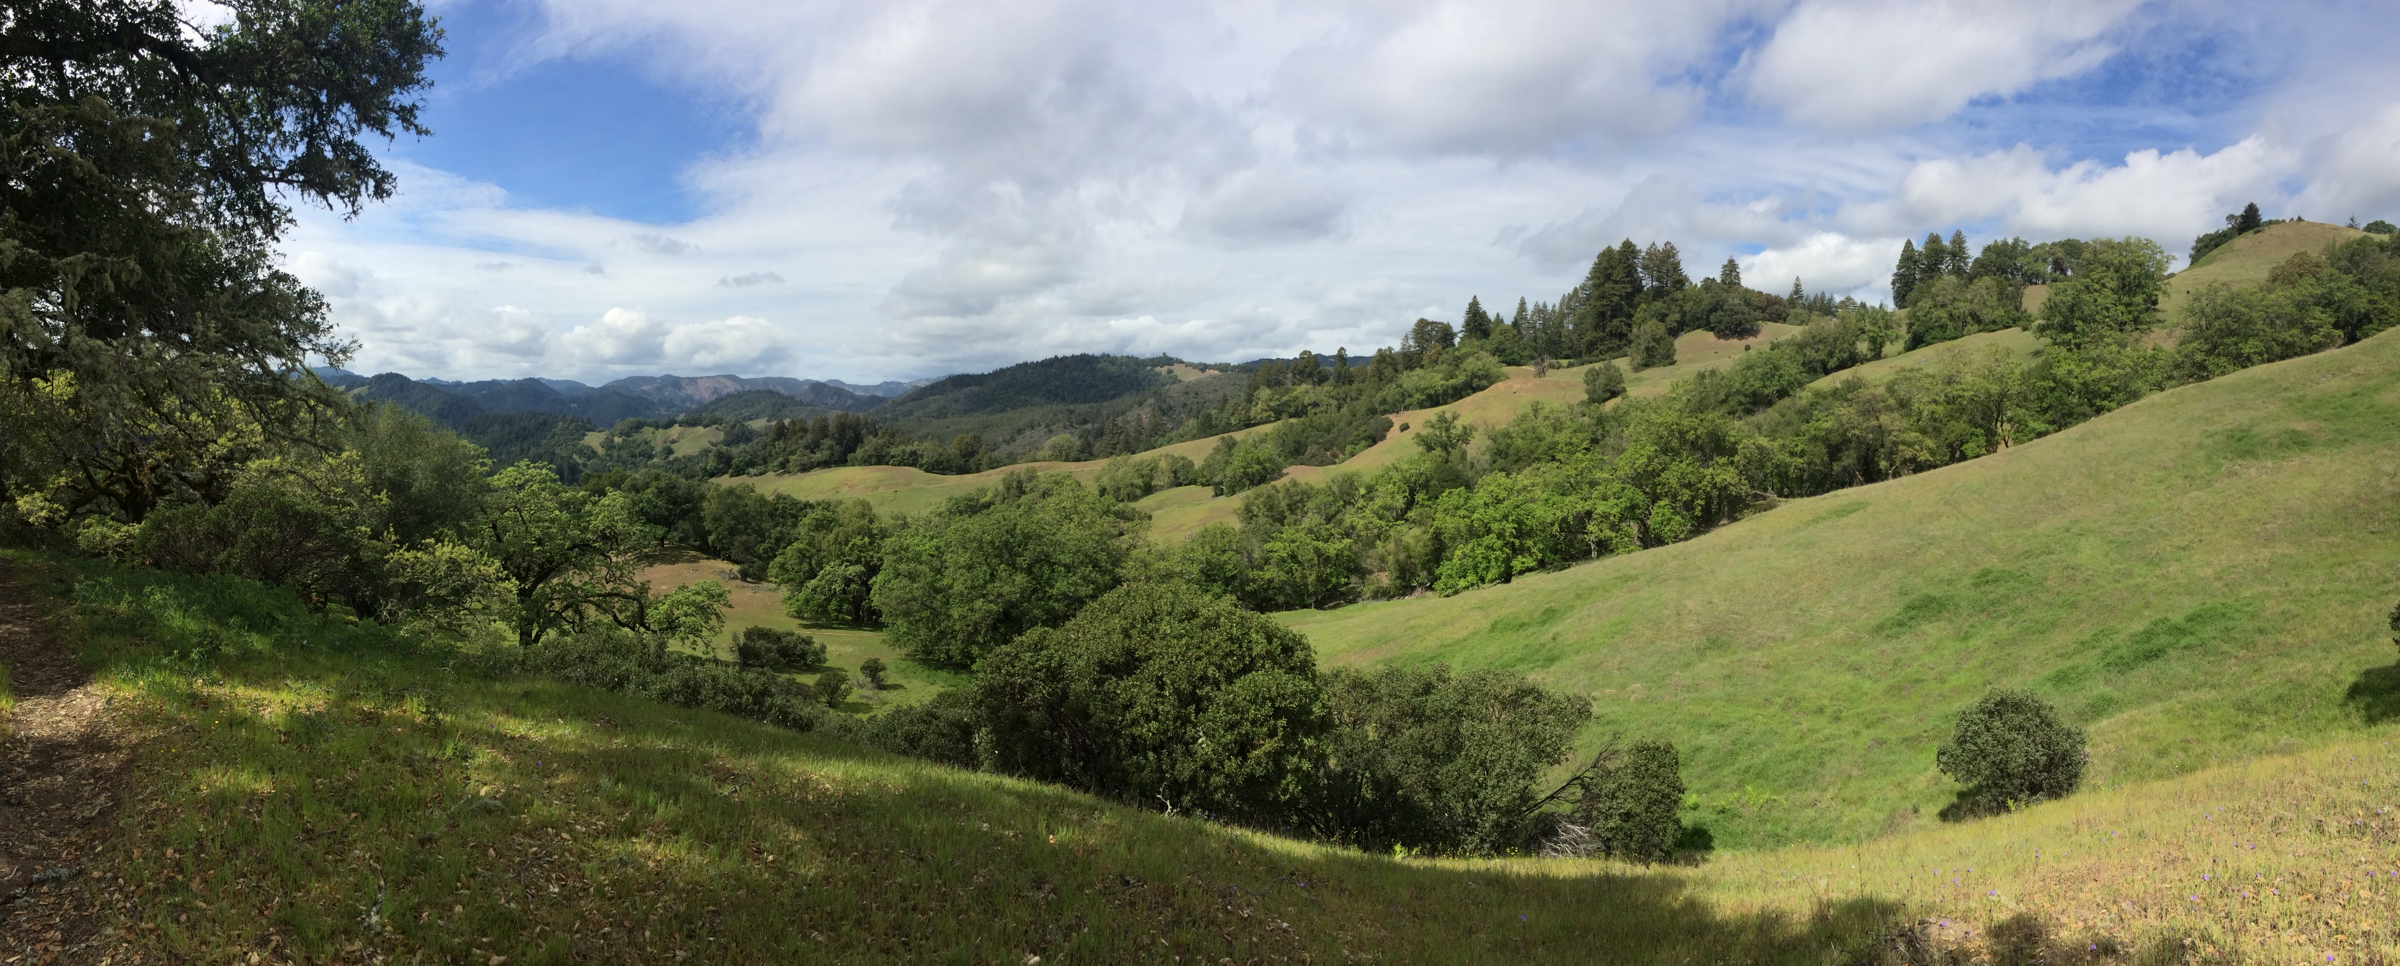

Thank you
mralph@ucsd.edu
cw3e.ucsd.edu

Slide 12
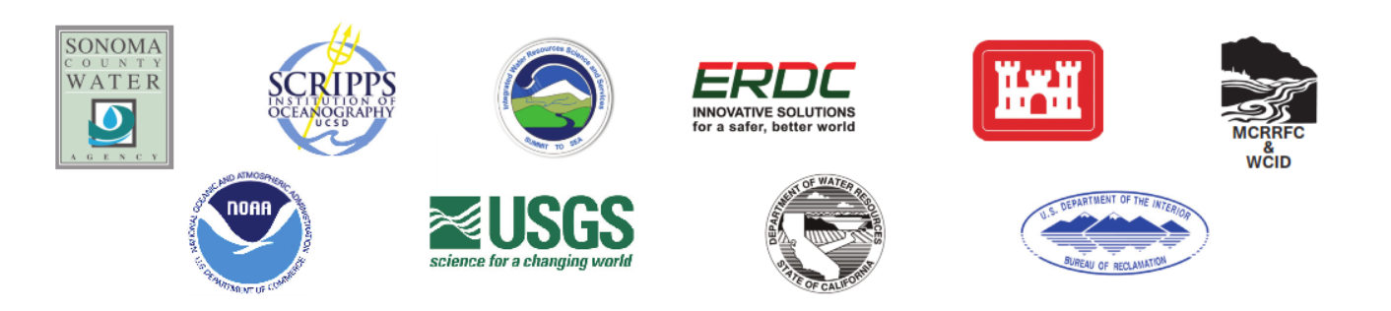
Lake Mendocino FIRO Viability Assessment – A Collaborative Effort
Coalition of federal, state, & regional agencies comprised of scientists & water managers
Co-Chaired by J. Jasperse (SCWA) and M. Ralph (Scripps/CW3E)
Steering Committee:
Federal: NOAA (OAR, NWS, NMFS), USGS, Army Corps of Engineers, & Bureau of Reclamation
State: CA Dept. of Water Resources & Scripps Center for Western Weather & Water Extremes
Regional: Sonoma County Water Agency
Partnerships: NOAA Habitat Blueprint
Integrated Water Resource Sciences & Services

Slide 13
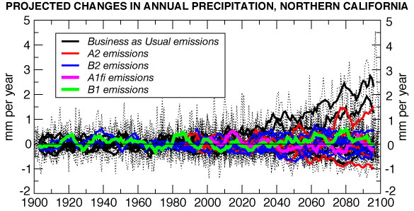
A Key Challenge: Changing Climate
Guerneville
19 of 23 in this range
cm/month
cm/month
Dettinger, 2005
Annual precipitation projections vary mostly due to how extreme precipitation events are handled (in CA this means ARs).
Pierce et al 2013 (J. Clim.): Model disagreements in the projected change in occurrence of the heaviest precipitation days (>60 mm day⁻¹) account for the majority of disagreement in the projected change in annual precipitation, and occur preferentially over the Sierra Nevada and Northern California.
Notes:
The Sonoma County Water Agency faces many challenges in an era of increasing government regulation, declining fish populations and climate uncertainty.
The Russian River Watershed is one of the most flood prone regions in the nation.
Sonoma County receives more FEMA flooding assistance that any other county in California.

Slide 14

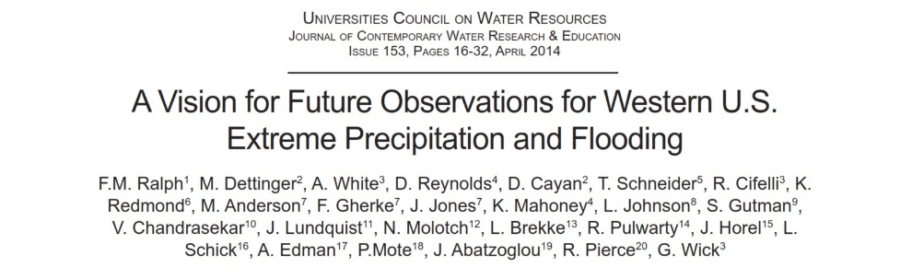

Slide 15
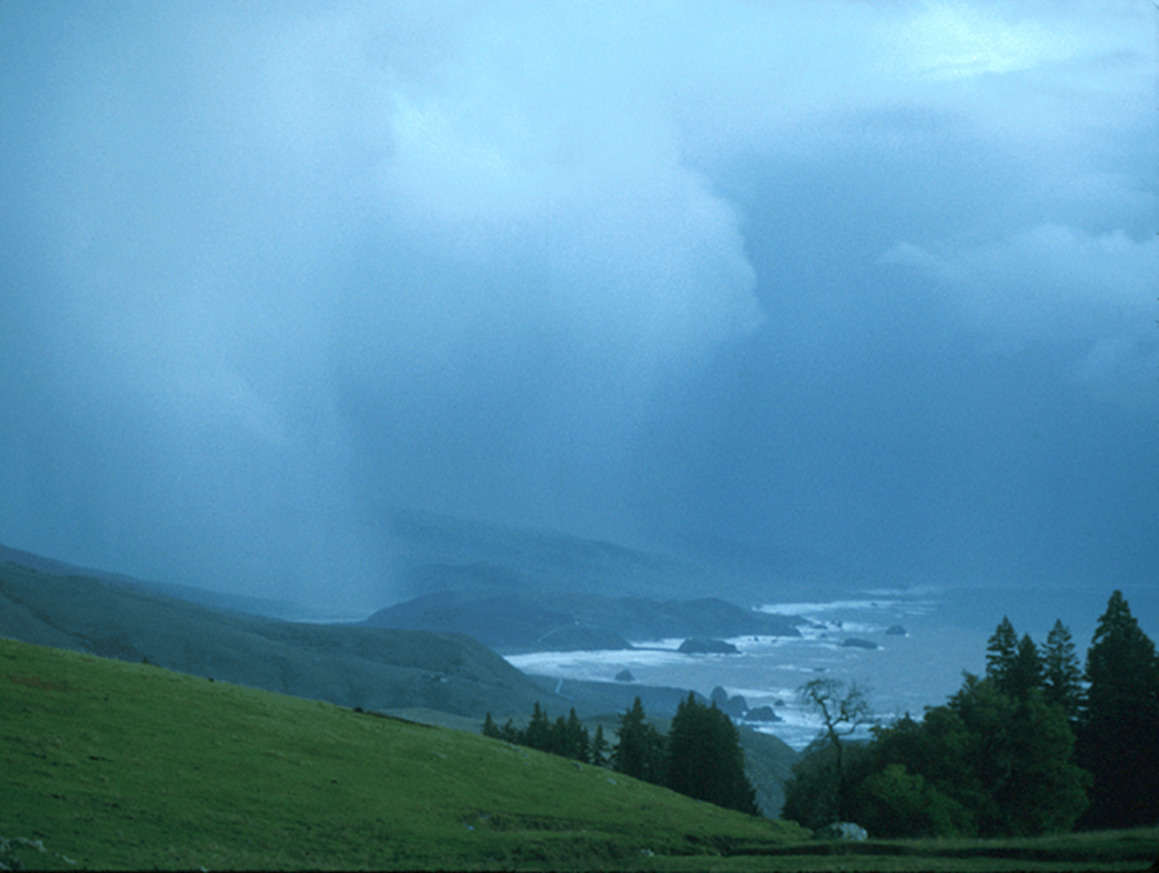
Background
The WSWC passed a Resolution in 2011 that
  “supports development of an improved observing system for Western extreme precipitation events, to aid in monitoring, prediction, and climate trend analysis associated with extreme weather events”
NOAA’s Hydrometeorology Testbed (HMT) and other efforts have improved understanding of how extreme events occur, have identified gaps and prototyped solutions, which are the foundation of this Vision
The “Western Obs’ Vision,” by Ralph and 26 co-authors from across the West, was peer reviewed and published in 2014 in the Journal of Contemporary Water Research and Education.

Slide 16
Key reports, papers and other sources used to inform the development of this Vision
Source | Description and references
NRC reports | Flooding in Complex Terrain; Network of Networks; GPM Satellite system
Needs assessments | Workshop on non-stationarity…(2010), USBR Science and Technology Program (2011), NOAA’s Water Cycle Science Challenge Workshop (2012), USWRP Workshop (2005)
IWRSS | USACE, USGS, NOAA formal agreement and coordination; National Water Center
NOAA/HMT | 10-year effort on extreme precipitation causes and predictions (Ralph et al. 2005; 2013a)
Atmospheric rivers | Understanding of the joint roles of atmospheric rivers in extreme events and water supplies in the west (Ralph et al. 2006, Neiman et al. 2008, Dettinger et al. 2011, etc…)
ARkStorm | USGS-led emergency preparedness exercise in California focused on atmospheric rivers
NOAA/RISA | Regional Integrated Science and Assessment (RISA) studies on climate change
State Climatologists | Regional expertise and deep experience in states’ needs for climate information
Unmanned Aircraft | NOAA UAS Program observing system gap analysis for atmospheric rivers over Pacific
NOAA Radars | Cross-NOAA Radar planning team reports
NOAA Science Plans | NOAA held interagency workshops on water cycle and climate science that produced detailed recommendations for future science directions nationally (NOAA 2012a, 2012b)

Slide 17
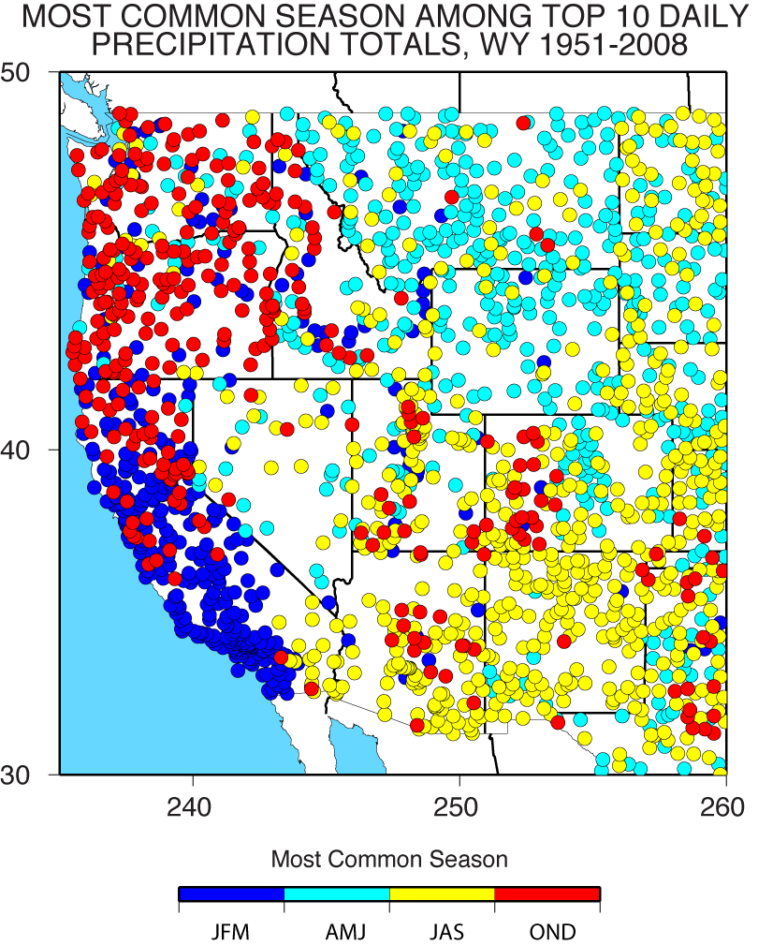
Analysis from COOP daily precipitation observations.
Each site uses at least 30 years of data
The top 10 daily precip dates are found
The season for which most of these top-10 dates occurred at that site is color coded.
Ralph et al. 2014 (JCWRE)

Slide 18
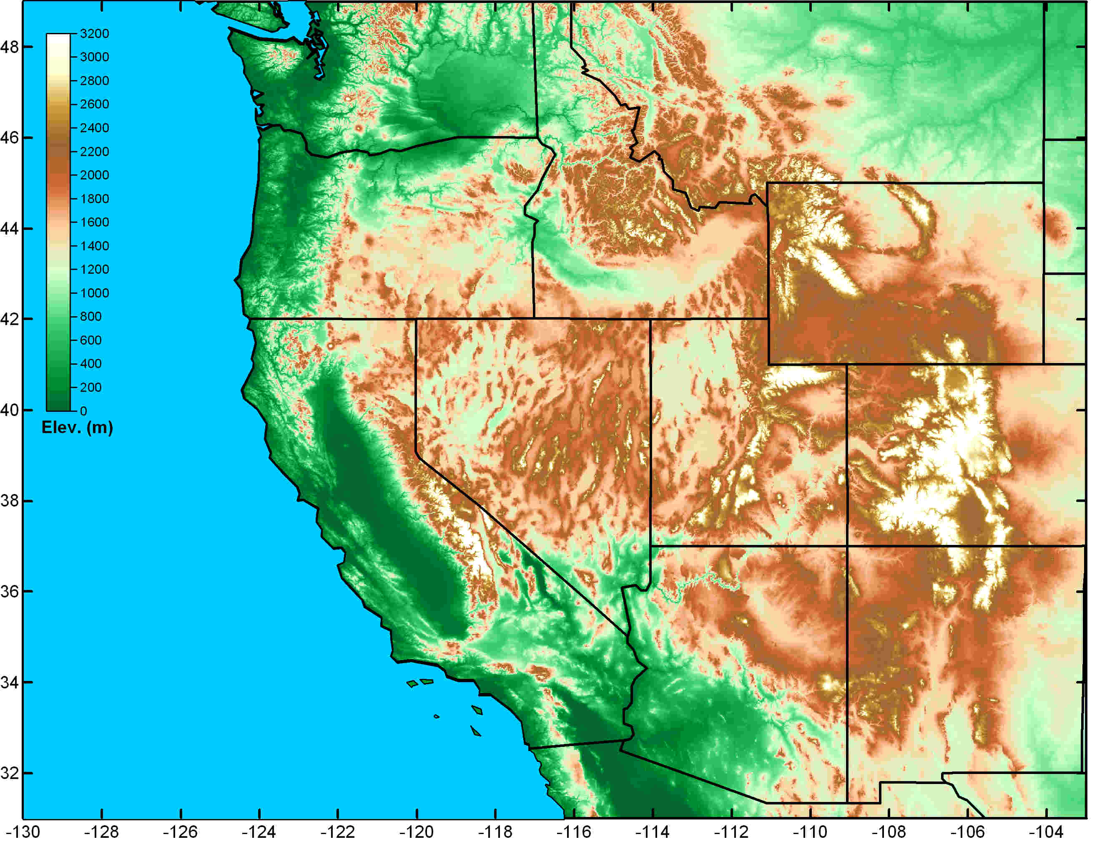
Schematic illustration of regional variations in the primary weather phenomena that lead to extreme precipitation, flooding and contribute to water supply in the Western U.S. (Ralph et al. 2014)
Great Plains Deep Convection
(spring and summer)
Atmospheric Rivers
(fall and winter)
Front Range Upslope (rain/snow)
Key
Weather
Phenomena
Southwest Monsoon (summer & fall)

Slide 19

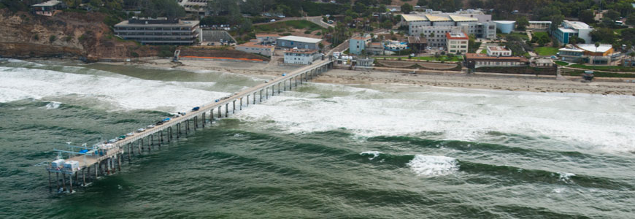

Great Plains Deep Convection
(spring and summer)
Atmospheric Rivers
(fall and winter)
Front Range Upslope (rain/snow)
Where: UC San Diego/Scripps Inst. Oceanography
La Jolla, California, and SCWA Santa Rosa CA
When: Started - 2013
Who: Dr. F. M. Ralph (Director)
Dr. Dan Cayan
Dr. Mike Dettinger
15 other staff or affiliates
Southwest Monsoon (summer & fall)
Mission
Provide 21st Century water cycle science, technology and outreach to support effective policies and practices that address the impacts of extreme weather and water events on the environment, people and the economy of Western North America
Scripps Institution of Oceanography

Slide 20
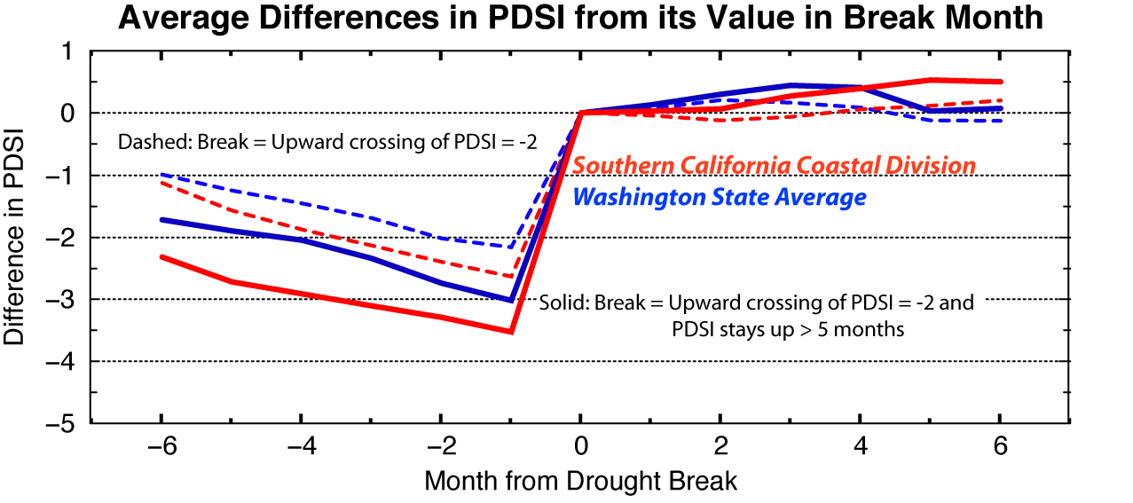
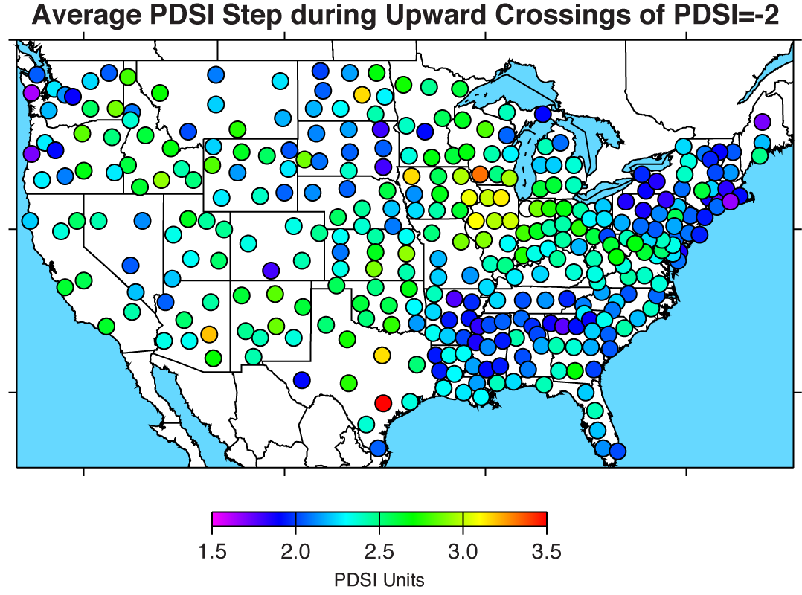
Droughts, on average, end with a bang (and begin with a whimper) all over the U.S.
Atmospheric rivers provide the bang in a large fraction of the west coast drought breaks, especially in winters
1895-2010
Dettinger, Michael D., 2013: Atmospheric Rivers as Drought Busters on the U.S. West Coast. J. Hydrometeor, 14, 1721–1732.

Slide 21
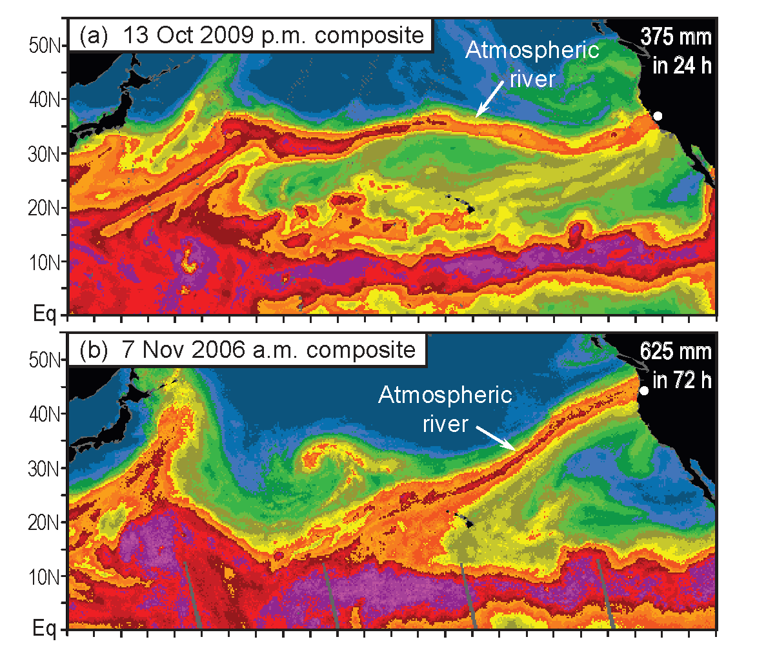
Atmospheric rivers: Two recent examples that produced extreme rainfall and flooding
These color images represent satellite observations of atmospheric water vapor over the oceans.
Warm colors = moist air
Cool colors = dry air
ARs can be detected with these data due to their distinctive spatial pattern.
In the top panel, the AR hit central California and produced 18 inches of rain in 24 hours.
In the bottom panel, the AR hit the Pacific Northwest and stalled, creating over 25 inches of rain in 3 days.
From Ralph et al. 2011, Mon. Wea. Rev.

Slide 22
Atmospheric River Observatory
Plan view
Rain shadow
Atmos. Riv.
Heavy rain
Dividing streamline
Heavy rain
GPS satellite
Wind direction in AR
400 km wide
Mountains
ARO
3
Wind profiler beam with 100-m vertical resolution
S-PROF data up to 10 km MSL
Orographic cloud and precipitation
2
Snow level
Altitude MSL (km)
“Controlling layer” (upslope winds)
1
Rain shadow
Atmospheric River
Surface friction and barrier jet
Mountain
S-PROF precipitation profiler; surface met; disdrometer
0
Ocean
GPS-met receiver
10-m surface meteorology tower
Wind profiler
(915 or 449 MHz)
0-50 km between wind profiler/GPS-met site and S-PROF precipitation profiler

Slide 23
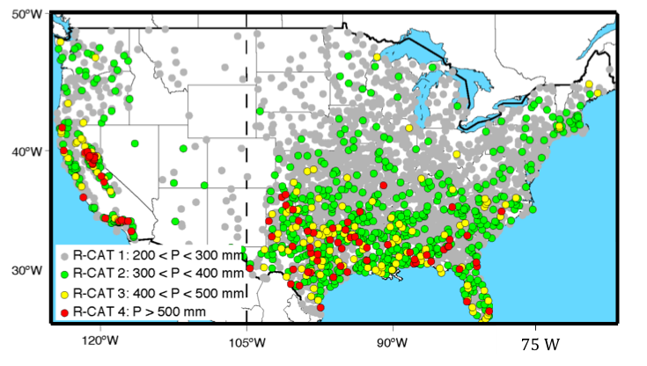
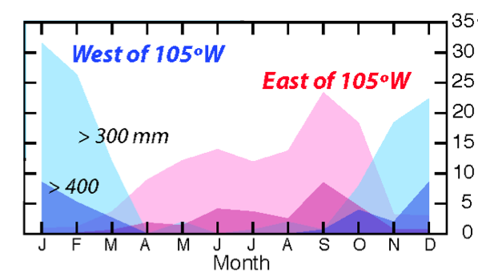
Why study the West Coast?
Maximum 3-day precipitation totals at 5877 COOP stations in lower U.S.
Seasonality of 3-day precipitation totals between West and East U.S.
Episodes/1000 events
Ralph and Dettinger (2012, BAMS): Intensity of extreme precipitation events over U.S.
Seasonality of extreme precipitation events
R-CATs used to describe intensity of extreme precipitation events
Large R-CAT events along West Coast in winter
Large R-CAT events over south/southeast U.S. in spring, summer, and fall
Largest precipitation events on West Coast are comparable to largest events (tropical cyclones) on the East Coast

Slide 24
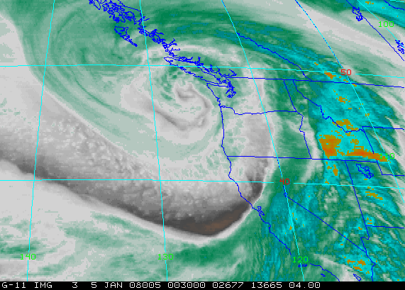
Why study the West Coast?
Just a few winter storms each year form the core of water supply along the U.S. West Coast
0030Z 5-Jan-08: Intense western U.S. storm
Dettinger et al, Water, 2011

Slide 25
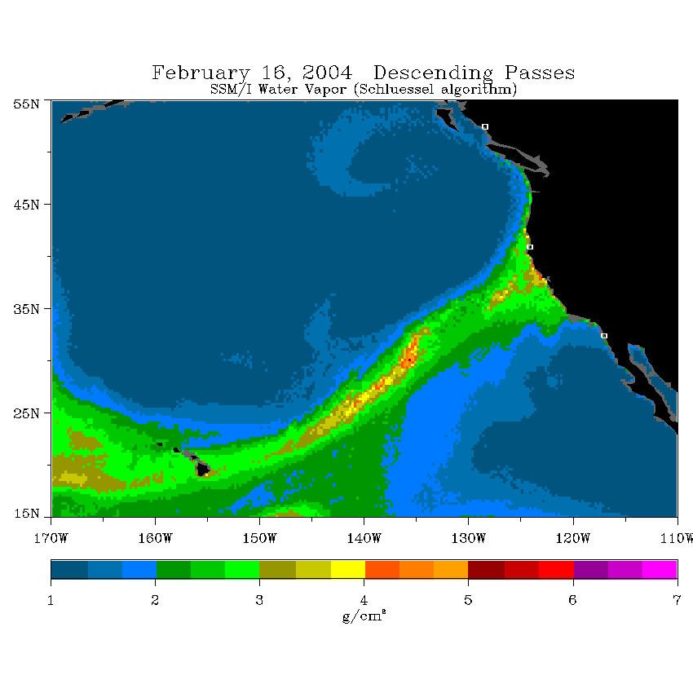
What is an Atmospheric River?
Long, narrow plume of enhanced atmospheric water vapor in warm sector of winter storms
Identified via integrated water vapor (IWV) in numerical models or observed in SSMI/S Satellite estimates
Example from 2014 illustrates AR landfall in California
16-Feb-04
North coast
IWV >2cm:
>2000 km long
South coast
IWV >2cm:
<1000 km wide
Neiman, P.J., F.M. Ralph, G.A. Wick, J. Lundquist, and M.D. Dettinger (2008), J. Hydrometeor., 9, 22-47.
SSM/I Integrated Water Vapor (cm)

Slide 26
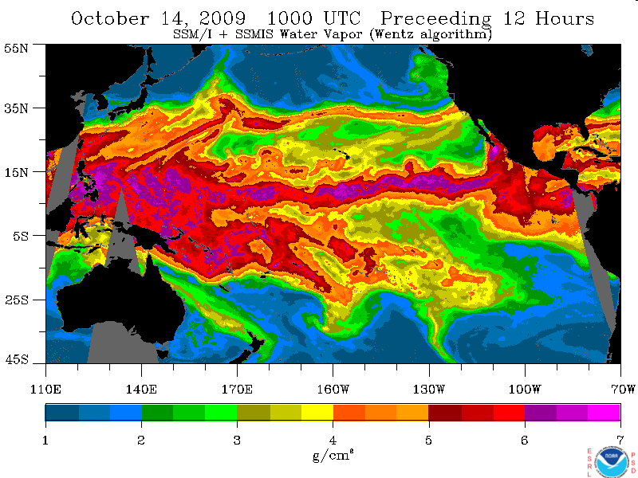
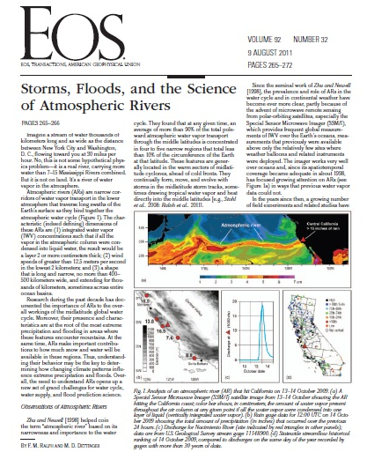
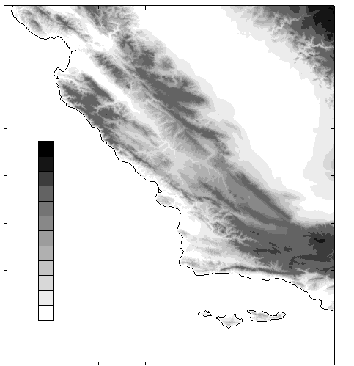
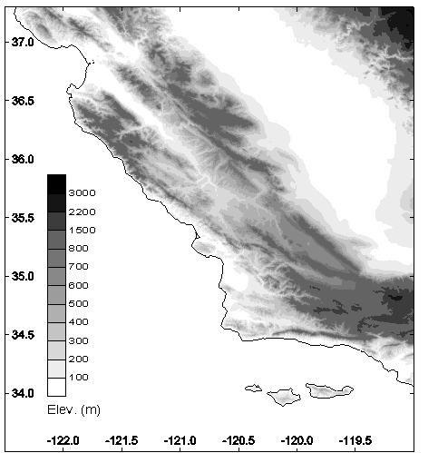
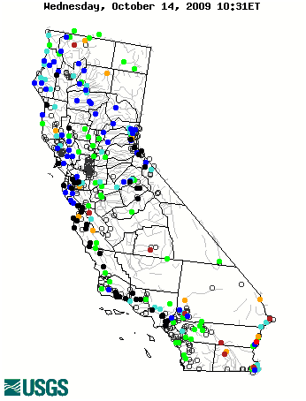
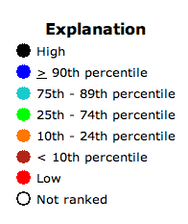
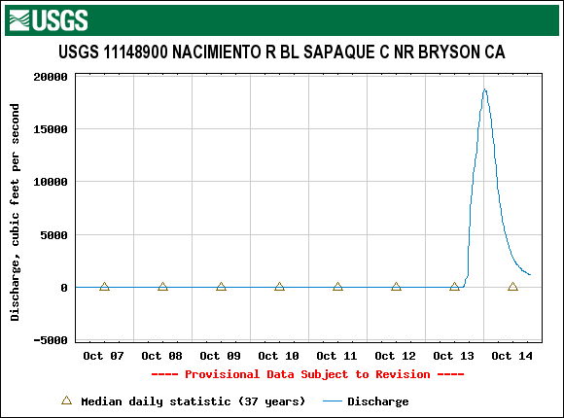
Why is there a need to study and forecast ARs?
ARs are the primary meteorological cause of extreme precipitation and flooding on U.S. West Coast
Atmospheric River
Central CA
>15 inches
rain
45ºN
35ºN
25ºN
140ºE
170ºE
160ºW
130ºW
100ºW
Vertically integrated
water vapor, g/cm²
(a)
1
2
3
4
5
6
7
Discharge at Nacimiento River (USGS 11148900)
Daily Streamflow Ranking for 14 Oct 2009 Relative to Historic Records at Each Site
10.5
Central Valley
Monterey
Ralph, F.M., and M.D. Dettinger, 2011: Storms, Floods and the Science of Atmospheric Rivers. EOS, Transactions, Amer. Geophys. Union., 92, 265-266.
13.8
“Three Peaks” raingage
15
16.5
7.6
10
Discharge (1000s cfs)
5
8.8
Santa Barbara
0
12
13
14
(c)
Date (October)
(d)

Slide 27
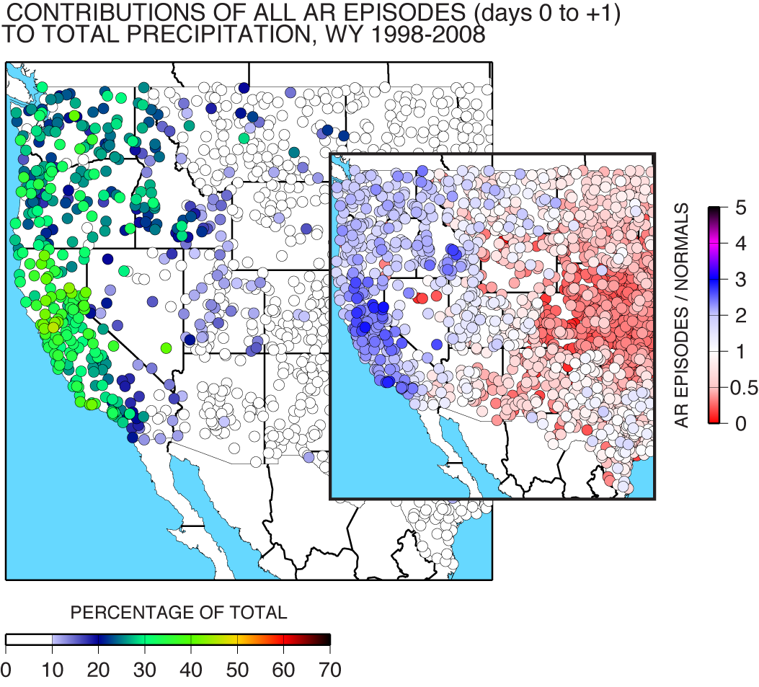
Why is there a need to study and forecast ARs?
ARs are responsible for 25-45% of annual precipitation along U.S. West Coast
25-35% of annual precipitation in Pacific Northwest occurs in ARs
35-45% of annual precipitation in California occurs in ARs

Slide 28

CalWater-2015
DOE G-1
NOAA P-3
NOAA G-IV
Research Aircraft at McClellan Airfield, Sacramento, CA
25 January 2015
Photo by Marty Ralph (UCSD/Scripps/CW3E)
DOE G-1 aircraft: measuring cloud, rain and snow particles, as well as aerosols such as dust and smoke from sources near and far
NOAA G-IV aircraft: measuring atmospheric river strength and structure offshore using dropsondes and precipitation radar
NOAA P-3 aircraft: measuring ocean and atmosphere with radars for precipitation, cloud & ocean waves, and air & ocean sondes
NOAA Ron Brown Ship: measuring aerosols, clouds, atmospheric rivers, ocean surface and subsurface conditions
DOE AMF2: many sensors mounted on the NOAA ship; measuring aerosols, precipitation, clouds & winds aloft and at the surface
CA Dept. of Water Resources extreme precipitation network: measuring atmospheric rivers, snow level and soil across California
NSF - sponsored aerosol and rain measurements at the coast
NASA ER-2 aircraft: measuring aerosols, clouds and water vapor with radar, lidar and radiometer

Slide 29
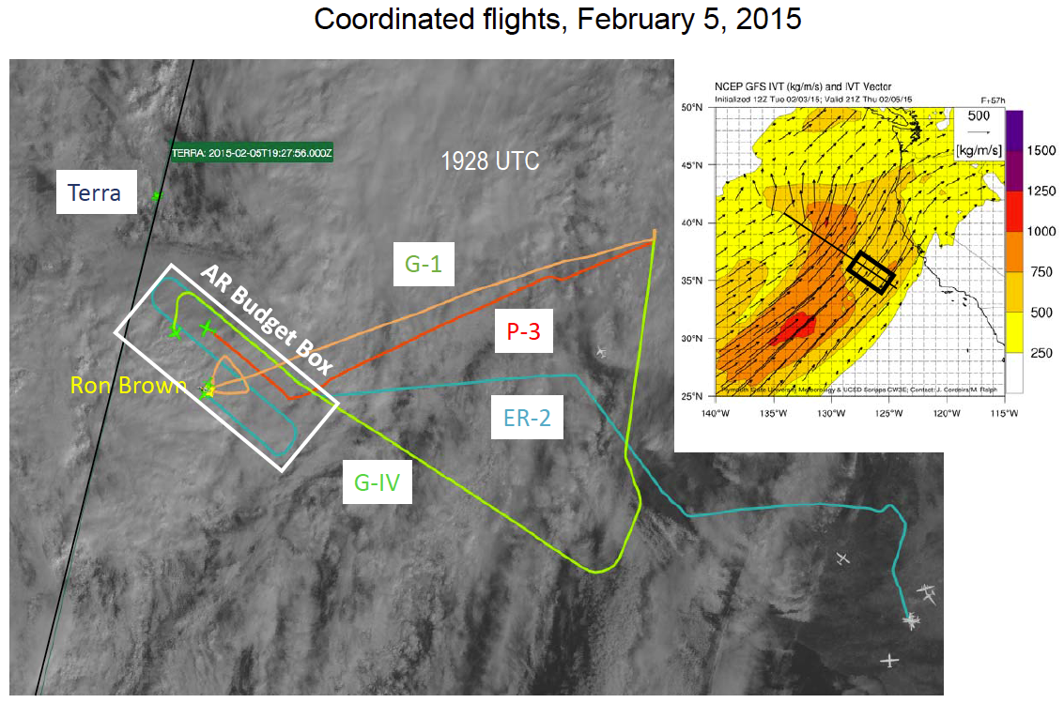
CalWater 2015: Flight planning, coordination, and attention
AR Portal forecast products
  Provided valuable guidance flight planning and coordination efforts to gather crucial data to better understand ARs prior to landfall
  Gained national media attention
  Actively used by National Weather Service offices along West Coast

