Slide 1
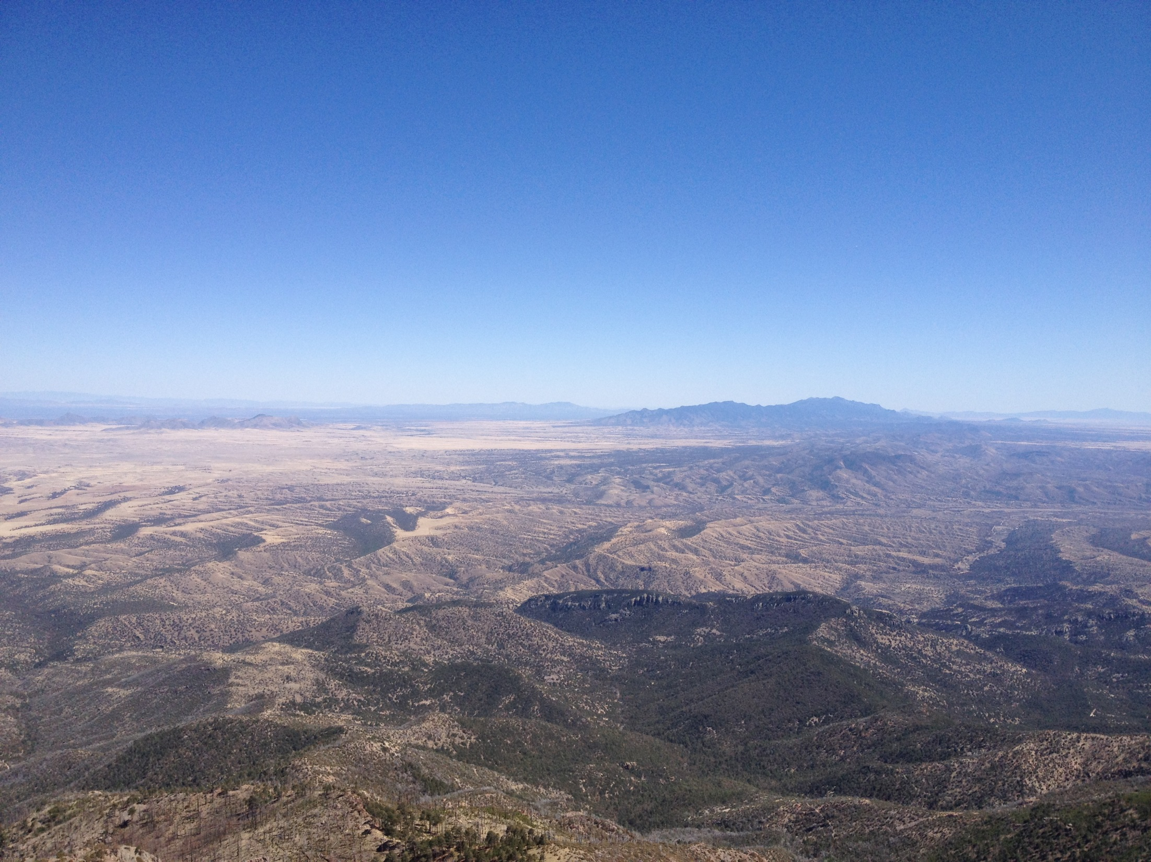


Western Precipitation Observations:
The Role of Extreme Precipitation Events
F. Martin Ralph, Ph.D.
Scripps Institution of Oceanography, UCSD
Western States Water Council Workshop on
Seasonal Precipitation Forecasting for Water Resources
Las Vegas, NV
15 December 2015

Slide 2
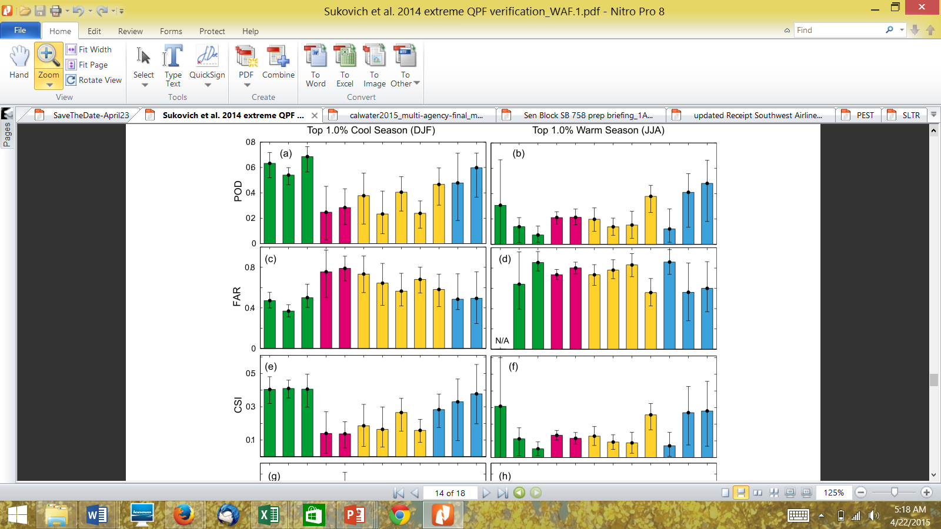
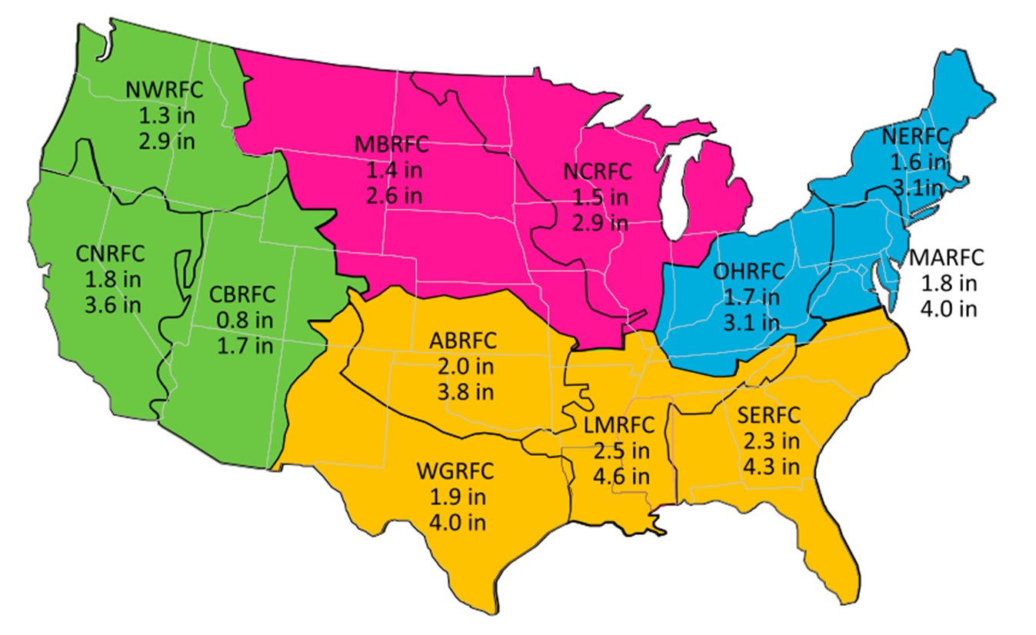
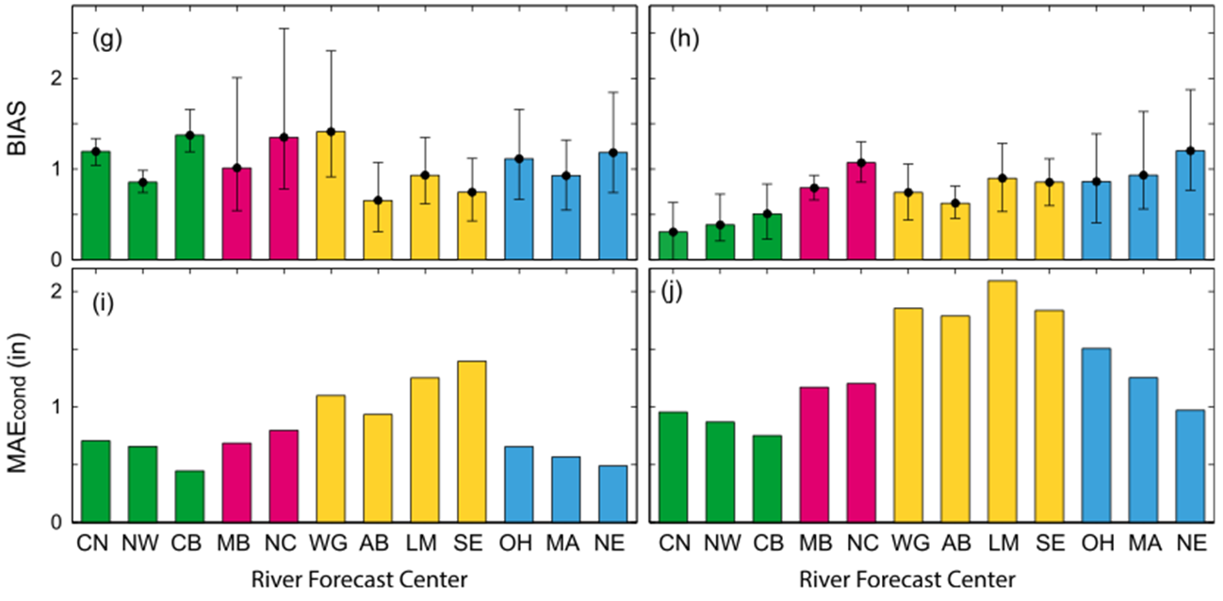
Extreme quantitative precipitation forecast performance
at the Weather Prediction Center from 2001 to 2011
Sukovich, E. M., F. M. Ralph, F. E. Barthold, D. W. Reynolds and D. R. Novak
Wea. Forecast. (2014)
Regional thresholds for
Top 1% heaviest daily precipitation
Used 32 km gridded QPE from NCEP/WPC from 2001-2011, >12,000,000 wet days
Used 32 km gridded QPE and QPF from NCEP/WPC from 2007-2011. For 1-day lead time. Note QPF for Western RFC’s and New England are best.
Slide courtesy of F.M. Ralph, Scripps/CW3E

Slide 3
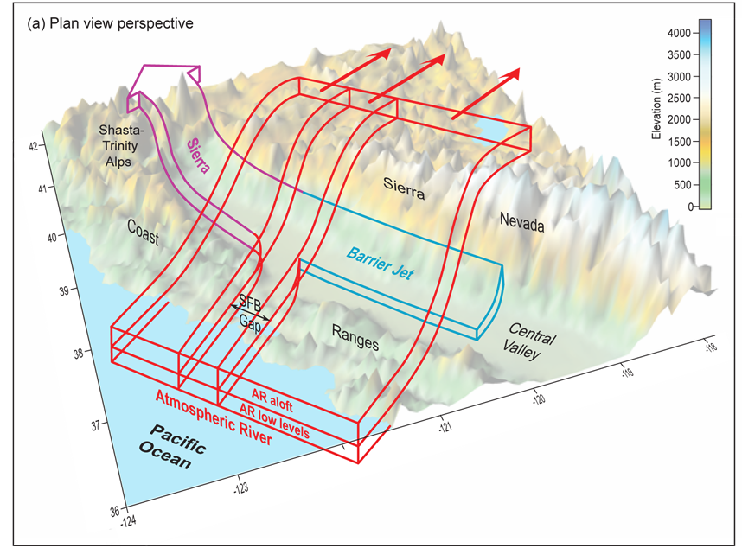
The Sierra Barrier Jet is key to regional precipitation
Neiman, Hughes, Moore,
Ralph, and Sukovich (MWR 2013)

Slide 4
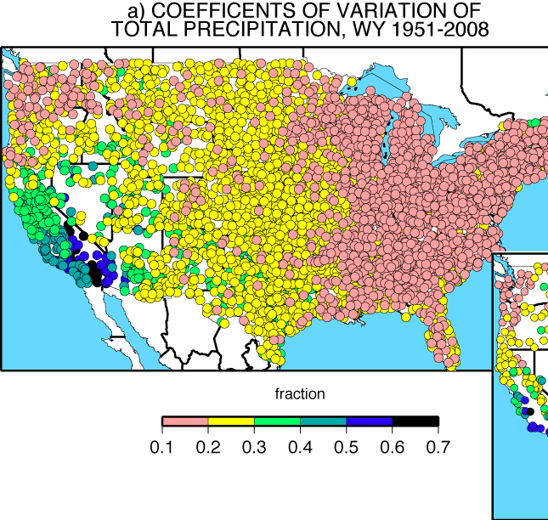
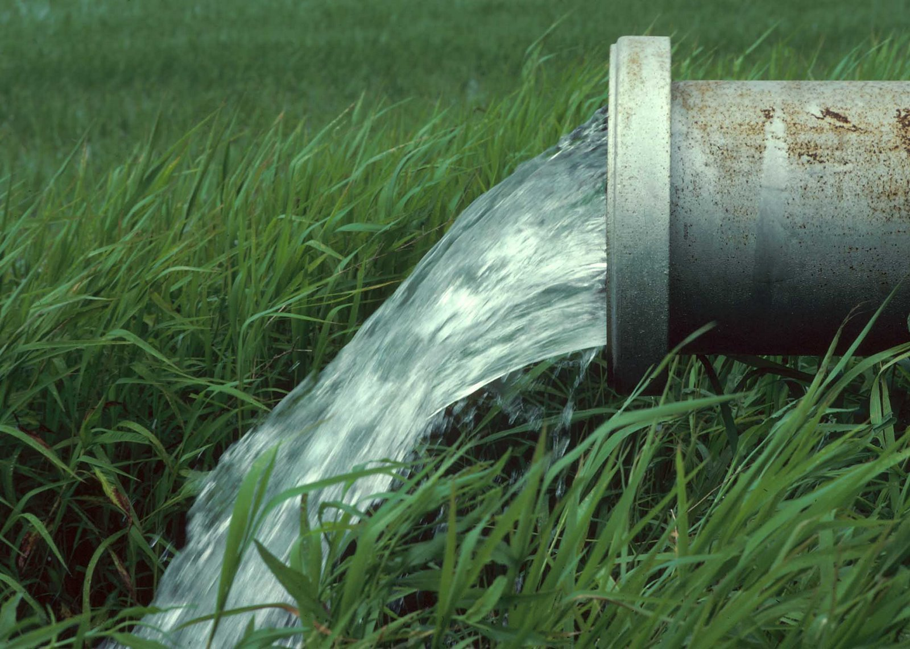
WESTERN U.S. ANNUAL PRECIPITATION IS 2-3 TIMES MORE VARIABLE THAN EASTERN U.S.
Dettinger et al. 2011, Water

Slide 5
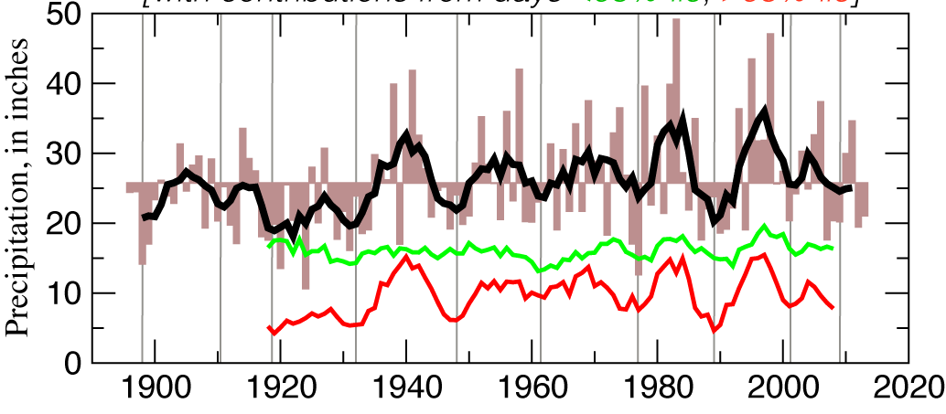

Atmospheric Rivers and the Need for Seasonal Outlooks by F.M. Ralph Scripps May 2015
A few large storms (or their absence)
Account for a disproportionate amount of California’s precipitation variability
Water year precipitation, Delta catchment
with contributions from days <95%-ile, >95%-ile
Dettinger and Cayan 2014, San Francisco Estuary and Watershed Science
Notes:
Use Verdana for all copy

Slide 6
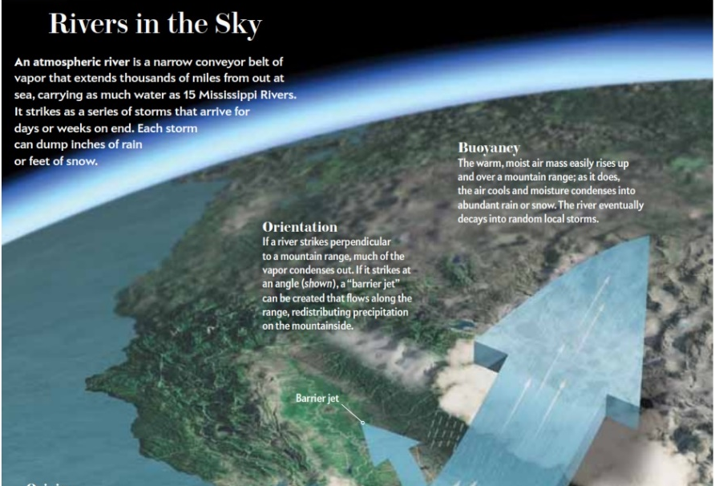
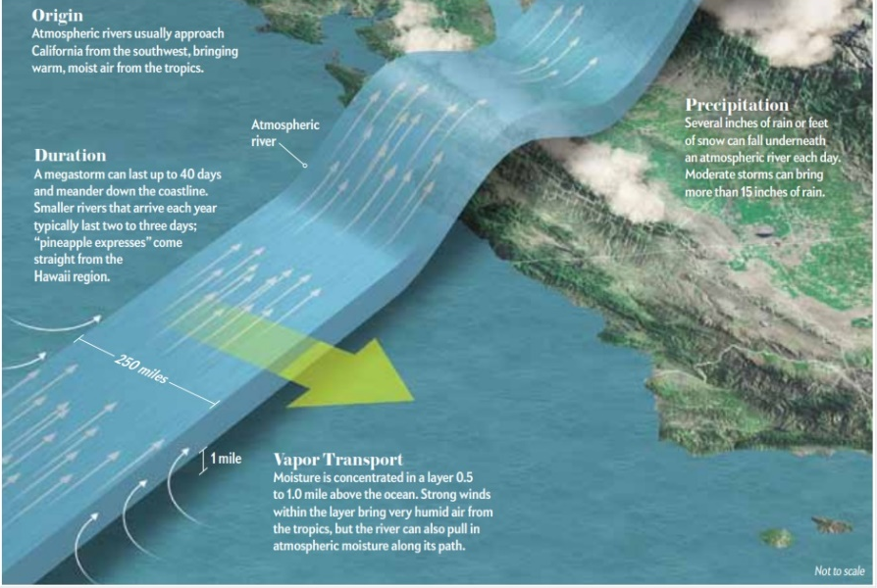
Figure from an article in
Scientific American by Dettinger and Ingram (January 2013)
A Major Result from 10-years of Research
Atmospheric rivers – what they are, how they work, and their crucial role in both water supply and flooding across much of the U.S. West Coast

Slide 7
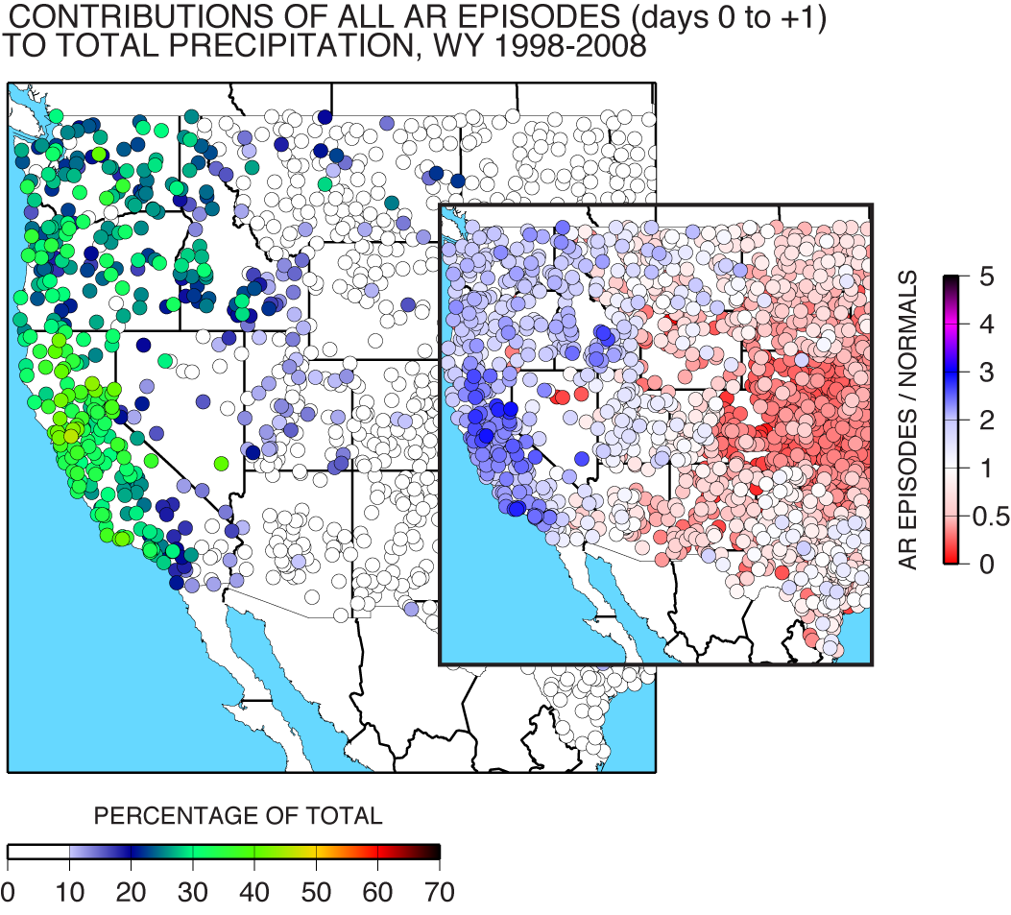
Why is there a need to study and forecast ARs?
ARs are responsible for 25-45% of annual precipitation along U.S. West Coast
25-35% of annual precipitation in Pacific Northwest occurs in ARs
Dettinger et al. 2011, Water
35-45% of annual precipitation in California occurs in ARs

Slide 8
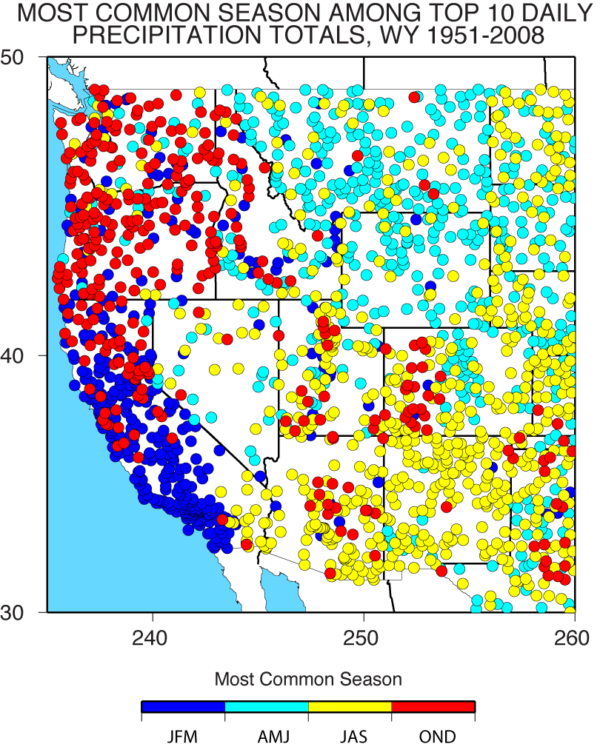
A vision for future observations for Western U.S. extreme precipitation and flooding
F.M. Ralph, M. Dettinger, A. White, D. Reynolds, D. Cayan, T. Schneider, R. Cifelli, K. Redmond, M. Anderson, F. Gherke, J. Jones, K. Mahoney, L. Johnson, S. Gutman, V. Chandrasekar, J. Lundquist, N.P. Molotch, L. Brekke, R. Pulwarty, J. Horel, L. Schick, A. Edman, P. Mote, J. Abatzoglou, R. Pierce, G. Wick
J. Contemporary Water Resources Research and Education, Univ. Council for Water Resources, Issue 153, 2014
MOST COMMON SEASON AMONG
TOP 10 DAILY PRECIPITATION TOTALS
WY 1951-2008
Analysis from COOP daily precipitation observations.
Each site uses at least 30 years of data
The top 10 daily precip dates are found
The season for which most of these top-10 dates occurred at that site is color coded.
Ralph et al. 2016 JCWRE

Slide 9
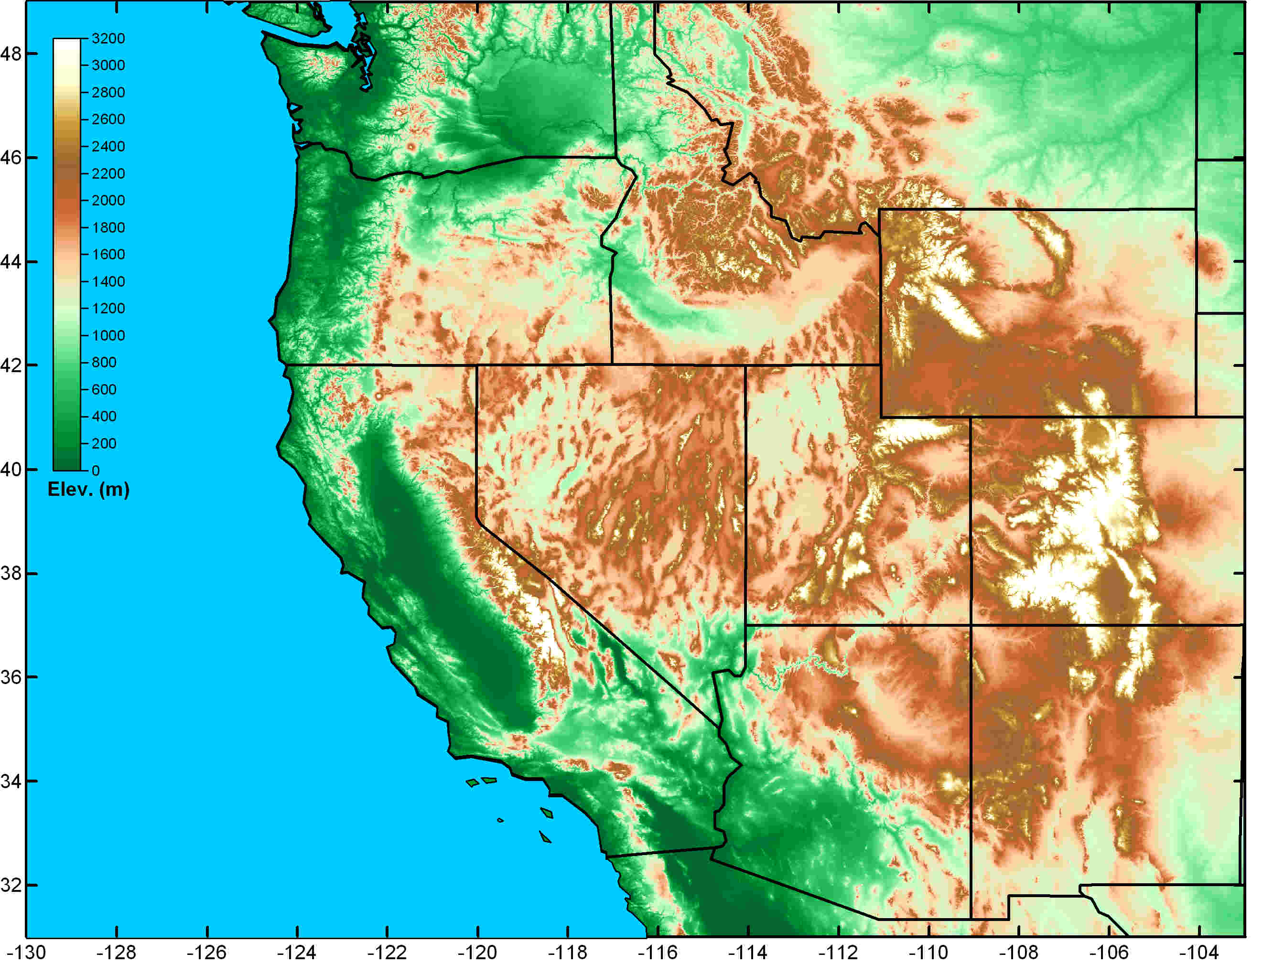
Schematic illustration of regional variations in the primary weather phenomena that lead to extreme precipitation, flooding and contribute to water supply in the Western U.S. (Ralph et al. 2014)
Great Plains Deep Convection
(spring and summer)
Atmospheric Rivers
(fall and winter)
Front Range Upslope (rain/snow)
Key
Weather
Phenomena
Southwest Monsoon (summer & fall)

Slide 10
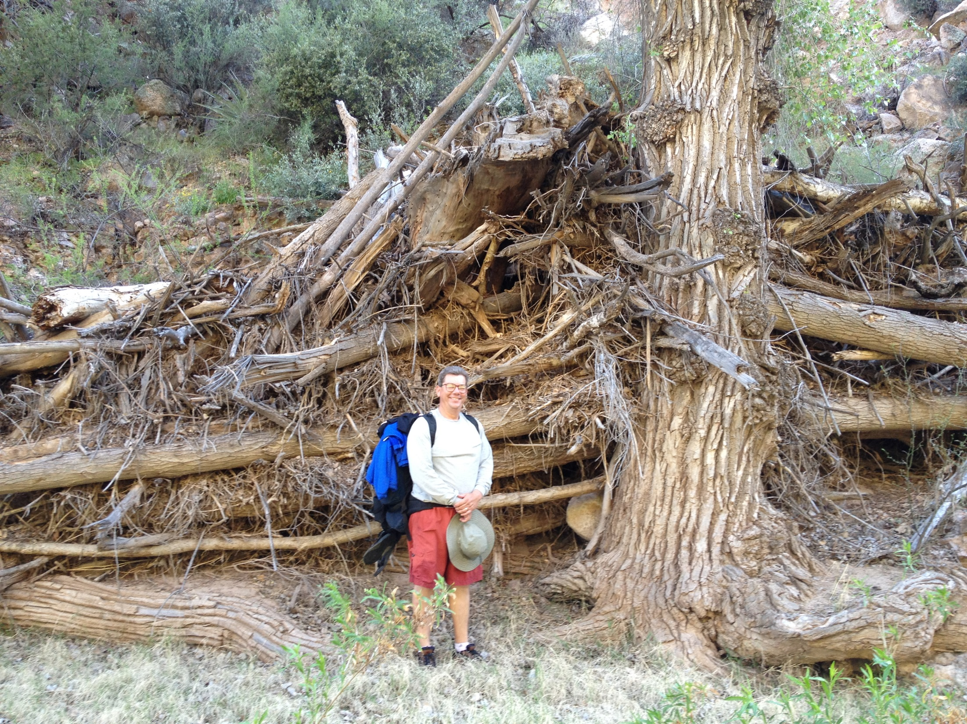
Seasonality of Annual
Peak Daily Flow in Arizona
Aravaipa Canyon Wilderness, April 2013

Slide 11
Are ARs a factor inland from the coastal states?
Seasonality of Annual Peak Daily Flow in Arizona – Preliminary analysis using USGS data
  10 Moderate sized basins (avg. area is 460 sq miles)
  5 Large basins (avg. area is 4329 square miles)
    Stream Gage sites used for the “Large” basins
      Santa Cruz River near Cortaro
      Gila River near Clifton
      Salt River near Roosevelt
      Verde River near Camp Verde
      Virgin River at Littlefield
  Little Colorado near Cameron (29,000 square miles)

Slide 12
Methodology
Annual peak daily flows available online from USGS are examined.
Watersheds of modest or large size and covering a range of latitudes and longitudes across central and southern AZ were selected.
Each one needed to have at least 20 years of record
Spring snowmelt dominated watersheds were avoided
Most watersheds had an aspect facing southerly or southwesterly.
Annual peak flow was examined
All dates fell either in Jul-Sep, or in Oct, or in Nov-Mar
Nov-Mar events were considered “cool season”
Oct events were likely remnant tropic systems as on 2-3 Oct 1983

Slide 13
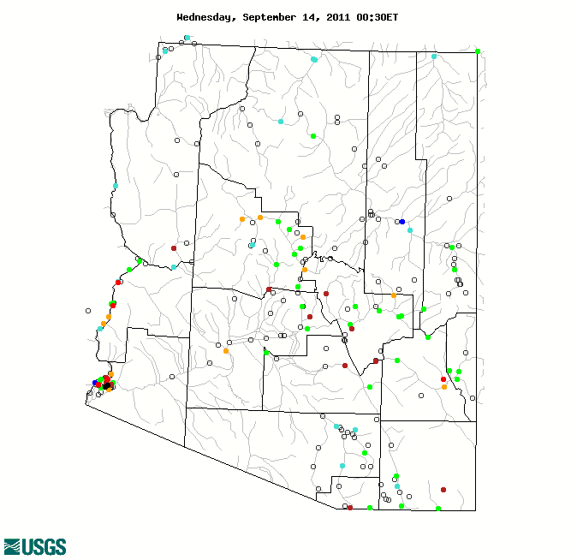
Modest sized watersheds
Record flows range from 15-75 kcfs
Drainage areas are between 200-675 sq mi (except Sabino is 36)
Gage elevations are between 1880-3703 ft msl
Oak Creek
Burro
Tonto
Agua Fria
Cherry
Aravaipa
Eagle
Sabino
Pantano
Santa Cruz near Nogales

Slide 14
Modest sized watersheds
Record flows range from 15-75 kcfs
Drainage areas are between 200-675 sq mi (except Sabino is 36 sq mi)
Gage elevations are between 1880-3703 ft msl
Oak Creek
Burro
Tonto
70% - 90% of the 10 highest annual peak daily flows occurred between
1 November and 31 March
Agua Fria
Cherry
Aravaipa
Eagle
Sabino
0% - 40% of the 10 highest annual peak daily flows occurred between
1 November and 31 March
60% - 100% occurred from 1 July to 31 October
Pantano
Santa Cruz near Nogales

Slide 15
Large watersheds (avg area: 4329 sq mi)
Virgin River at Littlefield: 80%
Record flows range from 25-143 kcfs (average record = 96 kcfs)
Except for Little Colorado gage, Drainage areas are between 3503-5092 sq mi (average = 4329 sq mi)
Little Colorado 26091 sq mi
Gage elevations are between 1700-4000 ft msl
Little Colorado at Cameron: 50%
Verde River near Camp Verde: 90%
Percentages listed are the percent of the top-10 annual peak daily flows that occurred between 1 November and 31 March
Salt River near Roosevelt: 100%
Gila River near Clifton: 60%
Santa Cruz River near Cortaro: 20%

Slide 16
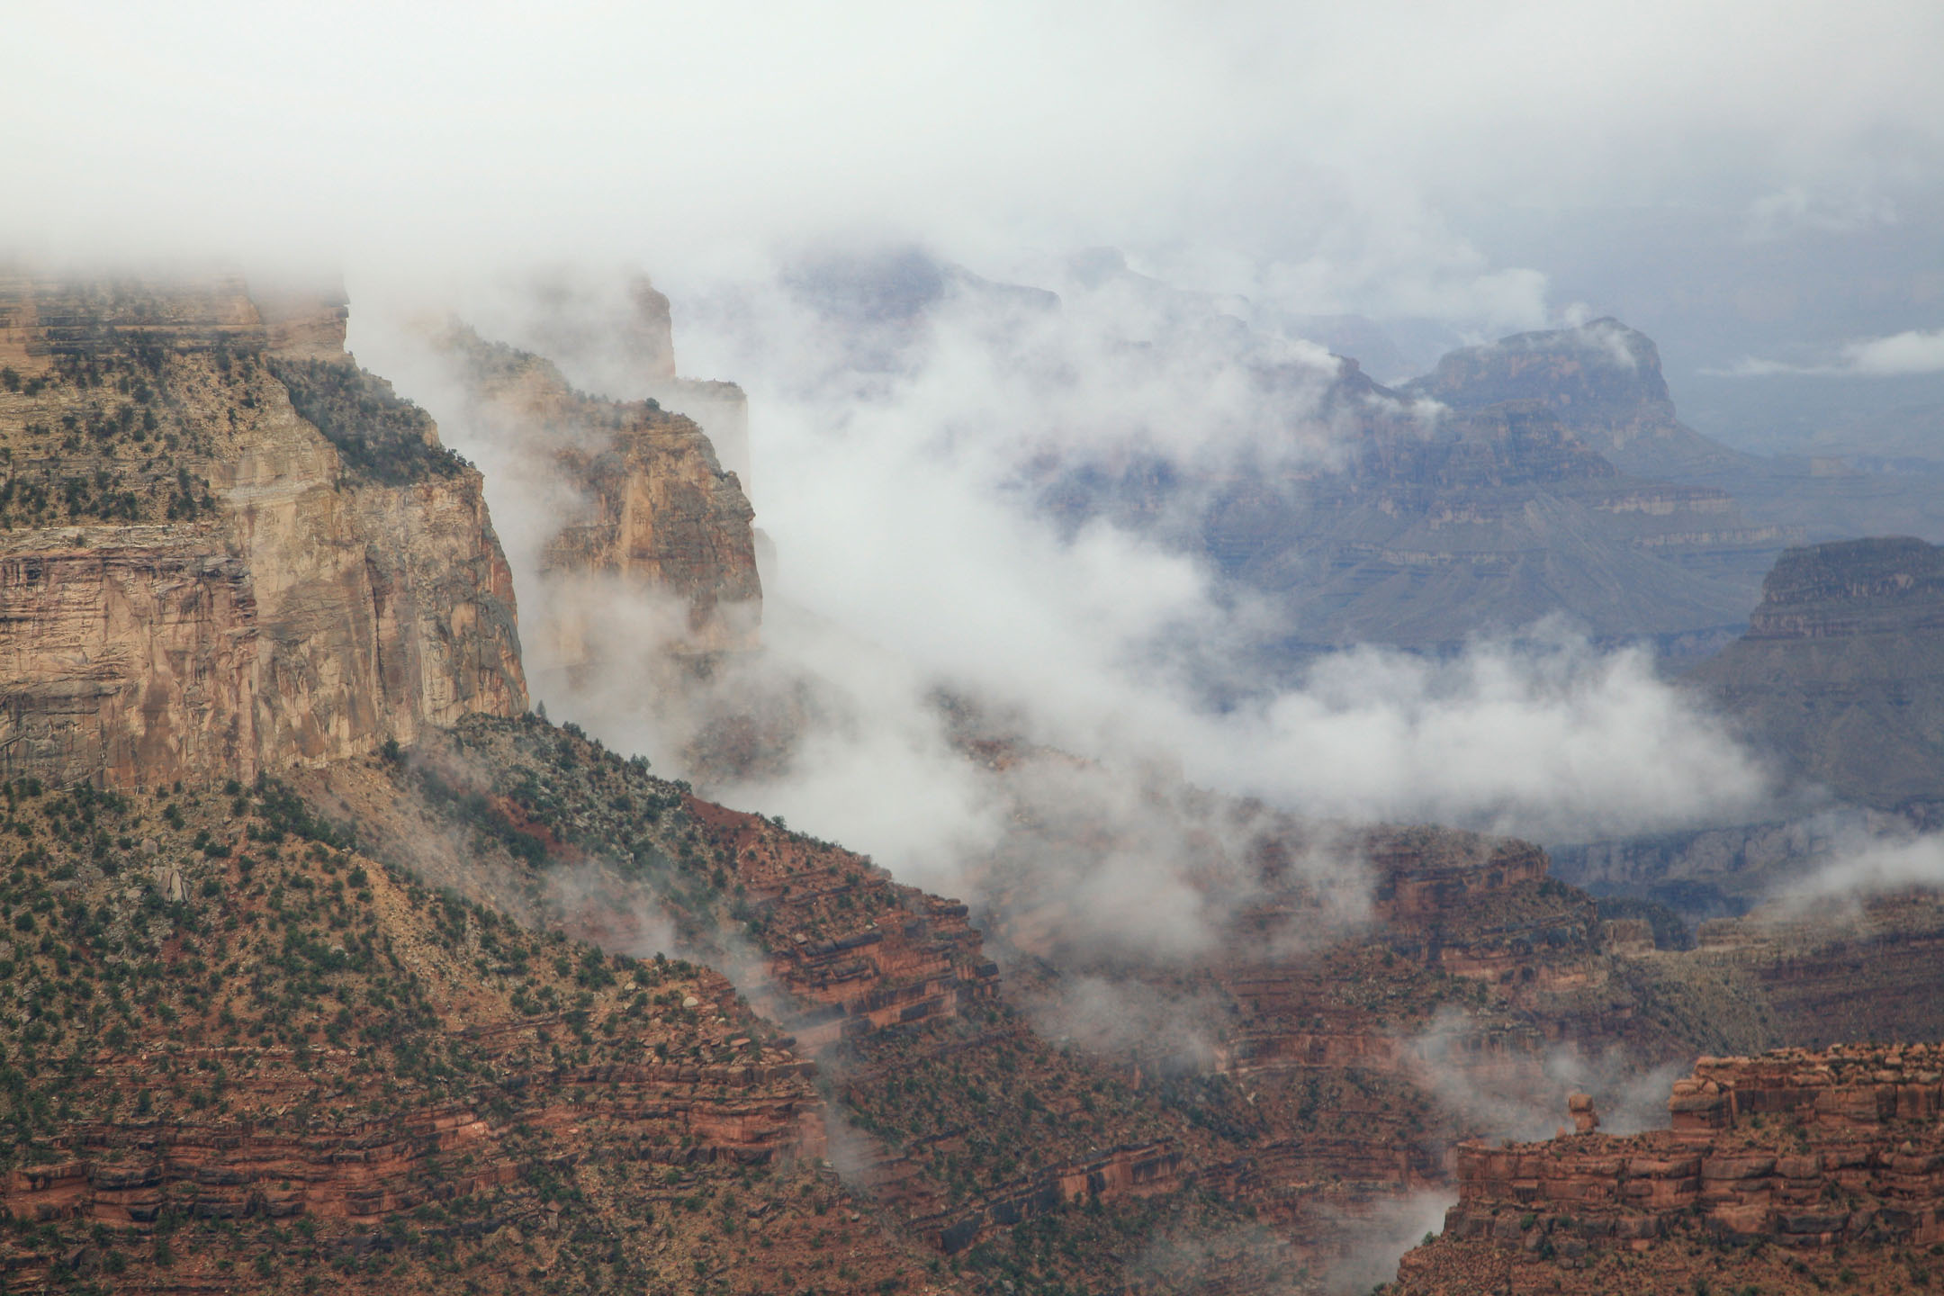
The Landfall & Inland Penetration of a Flood-Producing Atmospheric River in Arizona:
Part 1: Observed Synoptic-scale, Orographic, & Hydrometeorological Characteristics
Paul J. Neiman¹, F.M. Ralph¹, B. Moore², M. Hughes², K. Mahoney², J. Cordeira², M. Dettinger³
¹NOAA/Physical Sciences Div., Boulder, CO; ²CIRES/NOAA, Boulder, CO; ³Scripps, La Jolla, CA
J. Hydrometeor., 14, 460-484 (April 2013)
Grand Canyon South Rim
©2008 Paul J. Neiman

Slide 17
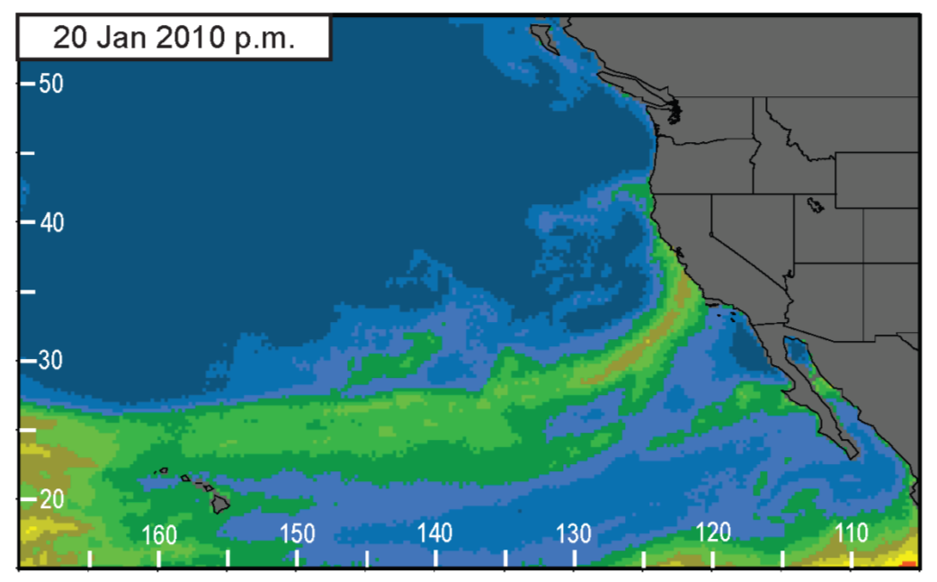
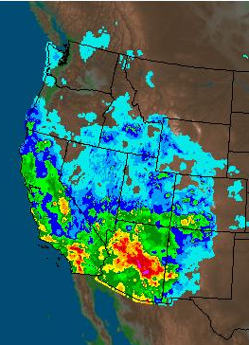
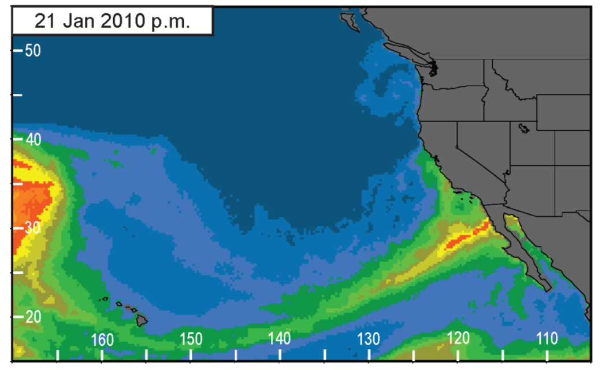
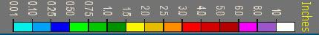
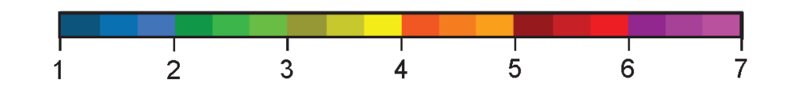
SSM/I IWV satellite imagery 20-21 Jan. 2010 depicts a strengthening AR making landfall
24-h precip ending 12Z 22 Jan. 2010:
Advanced Hydrological Prediction Services
atmospheric river
atmospheric river
12Z 22-Jan-2010
cm

Slide 18
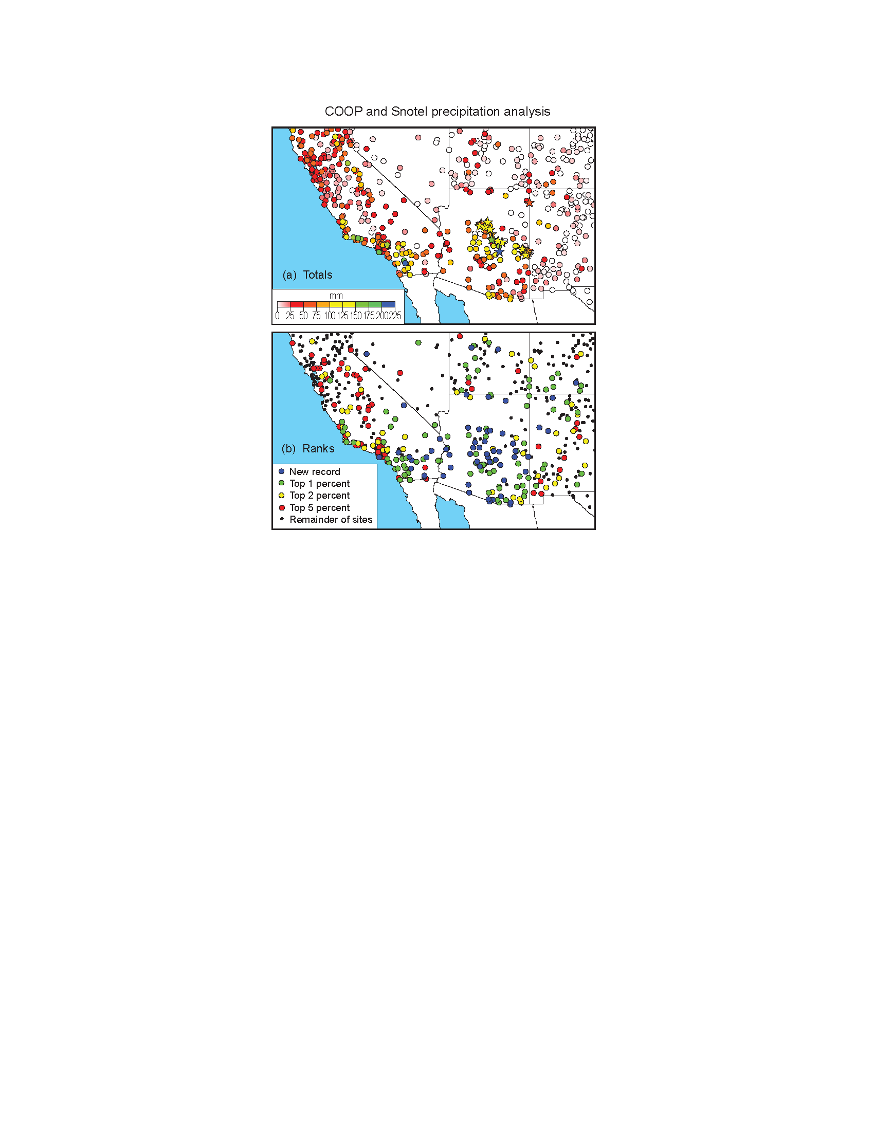
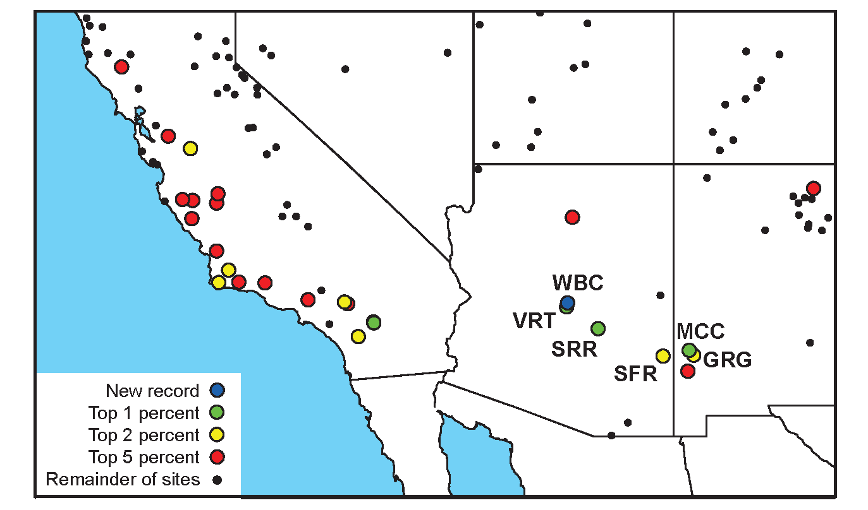
COOP precip on 21-22 Jan. 2010: Rank relative to all January pairs of days between 1950-2009 for gauges with >25 Januarys of data.
USGS streamflow on 21-22 Jan. 2010 for unregulated channels: Rank relative to all January pairs of days between 1901-2009 for gauges with >25 Januarys of data.

Slide 19
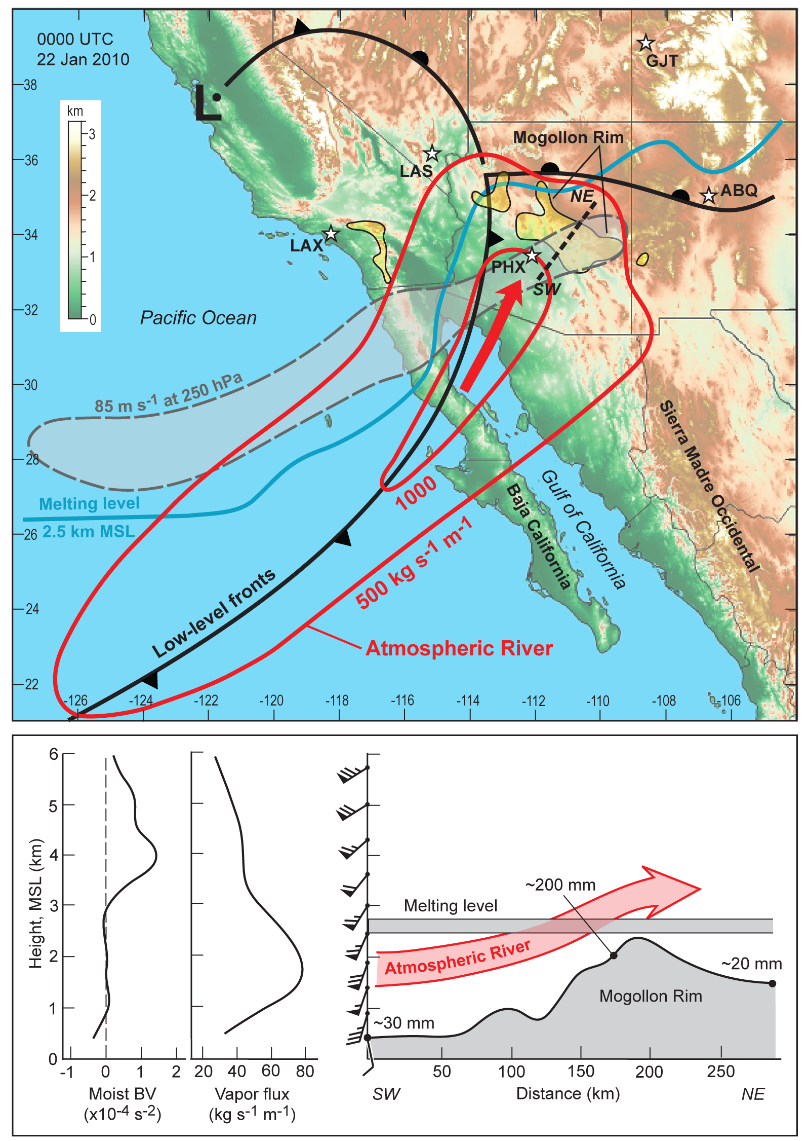
Ideal conditions for creating heavy orographic rain on the Mogollon Rim and associated mountains
2.5 km (AGL) deep moist neutral layer
75% of water vapor transport in lowest 3.3 km AGL
Summary schematic for Jan 2010 case presented by Neiman et al. (in preparation)

Slide 21
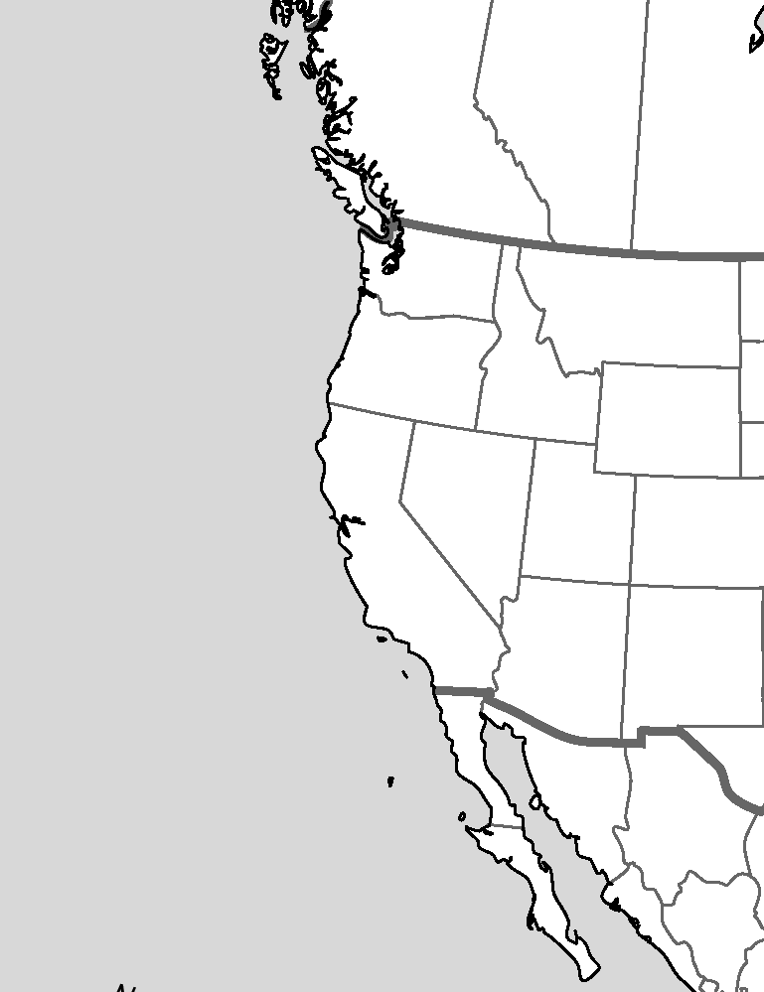
ARs crossing the Baja Peninsula
Rutz, J. J. and Steenburgh, W. J. (2012), Quantifying the role of atmospheric rivers in the interior western United States. Atmos. Sci. Lett., 13: 257–261. doi: 10.1002/asl.392
Motivation
  Provide a follow-up to the work of Dettinger et
  al. (2011), which assessed the influence of ARs on
  western U.S. precipitation, but did not consider
  ARs crossing the Baja Peninsula
Method
  If an AR is present for ~24 h along the North
  American west coast from 24–52.5°N,
  precipitation on that day and the next are
  attributed to the AR.
  The “AR fraction” is the fraction of total
  cool-season (Nov – Apr) precipitation
  attributed to ARs
  Includes Baja Peninsula
52.5°N
Neiman et al.
(2008)
Dettinger et al.
(2011)
32.5°N
addition by Rutz
and Steenburgh (2012)
24.0°N

Slide 22
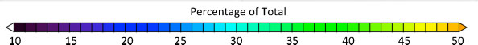
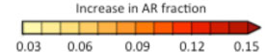
ARs crossing the Baja Peninsula
a)
b)
c)
Cool-season “AR fraction” (a) without and (b) with ARs crossing the Baja Peninsula in the CPC gridded precipitation analysis during water years 1998–2008. (c) (b) - (a).

Slide 23
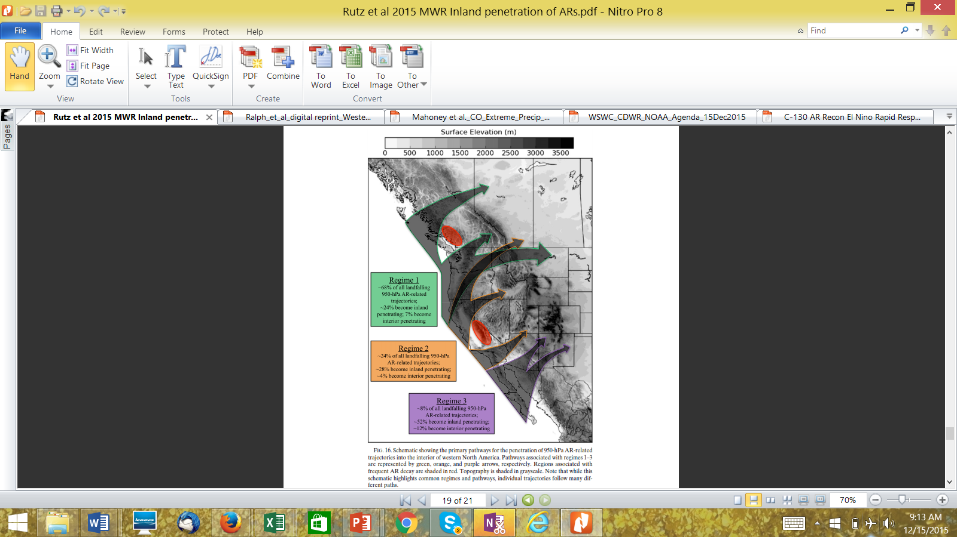
The Inland Penetration of Atmospheric Rivers over Western North America: A Lagrangian Analysis
J.J. Rutz, J. W. Steenburgh and F.M. Ralph
Mon. Wea. Rev., 2015

Slide 24
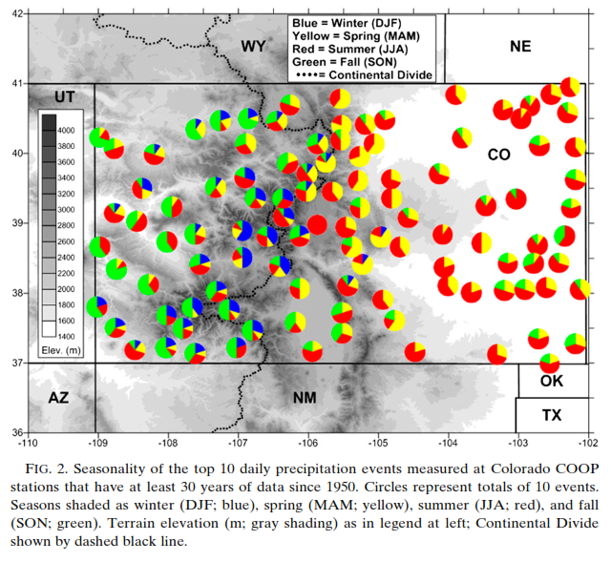
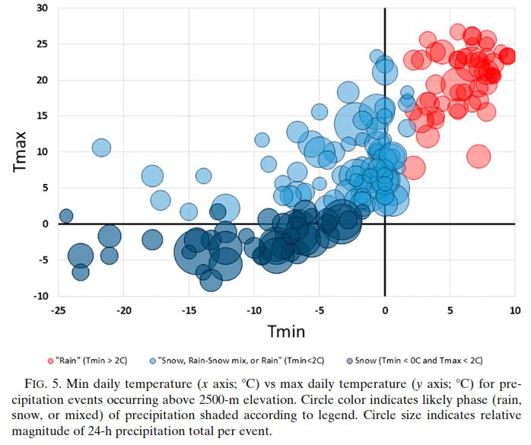
Climatology of extreme daily precipitation in Colorado
and its diverse spatial and seasonal variability
Mahoney, K., F.M. Ralph, K. Wolter, N. Doesken, M. Dettinger, D. Gottas, T. Coleman, and A. White
J. Hydrometeorology, 2015
Events above 2500 m MSL

Slide 25
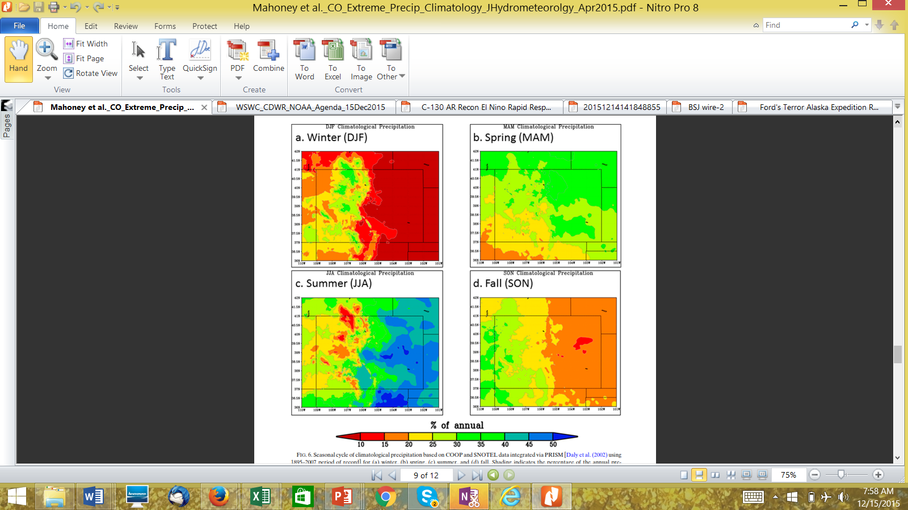
Seasonal contribution to annual precipitation

Slide 26
Atmospheric Rivers and the Need for Seasonal Outlooks by F.M. Ralph Scripps May 2015
A few large storms (or their absence)
Account for a disproportionate amount of California’s precipitation variability
Water year precipitation, Delta catchment
with contributions from days <95%-ile, >95%-ile
Dettinger and Cayan 2014, San Francisco Estuary and Watershed Science
Notes:
Use Verdana for all copy

Slide 27
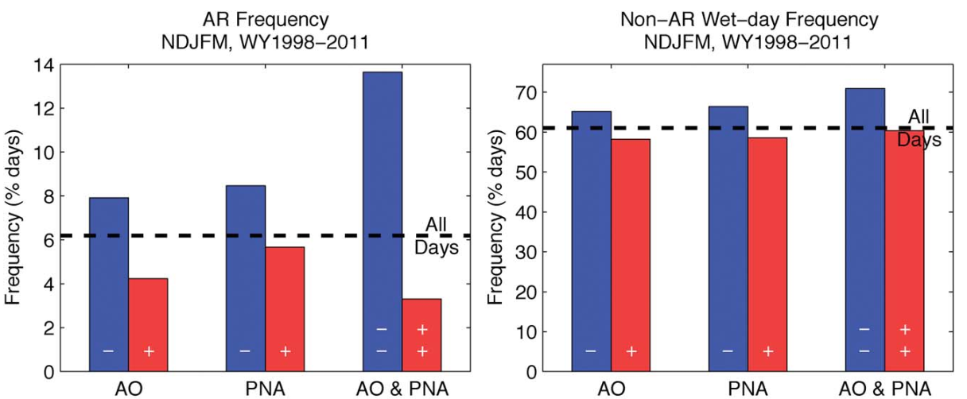
The 2010/2011 snow season in California’s Sierra Nevada:
Role of atmospheric rivers and modes of large-scale variability
Guan, B., N.P. Molotch, D. E. Waliser, E. Fetzer and P.J. Neiman
Water Resources Research (2013)
Arctic Oscillation (negative , i.e., southward cold-air outbreaks) combined with
Pacific North American “teleconnections” pattern (negative, southern storm track)
Favors Atmospheric river conditions striking the Sierra and causing precipitation
Notes:
Use Verdana for all copy

Slide 28
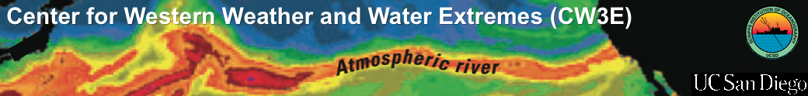
  Application of AR Detection Scheme to Reanalysis Output
Annual number of days with
landfalling ARs along California coast
Percent of total precipitation
associated with nearby
landfalling AR
Gershunov, Shulgina, Ralph
Scripps/CW3E

Slide 29
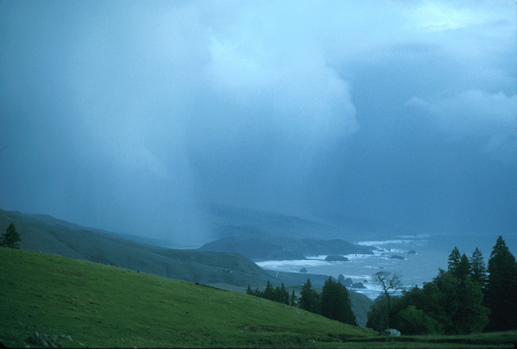
Atmospheric Rivers – A UCSD/CW3E Vision Supporting California Water Management
There is no “Silver bullet” for this complex problem.
There is no “silver bullet”
Requires an Integrated, Multi-disciplinary Strategy
BENEFITS: Water Supply, Flood Control
Ecosystems, Hydropower, etc…
Decision Support Tools + Forecast-Informed Reservoir Operations
21st Century
Observations
Complex Simple methods
21st Century
Modeling
Science
F.M. Ralph
Scripps/CW3E

Slide 30
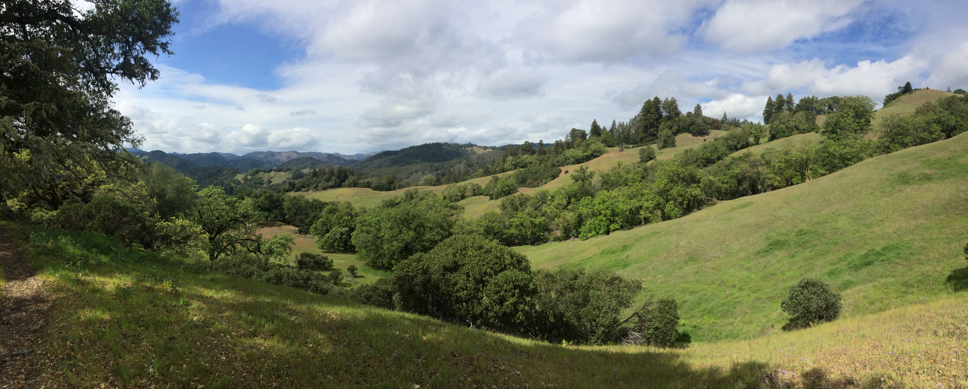

Thank you
mralph@ucsd.edu
cw3e.ucsd.edu

Slide 31
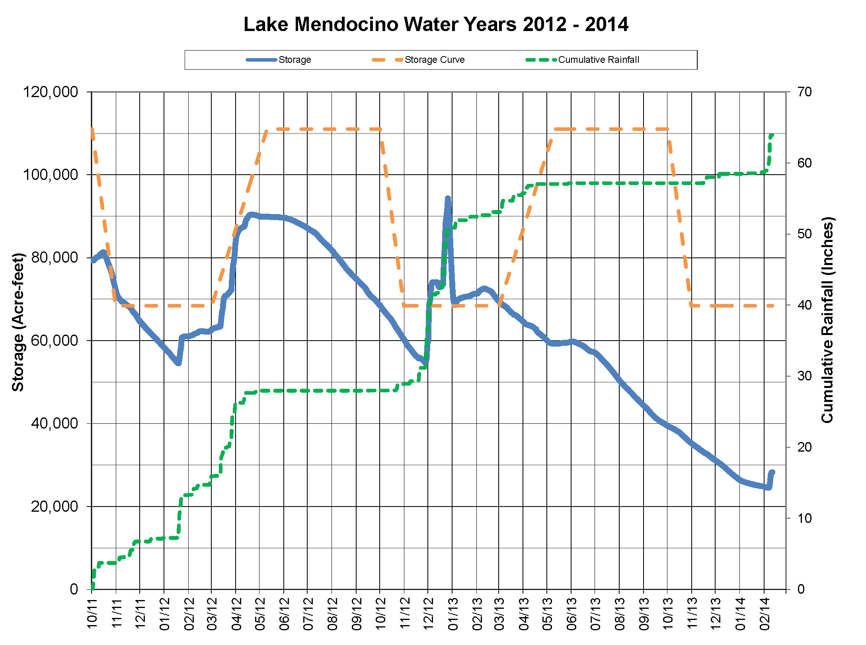
Lake Mendocino FIRO Viability Assessment – A Collaborative Effort
Coalition of federal, state, & regional agencies comprised of scientists & water managers
Co-Chaired by J. Jasperse (SCWA) and M. Ralph (Scripps/CW3E)
Steering Committee:
Federal: NOAA (OAR, NWS, NMFS), USGS, Army Corps of Engineers, & Bureau of Reclamation
State: CA Dept. of Water Resources & Scripps Center for Western Weather & Water Extremes
Regional: Sonoma County Water Agency
NOAA Habitat Blueprint, Integrated Water Resource Sciences & Services
Atm. River Events
Reservoir Storage Curve
Atm. River Events
Can we save some of this water?
WY 2013 Rainfall
WY 2012 Rainfall
Atmospheric River Events

Slide 32
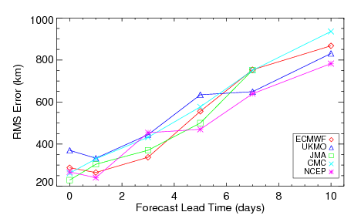
AR Landfall Position Forecast Errors
While overall occurrence well forecast out to 10 days, landfall is less well predicted and the location is subject to significant errors, especially at longer lead times
RMS Error in Forecast AR Landfall Location
Errors in location increase to over 800 km at 10-day lead
Errors in 3-5 day forecasts comparable with current hurricane track errors
Model resolution a key factor
500 km forecast error at 5-day lead time
From Wick et al., 2013 (Weather and Forecasting)
Models provide useful heads-up for AR impact and IWV content, but location highly uncertain
Location uncertainty highlights limitations in ability to predict extreme precipitation and flooding
Improvements in predictions clearly desirable

Slide 33
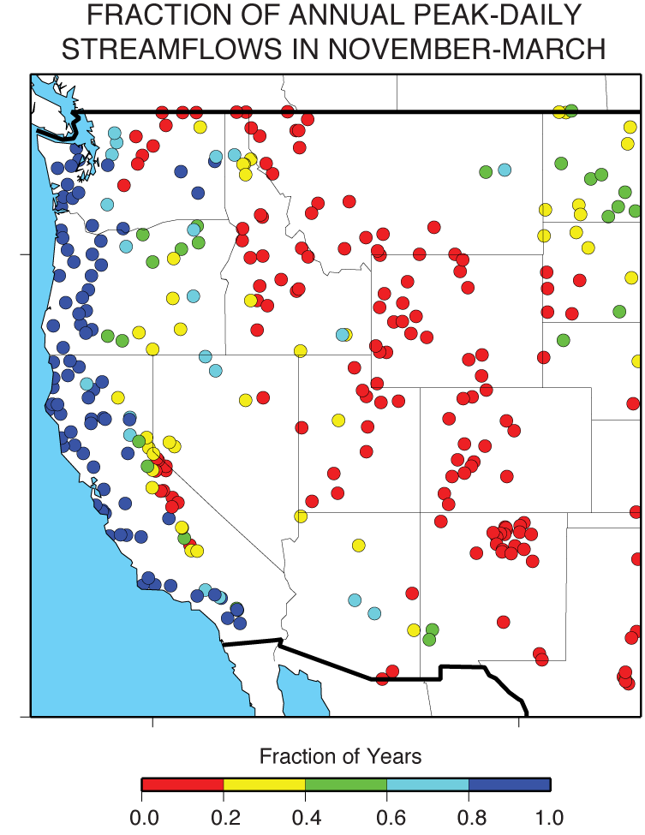
Seasonality of Annual Peak Streamflow
Seasonality of annual peak daily stream flows highlighting the preponderance of AR-dominated regions (blue dots) and Spring-melt dominated regions (red dots in mountains)
Spring-Summer snowmelt
Atmospheric rivers
Fall-Winter
Ralph et al. 2016 JCWRE

