Slide 1
Seasonal Precipitation Forecasting, Applications & Justification
Jeanine Jones , California Department of Water Resources

Slide 2
“While everybody talked about the weather, nobody seemed to do anything about it” – Charles Warner, misattributed to Mark Twain

Slide 3
Western States Water Council Position #366
WHEREAS, the present scientific capability for forecasting beyond the weather time domain – beyond the ten day time horizon – and at the subseasonal to interannual timescales important for water management is not skillful enough to support water management decision-making; and …..
BE IT FURTHER RESOLVED, that the federal government should place a priority on improving subseasonal and seasonal precipitation forecasting capability that would support water management decisions.

Slide 4
Definitions
Timeframe of interest is 2 weeks+ out to a year (sub-seasonal to seasonal)
Prediction of precipitation -- not runoff, snow products, or “drought”

Slide 5
[Many Runoff Forecasting Products Already Available! (for example, CDWR products)]
Seasonal Runoff Forecasts
Monthly Bulletin 120 river runoff forecast (issued from February 1 through May 1): Latest | Previous
Weekly update to the Bulletin 120 river runoff forecast (issued from February through June): Latest | Previous
State map of April through July unimpaired snowmelt runoff
Historical Bulletin 120 - Water Conditions in California
Sacramento and San Joaquin Valley Water Year Type Index forecast (issued monthly from December 1 through May 1): Latest | Previous
Historical Sacramento and San Joaquin Valley Water Year Type Index
Peak snowmelt runoff forecast (issued from April through June cooperatively with the California-Nevada River Forecast Center)

Slide 6
Applications for Sub-Seasonal Prediction (i.e., will the rest of this winter be dry?)
How much water should we allocate to State Water Project contractors?
Will we be processing many water transfer requests, and will transfer water be available?
How should we plan reservoir and aqueduct water and power operations?
Will emergency Delta salinity control measures be needed?
Should we operate reservoirs to maximize conservation of cold water for salmonids?

Slide 7
Applications for Seasonal Prediction (i.e., will next year be dry?)
Do we need to reprogram funds for drought response activities, or seek new funding in the state budget process?
Should we plan to operate a drought water bank?
Should we develop enhanced conservation or drought outreach programs?
Will we be processing many water transfer requests, and will transfer water be available?

Slide 8
Example -- CDWR Winter Season Decision Timeframes
WY begins October 1st
Publish annual water transfers guidance, November
Contractual requirement for initial allocation to SWP contractors by Dec 1st (then updated based on observed hydrology)
Snow surveys begin Jan 1st
Seasonal snowmelt runoff forecasts begin in February
Water transfer applications due by March (in an ideal world…..)

Slide 9
Delicate Balancing Act Between Reservoir Ops for Flood & for Water Supply
And long-term need for climate change adaptation tools

Slide 10
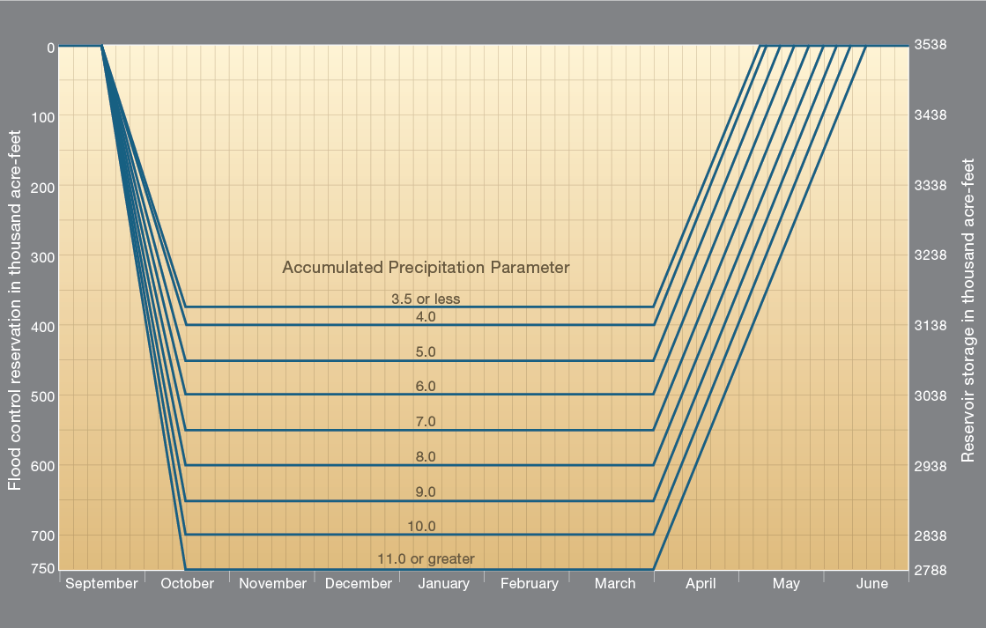
Lake Oroville Rule Curve

Slide 11
Reservoir Operations
Forecast-informed reservoir operations (FIRO)
Make more efficient use of reservoir storage for water supply/flood control purposes
Long-term tool for climate change adaptation in response to expected loss of mountain snowpack

Slide 12
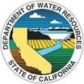
Lake Mendocino FIRO Demonstration Project – A Collaborative Effort
Broad coalition of federal, state, & regional agencies comprised of scientists & water managers
Steering Committee:
Federal: NOAA (OAR, NWS, NMFS), USGS, Army Corps of Engineers, & Bureau of Reclamation
State: California Department of Water Resources & Scripps Center for Western Weather & Water Extremes
Regional: Sonoma County Water Agency
Partnerships: NOAA Habitat Blueprint
Integrated Water Resource Sciences & Services
Courtesy of Jay Jasperse, SCWA

Slide 13
Lake Mendocino Vulnerability Need to Update
J. Jasperse, SCWA
Atm. River Events
Reservoir Storage Curve
Can we save some of this water?
Atm. River Events
WY 2013 Rainfall
Atmospheric River Events
WY 2012 Rainfall
To avoid this

Slide 14
Seasonal Forecasting Relevance at Water User Level
Especially important for agricultural water users; need for adequate lead time for planting decisions (for getting production loans). Agriculture is West’s major water user
Lead time needed for planning response actions such as water transfers & local conservation programs/budgets, rate-setting
Also important for urban demand forecasting
Importance of reliable predictive capability increases with length of drought

Slide 15
Justifying Federal Investment in Improving Seasonal Forecasting
Federal agencies are required to use NWS products
Potential reduction in federal drought disaster assistance payments (e.g., USDA)
Improved management of federal, state, local water infrastructure, reduced costs/impacts to water users

Slide 16
USDA Drought-Related Financial Assistance
Emergency loan program (Secretarial disaster designations)
Crop insurance
Noninsured crop disaster assistance program
Livestock indemnity program
Livestock forage disaster program

Slide 17
California Drought Example: Funding from State & Federal Sources -- PPIC August 2015
 | State, $M | Federal, $M
Emergency community assistance | 200 | 109
Livestock feed subsidies | 0 | 250
Emergency ecosystem support | 66 | 67
Emergency fire protection | 131 | 4
Water system investments | 2609 | 104
Total | 3006 | 534

Slide 18
NOAA NCDC Billion $ Weather Disasters, 1980-2014
Type | # of Events | % Frequency | Losses, $B | % of Total Losses
Drought | 22 | 12.4 | 206 | 19.1
Flood | 20 | 11.2 | 88 | 8.2
Severe Storm | 70 | 39.3 | 155 | 14.4
Trop. Cyclone | 34 | 19.1 | 539 | 50.0
Wildfire | 12 | 6.7 | 26 | 2.4
Winter Storm | 13 | 7.3 | 37 | 3.4

Slide 19
Let’s do something about the weather……

Slide 20
