Slide 1
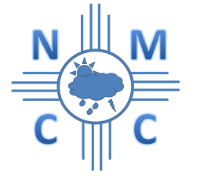
NM Climate Center AgMet Network
Dave DuBois
NM State Climatologist
Las Cruces, NM
Presented at the Irrigation Management Information Systems’ Workshop
San Diego, CA, August 26, 2016

Slide 2
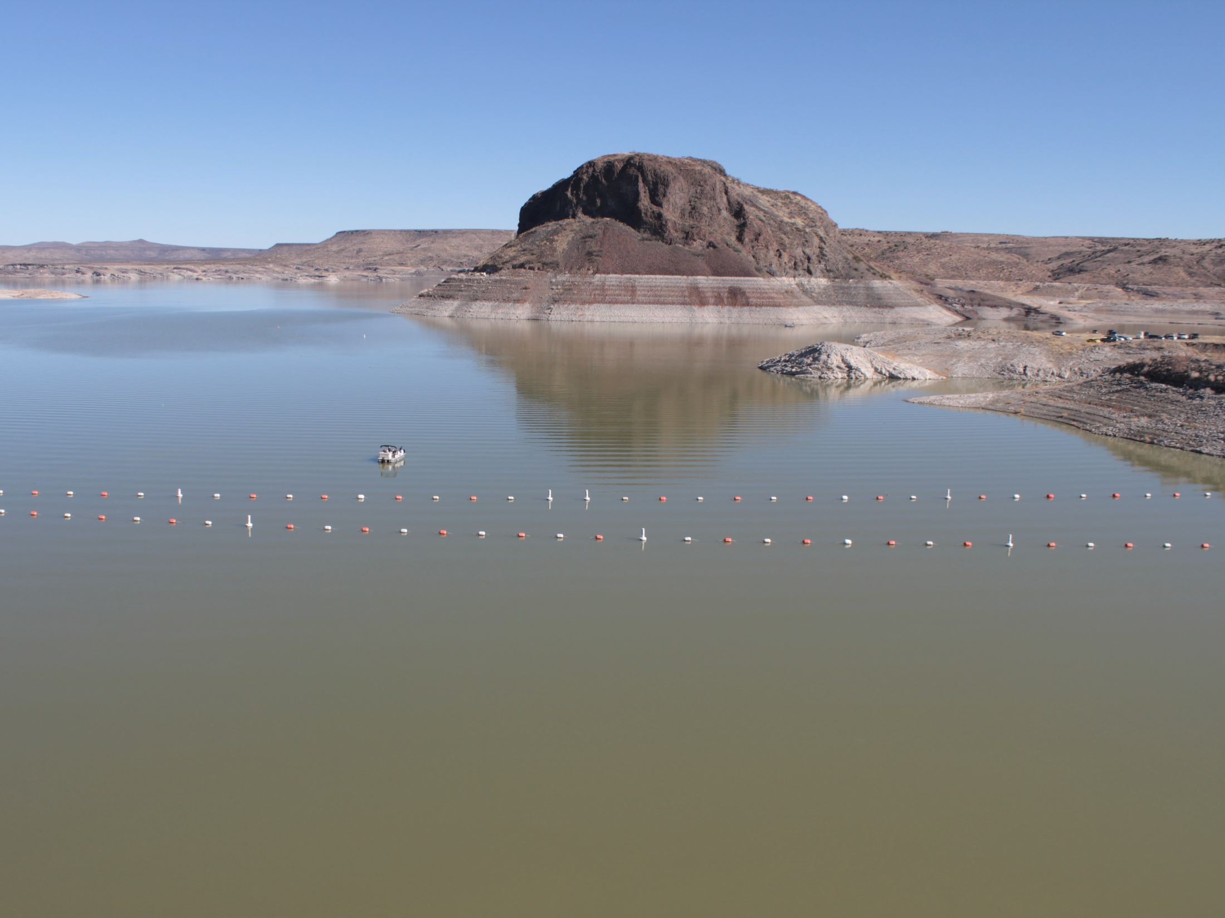
The 2016 Elephant Butte (southern NM) Irrigation District allotment 13 acre-inches, 28 percent of what EBID considers to be a full allotment
This reservoir at about 7.5% capacity

Slide 3
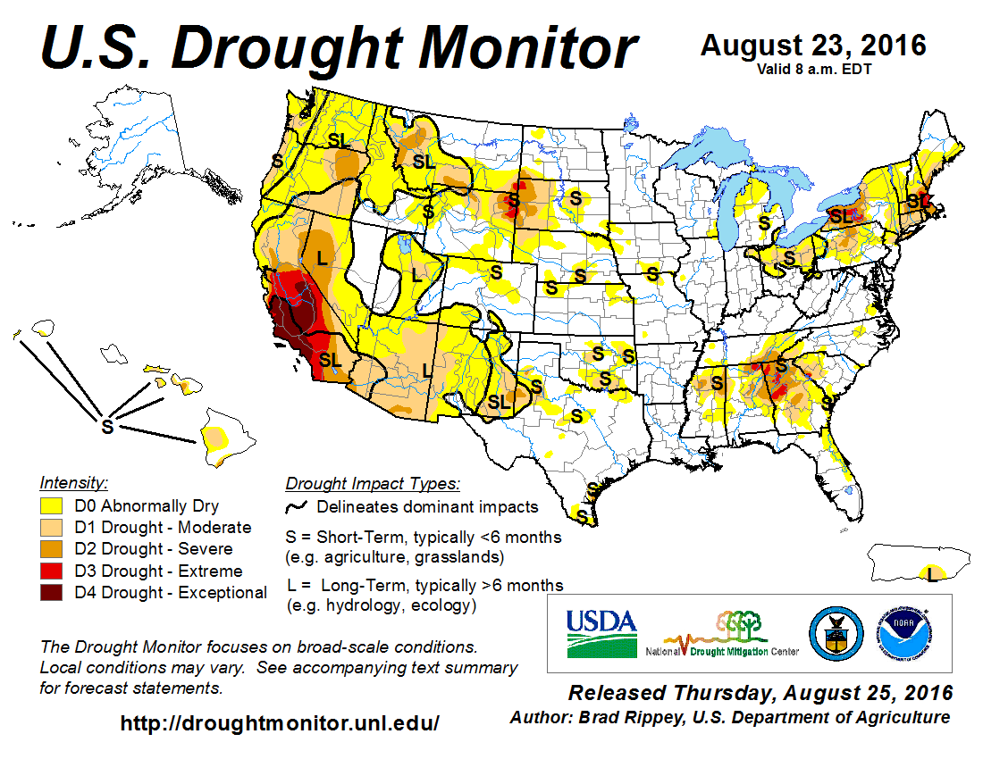

Slide 4
AgMet Network History
Started by Ken Kunkel, the first NM state climatologist in late 1980s
Installed at NMSU Agricultural Science Centers
Currently 12 centers state-wide
Most collocated with NWS cooperative stations
In mid-1990s Ted Sammis created the NM Climate Center and housed hourly data at his lab for >15 years
Sammis’ network all connected through phone lines and Loggernet - dialed in after midnight each day

Slide 5
NM Climate Center Now
Data ingested daily/hourly into MySQL database from Loggernet
Data system: Dedicated PCs on Ubuntu linux using python scripts
Public access on weather.nmsu.edu
Annual operating funds from NM
Funds from grants and contracts
Funds come from National Mesonet contract

Slide 6
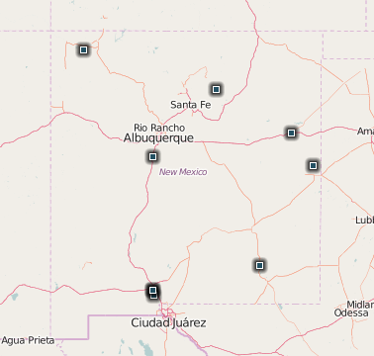
AgMet Station Map
10 active (4 in Las Cruces area)
3 permanently closed
Intend to bring 4 back online (no telemetry, being moved)
Carlsbad
Clayton
Corona
Derry area

Slide 7
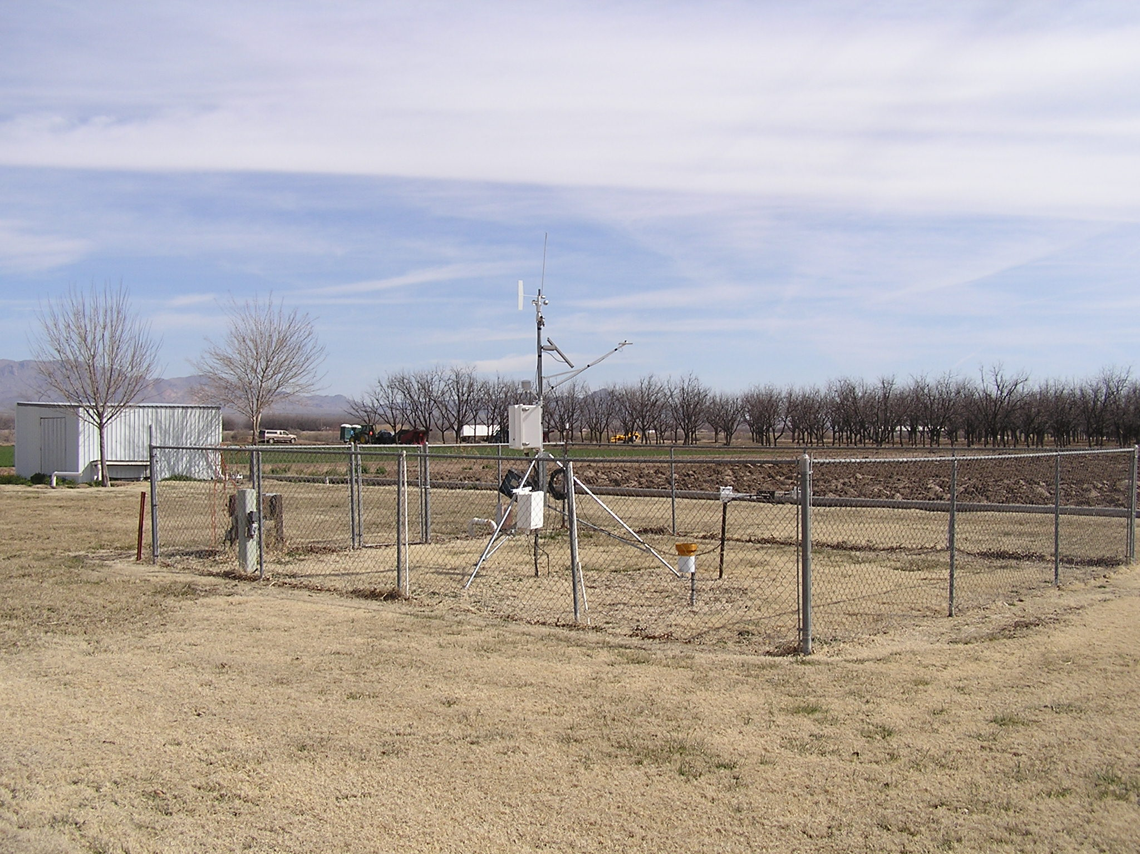
Leyendecker Plant Science Research Center, Mesilla
Pecans, chile, cover crops, alfalfa

Slide 8
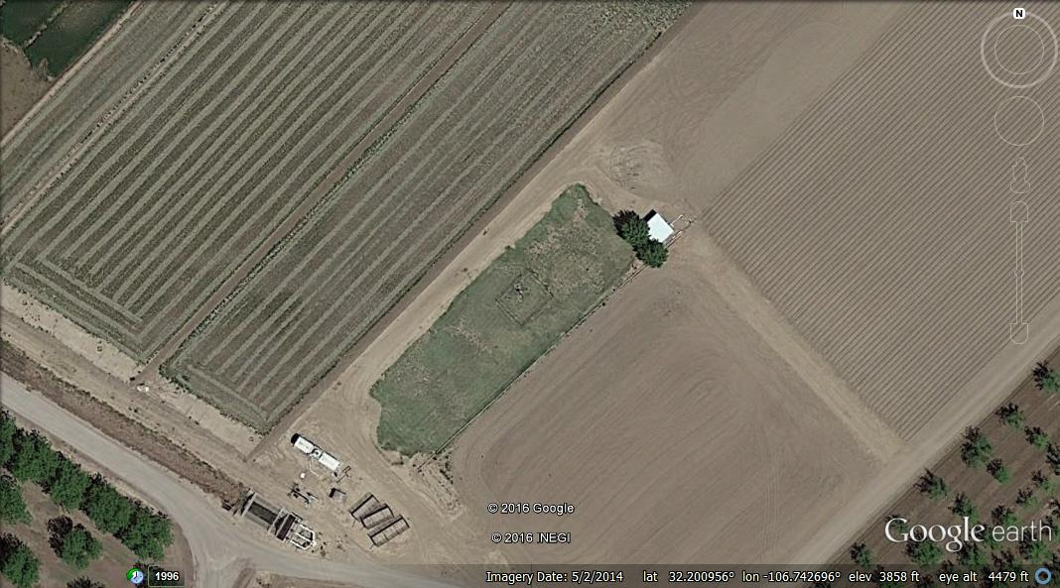

Slide 9
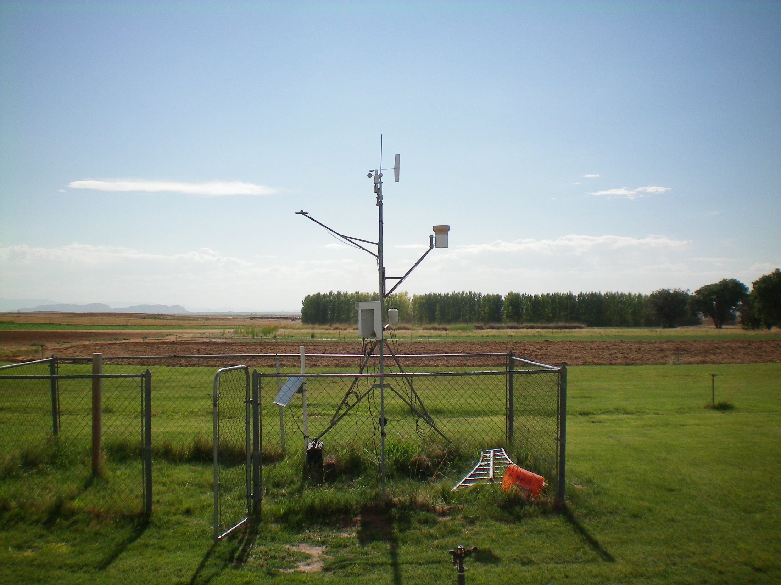
Farmington Ag Science Center
alfalfa, corn, dry beans, potatoes, onions, chile, etc.

Slide 10
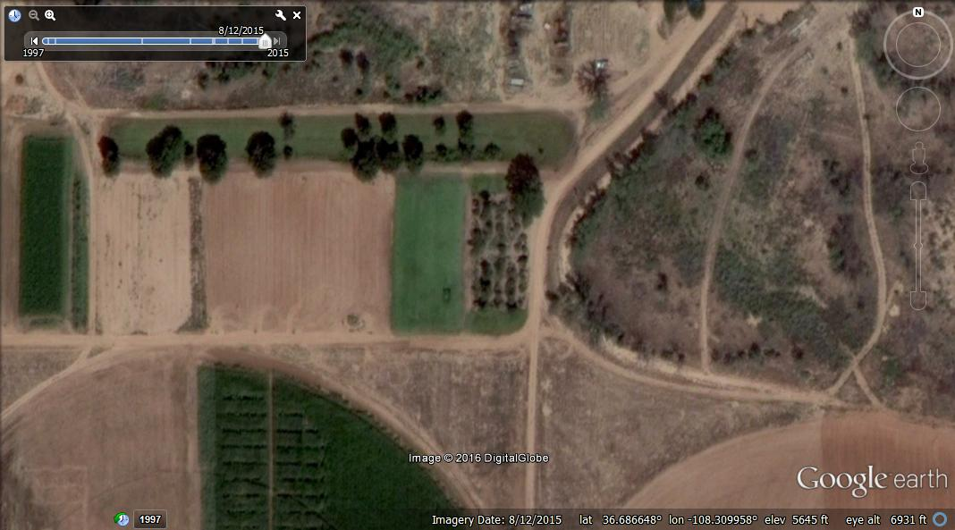

Slide 11
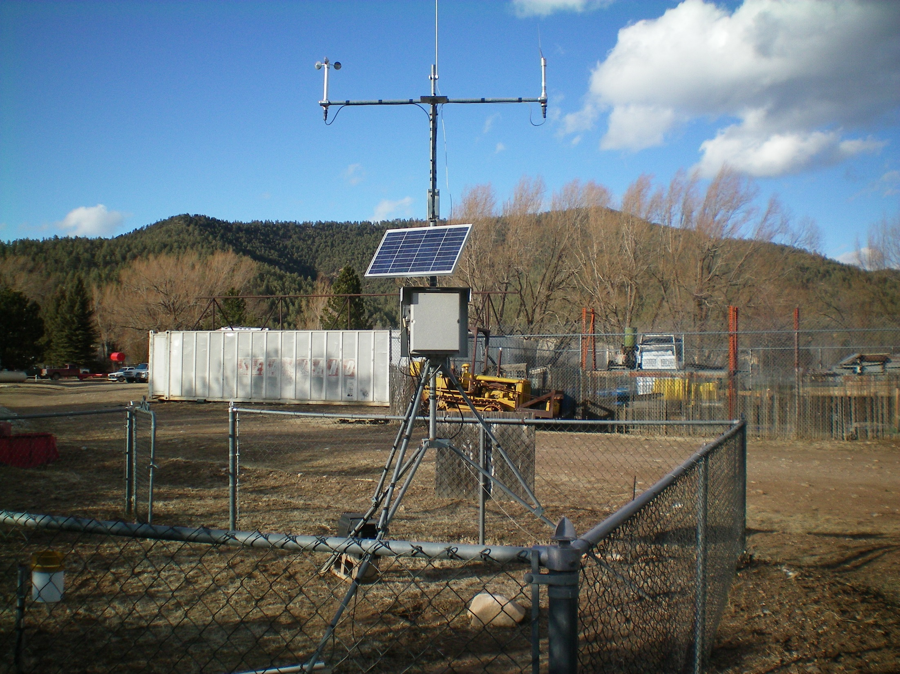
John T. Harrington Forestry Research Center at Mora
Silviculture, reforestation, etc.

Slide 12
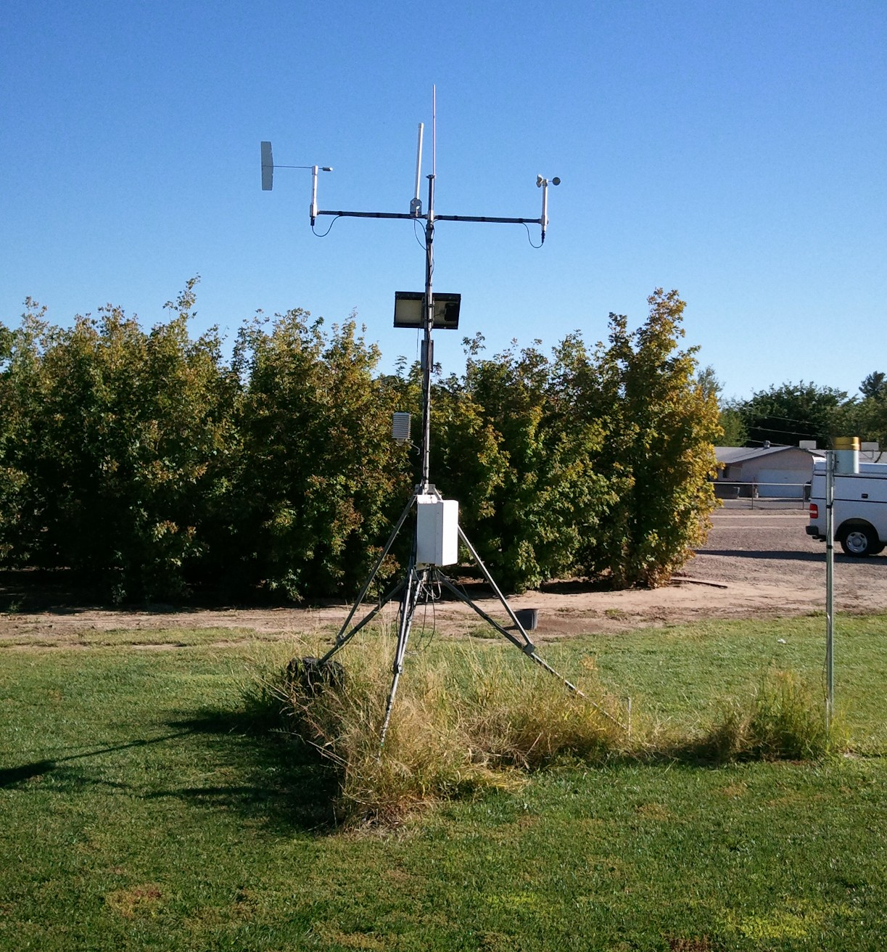
Fabian Garcia Science Center, Las Cruces
Chile, algae, onion, viticulture, turfgrass

Slide 13
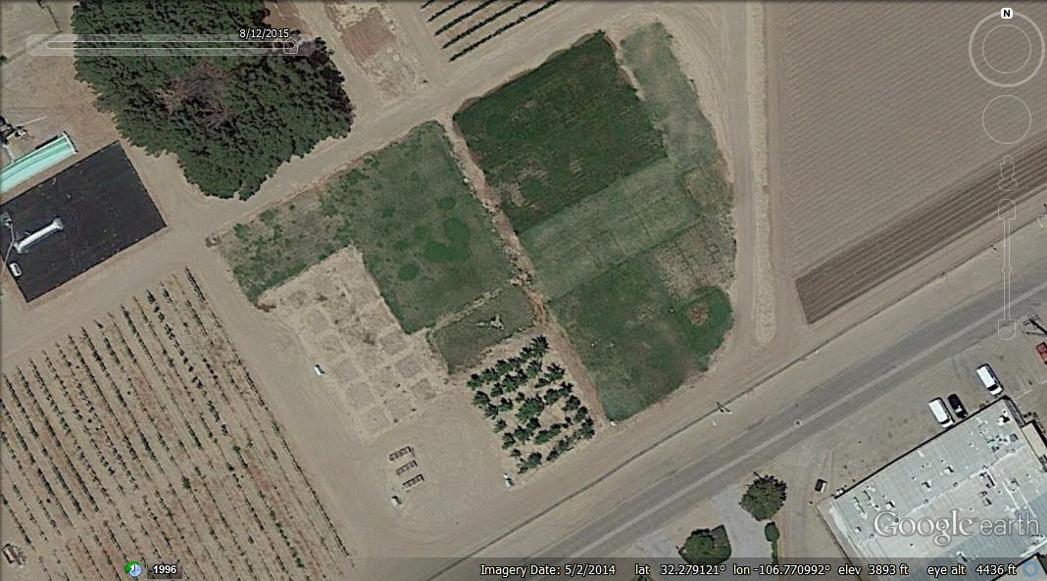

Slide 14
Basic Description: Equipment
Temperature/RH: Vaisala HMP60/50 at 2 m
Precipitation: Texas Electronics TE-525
Soil temperature: CS-107 at 10 cm
winds: Mostly MetOne 034B at 3 m
Solar radiation: Li-COR LI200X
Data loggers: mostly CR10X, few with CR1000
Telemetry: mix of 400MHz RF and telephone, one on Ethernet line
powered with 10W panel, & deep cycle battery

Slide 15
Maintenance Schedule
Since 2010 we started collecting maintenance logs, equipment replacement logs & photos
Starting in 2010 replaced most soil temperature probes, verified sensor heights and depths
Starting in 2013 agreements with local operators assisting in maintenance and operation
Current maintenance
Annual site visit by NMCC staff (Stan Engle, student or me)
No calibrations
Sensor replacements (mainly T/RH) every 3 to 4 years
Windsets are repaired and used again

Slide 16
QA/QC
Daily automated ingest goes through hourly value QC checks
Looks for out of range values, missing data
Assigns a flag if data passes this level
I look at data each day using our website to look for missing and data that looks odd
Plot hourly data for all parameters
I relay odd behavior to Stan and local operator for next steps
Every year the NM State Engineer’s Office performs a QC on physical state of sites and checks data

Slide 17
Path Forward
Upgrade QC and maintenance methodology
Station metadata
Funding
Partnerships
Growers
Across agencies

Slide 18
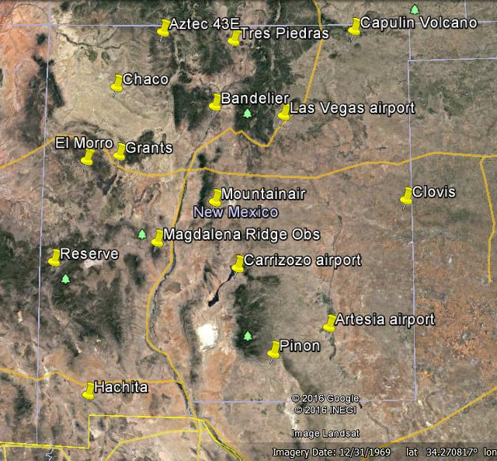
NM USRCRN
Joint effort between NMSU and Park Service
Handover ownerships in 2014-2015
16 total
5 NPS

Slide 19
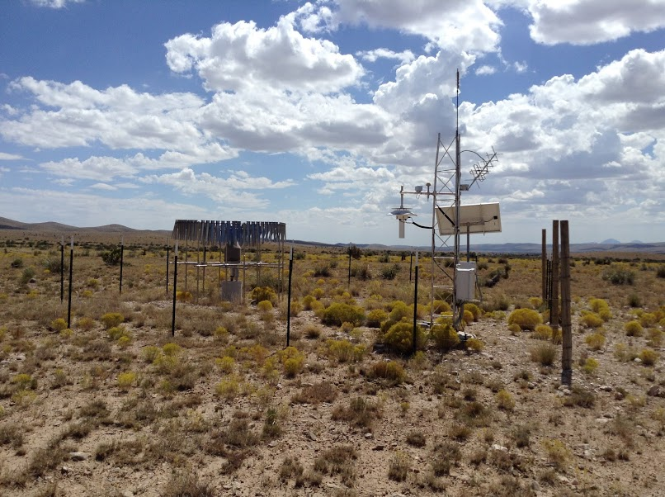

Slide 20
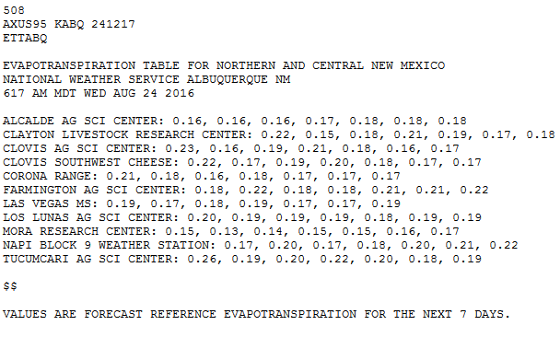
Recent efforts in et
National Weather Service FRET product
Started in Albuquerque office providing us ET at Ag Science Centers in their CWA

Slide 21
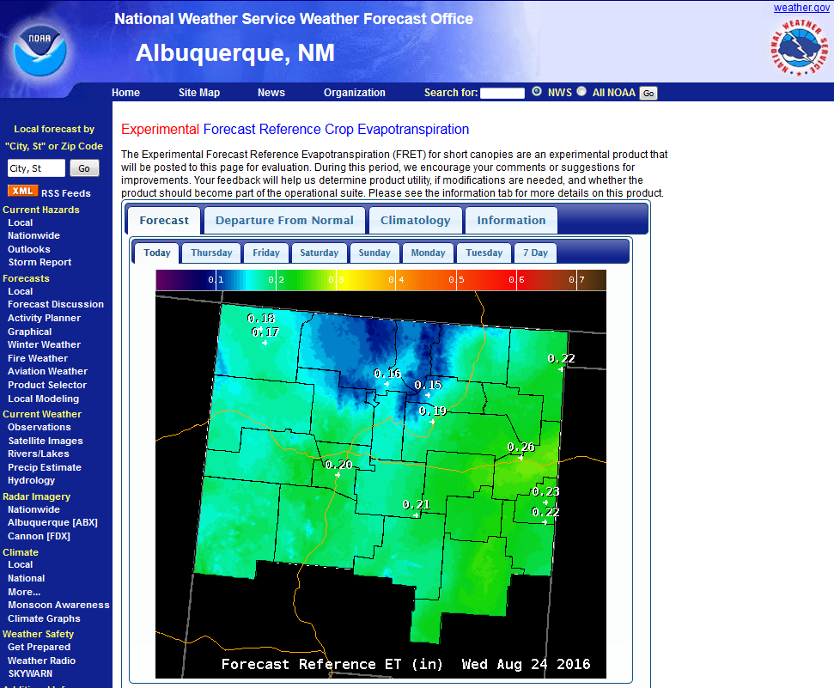
Uses P-M from ASCE-EWRI, 2004

Slide 22
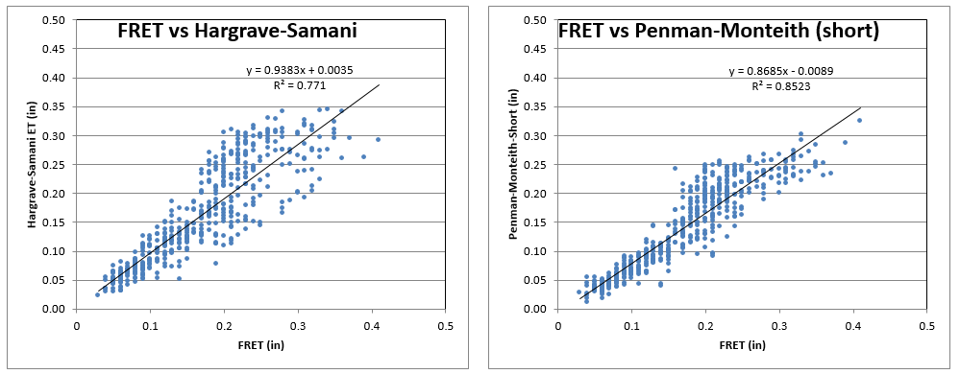
Some quick FRET comparisons
Los Lunas Ag Science Center 2013-2014

Slide 23
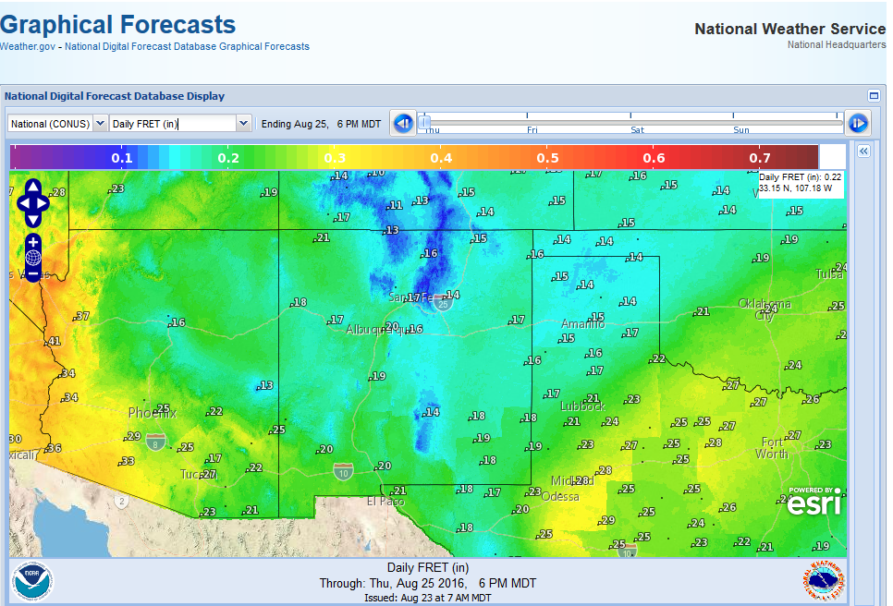
http://digital.weather.gov/

Slide 24
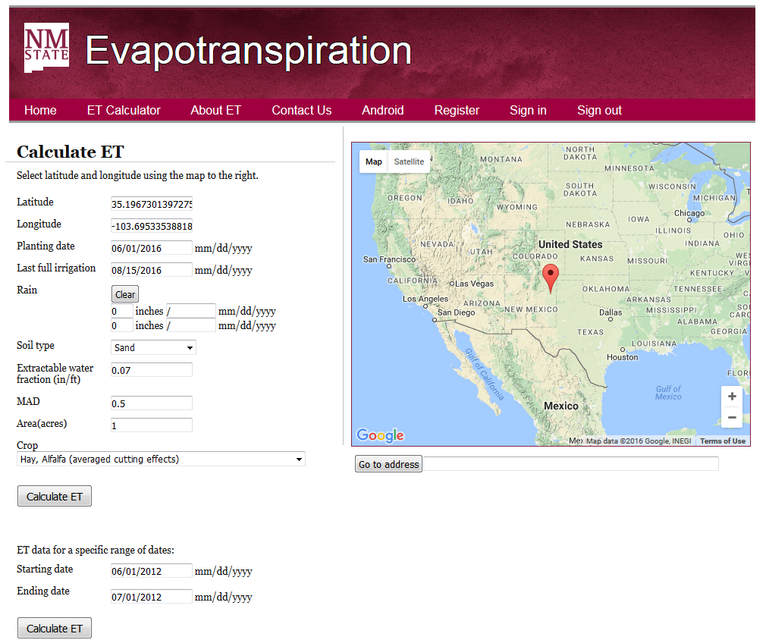
http://nmclimate.nmsu.edu/evapotr/

Slide 25
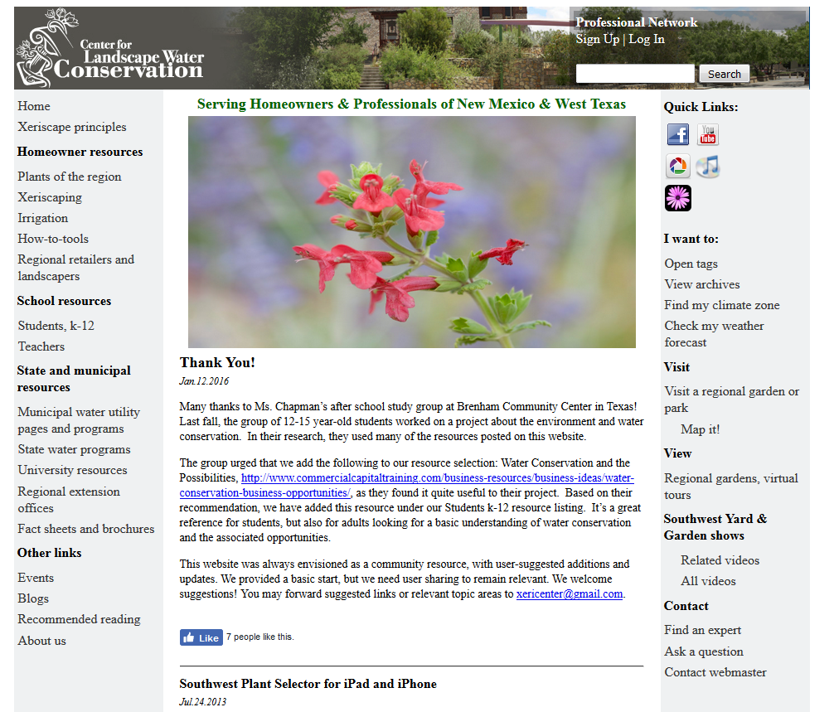
http://www.xericenter.com/

Slide 26
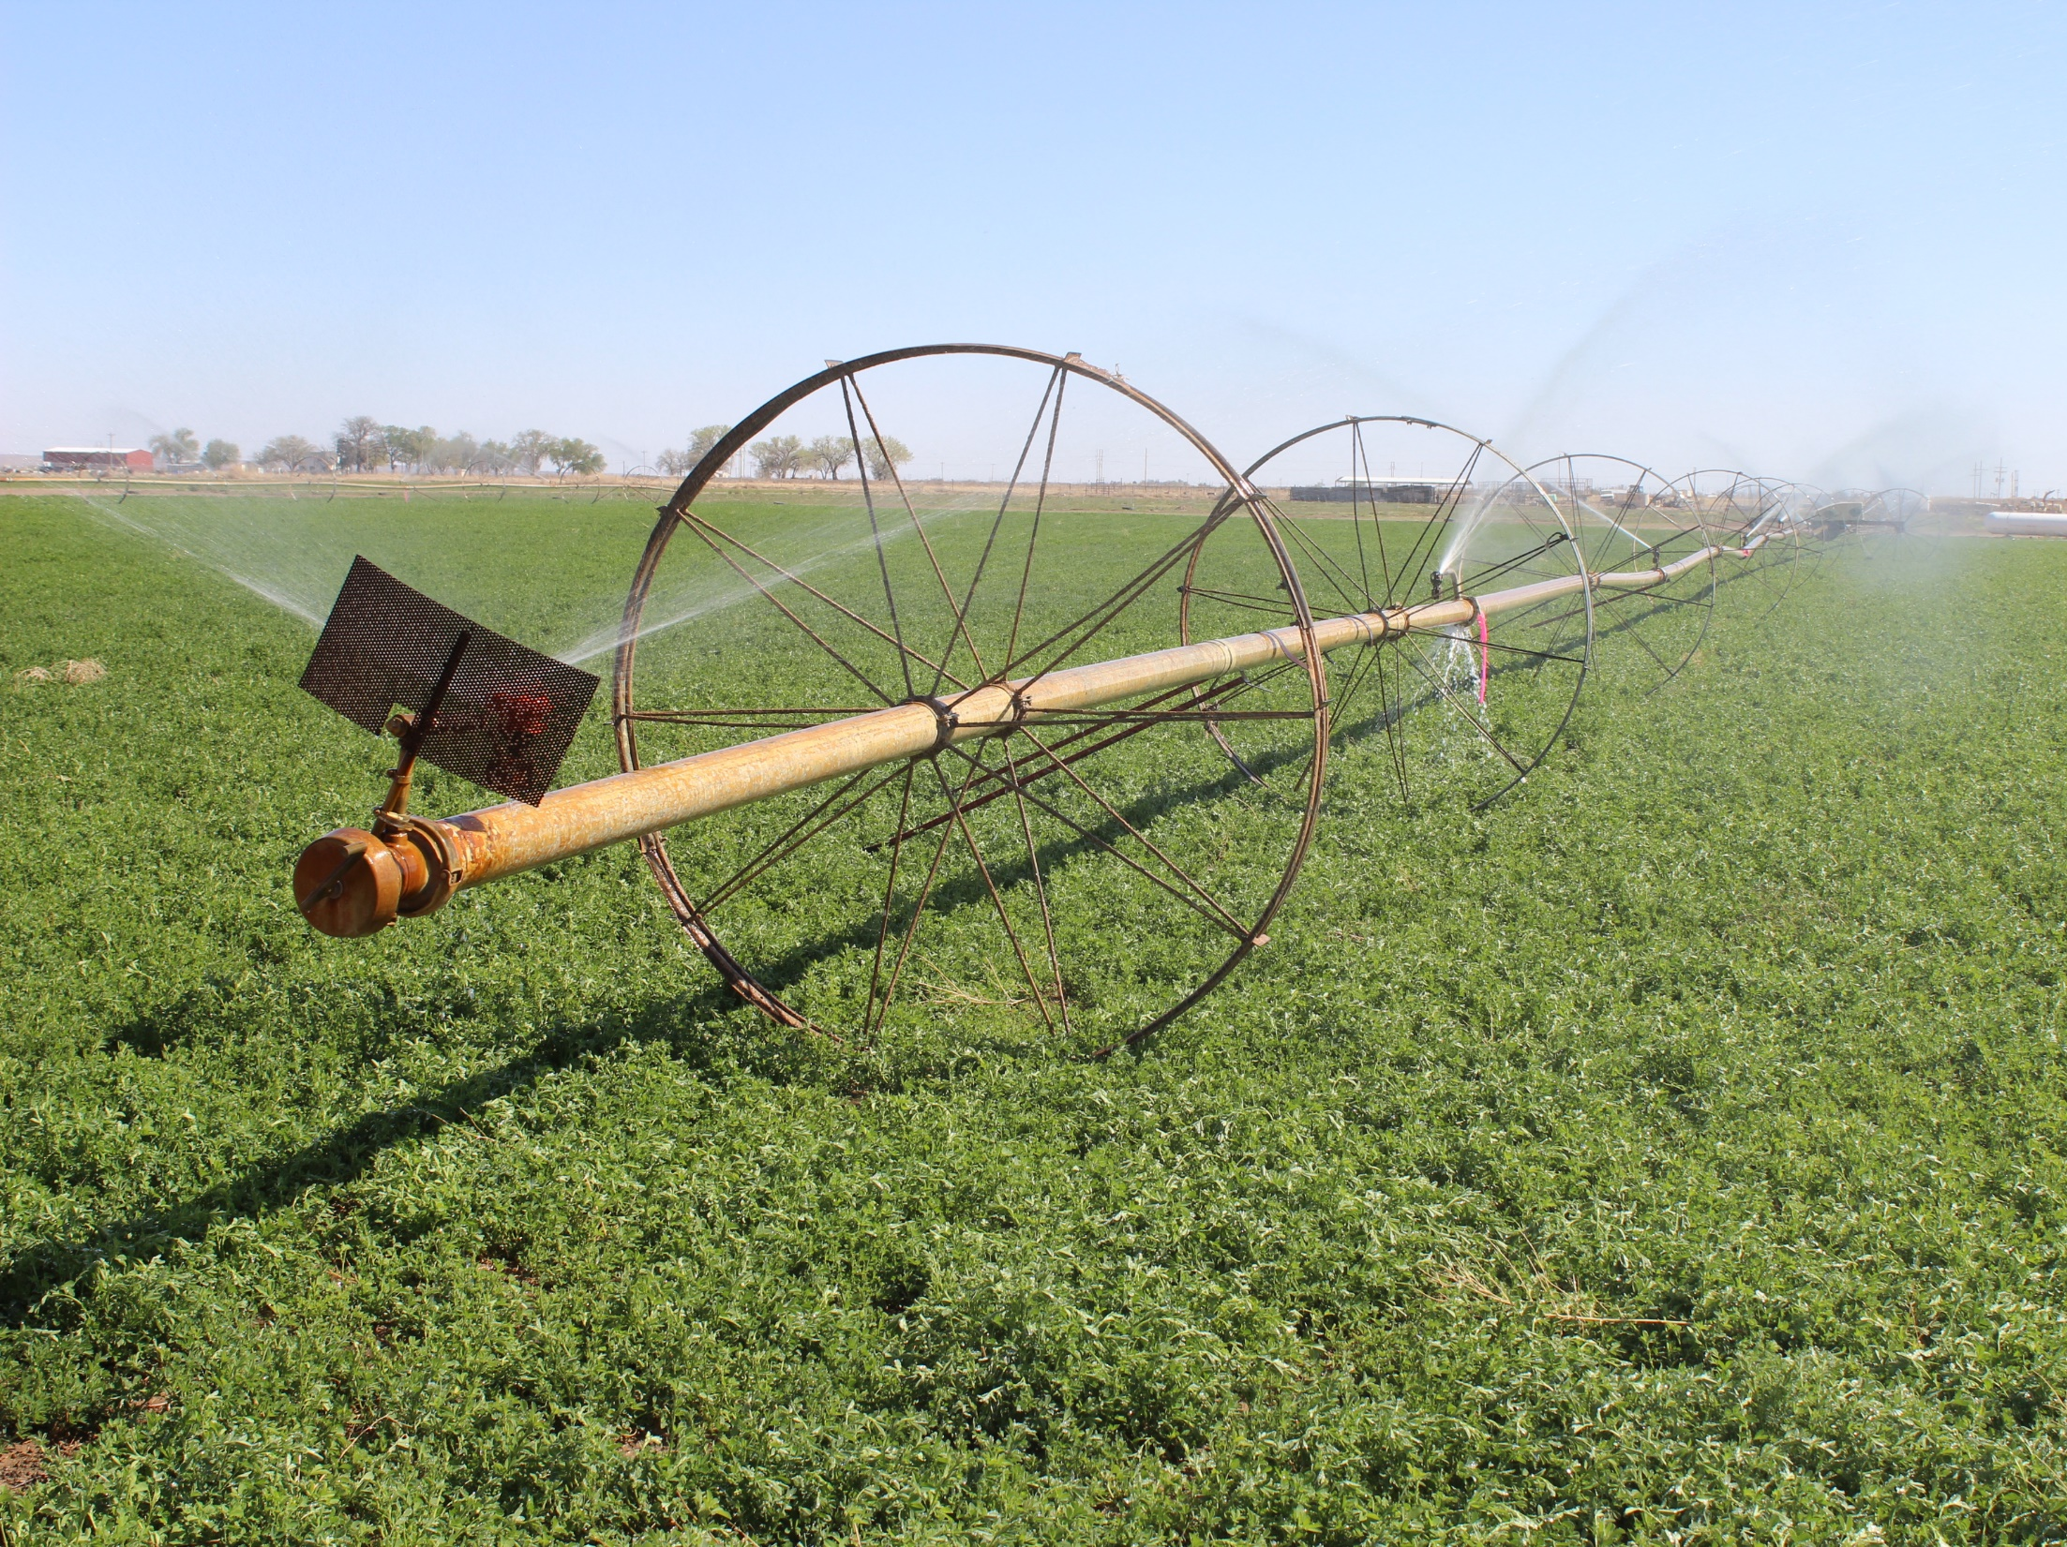
Dr. Dave DuBois State Climatologist New Mexico State Univ.
dwdubois@nmsu.edu weather.nmsu.edu @nmclimate

