Slide 1

THE ARIZONA METEOROLOGICAL NETWORK
Paul W. Brown, Bruce Russell & Ethan Smith
Arizona Cooperative Extension & Dept. of Soil, Water & Env. Science
University of Arizona

Slide 2
Topics for Discussion
Brief Review of AZMET
Challenges in Providing ETos
Arizona ET Activities/Outreach

Slide 3
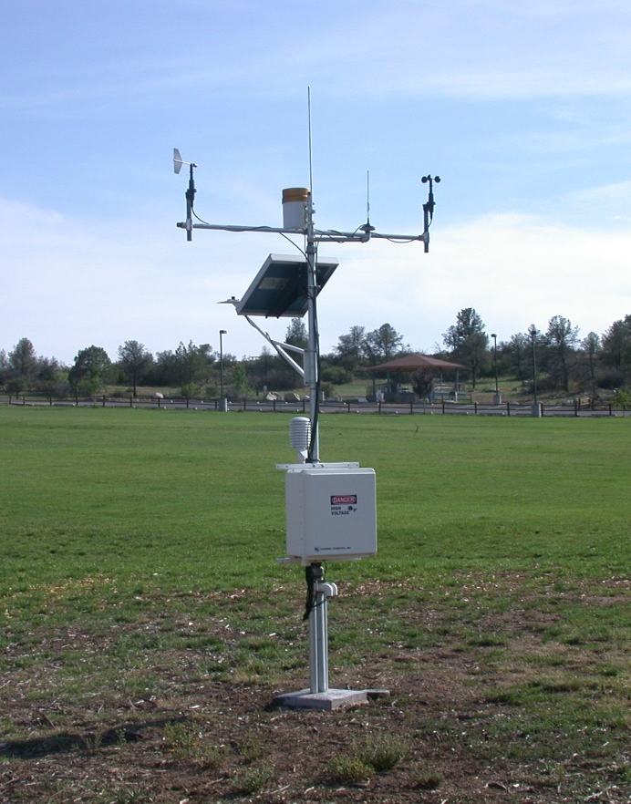

Arizona Meteorological Network
Weather-related information for producers of agricultural & horticultural crops
DATA PROCESSING CENTER
Dissemination
Data Collection

Slide 4
Brief History
1984-85
    AZ Legislative Decision Package Funded…
      10 Weather Stations + Computer System
      Extension Specialist
      No Operating Funds!
    Equipment Purchased & Specialist Hired
1986-87
    Permanent Staff Hired
    Operational: March 1987
      Computer Bulletin Board
    Installed First Urban Station

Slide 5
30 Years Later
Personnel
  Paul Brown, Extension Specialist
  Bruce Russell, Program Coordinator
  Ethan Smith, Maintenance & Calibration
28 Weather Stations
  21 Rural & 7 Urban
  2 In Northern AZ
Dissemination
  Internet/Email

Slide 6
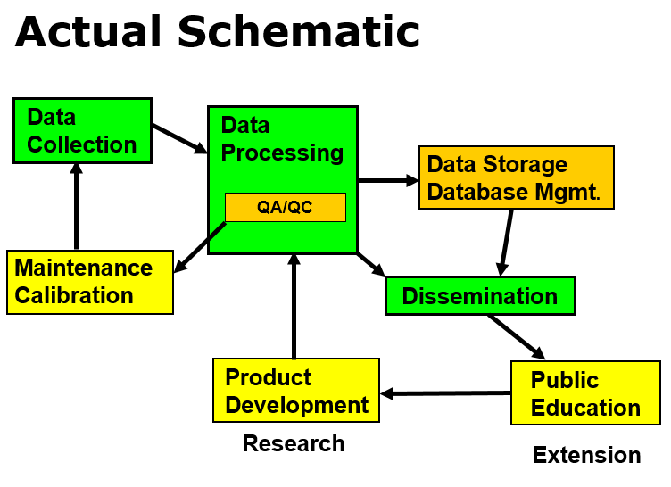
Simple Network Schematic
DATA PROCESSING CENTER
Dissemination
Data Collection

Slide 7
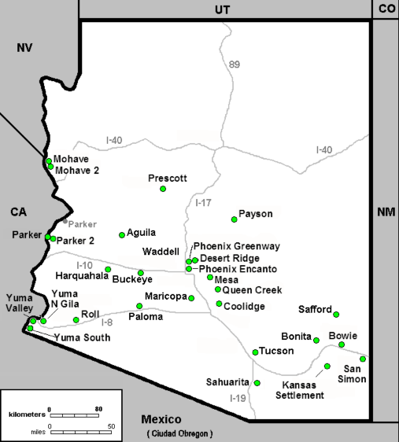
Station Locations
28 Permanent Stations plus 3 to 7 Temporary Stations (Not Shown)

Slide 8

Data Acquisition
Campbell Sci Equipment
Logger Sampling Frequency
  10 Seconds
Summary Periods
  Hourly
    Means, Totals
  24 Hrs @ Midnight
    Means, Totals, Extremes
Data Retrieval
  Daily @ Midnight
  Every 15 Minutes
    Real Time Outputs
Wind Direction
Precipitation
Wind Speed
Solar Radiation
Temperature
& Humidity
Soil Temperature

Slide 9
Station Maintenance
  Quarterly Maintenance (4/Yr)
    Calibration vs. Travel Stds
    Check Power Supply
    Cleaning
    Sensor Rotation/Replacement
      Refurbished/Calibrated
  Quick Checks (4-6/Yr)
    Visual Inspection
    Cleaning/Level Checks
  Emergency Maintenance
    Equipment Failure
    Vandalism
    Weather, Animals, Birds
Mean Travel Distance: Tucson to Weather Station: 168 Miles

Slide 10
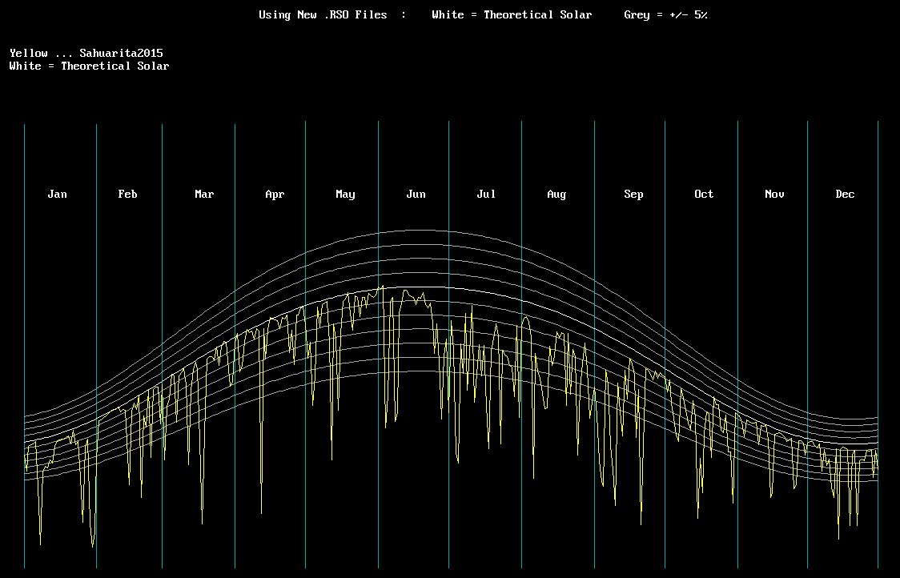
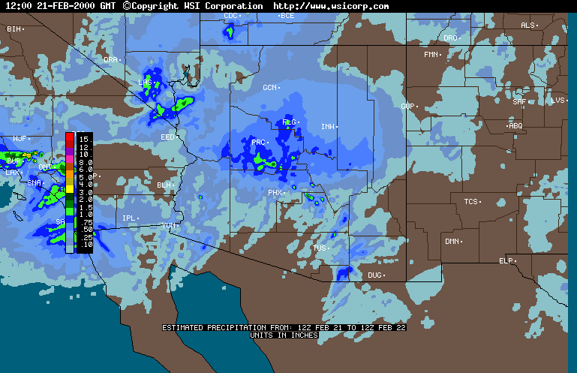
Quality Control
Automated Data Checks
  Data Format
  Physical/Record Extremes
Manual Data Checks
  Graphical & Numerical
    “Nearest Neighbors”
    Non-AZMET Data Sets
  Referrals From Automated Checks
Solar Radiation: Comparison With Clear Sky Estimates
Precipitation: Comparison with Radar Estimates

Slide 11
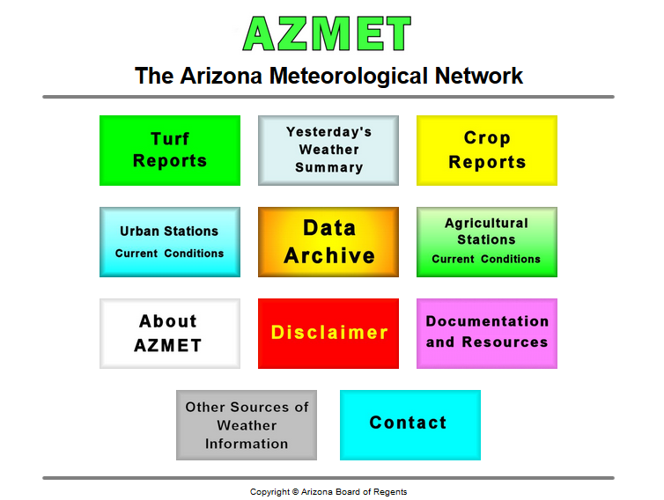
Internet Dissemination
(http://ag.arizona.edu/azmet)
Dust/PM10/2.5
Spraying
Precipitation Events
Frost
Planting (Soil Temp)
ET for Urban

Slide 12
Funding Strategy
Station Sponsorship
    Local Sponsors
    Non-Labor Costs
    25% of Labor
Labor Assistance Grants
    50% of Labor
    Interested Entities
University of Arizona
    25% of Labor
    Variable/Shrinking
A & P Growers | Harquahala Valley Irrigation District
Aguila Irrigation District | Hohokam Irrigation District
Arizona Apple Growers Assn | Mesa Community College
AZ Cotton Research & Protect. Counsel | Mike Harvey Ag.
AZ Cotton Growers Assn | National Pecan Corp.
Bureau of Reclamation | New Magma Irrigation District
Chiquita/Fresh Express | Paloma Irrigation District
City of Phoenix | Queen Creek Irrigation District
City of Prescott | Roosevelt Irrigation District
Cochise & Graham Co. Growers | San Carlos Irrigation District
Colorado River Indian Tribes | Town of Payson
Electrical District 2 | University of Arizona
Farmers Investment Corp. | USDA
Gila Water Commissioner | Wellton/Mohawk NRCD
Fort Mohave Indian Tribal Farm | Willcox Bench Growers

Slide 13
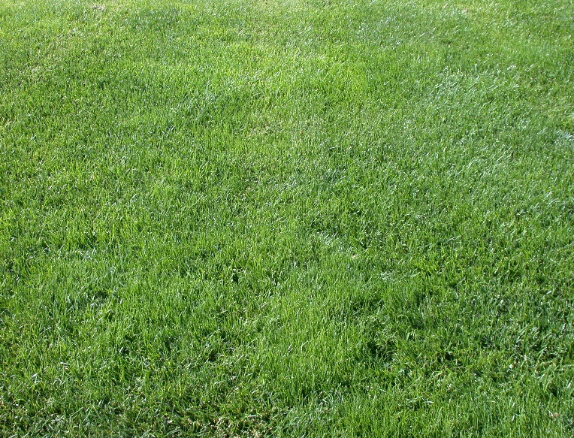
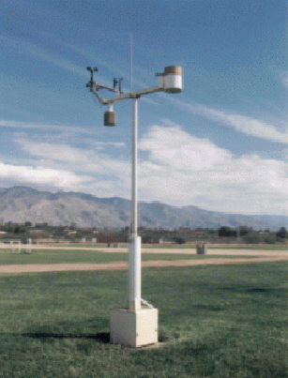
Reference ET
ETos
Penman Monteith Eqn
Computation Procedure
Station Siting
Station Maintenance

Slide 14
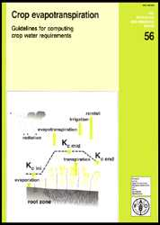
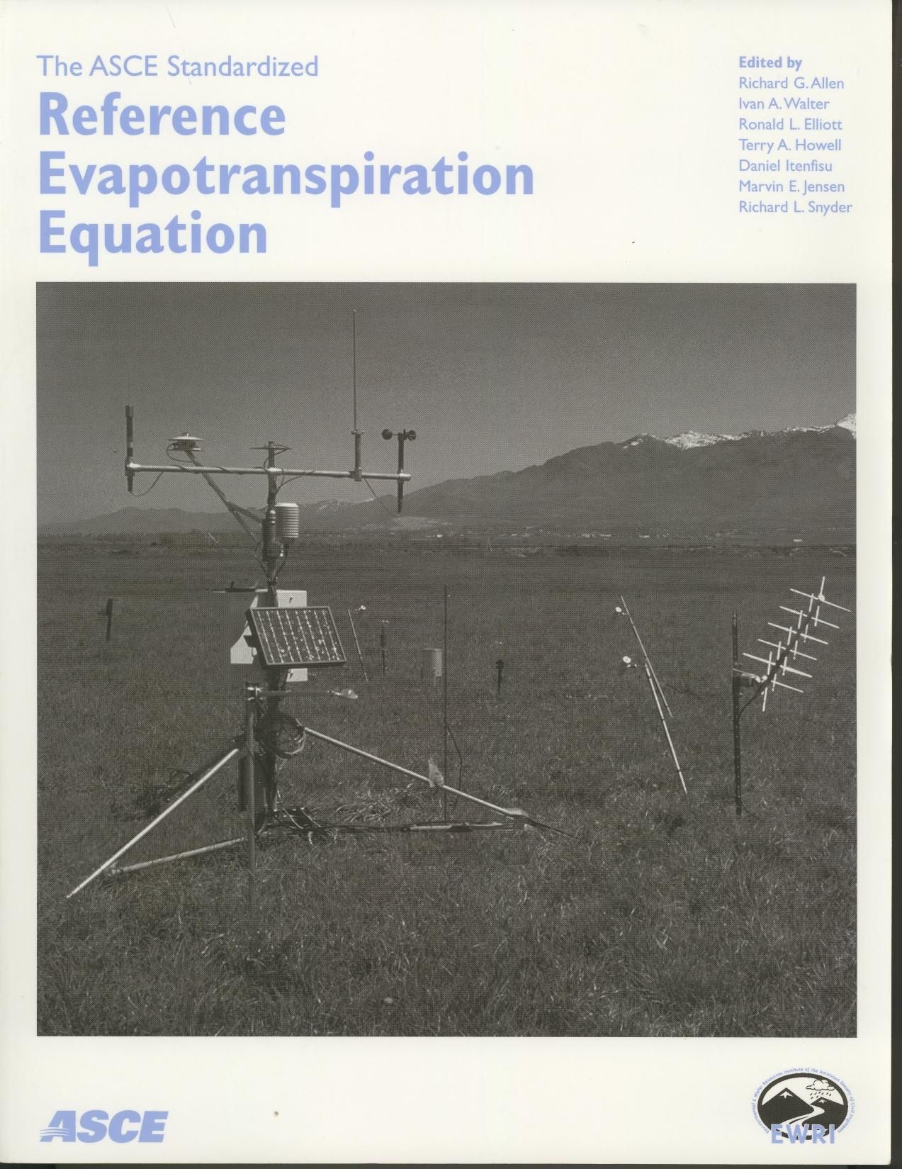
Standardized Computation
Penman Monteith Eqn.
FAO 56: 1998
ASCE: 2005

Slide 15
Siting Weather Stations
Wind
Stations should located in open, relatively level areas away from shade. The station should surrounded by green, well-watered vegetation (turf/alfalfa).

Slide 16
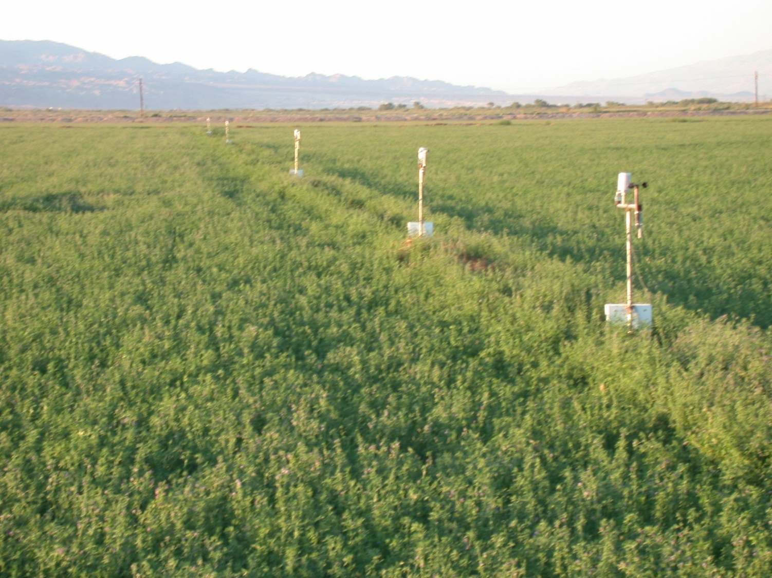
Station Siting Studies
Ft. Mohave Indian Reservation, North of Needles, CA

Slide 17
Station Siting Studies
Ft. Mohave Indian Reservation, North of Needles, CA
Temperature @ 2m
Humidity @ 2m
Wind Speed @ 2m
Solar Radiation (Common)
Wind Flow
25m
100m
Fallow
12.5m
50m
200m
Alfalfa

Slide 18
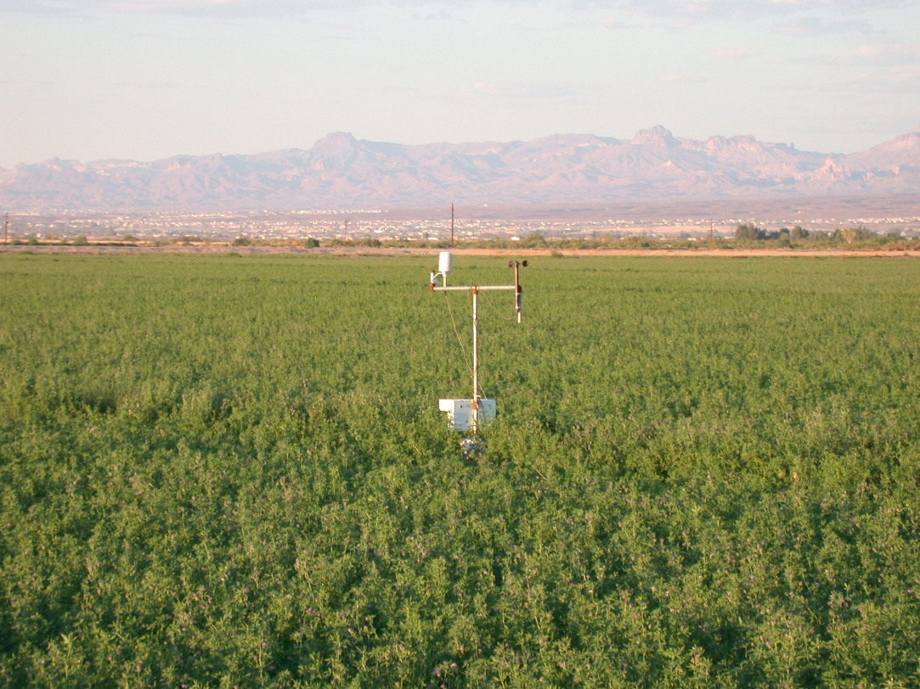
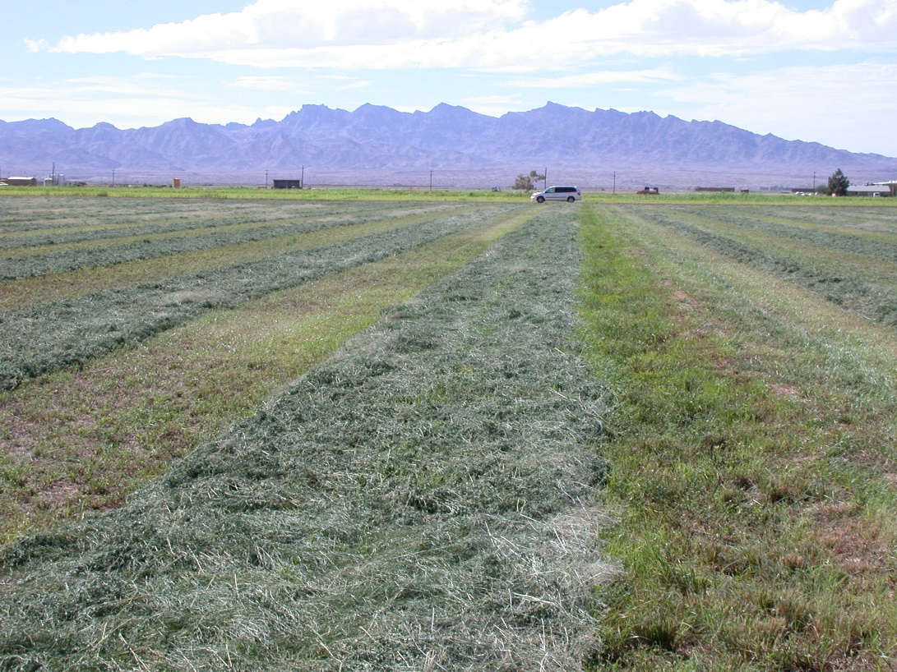
Good Site Until…
Harvest: 5-7 Days Until Irrigation

Slide 19
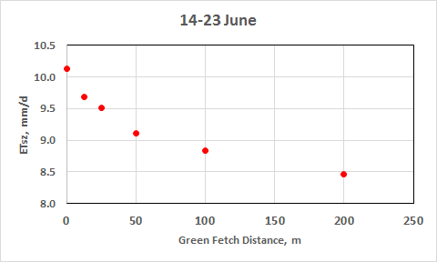
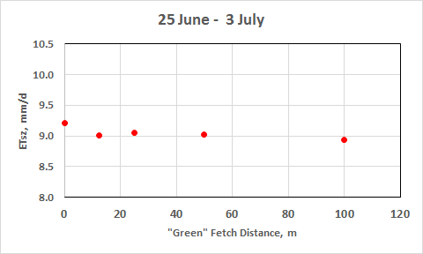
Siting Results
10 Days Prior to Cut
7 Days After Cut
--Fallow Sites: 15-20% Higher
--Ongoing Adjustment at 200 m
--Little Change With Distance
--All Locations Within 3%

Slide 20
Preferred Siting Options
Daytime Winds
100 -200 m
100 -200 m
100 -200 m
4 – 16 ha
2 – 8 ha
Short, Full Cover Crop: Turf, Alfalfa, Wheat/Barely (Winter)

Slide 21
Station Siting
VS
Station
Reference Site
Variable Upwind Fetch (Row/Field Crop)

Slide 22
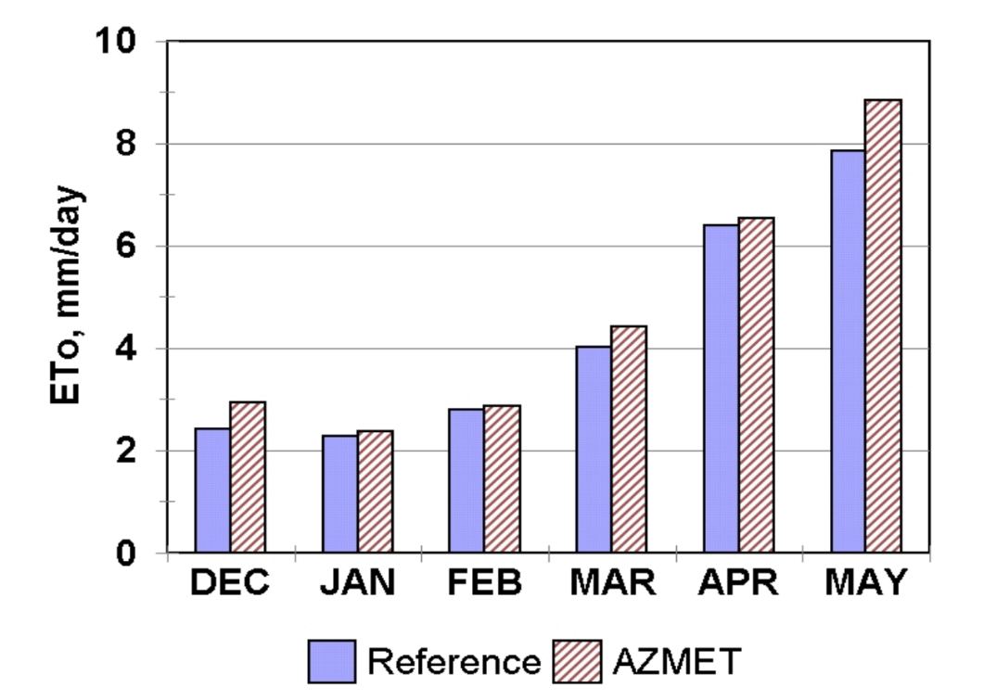
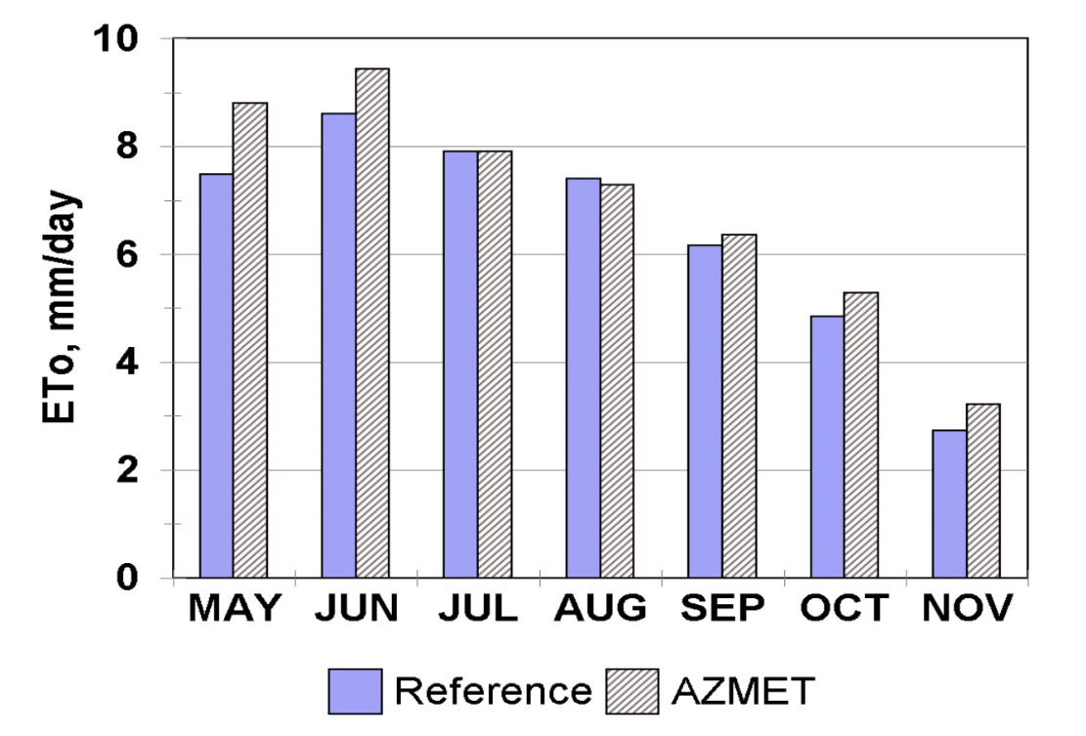
Station Siting
Parker Valley, AZ
Wheat
Jan. – Apr.: 4.3%
Cotton
July – Sept.: <2%

Slide 23
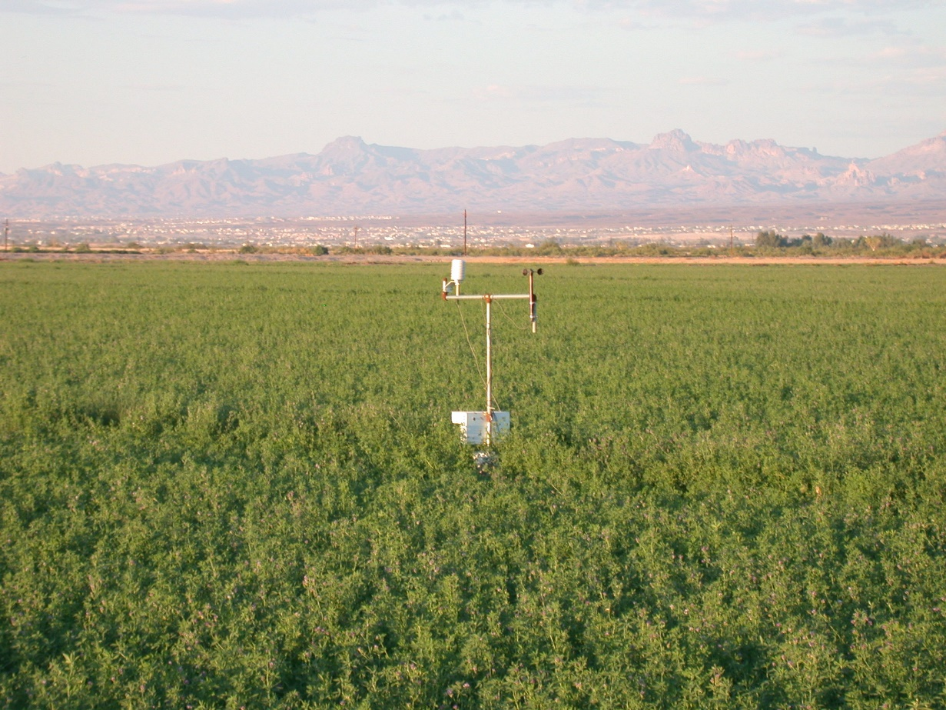
Best Ground-Based Solution
Smaller, portable stations that can be moved when sites degrade.

Slide 24
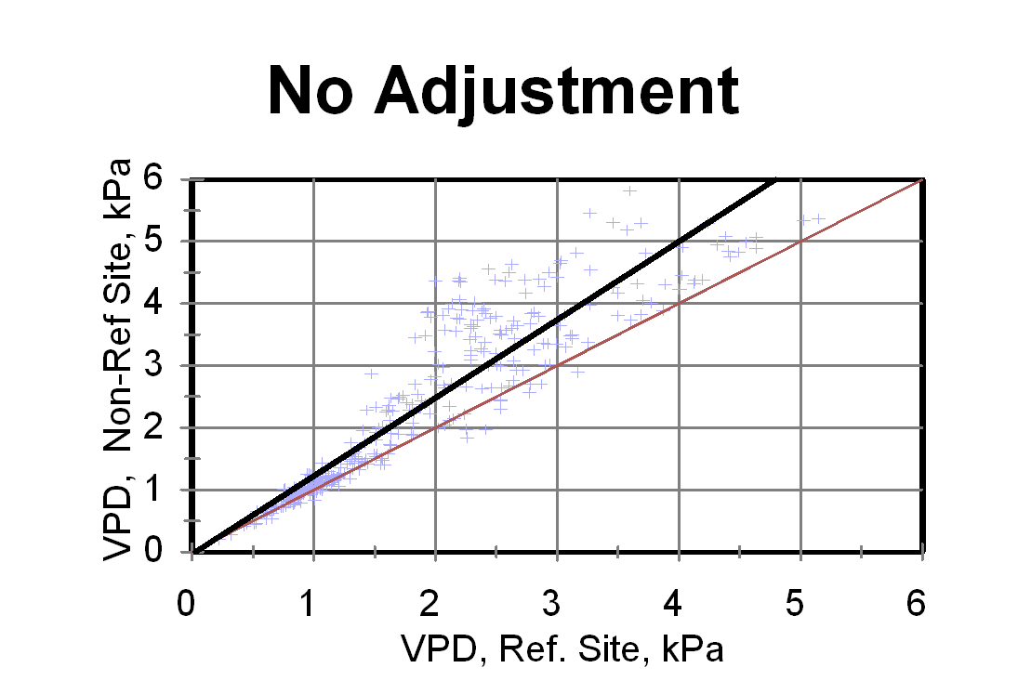
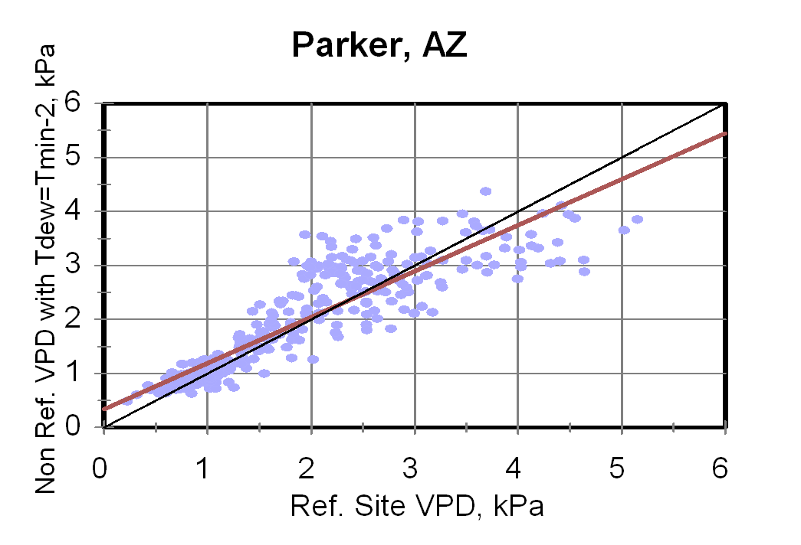
Aridity Adjustment
Non-Reference Stations
Adjusted
Setting Tdew = Tmin – 2 C

Slide 25
Poor Station Maintenance
Low ETos Estimates
Sensor | Impact on ETos
Solar Radiation Contamination | Reduction
Wind Speed Bearing Degradation | Reduction
Temperature/Humidity Humidity Drifts Higher | Reduction
Rain Gauge Funnel Plugging | None Inaccurate Precipitation

Slide 26
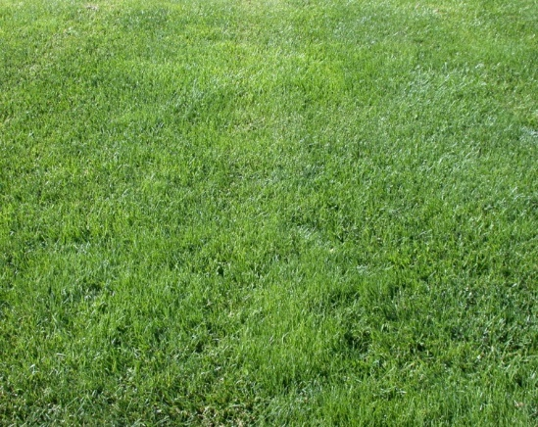
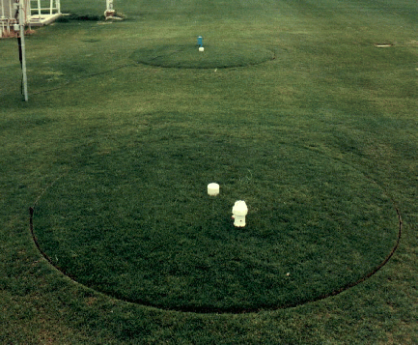
Water Use of Fairway Quality Desert Turfgrass
~29000 Acres of Golf Turf in Arizona
Lysimeters
ET
Crop Coefficients
Estimating Water Use
(Using Reference ET)
Measuring Water Use

Slide 27
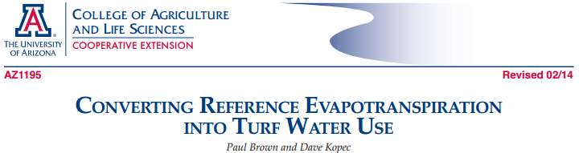
CROP COEFFICIENTS
For Desert Turf
Turf | Turf Quality
 | Maximum | Good | Acceptable | Minimum
Overseeded | 0.83 | 0.75 | 0.68 | 0.60
Bermudagrass | 0.80 | 0.70 | 0.60 | 0.50
Source: Brown et al., 2001. Crop Sci. 41:1197-1206.
Maximum: highest quality golf & sports turf, irrigated daily
Good: high quality golf & sports turf, irrigated every 2-3 days
Acceptable: parks & schools
Minimum: marginal to acceptable quality turf

Slide 28
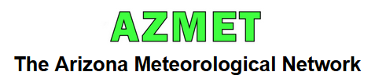
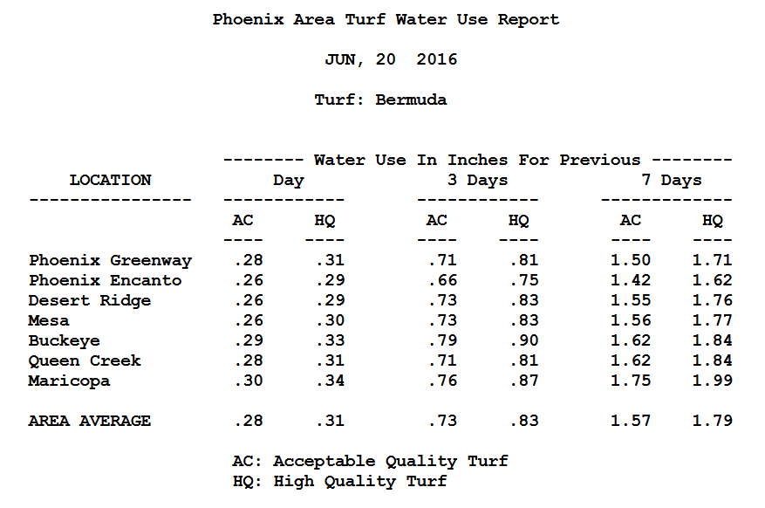
Distribution of Turf Water Use Information
Updated daily & free of charge
Available by internet or delivery via email listserv

Slide 29

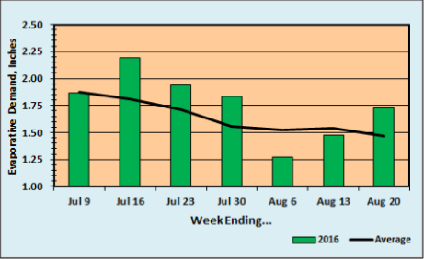
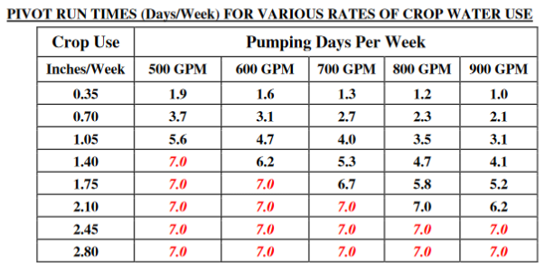
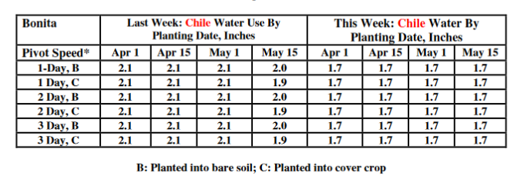
Reference ET vs Normal
Crop Water Use: Last Week & This Week

Slide 30
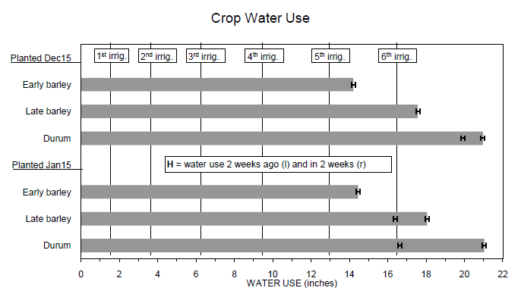
SMALL GRAINS ADVISORY
Developed By Mike Ottman Using AZMET Data
- Grows Crop Using Thermal Time (Degree-Days)
- Estimates ET Using ETo and Kcs
- Accumulates ET and Provides Estimated Times for Irrigations

Slide 31
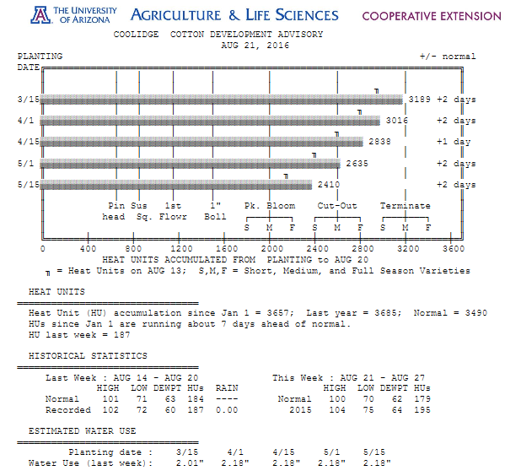
Generated Weekly for 14 Locations

Slide 32
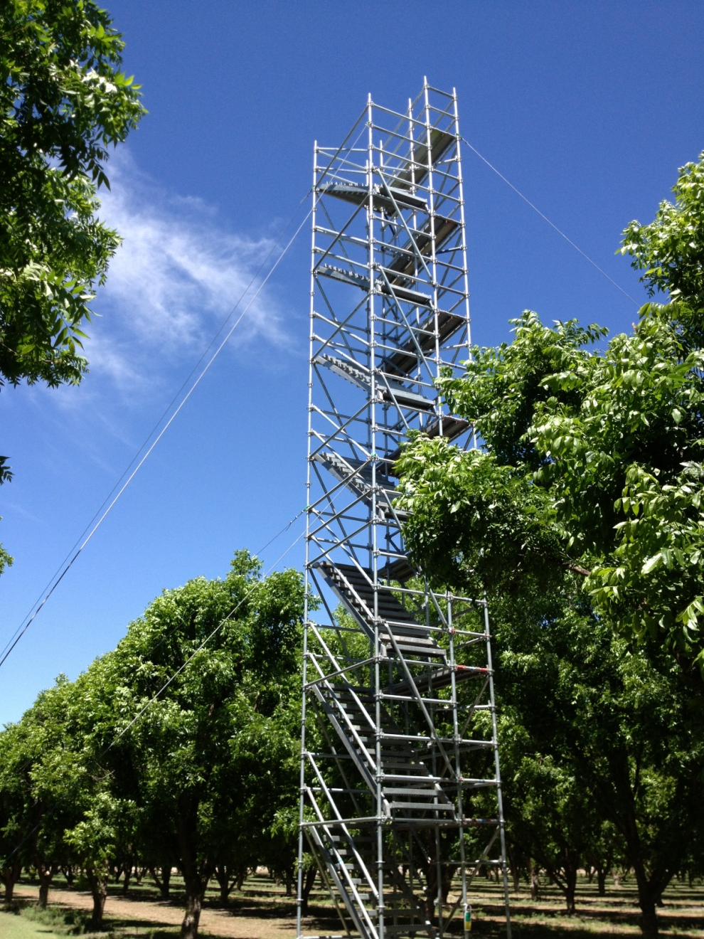
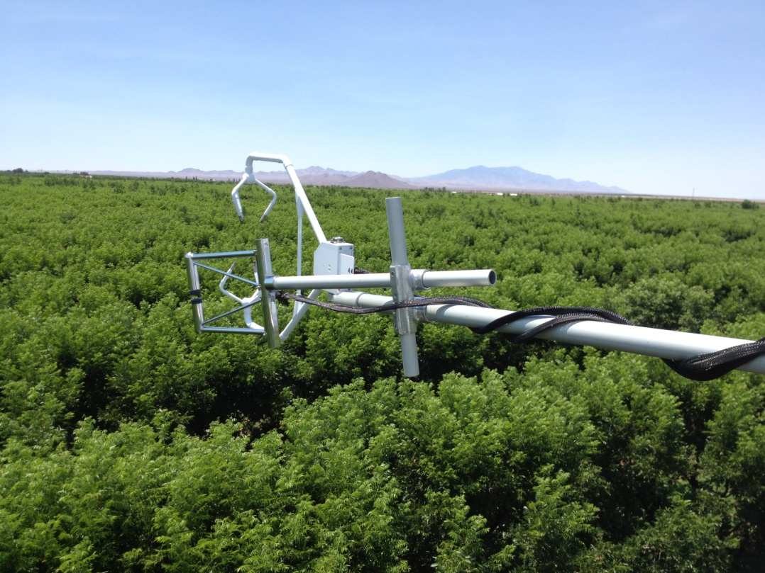
Updated/New Crop Water Use Data
Irrigation Management
Water Supply Concerns
Location of Orchards
Eddy Covariance Towers

Slide 33
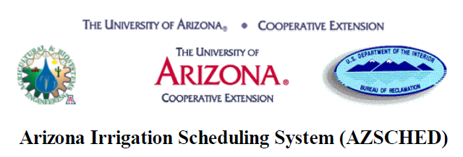
Inputs (Paychecks)
  Irrigation
  Precipitation
Outputs (Expenditures)
  ET or Consumptive Use
  Drainage
  Runoff
Goal (Avoid Overdraft)
  Positive Soil Water Reservoir
  Avoid Plant Stress
Checkbook Irrigation Scheduling
Windows Based Irrigation Scheduling Software (Windows NT, 98, XP)
http://ag.arizona.edu/crop/irrigation/azsched/azsched.html

Slide 34
Thank You!

