Slide 1
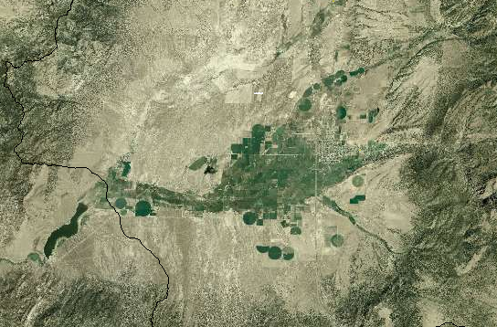
Utah Division of Water Resources
Water Budget Process
July 21, 2011

Slide 3
Surface flows and diversions
USGS Stream gauges
Reservoir storage and release records
Municipal potable and secondary diversion records
Diversion records from river commissioners
Water rights
USGS mean annual reach estimates
USGS Streamstats
Area Altitude
Other irrigation company records

Slide 4
Reservoir operations
Elevation-Area-Capacity tables gathered from State Engineer’s data, USBR records and past Water Resources studies.
Historical records obtained from irrigation company, federal or state archives.
Rainfall and evaporation estimates from PRISM data and Research Report 145.

Slide 5
Groundwater flows and diversions
Agricultural groundwater pumping from “Groundwater Conditions in Utah” estimates proportioned to subareas
  Outside of major groundwater development areas, pumping allocated using Water Rights wells proportioned for use that year ≈ 5% of total.
Municipal groundwater usage from Division M&I Reports
USGS estimates of basin groundwater flows used to refine basin yield

Slide 6
Municipal and Industrial Consumptive use
Municipal records collected every 5 years
Water use records tabulate water use by:
  Community systems
  Non-community systems
  Self-supplied industry
Commercial and Institutional uses are broken out into indoor and outdoor use.
Half of outdoor irrigation is assumed to be consumed.
A smaller portion of indoor use is consumed.
  If evaporation ponds are used by system, that portion in excess of pond evaporation returns to system. Each system’s water treatment methods are tabulated.
Sources of supply (surface, groundwater, springs) for each system are identified.

Slide 7
Crop potential consumptive use
Crop acreages surveyed every 5 years
Cropland potential consumptive use
  Blainey-Criddle crop coefficients from USU Research Report 145.
Soil moisture capacity from crops and STATSGO soils data.
Monthly temperature and precipitation from PRISM.
  Cropland precipitation assumed to be 80% effective.
  Winter carryover soil moisture reduced by 35%.

Slide 8
Crop potential consumptive use-cont.
Cropland potential ET estimates aggregated within 12-digit HUCs.
Conveyance and on-farm efficiency by county provided by USU
  corrected for individual subareas as needed.
Shortages occur whenever crop demand exceeds available supplies (surface diversions, pumped groundwater or available soil moisture)
Actual crop consumptive use is equal to potential consumptive use minus (shortages times irrigation efficiency).

Slide 9
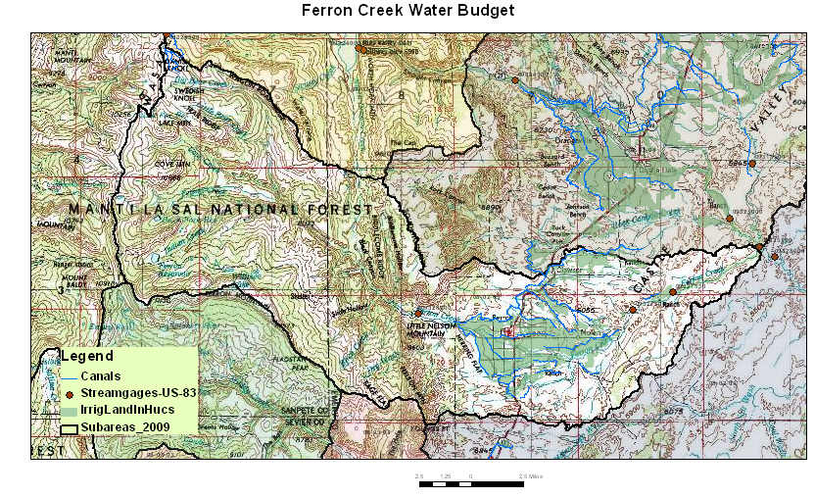
Water Budget Process
GIS maps are produced that show the relationship between cropland, municipalities, stream networks, stream gauges, pour points and reservoirs.

Slide 10
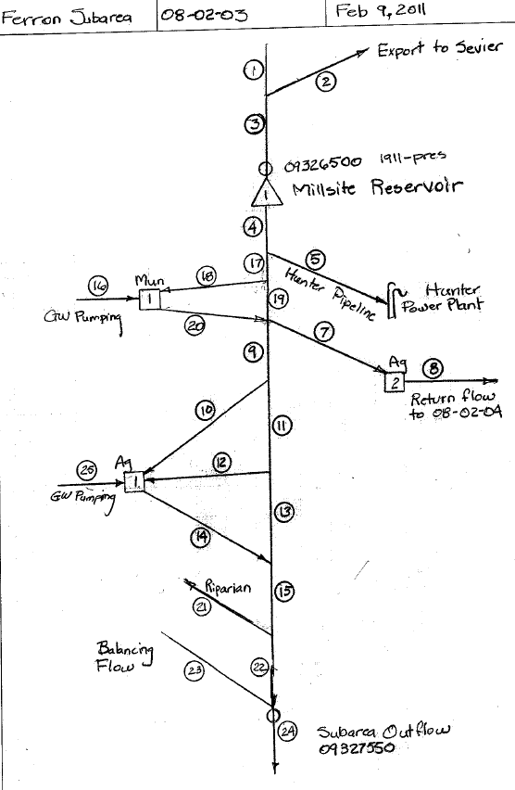
Modeling Process
Flow logic diagrams

Slide 11
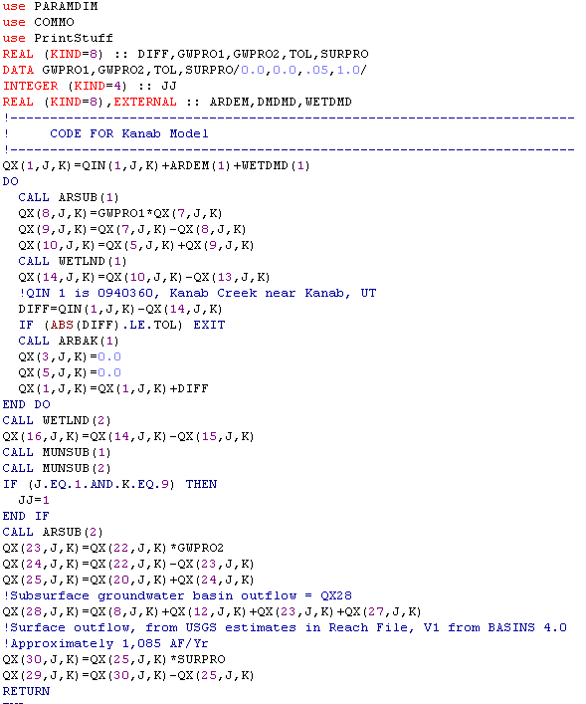
Coding

Slide 12
Documentation
GIS map
Logic diagram
Narrative description of assumptions and data
Model printouts
Database of important information from final run

Slide 13
Budget output
Monthly and annual values for:
Total Precipitation
Natural System Use
Total Surface Supply
Total Groundwater Use
Inflow
Outflow
Agricultural Diversions
Agricultural Depletions
M&I Diversions
M&I Depletions
Wetland Depletions
Yield

Slide 14
Potential future improvements
Adopt ASCE Penman Standardized ET calculation methods in the near future.
Explore methods to make annual irrigated cropland survey updates.

