Slide 1
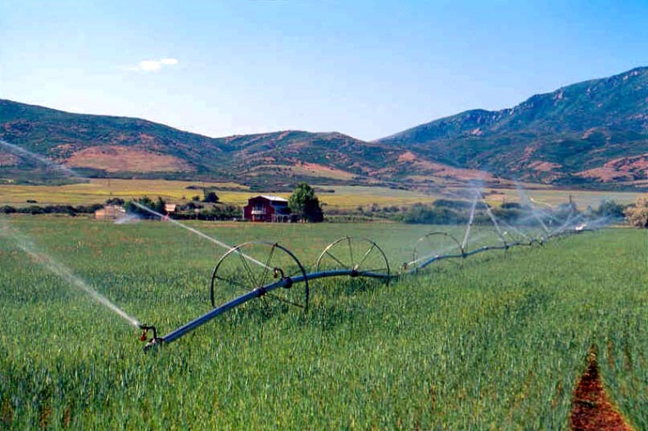
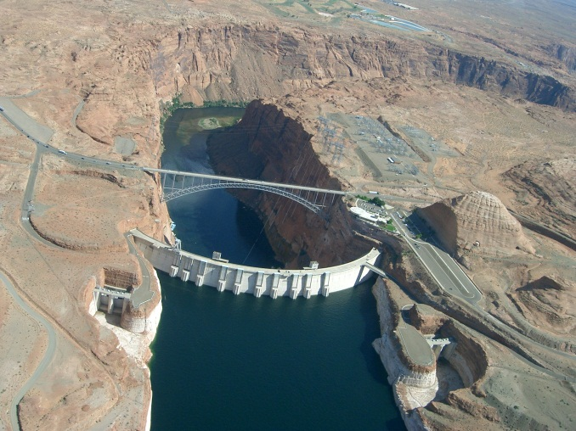
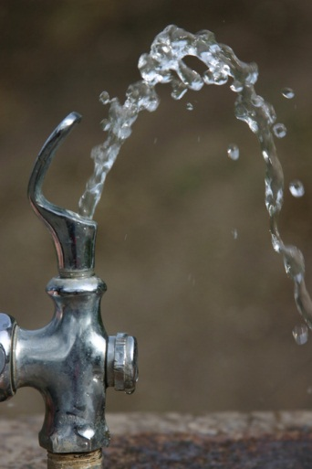
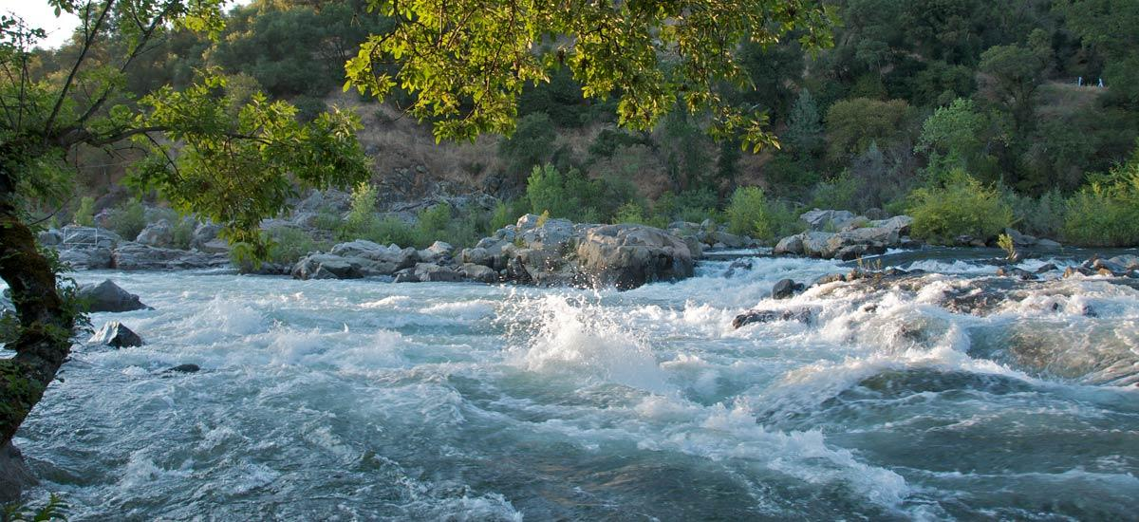
State Water Budgets
Craig Miller
Utah Division of Water Resources
September 27, 2016
Notes:
Thank you for coming
We have just finished our first round of water budgets
No one in our office has seen what you will see—all results are preliminary
The results haven’t been reviewed if this is ever presented again you may see slightly different results.

Slide 2
Motivation
STATE NEEDS to know:
Total Water Use (surface and groundwater)
MUNICIPAL AND AGRICULTURAL DEPLETIONS
TRENDS
  Changes in Land Use
  Conservation
  changes in Irrigation Methods
  Yield
Recent audit calls for better data
  Plans for Billion dollar, controversial projects

Slide 3
Specific issues
Colorado river compact
  Lake powell pipeline
Bear river compact
  Bear river pipeline
Great salt lake historic low elevations
  Iwrmm basic data needed
  Identify Man’s impact on the lake
  Wildlife and industry in peril
Utah’s population double by 2060
16 year drought

Slide 4
unresolved
How do we determine depletion? (human impact on streamflows)
Common definition for consumptive use?
How to test our concepts?
Where’s the data?

Slide 5
A thorny Problem
For any model, how we calculate depletion and consumptive use is a significant factor in the computed results.
There are developing standards but nothing agreed upon yet.
ground truthing is difficult.
  Lysimeters can be error prone
  Eddy covariance towers very expensive and require extensive training to interpret data

Slide 6
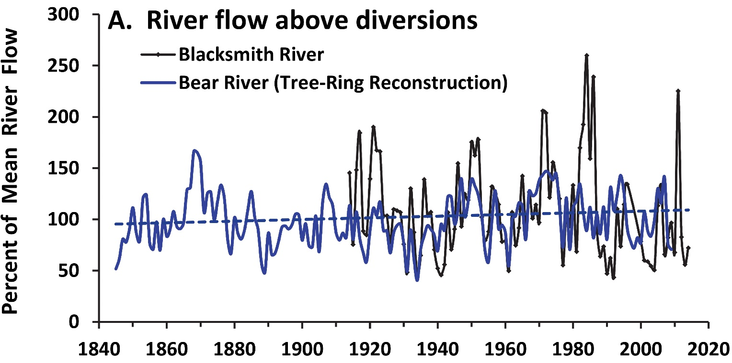
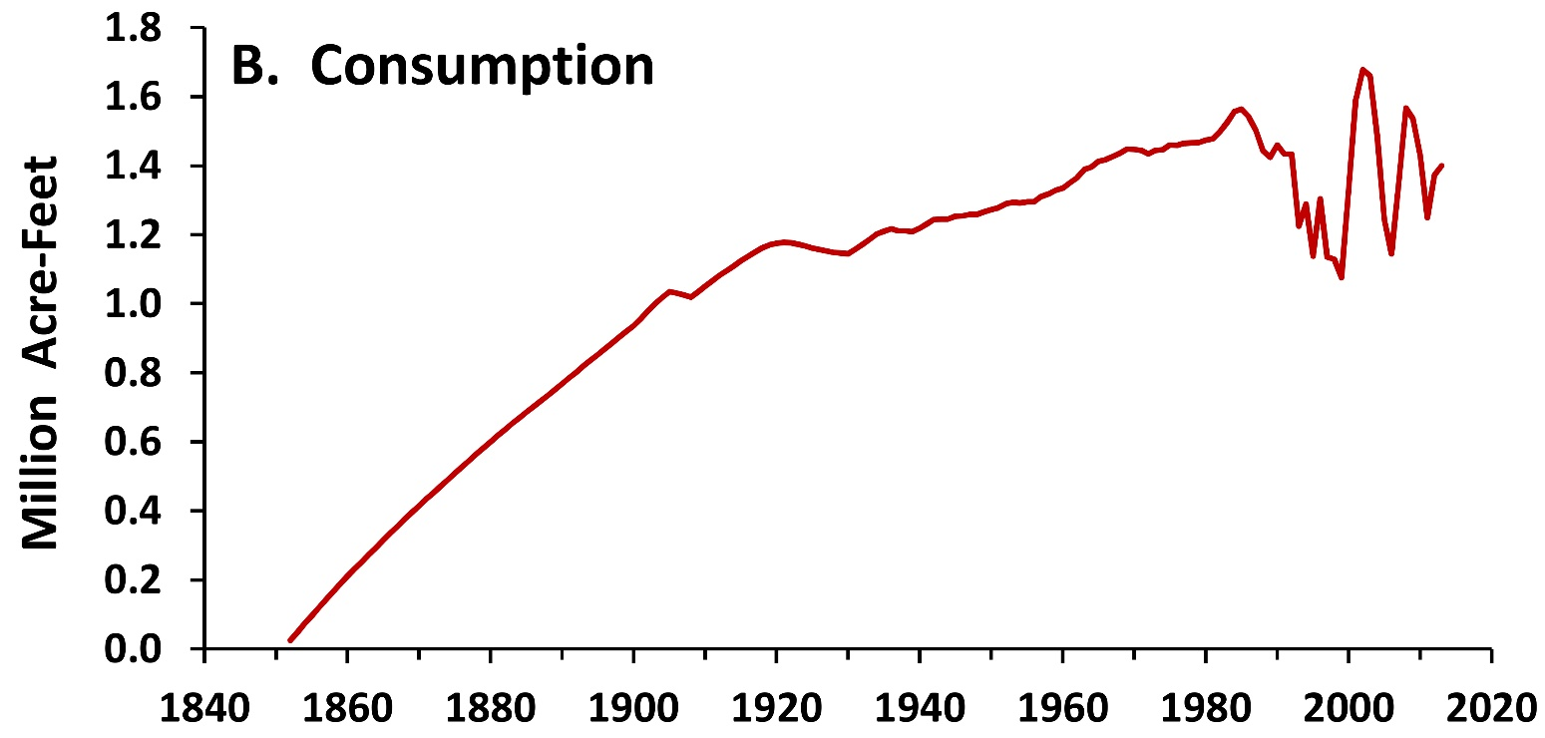
No observable LONG-TERM trend in natural streamflow

Slide 7
Depletion upstream of great salt lake natural lake with no trend

Slide 8
defining consumptive use
For years upper Colorado state standard was blainey-criddle.
  Requires only temperature. Gridded prism temperature available to 1890s
  location specific crop coefficients determined from penman equation correction.
Asce penman is now considered the standard for potential ET.
  No standards for how gridded et is determined.
    California cimis
    Utah GridET
    Each state has different methods.
    Upper Colorado river commission is hoping to establish standards.
Remotely sensed Actual et proven more accurate
  Metric, sebal, ReSET, SEBS, Etc.
  Eddy covariance, BOWEN RATIO AND WATER BALANCE used as a check.
  2008 Palo verde study, METRIC WINS

Slide 10
Water Resources M&I DataBase
Data Sources
Models start in 1989
M&I Data
Water Rights M&I DataBase
Water Resources Land Use Database
Riparian Demands
Land Use Data, Crop Data
NASS Gridded Crop Data
PRISM data (Precipitation, Temperature)
Canal Conveyance Efficiency, Irrigation System Efficiency
Gridded ET
NLDAS Weather Data for gridded ASCE Penman ET
Water Budget Module
USGS Groundwater Withdrawals
Stream Gauge and Watershed Outlets Table
Reservoir Data

Slide 11
Tributary Inflow (Yield)
River Inflow
Potential Consumptive Use
Flow Constrained Actual Consumptive Use
Agricultural Depletions
Water Budget Module
Municipal &Industrial Diversions
M&I Consumptive Use
M&I Depletion
Wetland Depletions
Reservoir Evaporation
Irrigated Acreage
Groundwater Use

Slide 12
Water budget model
Fortran code originally from Utah state university and includes:
  Demand from agricultural land areas
  Municipal and industrial demand
  Basic reservoir operations
  Some optimization capability
Interface in vb.net
  We believed fortran would not work with databases (we were wrong)
  Data stored in sql server
Data can be extracted using sql queries.
Dr. Khatri has done a more thorough review of the output data than any other human.

Slide 13
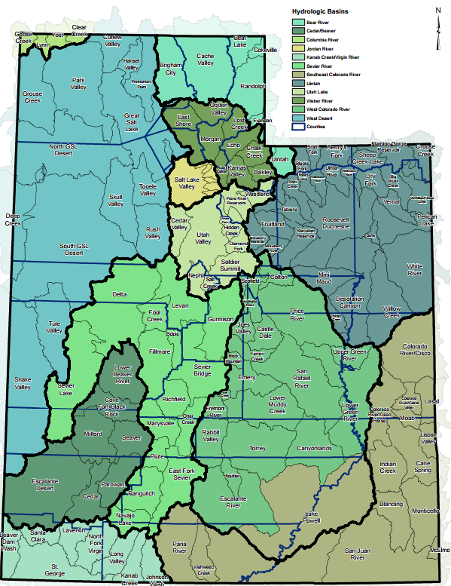
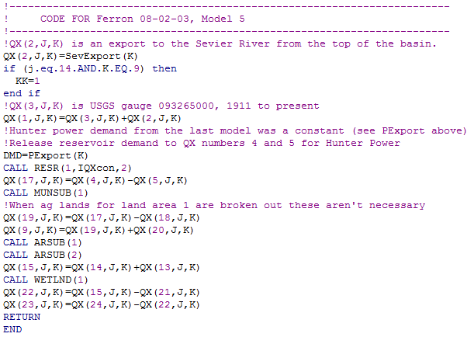

Slide 14
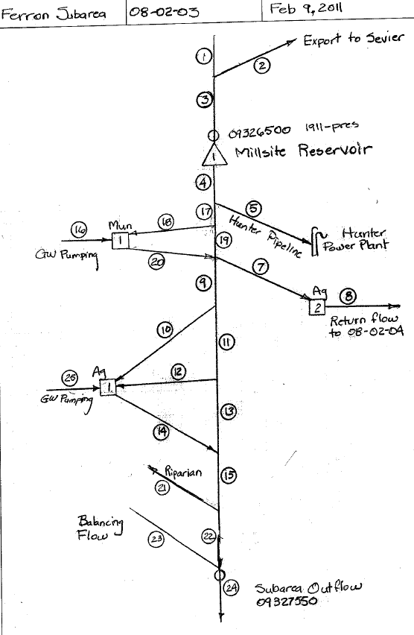
Modeling Process
Flow logic diagrams

Slide 15
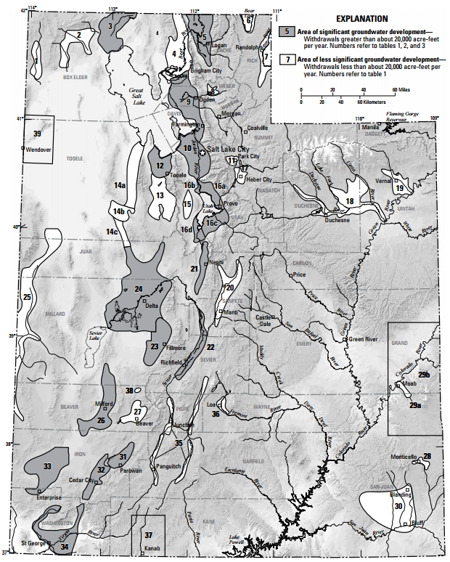
Fitting data to our subareas
USGS Groundwater Development Areas
Additional annoying problem – areas changed shape over time

Slide 16
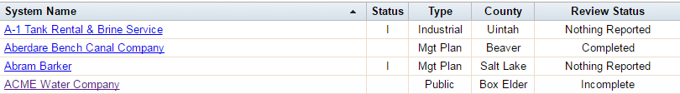
Municipal and industrial challenges
Secret data (self-supplied industries)
Some water providers did not provide their data
  http://www.waterrights.utah.gov/wateruse/WaterUseList.asp
Overlapping water provider districts
  Important for determining lot size , persons per household, TOTAL POPULATION
OUT OF STATE WATER PROVIDERS (BEAR RIVER BASIN)

Slide 17
OTHER ISSUES
IDAHO AND WYOMING
  IRRIGATED ACRES AND CROPS
    BEAR RIVER COMMISSION RECORDS PROBLEMATIC
  RESERVOIR RECORDS AND CAPACITY CURVES
    DATA IS SPOTTY
  GROUNDWATER
    USGS NATIONAL WATER USE RECORDS
I HAD NOT ORIGINALLY INTENDED TO MODEL AREAS OUTSIDE OUR STATE (DATA WAS NOT ORGANIZED TO IDENTIFY UTAH USE ONLY)

Slide 18
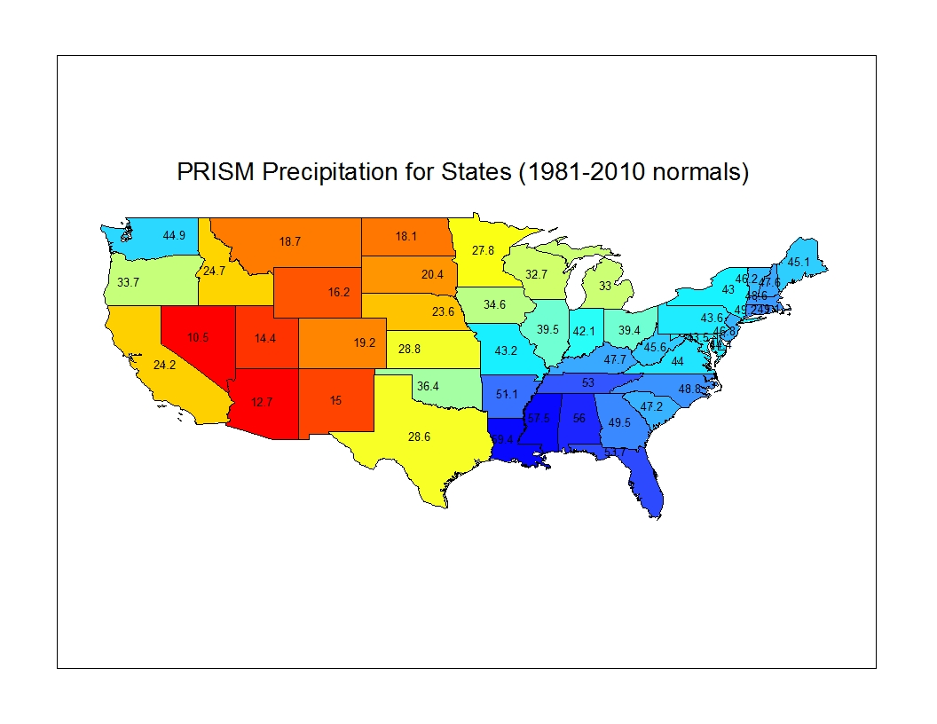
Interesting/important findings
57.5
59.4
Utah is the 3rd or 4th Driest State
Not 2nd

Slide 19
Colorado river allocation
While we are allocated 1.325 maf, we aren’t yet using that amount.

Slide 20
How to restore the great salt lake
Upstream of the great salt lake, 85% of depletions from irrigated agriculture is from forage crops.
  Pay farmers not to irrigate during extremely dry periods ($183 per acre foot).
  Let them purchase feed from other areas.
  Encourage them to irrigate during wetter periods.
Encourage managers of artificial wetlands to carve out a portion of the inundated lake bed for their ponds.
Encourage solar concentration industries to place their ponds in part of the inundated lake bed.
Remove invasive phragmites and replace with native plants.
Cloud seeding in Idaho and wyoming

Slide 21
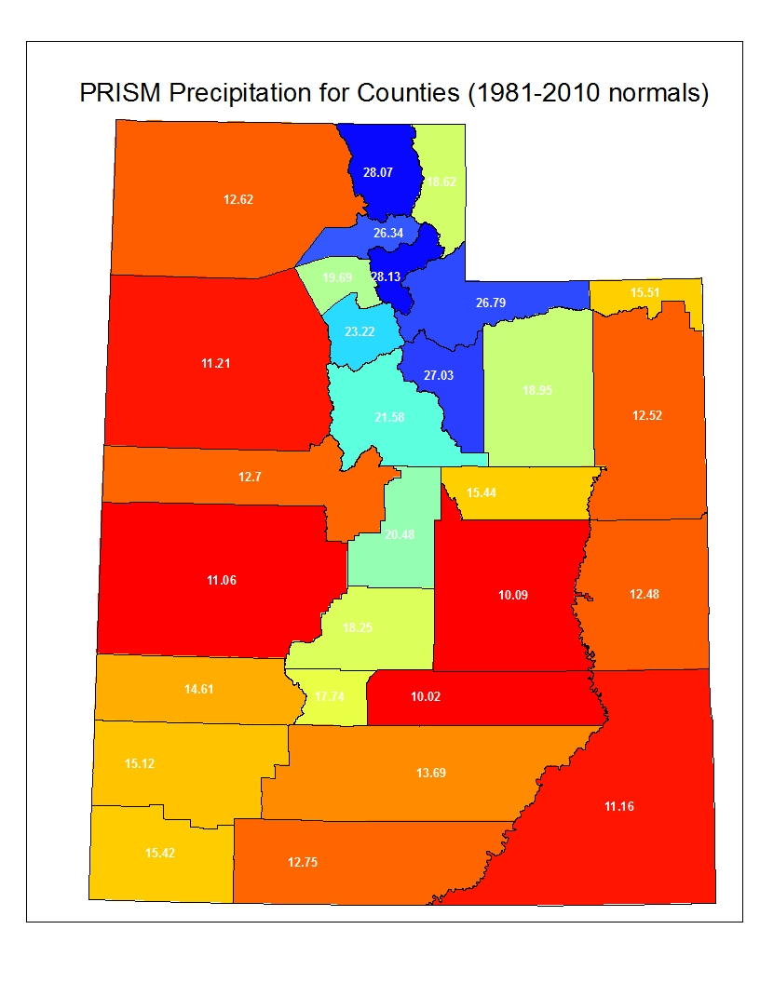
Population follows the rain

Slide 22
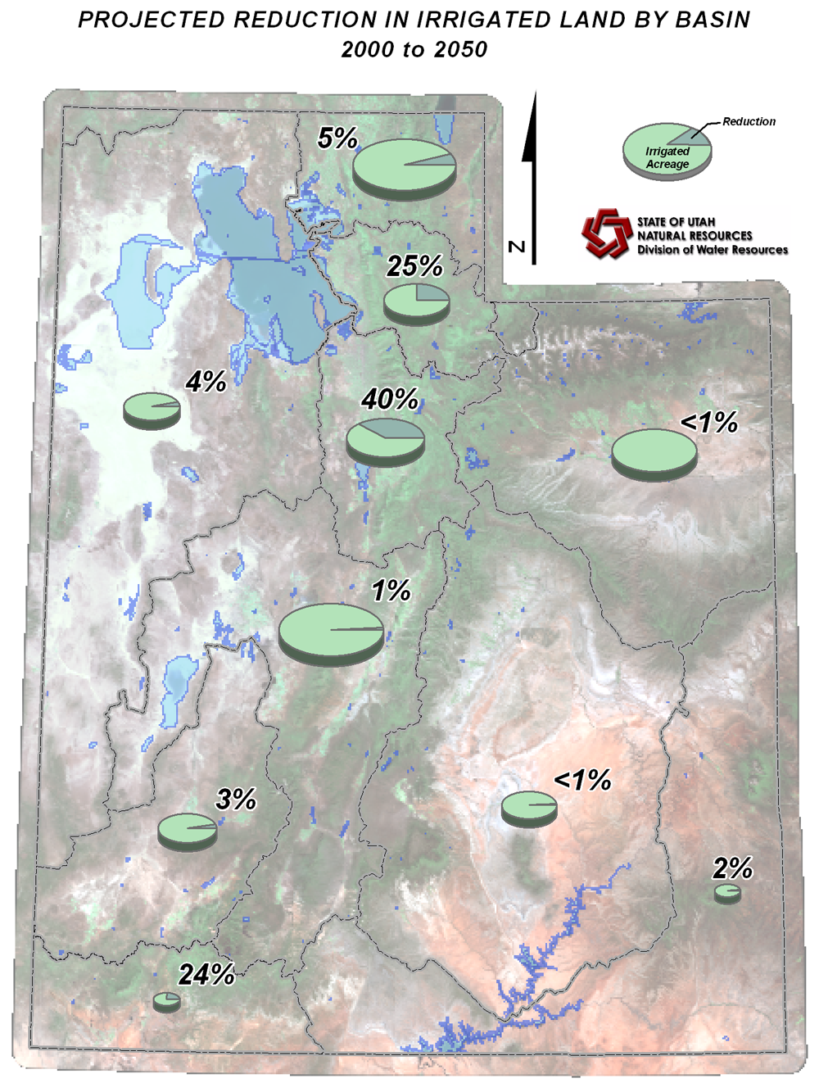
Reduction in Irrigated Acres
Total irrigated land – 1,200,000 acres
Approx. 10% of the total farm land will be urbanization by 2050.

Slide 23

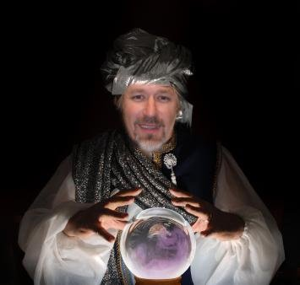

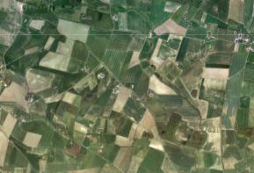
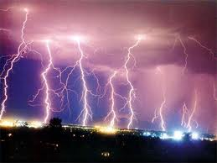
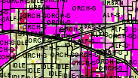
What the Future May Hold
Updated methods for calculating evapotranspiration (ET).
  Remote sensing of actual ET.
  Map based ET in near real-time on Water Resources web.
  ET forecasts.
Estimation of crop acres between years by remote sensing.

Slide 24
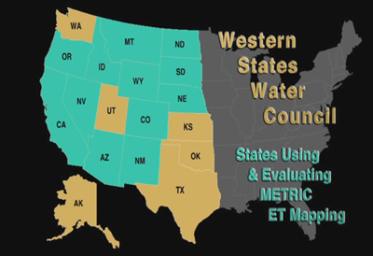
Satellite Sensed ET
Satellite remote sensing of ET is emerging as a standard.
The Upper Colorado River Commission is evaluating remote sensing

Slide 25
Why not use remote sensing now?
Time – Kansas took 3 years to process one season’s ET
Cost – eLEAF provides a statewide service that could provide ET with 250 m spatial accuracy for ~ 300 K per year
Training – requires trained and experienced personnel.
Personnel – could require hiring in financially uncertain times

Slide 26
Costs?
Manpower
Computer time
IT Personnel
Services can provide it all for $$
Training
Weather station network

Slide 27
Questions?
Thanks for your time!

