Slide 1
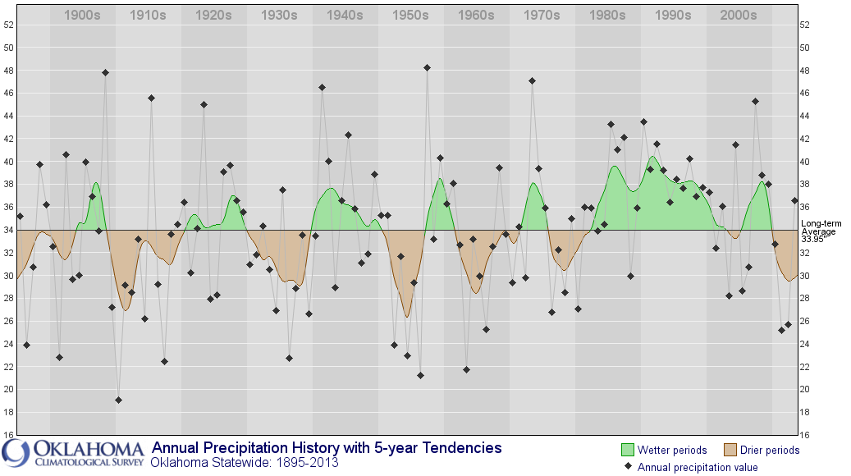
Oklahoma Hydrology 1900 to present

Slide 2
MOVING FORWARD
Altus City Lake
Reuse and Recycling
New Groundwater Wells
Administrative Reliability
Irrigation Efficiencies
Reservoir Development
Municipal Conservation

