Slide 1
Water Planning: Scarcity and Collaboration Arizona and the DCP
Kenneth C. Slowinski
Chief Counsel
Arizona Department of Water Resources
August 13, 2019

Slide 2
Authorization By Arizona Legislature Required for ADWR Director to Sign DCP Agreements
A.R.S. § 45-106 states:
“An agreement entered into between the [ADWR] director and the United States or a state or government involving a sovereign right or claim of this state is not effective unless approved by the legislature by concurrent resolution.”

Slide 3
Reduction Tiers For Arizona Under 2007 Guidelines and DCP
2007 Guidelines (Lake Mead Elevation projection as of January 1)
Tier 1 – at or below 1075 feet (320k reduction)
Tier 2 – below 1050 feet (400k reduction)
Tier 3 – below 1025 feet (480k reduction)
2007 Guidelines and DCP (Lake Mead Elevation projection as of January 1)
Tier Zero – at or below 1090 feet (192k reduction)
Tier 1 – at or below 1075 feet (320k + 192k reduction)
Tier 2a – below 1050 feet (400k + 192k reduction)
Tier 2b – below 1045 feet (400k + 240k reduction)
Tier 3 – below 1025 feet (480k + 240k reduction)

Slide 4
CAP Priority Pools & Shortage
2007 Guidelines
07’ Guidelines + LBDCP
T Zero (0 + 192k)
T1 (320k)
T2 (400k)
T3 (480k)
T1 (320k + 192k)
T2a (400k + 192k)
T2b (400k + 240k)
T3 (480k + 240k)
Notes:
* Based on current usage patterns

Slide 5
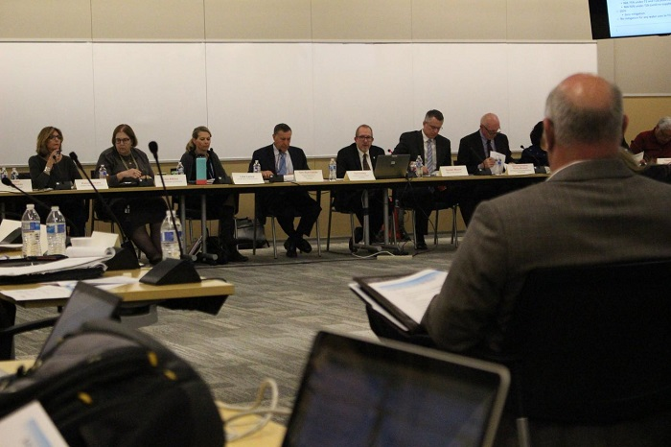
Arizona LBDCP Implementation Plan Process
ADWR and CAWCD hosted 9 public Steering Committee meetings during 2018 and 2019 to discuss a DCP Implementation Plan.

Slide 6
LBDCP Implementation Plan – 2 Components
Mitigation Component (to mitigate reductions in water)
Wet water CAP ICS deliveries for mitigation of reductions
Payment for reductions (compensated mitigation) when wet water mitigation is insufficient
Money for new groundwater infrastructure for CAP AG
Offset Component (to replace water used for mitigation)
System conservation water in Lake Mead.
ICS creation by GRIC
Voluntary ICS creation without compensation
Payment by U.S. and State for creation of ICS for pre-firming to meet their obligations under settlement agreements

Slide 7
Mitigation Component - Key Terms
2020 – 2022
100% mitigation for NIA Pool (Cities and Indian Tribes)
Fixed volume of CAP water for CAP Ag
2023 – 2025
No CAP Ag Mitigation (except USF to GSF and groundwater infrastructure)
CAP M&I and Indian priority supplies fully mitigated first
NIA 75% under T1 and T2a (until no supplies)
NIA 50% under T2b (until no supplies)
2026
Zero mitigation
No mitigation for any water user in T3 or 2026, whichever occurs first

Slide 8
Offset Component– Key Terms
Conserve 400 kaf to offset use of CAP ICS for mitigation
Offsets provided through:
100 kaf of ICS created by GRIC (to be paid by U.S.)
Pre-firming for US Tribal firming obligation(s)
50 kaf of ICS created by GRIC (to be paid by AWBA)
Pre-firming for Arizona’s firming obligation to GRIC
50 kaf Additional ICS by GRIC
150 kaf of System Conservation created by CRIT (approx. $38 million paid by State and EDF)
50 kaf - CAP-SRP Exchange payback

Slide 9
Participants in Funding & Water
CAWCD: Funding and Water
SRP: Water in exchange
CAP M&I Users: Water for USF-GSF
GRIC: Water for ICS and Firming
CAP AG: Funding for GW infrastructure
State of Arizona: Funding for GW infrastructure, System Conservation and Firming
AWBA: LTSC for USF-GSF exchange, Firming
US: Funding of GW Infrastructure and Firming
NGOs (EDF): Funding for System Conservation
CRIT: Water for System Conservation

Slide 10
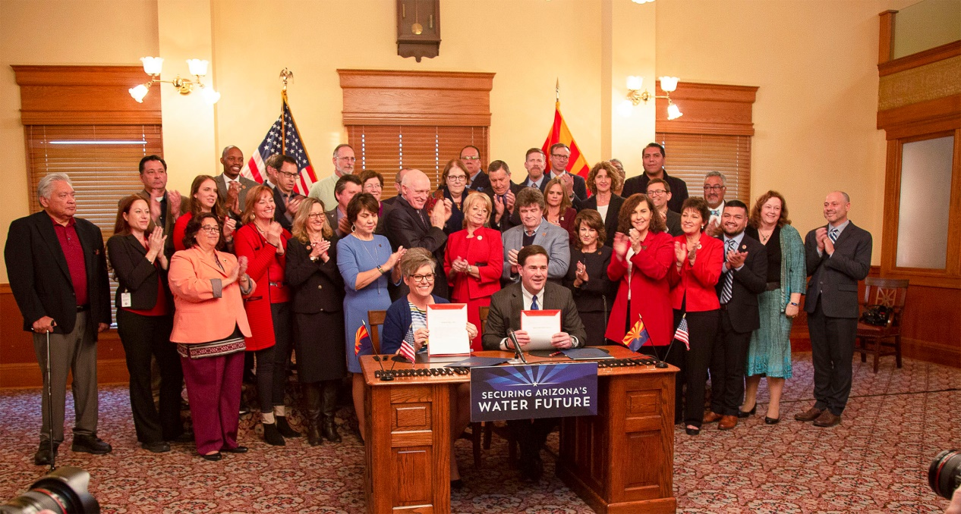
Drought Contingency Plan Recap
Arizona DCP Implementation Plan Legislation January 31 – Arizona Legislature passed & Gov. Ducey signed SB 1227 and Senate Joint Resolution 1001 The Resolution authorized ADWR Director to sign the Interstate DCP Agreements on behalf of Arizona

