Slide 1

Water Planning: Scarcity and Collaboration
Lower Colorado River Basin
Drought Contingency Plan (LBDCP)
Leslie A. Meyers
Area Manager
Phoenix Area Office
August 13, 2019

Slide 2
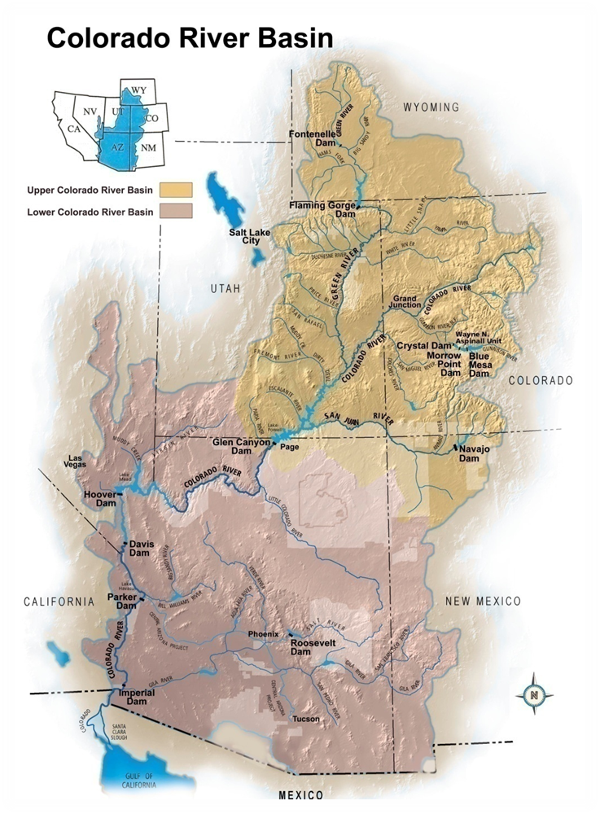
Colorado River Basin Overview
16.5 million acre-feet (maf) allocated annually
  7.5 maf each to Upper and Lower Basins
  1.5 maf to Mexico
14.8 maf average annual “natural” inflow into Lake Powell over past 110 years
Inflow is highly variable year-to-year
60 maf of storage
  4 times the annual inflow
Operations and water deliveries governed by the “Law of the River”
Notes:
Colorado River Basin is divided into the upper and lower basin. Lee Ferry, just downstream of Glen Canyon Dam, is the dividing point.
Upper Basin States
Wyoming
Utah
Colorado
New Mexico
Lower Basin
Arizona
California
Nevada
Key take aways -
We can store 4 times the average annual inflow
The system has worked exactly as designed as we have made essentially all of our delivery commitments in the Lower Basin despite having the worst drought in the last century

Slide 3
Natural Flow
Colorado River at Lees Ferry Gaging Station, Arizona
Water Year 1906 to 2019
Notes:
3
We have come to realize over the years that the upper and lower basin and Mexico allocations are significantly higher that than the average inflow.
Between this realization and the understanding that the original reductions under the 07 Guidelines could protect Lake Mead elevations, the Basin States agreed to develop the Drought Contingency Plans. The Upper and Lower Basins have each developed their own plans.
Points to make:
105-year (1906-2010) historical average is approximately 14.9 maf
2013-2015 are estimated values
Inflows are highly variable from year-to-year
2012-2013 was 4th driest 2-year period (2002-2003 was the driest)
Period from 2000-2009 was the lowest 10-year average inflow—there were two years with above average inflow during the period
Period from 1953-1964 was the lowest 12-year average inflow, but note there were a couple of good years in the period
Period from 2000-2014 is the lowest 14-year average inflow (at 12.4 maf, or 83% of the long-term average of 14.9 maf)

Slide 4
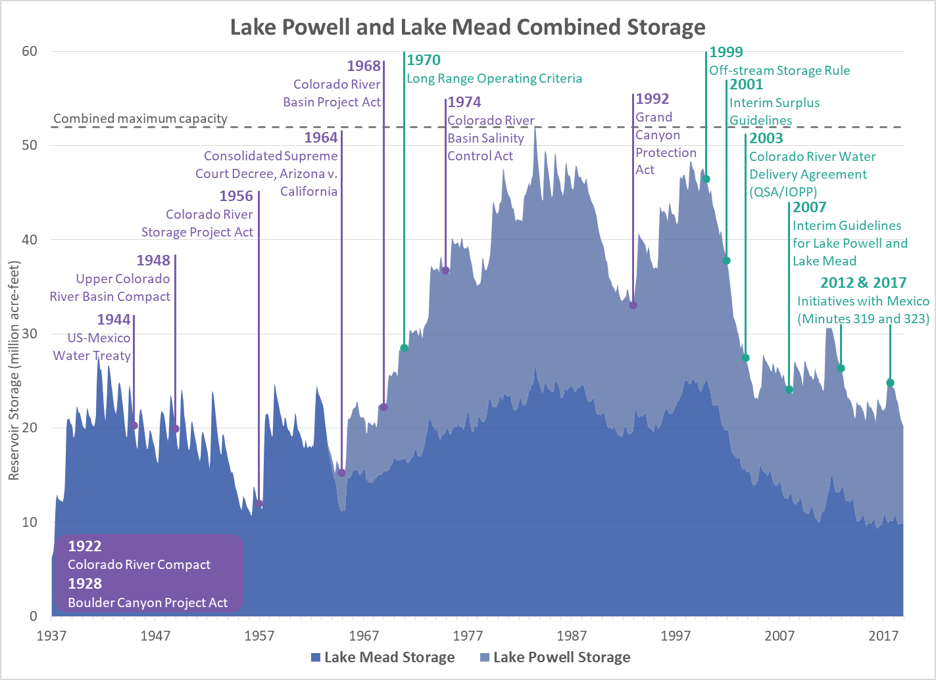
Notes:
This slide superimposes the key pieces of the “Law of the River” over the Lake Powell and Lake Mead storage volumes.
Note that the Interim Surplus Guidelines where completed in 2001 before the Shortage Sharing Guidelines. And, that the Shortage Sharing criteria (2007 Guidelines) were started in 2000 when the system had been full for many years. By the time that the 07 Guidelines where completed, we were 7 years into this unprecedented drought.

Slide 5
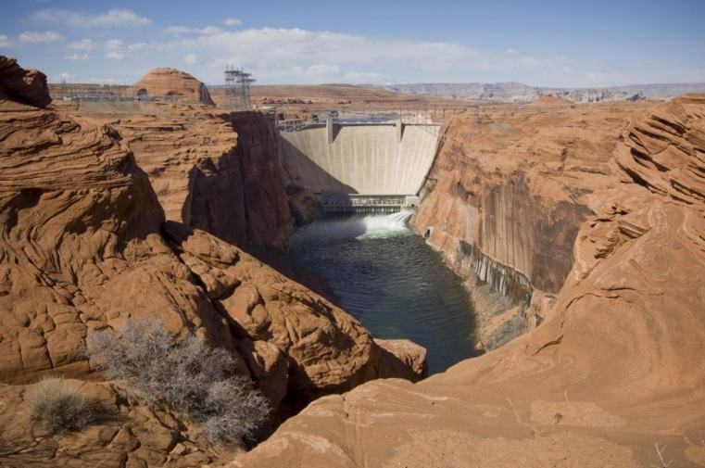
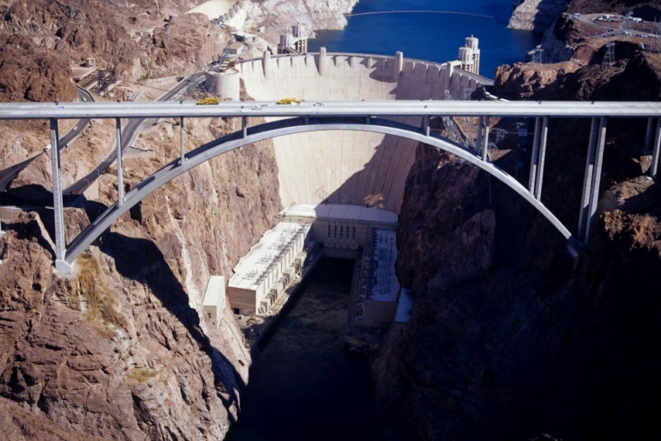
2007 Interim Guidelines
In place for an interim period (2007 through 2026)
Provide for coordinated operations of Lake Powell and Lake Mead to minimize Lower Basin shortages and Upper Basin curtailments
Encourage efficient use and management of Colorado River water through the Intentionally Create Surplus (ICS) mechanism
Establish guidelines for determining shortages in the Lower Basin
Does not include provisions for Mexico
Notes:
5
Key Points:
Use bullets from slide
In place for an interim period (2007 through 2026)
Provide for coordinated operations of Lake Powell and Lake Mead to minimize Lower Basin shortages and Upper Basin curtailments
Previously, operations were only coordinated at the highest elevations – to avoid spills and address flood control conditions
Encourage efficient use and management of Colorado River water through the Intentionally Create Surplus (ICS) mechanism
Previously Colorado River water was “Use it or lose it” – there weren’t mechanisms in place to encourage conservation and allow flexibility to the states to manage their water resources
Establish guidelines for determining shortages in the Lower Basin
Does not include provisions for Mexico – This required a Minute to the 1944 Treaty

Slide 6
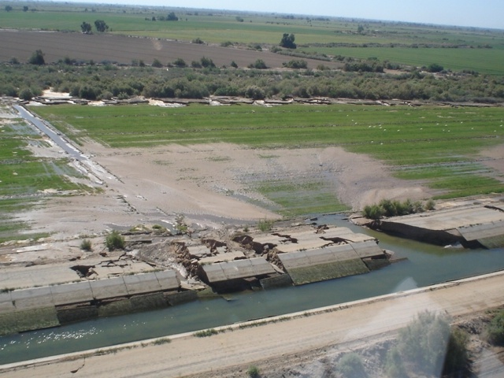
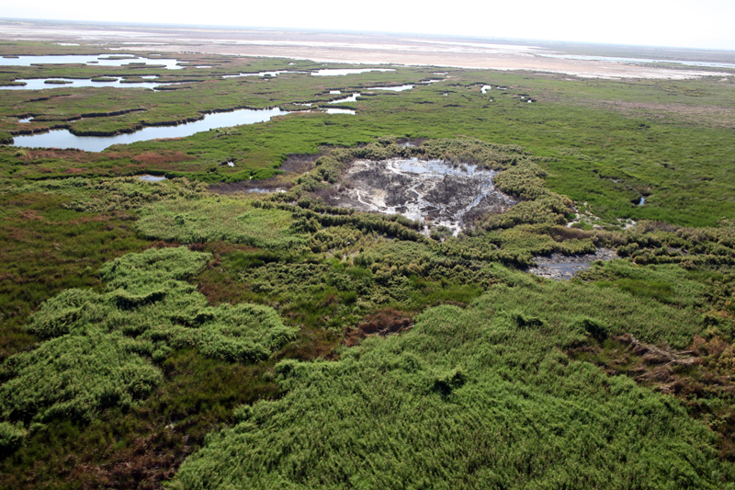
1944 U.S.-Mexico Water Treaty
  Minute 319 – November 2012
  International Boundary and Water Commission
  Minute 323 – September 2017
  Binational Water Scarcity Plan
Damage to canal in Mexico from earthquake, April 2010
View of riparian area in Colorado River Delta
Notes:
Key Points:
Cooperative 5-year agreement
In place for an interim period from 2013 to 2017
Provides for storage of Mexican conserved water in Lake Mead
Shortage and surplus and shortage sharing with U.S. water users at high and low reservoir conditions
Improved infrastructure for conservation
Environmental projects including riparian restoration sites in the Colorado River Delta
Minute 319 expired and was reaffirmed in 2017 with Minute 323. You’ll see Mexico’s contributions in the DCP tables.

Slide 7
Notes:
Drawdown since 2000 is a combination of Drought (no equalization events) and structural deficit.
Since early 2010’s working on “bending the curve”.
Programs include
Lower Basin Drought MOU
Pilot Systems Conservation Program
Others
These programs have helped avoid a Colorado River shortage declaration and helped Reclamation and the Lower Basin States better understand water users willingness to participate in programs that benefit the system as a whole.

Slide 8
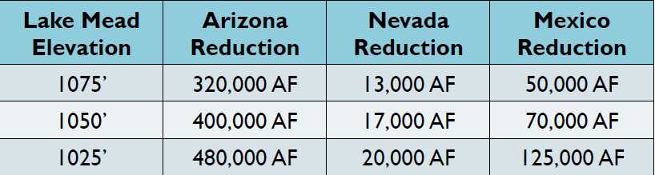
2007 Interim Guidelines
Arizona and Nevada share Lower Basin shortages under the 2007 Guidelines
Mexico voluntarily agreed in Minute 319 to accept reductions in its deliveries at the same elevations
No additional reductions to California under 2007 Guidelines
Notes:
The 07 Guidelines include Lower Basin reductions based on elevations in Lake Mead. Reductions are intended to slow the decline of the reservoir. Good start but not enough.
Based on lower basin priorities and the “Law of the River”, CA did not agree to take any lower basin reductions.
Mexico was not a part of the guidelines but voluntarily agreed to participate in reductions in Minute 319 and reaffirmed that commitment in Minute 323.

Slide 9
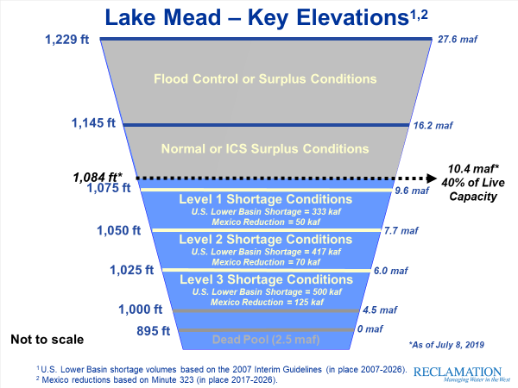
Notes:
9

Slide 10
Total Contemplated Lower Basin Volumes (in KAF) 2007 Interim Guidelines, Minute 323, Lower Basin Drought Contingency Plan & Binational Water Scarcity Contingency Plan
Lake Mead Elevation (ft msl) | 2007 Interim Guidelines Shortages |  | Minute 323 Delivery Reductions | Total Combined Reductions | DCP Contributions |  |  | Binational Water Scarcity Contingency Plan Savings | Combined Volumes by Country US: (2007 Interim Guidelines Shortages + DCP Contributions) Mexico: (Minute 323 Delivery Reductions + Binational Water Scarcity Contingency Plan Savings) |  |  |  |  | Total Combined Volumes
 | AZ | NV | Mexico | Lower Basin States + Mexico | AZ | NV | CA | Mexico | AZ Total | NV Total | CA Total | Lower Basin States Total | Mexico Total | Lower Basin States + Mexico
1,090 - >1,075 | 0 | 0 | 0 | 0 | 192 | 8 | 0 | 41 | 192 | 8 | 0 | 200 | 41 | 241
1,075 - >1050 | 320 | 13 | 50 | 383 | 192 | 8 | 0 | 30 | 512 | 21 | 0 | 533 | 80 | 613
1,050 - >1,045 | 400 | 17 | 70 | 487 | 192 | 8 | 0 | 34 | 592 | 25 | 0 | 617 | 104 | 721
1,045 - >1,040 | 400 | 17 | 70 | 487 | 240 | 10 | 200 | 76 | 640 | 27 | 200 | 867 | 146 | 1,013
1,040 - >1,035 | 400 | 17 | 70 | 487 | 240 | 10 | 250 | 84 | 640 | 27 | 250 | 917 | 154 | 1,071
1,035 - >1,030 | 400 | 17 | 70 | 487 | 240 | 10 | 300 | 92 | 640 | 27 | 300 | 967 | 162 | 1,129
1,030 – 1,025 | 400 | 17 | 70 | 487 | 240 | 10 | 350 | 101 | 640 | 27 | 350 | 1,017 | 171 | 1,188
<1,025 | 480 | 20 | 125 | 625 | 240 | 10 | 350 | 150 | 720 | 30 | 350 | 1,100 | 275 | 1,375
The US will work to create or conserve 100,000 af or more of Colorado River system water on an annual basis to contribute to conservation of water supplies in Lake Mead and other Colorado River reservoirs. All actions taken by the United States shall be subject to applicable federal law, including availability of appropriations.
Notes:
The Lower Basin Plan is an overlay to the 07 Guidelines that includes greater reductions.
The greatest reductions are taken by Arizona but are shared with Nevada and Mexico and even California at lower elevations.
Note that reductions at lower elevations are greater than the 1.2 M acre-ft structural deficit which greatly reduce the risk of Lake Mead dropping below elevation 1025. This allows that lower basin water users to continue to get deliveries throughout periods of shortage.

Slide 11
Risk of Lake Mead < 1,020’
5.7 maf
1,020’
22%
Stress Test Hydrology (1988-2016)
100%
Full Hydrology (1906-2016)
100%
2007 Projections
(1906-2005 hydrology)
No DCP
(March 2019 Projections)
With DCP
(March 2019 Projections with Upper & Lower Basin DCPs & Binational WSCP)
2007 Projections
(1906-2005 hydrology)
No DCP
(August 2018 Projections)
With DCP
(March 2019 Projections with Upper & Lower Basin DCPs & Binational WSCP)
90%
90%
80%
80%
70%
70%
60%
60%
50%
50%
40%
30%
20%
10%
0%
40%
30%
20%
10%
0%
2008
2009
2010
2011
2012
2013
2014
2015
2016
2017
2018
2019
2020
2021
2022
2023
2024
2025
2026
2008
2009
2010
2011
2012
2013
2014
2015
2016
2017
2018
2019
2020
2021
2022
2023
2024
2025
2026

Slide 12
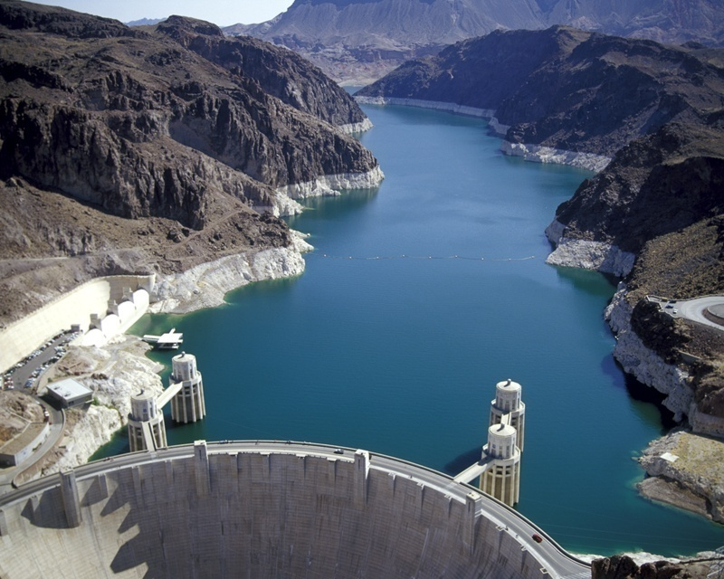
Questions?
Notes:
12

