Slide 1
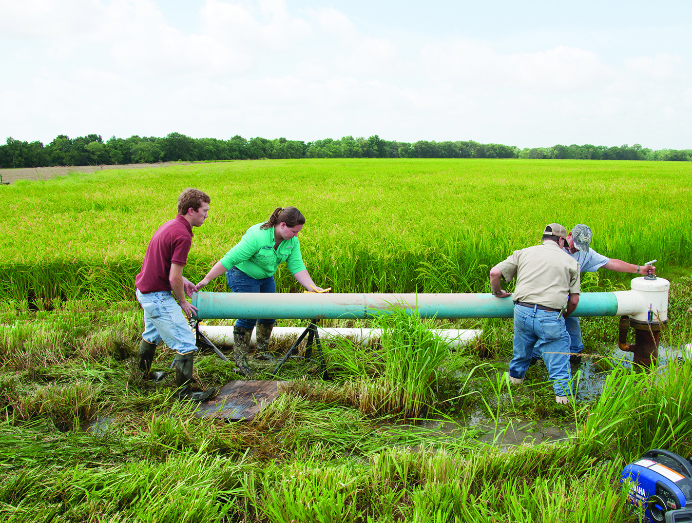
Regional Conservation Partnership Program
July 15, 2020

Slide 2
What is RCPP?
NRCS
Your Entity
Co-investing in targeted, innovative natural resource solutions

Slide 3
RCPP Basics
First authorized in the 2014 Farm Bill and reauthorized in the 2018 Farm Bill.
Promotes coordination of conservation activities with partners offering value-added contributions that expand our collective ability to address on-farm, watershed and regional natural resource concerns.

Slide 4
RCPP—now comes in three flavors!
RCPP Classic—traditional program
RCPP Renewals—allows for streamlined renewal of successful projects
RCPP Alternative Funding Arrangements (AFA)—separate competition for more progressive conservation approaches and infrastructure projects

Slide 5
RCPP Principles
Impact
Partner Contributions
Innovation
Partnership and Project Management

Slide 6
2018 Farm Bill--Significant Changes
Standalone program with $300 million annually
RCPP contracts and new agreement structure
Enhanced Alternative Funding Arrangement provision
Three funding pools reduced to two
Emphasis on project outcomes

Slide 7
RCPP Rule Development
Published on March 17, 2020.
75 public comments submitted.
Final rule scheduled for publication toward the end of the calendar year.

Slide 8
Partner Eligibility
Only organizations listed in the RCPP statute (same list as in the funding announcement, bottom of page 8) can apply to be a RCPP lead partner.
An agricultural or silvicultural producer association or other group of producers.
A State or unit of local government.
An Indian Tribe.
A farmer cooperative.
A water district, irrigation district, acequia, rural water district or association, or other organization with specific water delivery authority to agricultural producers.
A municipal water or wastewater treatment entity.
An institution of higher education.
An organization or entity with an established history of working cooperatively with producers on agricultural land, as determined by NRCS, to address—
Local conservation priorities related to agricultural production, wildlife habitat development, or nonindustrial private forest land management; or
Critical watershed-scale soil erosion, water quality, sediment reduction, or other natural resource issues.
An entity, such as an Indian Tribe, State government, local government, or a nongovernmental organization that has a farmland or grassland protection program that purchases agricultural land easements, as defined in 7 CFR Section 1468.3.
A conservation district.

Slide 9
Land Eligibility
Any agricultural or nonindustrial private forest land or associated land on which the Secretary determines an eligible activity would help achieve conservation benefits.

Slide 10
Land Eligibility—Important Note
2014 Farm Bill—water supply projects were carried out through PL-566, allowing for RCPP municipal water supply projects for rural communities that did not necessarily generate conservation benefits for agricultural/forest lands.
2018 Farm Bill—any water supply projects now carried out through the standalone RCPP program, which requires that projects generate conservation benefits for eligible lands.

Slide 11
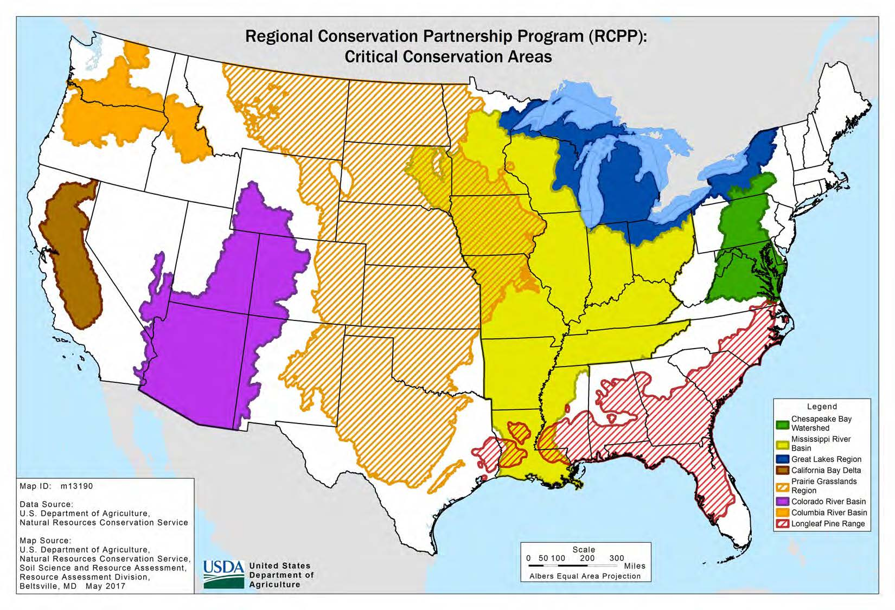
RCPP Funding Pools
State/Multistate—large and small projects, 50% of funding
Critical Conservation Areas—50% of funding

Slide 12
RCPP—what happens in a 5-year project?
Land management contracts
Land rental contracts
U.S.-held easements
Entity-held easements
Public works contracts

Slide 13
Lead Partner Input into RCPP Activities
geographic area
resource concerns
land uses
ranking
application bundling

Slide 14
RCPP Funding Approach
RCPP Funding
FA—70%
TA—30%
Technical Assistance—
required to help get
conservation on the ground
Financial Assistance—
conservation on the ground using
RCPP contracts and supplemental
agreements
Implementation TA—23%
Enhancement TA—7%
NRCS—5%
Negotiated—18%

Slide 15
Partner Contributions
Stated goal of contributions at least equal to the NRCS investment
Value-added, substantive, elevating, amplifying, etc.
Lead partner assumes full responsibility for delivery of contributions
2018 statute makes a distinction between cash and in-kind contributions
Non-USDA Federal contributions allowed if related to project objectives and resource concerns

Slide 16
What is an environmental outcome?

Slide 17
Project Outcomes
All RCPP projects must develop an approach to report on environmental outcomes.
Economic and social outcome reporting is optional.
Outcomes reporting is a lead partner responsibility
A combination of NRCS headquarters staff and State RCPP Coordinators will work with awardees to develop a standardized data collection and outcomes reporting plan.

Slide 18
Lower Gunnison Basin--CO
Colorado River Water Conservation District is the lead partner
Project combines on- and off-farm irrigation infrastructure improvements. Includes over $6 million in PL-566 funding for irrigation infrastructure.
As of Feb. 2020, partners had secured approval of the watershed plan/EA and had progressed to construction.

Slide 19
Lower Colorado River Authority--TX
Proposed to construct an off-channel reservoir to increase irrigation water supply for area rice fields ($7.35 million RCPP investment).
Watershed plan has been completed but project is on hold (as of Feb. 2020). Project sponsor is not ready to hold public meetings and the availability of construction funds is in question.

Slide 20
Central Arizona Regional Irrigation Efficiency
Proposes to increase water supply in five Arizona irrigation districts, as well as undertake water efficiency efforts.
Project leaders received tentative approval for the $10 million project in April 2020.
Project negotiations are underway.

Slide 21
RCPP On the Horizon
Late July/Early August—Combined fiscal year 2020 and 2021 RCPP Classic competition announced.
Winter 2020—the next AFA competition scheduled for announcement.

Slide 22
USDA is an equal opportunity provider, employer, and lender.

