Slide 1
Prize Competitions
WestFAST Topics Webinar
October 21, 2020

Slide 2
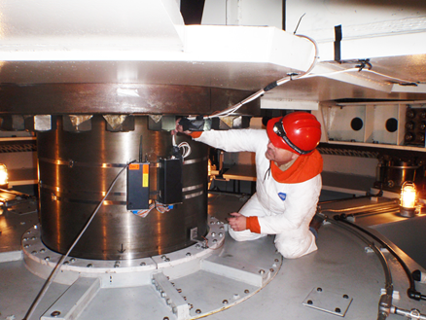
Research and Development Office
Programs
Desalination & Water Purification
Science & Technology
Address Technical Challenges in:
Developing water supplies (both programs)
Water infrastructure
Power and energy
Environmental issues in water management
Water operations and planning
Customers
Reclamation facility and resource managers, customers, stakeholders, private sector, public
https://www.usbr.gov/research/

Slide 3
Pathways for Advancing Research
Prize Competitions
Technology Transfer
S&T Research Reclamation Led
Science & Technology
S&T Program:
$11.0 – 22.0 million/year since FY 2016
Prizes:
$3.0 - 8.5 million/year
~ $24.7 million total
Technology Transfer
Cooperative Research and Development Agreement
Material Transfer Agreement
Facility Use/Service Agreement

Slide 4
Prize Competitions A tool for solving tough issues and advancing research
How it works:
Issue a challenge to solve a problem
Establish monetary and non-monetary incentive prizes
Set a “Bar of Success”
Since 2014:
24 Competitions launched
745 Solutions submitted
100 Winning solutions
~$1.5 million awarded
10 Winning solutions in research and development
Known Solvers
Problem
Solvers in other domains

Slide 5
Process
Workflow
Can include on-site demonstration that include solvers and commercial interests or investors
Identify Topics
(ongoing)
Design
Launch
Judge
Award
Input from Reclamation, other Feds, and external stakeholders on research ideas
Reclamation, partners (Federal/non-Federal), contractors, etc.
Paid by Reclamation and Fed/Non-Fed Co-Sponsors
Promotional Materials & Competition Web-Page
Announce Winners
Reclamation Public Affairs and Contractor

Slide 6
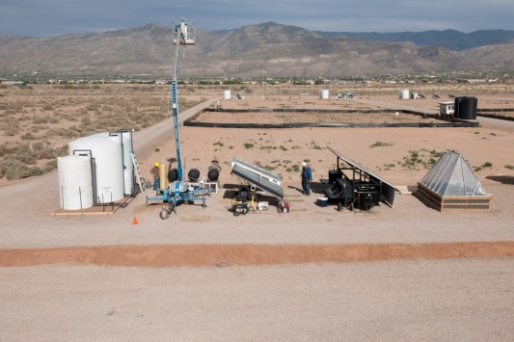
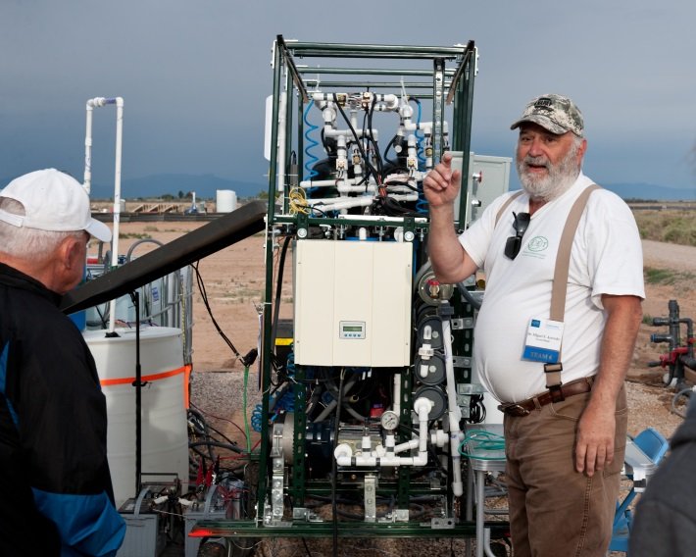
2015 Desal Prize (USAID Lead)
Challenge: Treat brackish groundwater for rural and underdeveloped areas
Success Criteria: Potable and irrigation water volumes, renewable energy-powered, demonstration event
Winners: Two sharing $200K, additional $400K in grants awarded
Maturing Solutions: Winner and Manufacturer partnering to commercialize
Bloomberg “Burning Man for Water Geeks”

Slide 7
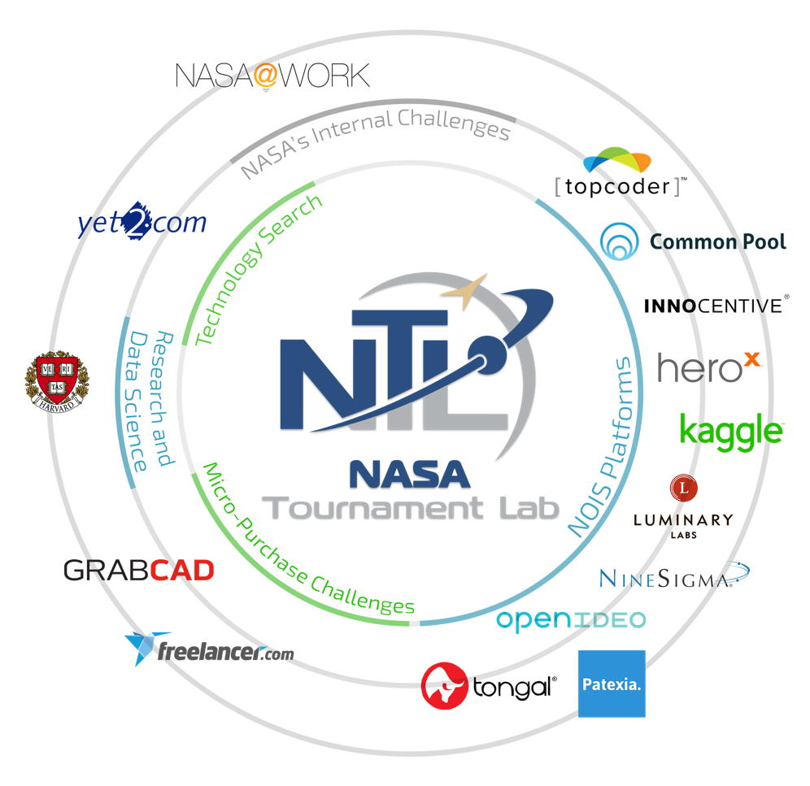
Program Evolution
2014 – 2019 - Theoretical and Ideation
2018 - Transition
Multiple stages
Reduction To Practice
Procurement authority
Partnership - NASA’s Center of
Excellence for Collaborative Innovation
Access to multiple prize competition vendors and solver communities
Technology Searches

Slide 8
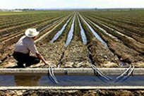
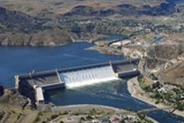
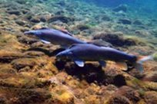
Program Organization
Water
Help water managers facing current and future water demands from agriculture, municipal, industrial, Native American, rural, recreation, power generation, and ecosystem needs
Infrastructure
Support safe, well-maintained, and reliable inventory of dams, pipelines, hydropower generation facilities, canals, and levees
Environment
Aids operations to ensure watersheds are healthy, continue producing water, and supports State and Federal law compliance

Slide 9
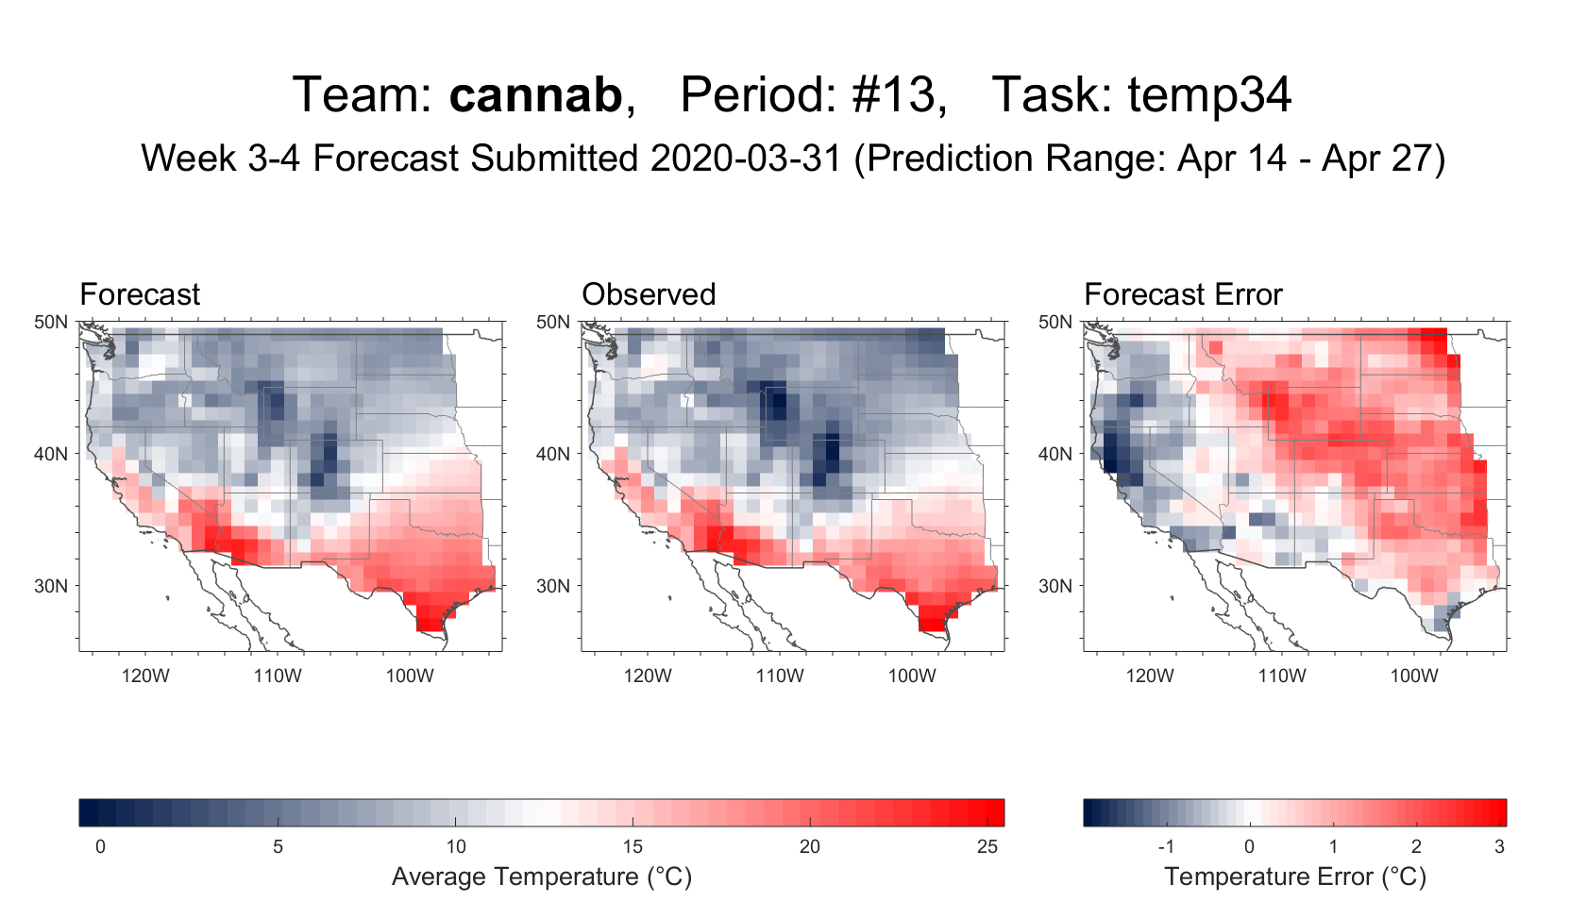
Water - Supplies
Current
Streamflow Forecast Rodeo
Scoping
Improving Snow-Water Equivalents Estimates
Multiple partnerships
Success
Sub-Seasonal Climate Forecast Rodeo II
www.drought.gov/drought/forecast-rodeo-ii-leaderboard
Lowering the Cost of Continuous Streamflow Monitoring

Slide 10
Water - Treatment
Launching Oct. 28!
More Water Less Concentrate
Scoping
Arsenic Sensor - Technology Search
EPA Partnership
Success
Pathogens Sensor
Maturing winning technology through DWPR grant
www.MoreWaterLessConcentrate.org

Slide 11
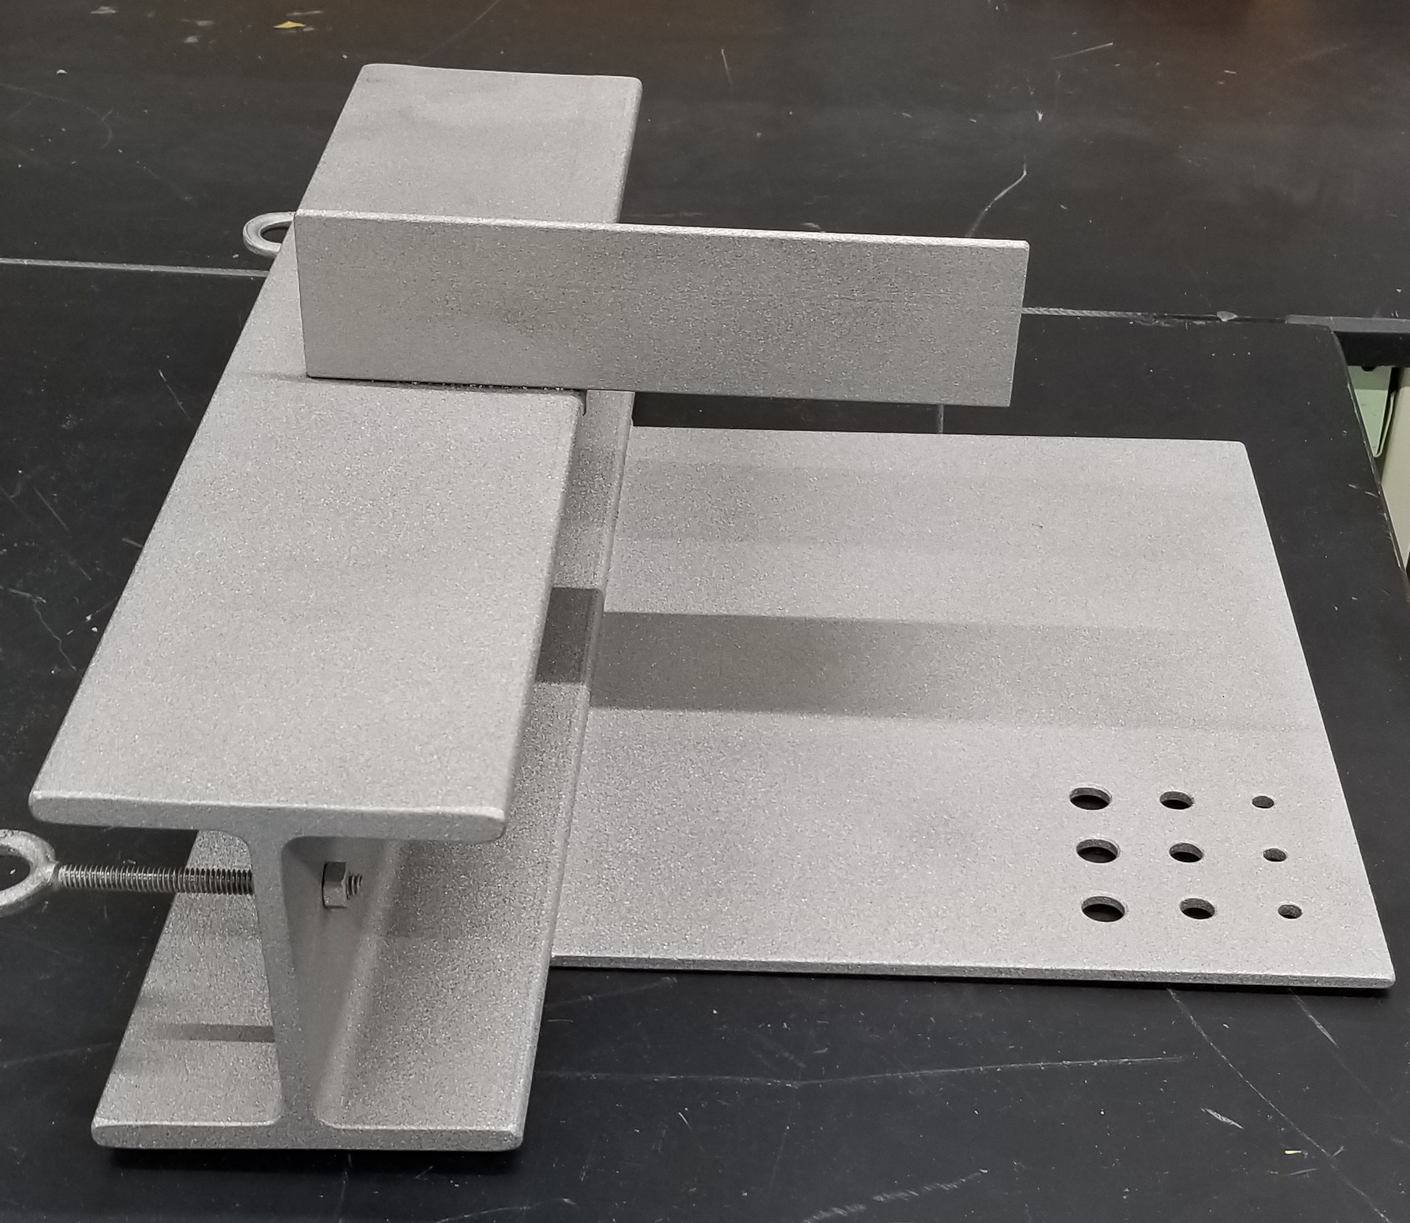
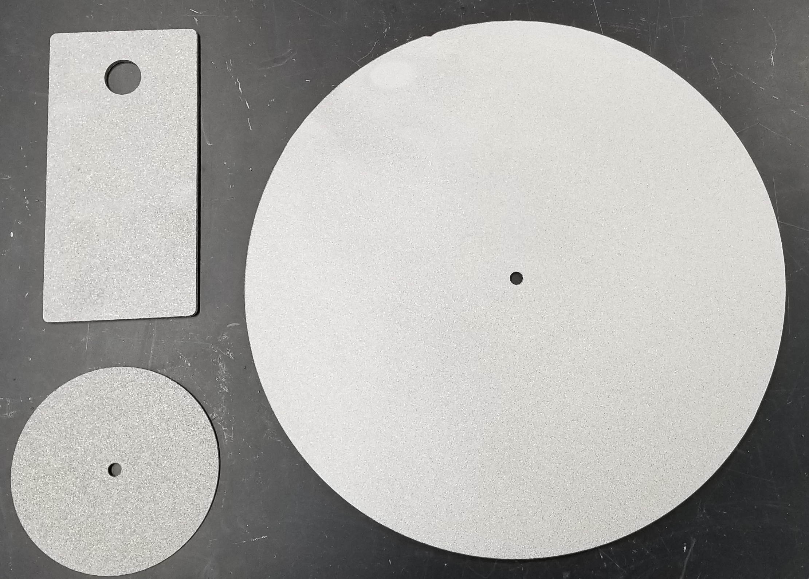
Infrastructure
Current
Improving Canal Safety – Launching 10/22/20
Rust Busters
Scoping
Reducing Canal Seepage
Non-Destructive Composites Condition Assessment
No Outage Testing of Hydropower Protection Systems
Success
Detecting Internal Erosion - Evaluating Distributed Acoustic Sensing
www.canalsafetychallenge.org

Slide 12
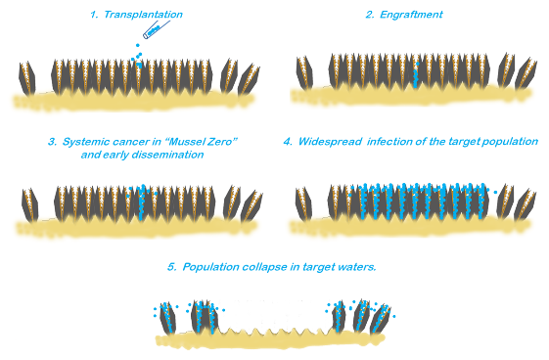
Environment
Current
Guardians of the Reservoir
Scoping
Management of Aquatic Vegetation in Canals
Success
Fish Exclusion/Fish Protection Prizes
Eradication of Invasive Mussels

Slide 13
Collaboration is Vital
Additional Perspectives, Opportunities, and Resources
Partnership Opportunities
Topic/Issue Identification
Subject Matter Experts for Design/Judging
Technical Support to Solvers
Solution Testing and Evaluation
Amplification of Competition
Monetary or Non-Monetary Recognitions/Contributions
Maturing Solutions

Slide 14
Jennifer Beardsley
Prize Competitions Program Administrator
jbeardsley@usbr.gov | 303.445.2127
https://www.usbr.gov/research/challenges
https://www.usbr.gov/research/docs/ks/ks-2019-04.pdf

