Slide 1
Settlement of Pueblo Water Rights in New Mexico v. Aamodt By Peter Chestnut, Alice Walker, & Richard Hughes August 24, 2021 17th Symposium on the Settlement of Indian Reserved Water Rights Claims

Slide 2
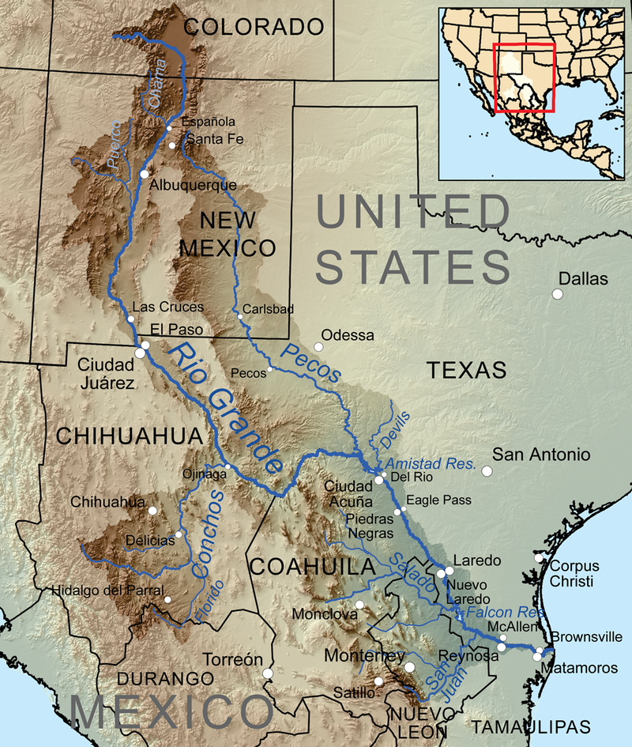

Slide 3
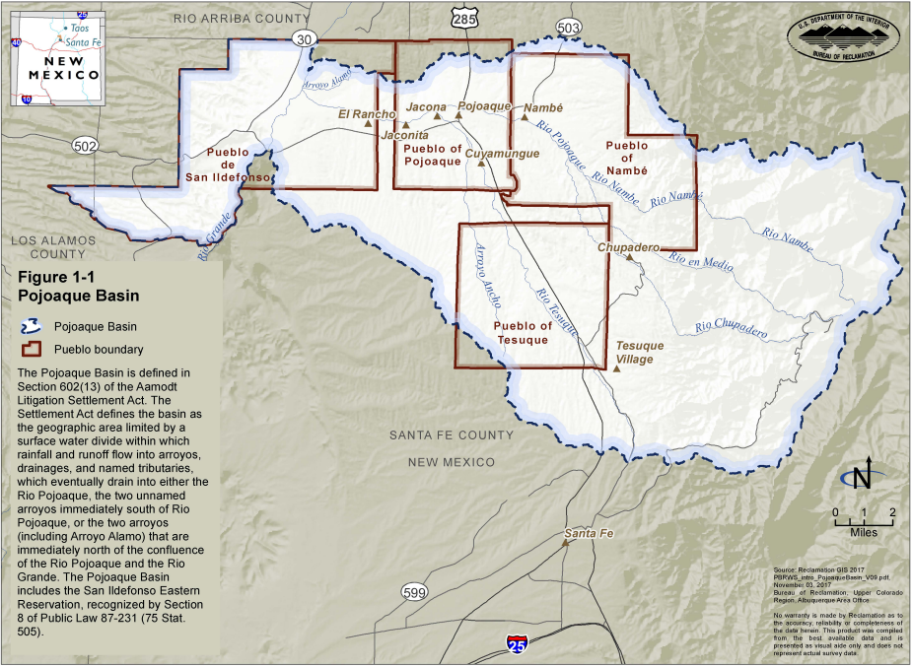

Slide 4
New Mexico v. Aamodt
Filed in 1966 in federal court by State Engineer to determine water rights in Nambé-Pojoaque-Tesuque Basin
Needed to determine water rights in order to assess costs of importing Colorado River water via San Juan-Chama Project and offset effects of constructing Nambé Falls Dam and Reservoir
United States and Pueblos intervened to assert aboriginal water rights for Pueblos

Slide 5
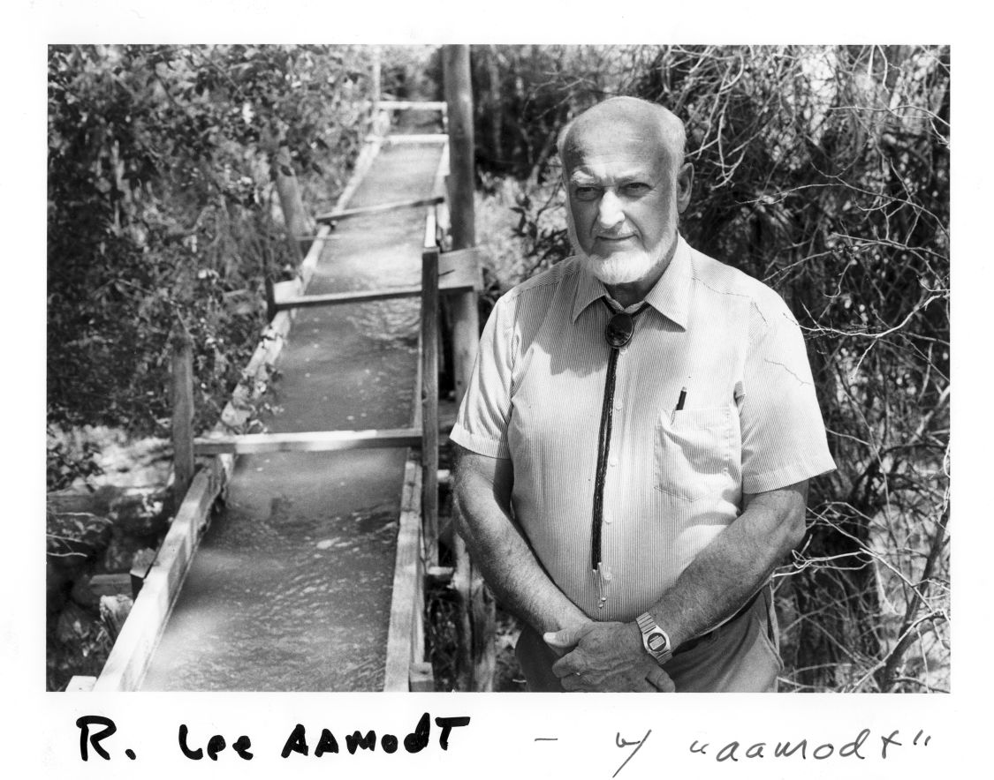

Slide 6
Primary Aamodt Parties:
State of New Mexico / State Engineer
City and County of Santa Fe
Individual claimants
United States
Four Pueblos

Slide 7
The Four Pueblos:
Pueblo of Nambé
Pueblo of Pojoaque
Pueblo de San Ildefonso
Pueblo of Tesuque

Slide 8
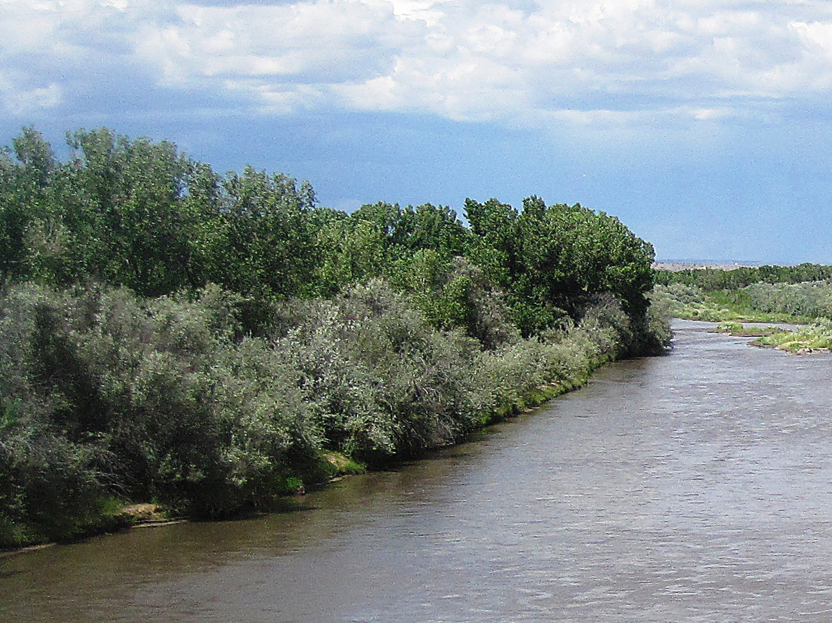

Slide 9
Pueblo Claims
Pueblos claimed time immemorial water rights preceding Spanish, Mexican, and U.S. law, and 10th Circuit confirmed their rights were prior to all non-Pueblos in New Mexico v. Aamodt (“Aamodt I”), 537 F.2d 1102 (10th Cir. 1976), cert. denied, 421 U.S. 1121 (1977).
District Court made key interlocutory holding in New Mexico v. Aamodt (“Aamodt II”), 618 F. Supp. 993 (D.N.M. 1985), but ruled Pueblo rights were cut off by the 1924 Pueblo lands Act:
“The Pueblos have the prior right to use all of the water of the stream system necessary for their domestic uses and that necessary to irrigate their lands. . . . The Pueblo aboriginal water right, as modified by Spanish and Mexican law, included the right to irrigate new land in response to need. Acreage brought under irrigation between 1846 and 1924 was thus also protected by federal law.”
“These rights have continued up until the present day . . . . ”

Slide 10
Pueblo Claims
Following Aamodt I and Aamodt II, the District Court quantified the Pueblos’ aboriginal water rights purportedly based on historically irrigated acreage between 1846 to 1924 but was mostly from a 1931 survey of Pueblo irrigated lands.
After 35 years of litigation without final resolution, the parties agreed to pursue a negotiated settlement that ultimately resulted in more water rights for the Pueblos than what the Court had found.

Slide 11
Settlement Timeline
1999
Settlement discussions begin
2006
Agreement on significantly modified settlement
2010
Aamodt Litigation Settlement Act
2012
Amended Settlement Agreement pursuant to Settlement Act
2004
Working draft of settlement
2007
Court adopts standards for approving settlement
2016
Partial Final Decree approving Settlement Agreement
2017
Final Decree
2018
10th Circuit rejects challenge to Settlement Agreement
2013
Show cause order for objections to Settlement Agreement
2009
Cost-sharing agreement

Slide 12
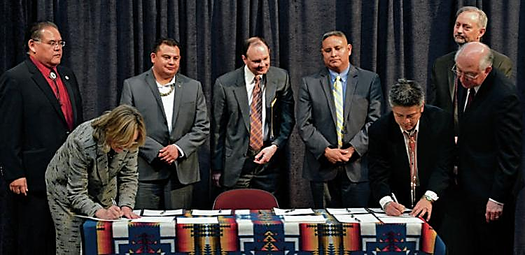
Notes:
Woman signing on left may be Kathy Holian a former Santa Fe County Commissioner. See https://farmersmarketinstitute.org/profile/kathy-holian/
The man standing behind Salazar looks like David Coss the former Mayor of Santa Fe. See https://www.santafenm.gov/david_coss

Slide 13
* Pueblos have first-priority water rights totaling 3,660 AFY (Existing Basin Use Rights and Future Basin Use Rights), plus other water rights
* Basin closed to new non-Pueblo groundwater appropriations
* Unlike Existing Basin Use Rights, Future Basin Use Rights generally not enforceable against non-Pueblos
* Non-Pueblo water users who comply with settlement not subject to Pueblo priority enforcement
* State Engineer acts as Water Master and must issue rules to administer water rights in Basin
* Centerpiece is Regional Water System funded by 2010 Aamodt Litigation Settlement Act
Key Terms of Settlement

Slide 14
General Benefits of Settlement
Pueblos
Provides firm, reliable water supply to be developed for general homeland purposes.
Non-Pueblos
Removes cloud of uncertainty hanging over Basin.
Everybody
Less reliance on groundwater use.
Avoids risks associated with litigation.
Local solution built on mutual trust.
Protects existing uses.

Slide 15
Objections to Settlement
Court received over 800 objections to Settlement Agreement from individual claimants.
Court rejected them all.
Objections generally fell into two categories:
(1) Settlement Agreement unlawfully altered the state water right priority system; and
(2) New Mexico Attorney General cannot approve Settlement Agreement without authorization from state legislature.

Slide 16
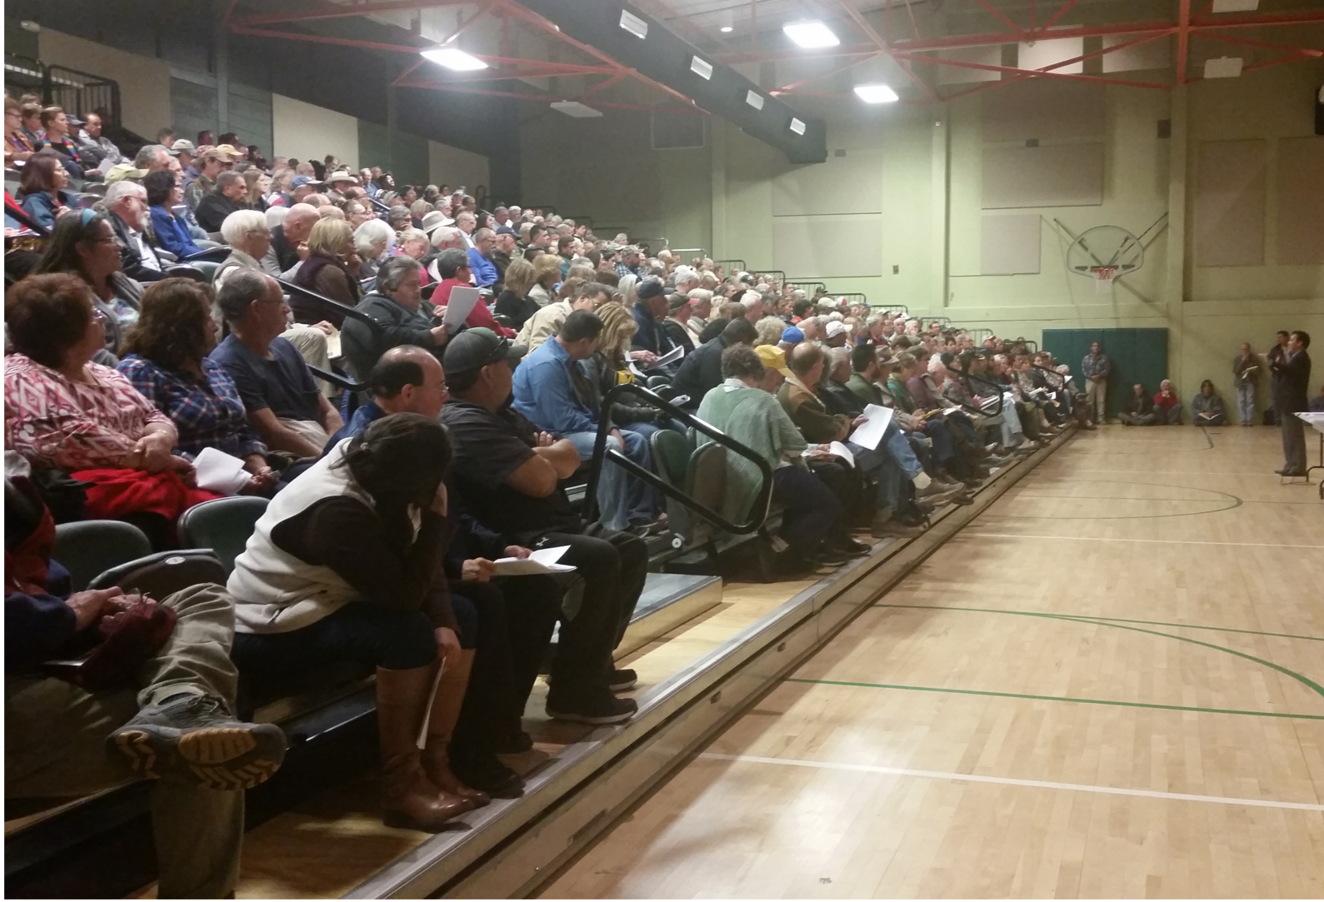

Slide 17
* Approved Pueblo water rights as set forth in Settlement Agreement
2016 Partial Final Decree
2017 Final Decree
* Incorporated Partial Final Decree and Settlement Agreement into Final Decree

Slide 18
* Objectors appealed to 10th Circuit, which held they lacked standing to challenge Settlement Agreement
Court of Appeals

Slide 19
Implementing the Settlement Agreement
State Engineer promulgated rules in 2017 to administer water rights in Nambé-Pojoaque-Tesuque Basin.
Final Environmental Impact Statement for Regional Water System in 2018 and Record of Decision in 2019.
Even so, implementation is difficult, complicated and lengthy, just like negotiating the settlement.

Slide 20
Regional Water System
Pueblos agreed to reduce claims in exchange for Regional Water System.
Will divert water from Rio Grande and deliver to Nambé-Pojoaque-Tesuque Basin.
Pueblos get 2,500 AFY and County gets 1,500 AFY.
Non-Pueblo well users must cease pumping before connecting to RWS.
Regional Water Authority consists of four Pueblo representatives and three County representatives per Joint Powers Agreement.
In addition to local contributions, 2010 Aamodt Litigation Settlement Act authorized $106.4 million in federal money for construction and $37.5 million for Pueblos’ share of OM&R.
Construction was to begin in 2018 but funding issues caused delays.
Notes:
Is three County reps accurate?

Slide 21
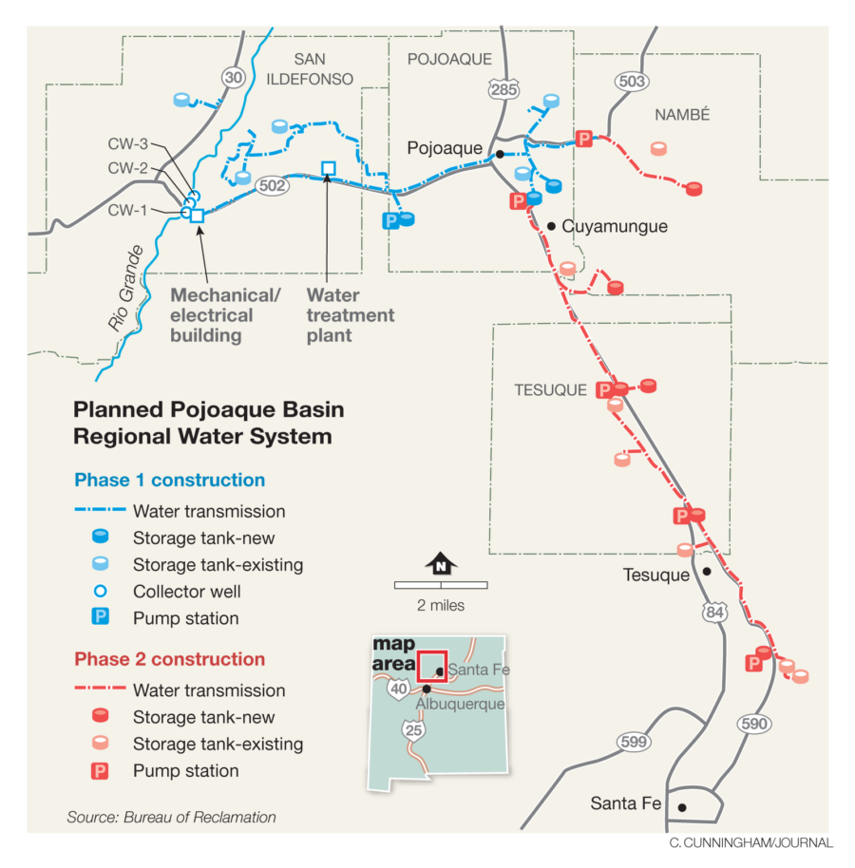

Slide 22
Funding Debacle
Became clear that funding amounts and time deadlines set out in Settlement were inadequate.
Original engineering was conceptual only and substantially underestimated true costs.
Following 2010 Act, Bureau of Reclamation made detailed examination of project design and cost.
Actual cost more than doubled original estimate, requiring congressional approval of amended settlement.

Slide 23
611(g) Negotiations
Finding that cost would exceed available funds triggered negotiations under 611(g) of the Settlement Act.
Total project cost $406 million, so $137 million needed in federal funds.
Negotiations took a year, from August 2018 to September 2019.

Slide 24
611(g) Agreement
611(g) Agreement reduced initial water production from 4,000 AFY to 2,500 AFY.
Starting with two collector wells instead of four.
State agreed to increase its contribution to $100 million and County pledged an additional $24 million.
$137 million needed for federal share.
Substantial completion deadline extended to 2028.
Major change in definition of substantial completion.

Slide 25
Substantial Completion
Section 623 of 2010 Settlement Act required delivery of 2500 acre-feet per year to Pueblos in order to have substantial completion.
Failure to reach substantial completion gave Pueblos the option to void settlement and return to litigation.
611(g) Agreement changed substantial completion criteria:
Secretary diligently pursues construction.
Spends all authorized funding.
Even if not completed, these actions now constitute substantial completion.
Project-based settlement fund-based settlement.

Slide 26
OMB Approval
2018
Administration support for amendments to Settlement Act required approval by Office of Management and Budget.
May 2019
Parties met with OMB in May 2019.
July 2019
Support from settlement partners, especially Santa Fe County, helped obtain OMB approval in July 2019.

Slide 27
Limited Construction
2010 Settlement Act made $140 million available for Regional Water System construction.
Bureau of Reclamation would not authorize construction to begin until all funding necessary was authorized by Congress.
Bureau of Reclamation allowed only limited construction while waiting for additional federal funding authorization.

Slide 28
August 10, 2020
Limited construction begins . . . .

Slide 29
Congressional Action
Bills introduced in House and Senate to amend Settlement Act.
Congressional Budget Office determined that new funding would not be funded from Bureau of Reclamation Indian Water Settlement Fund.
Senate bill did not move in House.
Final amendments included in FY 2021 Consolidated Appropriations Act.

Slide 30
Consolidated Appropriations Act for 2021
President Trump signed Consolidated Appropriations Act for FY 2021 in December 2020.
Increased federal funding for RWS from $106.4 million to $243.4 million.
Extended deadline for substantial completion of RWS to June 2028 (formerly 2024).

Slide 31
Omnibus Appropriations Act
Act authorized $137 million in additional funding to implement the settlement for a total federal contribution of $243.4 million, indexed.
Extended the date for substantial completion from 2024 to June 30, 2028.
Approved 611(g) Agreement.
Did not change Aamodt priority for access to Bureau of Reclamation Indian Water Rights Settlement Fund.

Slide 32
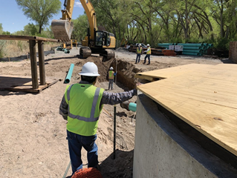
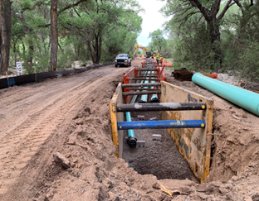
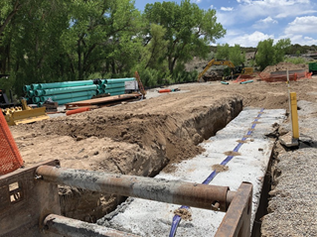
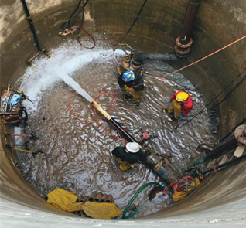
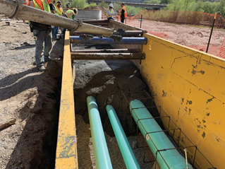
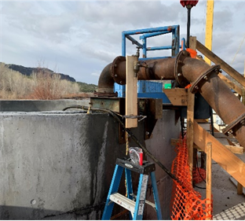
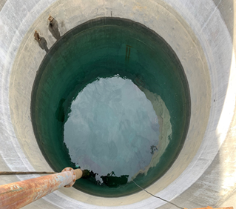
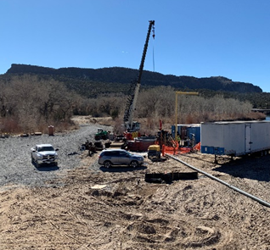

Slide 33
Lessons Learned
Settlement projects require careful design, with competent cost figures.
If a settlement project must be fund-based, involved Indian tribes must take all steps to ensure sufficient funding for the project.
Indian tribes should insist on significant control over project design and contracting.

Slide 34
