Slide 1

Tribes and the Colorado River:
Arizona’s Perspective
Nicole Klobas
Chief Counsel
Arizona Department of Water Resources
August 8, 2023

Slide 2
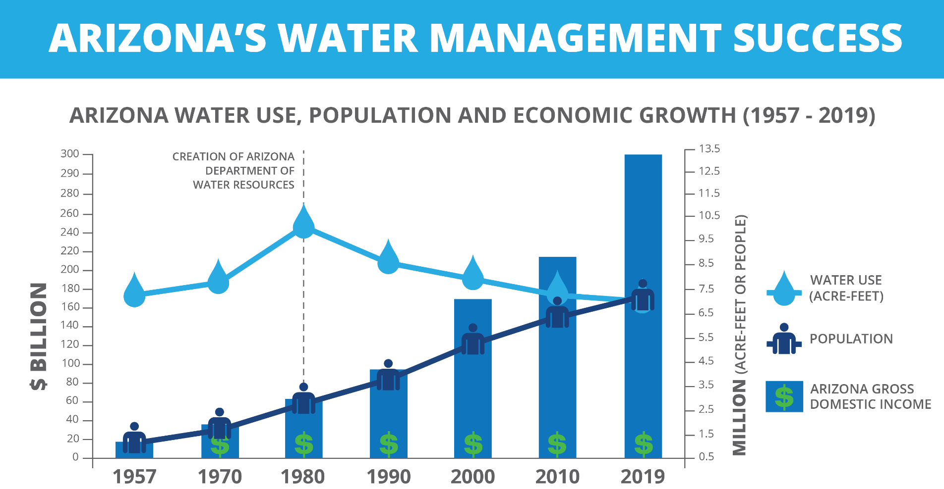
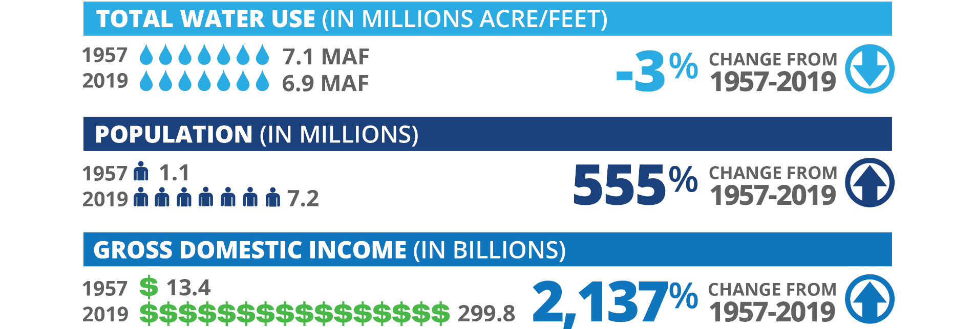

Slide 3
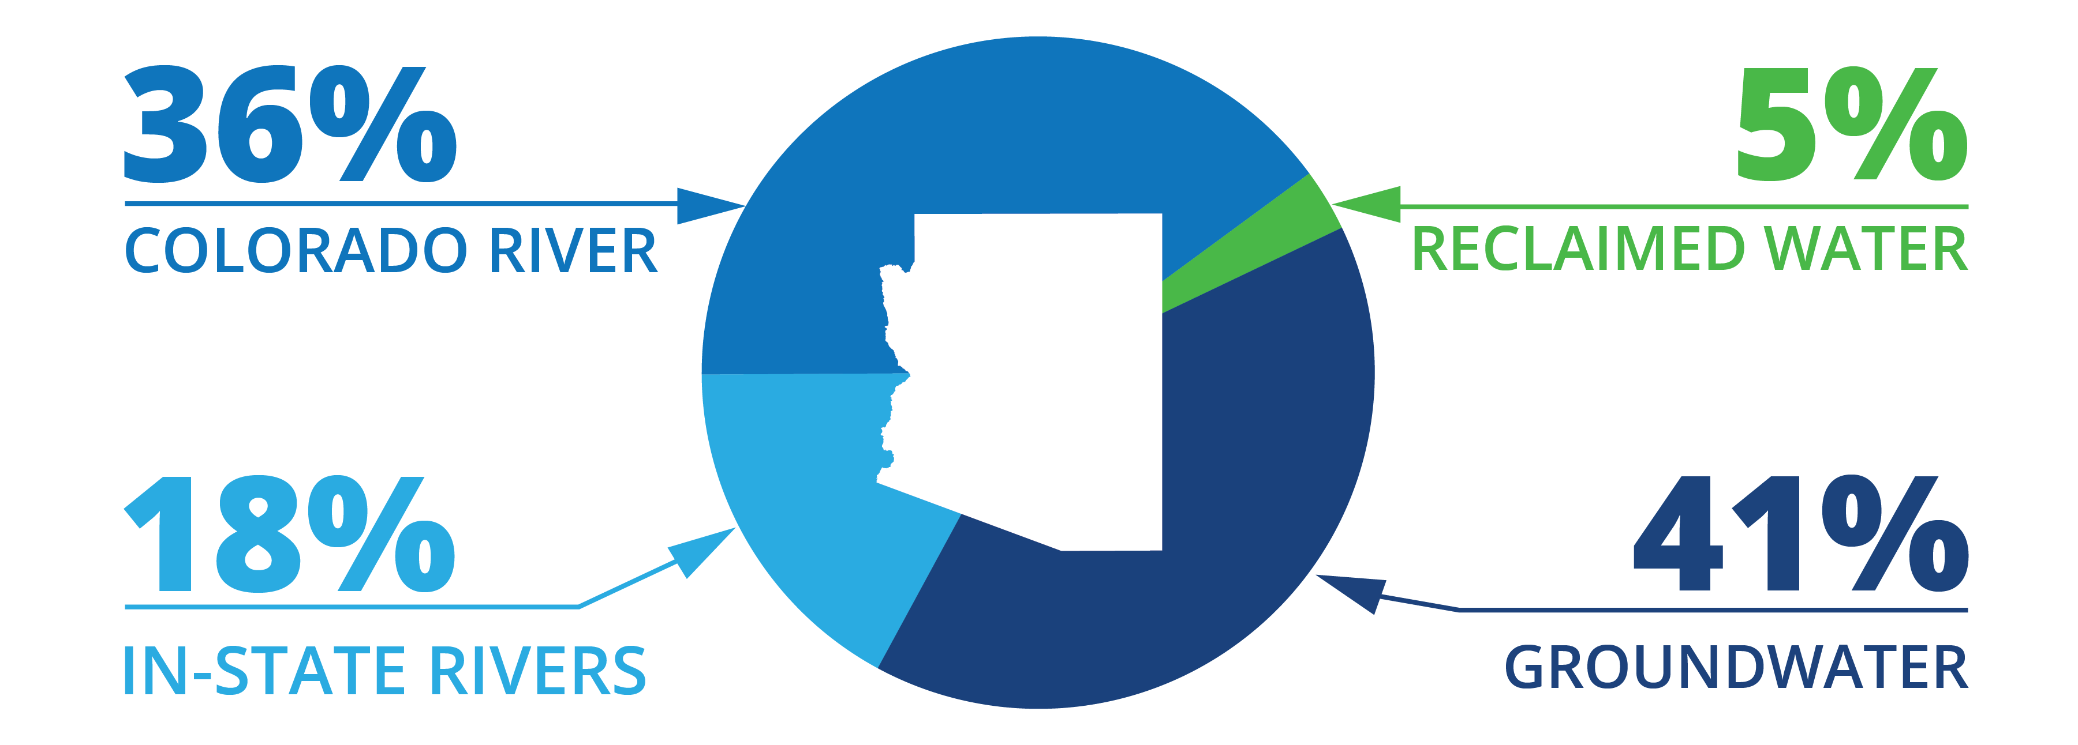
Arizona Water Use By Source (2019)

Slide 4

Arizona’s Colorado River Use (2022)
_{.5%}
11.1%
_{On-River Wildlife Refuge}
11.4%
On-River Tribal
‘07 Guidelines Reduction
6.9%
DCP Contribution
24.7%
9.8%
On-River AG
Conservation
(ICS & System)
1.4%
34.2%
On-River M&I
CAP
Notes:
28.1% reductions

Slide 5
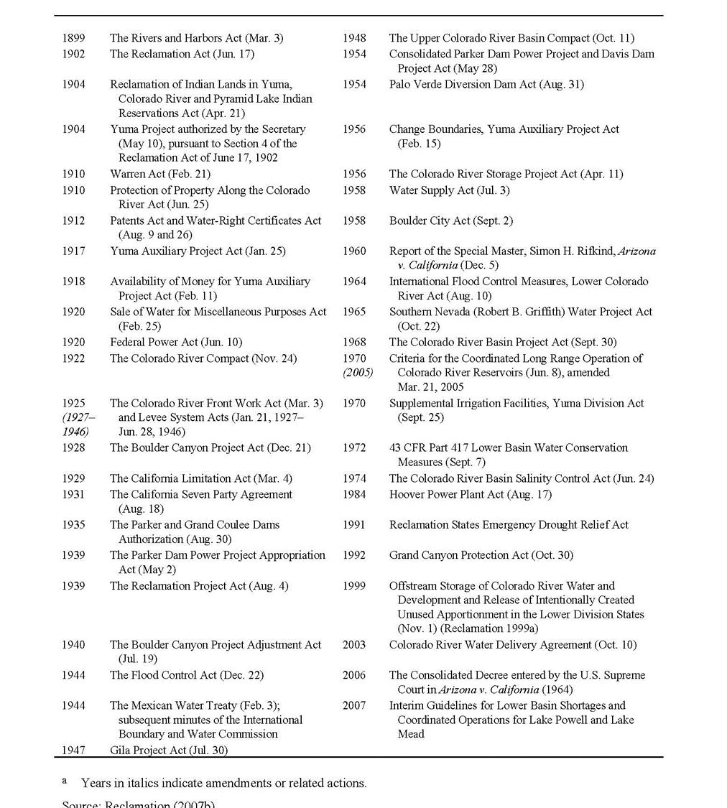
Law of the River
1.9.4 Law of the River
The treaties, compacts, decrees, statutes, regulations, contracts, and other legal documents and agreements applicable to the allocation, appropriation, development, exportation, and management of the waters of the Colorado River Basin are often referred to as the Law of the River. There is no single, universally agreed upon definition of the Law of the River, but it is useful as a shorthand reference to describe this longstanding and complex body of legal agreements governing the Colorado River. Documents generally considered to be part of the Law of the River include those listed in Table 1-2.
Glen Canyon Dam Long-Term Experimental and Management Plan Draft Environmental Impact Statement, December 2015 (emphasis added).

Slide 6
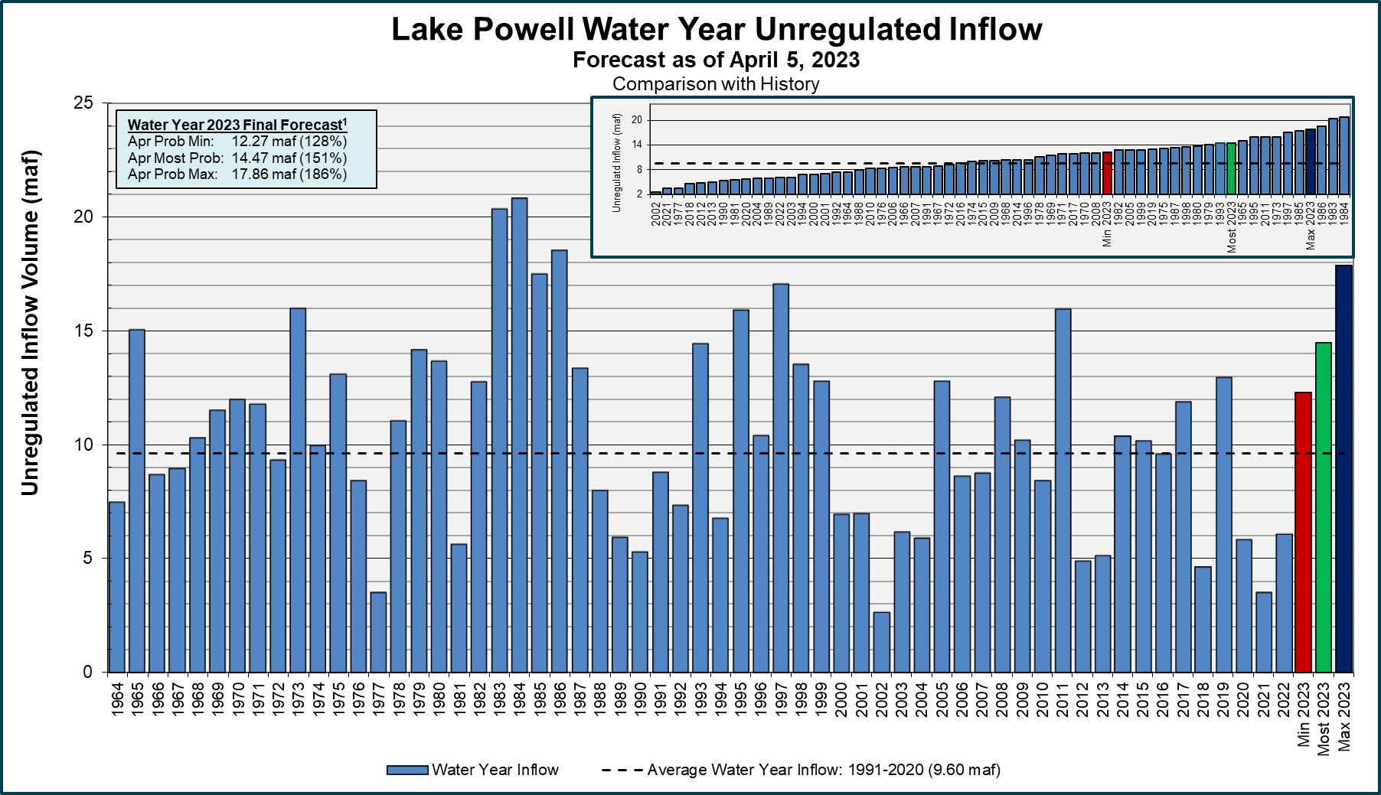

¹Water Year statistics are based on the 30-year period of record from 1991-2020.

Slide 7
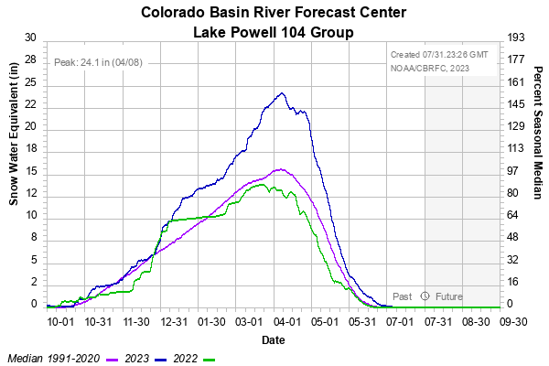
Basin Snow-pack and inflow projections
Snowpack vs. Runoff (% of average)
 | Snowpack | Runoff
2020 | 105% | 61%
2021 | 86% | 37%
2022 | 90% | 63%
April 2023* | 161% | 145%
Notes:
Graphic updated July 18, 2023. Snowpack peaked on April 7 at 161% of Median.
Note: These are based on WY unregulated inflow totals. Mid-month Apr WY forecast down slightly: ~13.9 MAF or 145% of average.

Slide 8
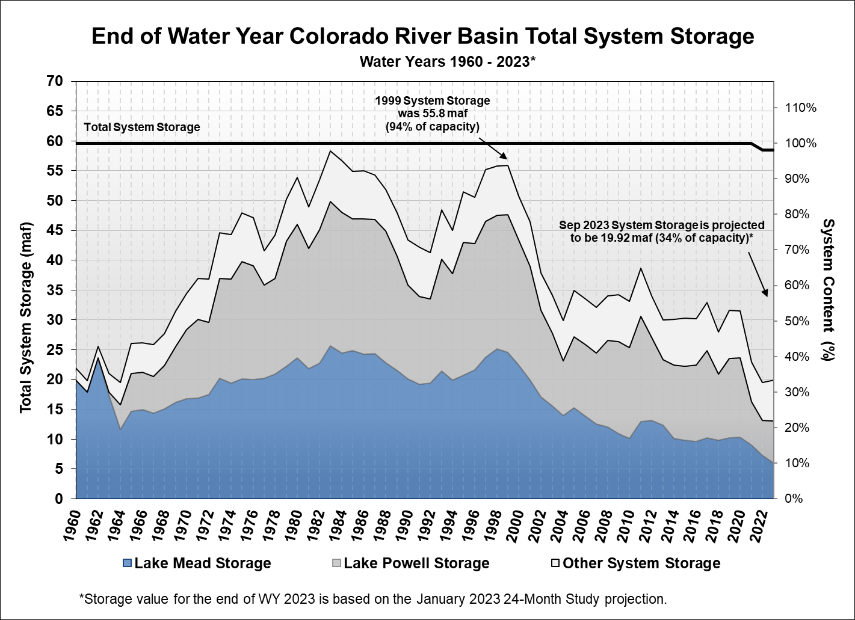
Notes:
System storage includes: UB: Powell, Flaming Gorge, Fontenelle, Blue Mesa, Morrow Point, Crystal and Navajo, LB: Mead, Mohave and Havasu
System Storage as of 4/30/23: 19,796 KAF or 34%
(5/1/23 Water Supply Report)

Slide 9
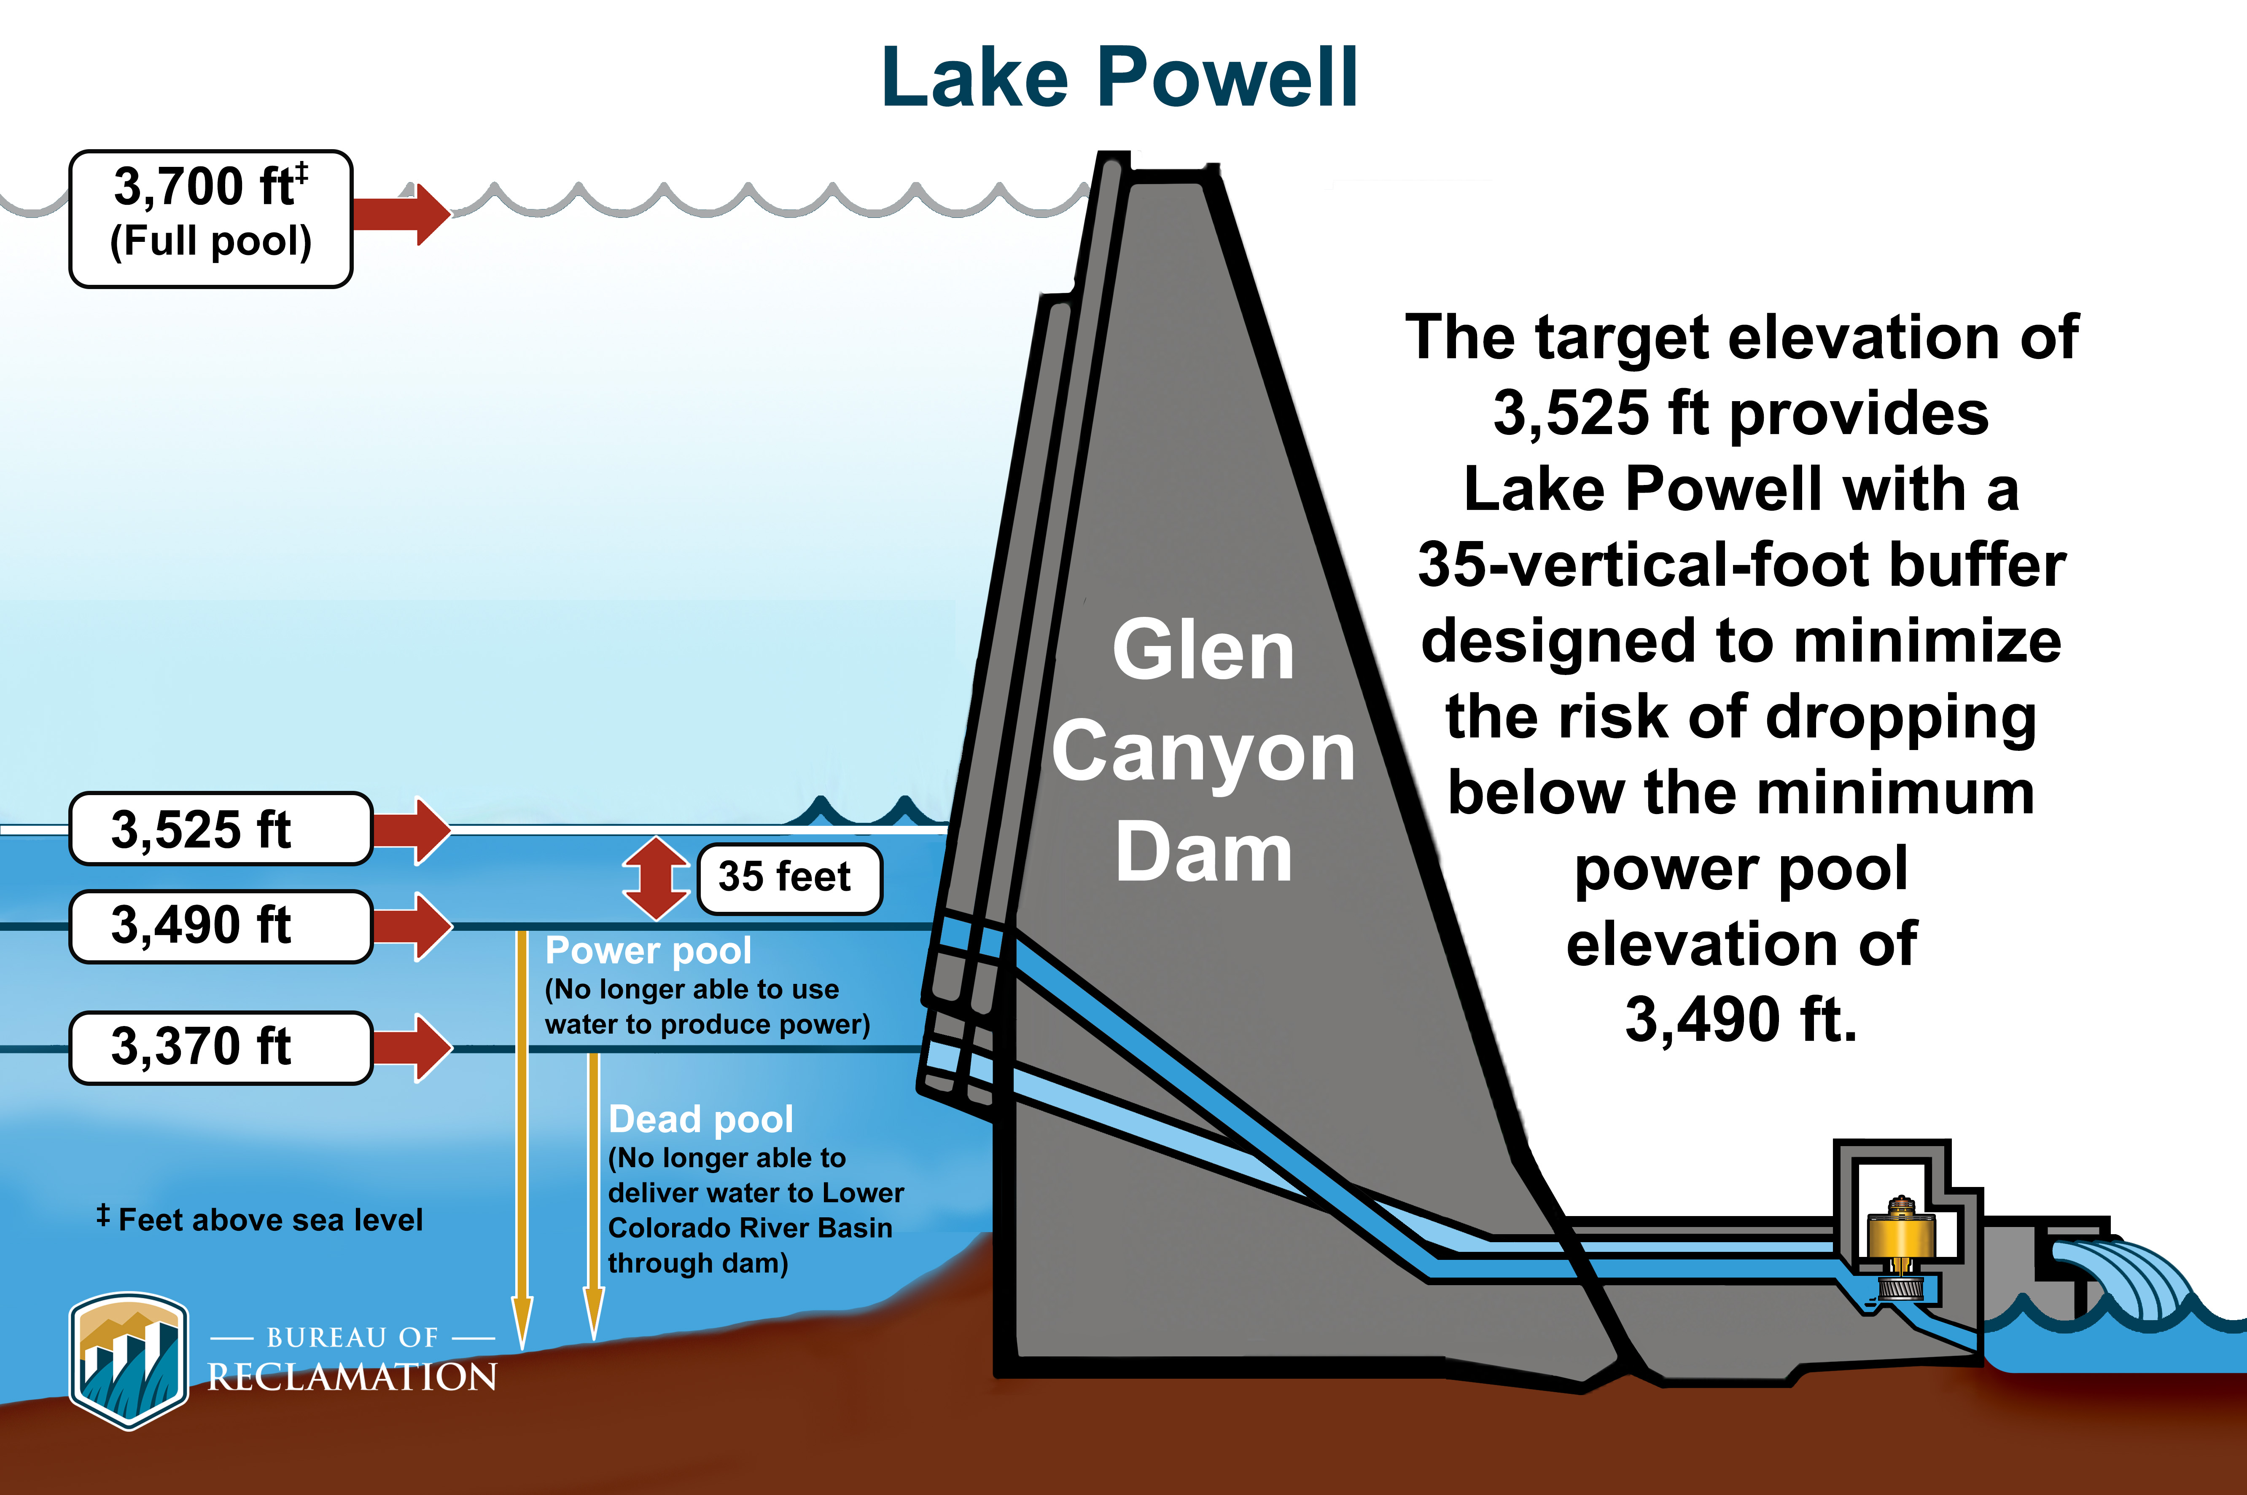
Lake Powell – Key Elevations

Slide 10
Arizona’s Recent Colorado River Use
Based on Draft 2022 USBR Decree Accounting
~1.7 MAF
~1.1 MAF
Provisional data; subject to change
10
Notes:
BRENDA
This is a chart showing Arizona’s recent Colorado River use under a Tier 1 shortage condition. This provides a general reference of the magnitude of the supplies. On the left is the use along the mainstem of the Colorado River. On-River consumptive uses do fluctuate a bit as there is a fair amount of agricultural use and in total is about 1.1 MAF. You can see the split between 1st Priority (approximately 500 KAF) and Priorities 2 and 3 is about the same. There is a small portion of 4th priority on-river use (about 50 kaf). On the right is the CAP supply. There is a small piece of 3rd priority, but a bulk of the supply CAP delivers is 4th priority. Both categories show System Conservation.

Slide 11
CAP Priorities—Full Supply
“Block Chart” illustrates delivery requests by CAP priority
  Higher priority entitlements are towards the bottom of the chart
The names of the “pools” do not neatly align with uses
Assumptions for 2024:
  1.595 MAF delivery supply prior to reductions
  Water orders similar to 2023
  Includes NIA Reallocation
← Lower ---- Priority ---- Higher→
Cities & Industry
Tribes
Notes:
BRENDA
The majority of the CAP water supply is “junior” to other Colorado River water users in Arizona and the Lower Basin, so most of the shortage impacts fall to CAP water users. However, there are also priorities within the CAP system that affect those impacts.
To illustrate priorities in the CAP system, we use this “block chart” in which the size of the blocks is proportional to the volume of water anticipated to be ordered in 2024. We won’t know final numbers until orders are placed in October, so these numbers are provisional. This version is also showing how those orders would be filled if we had a full delivery supply in 2024, which we won’t.
In this chart, the highest priority is at the bottom, and the lowest is on the top. One thing to note is that the names of the priorities do not perfectly align with how they are used. For instance, some of the Indian priority supply is leased to cities. This is also true for the so-called “NIA priority” supply, which is allocated to a mix of tribes and cities. The NIA Priority pool factors prominently in our discussion today because those are the first category of CAP long-term contract supplies to be reduced.

Slide 12
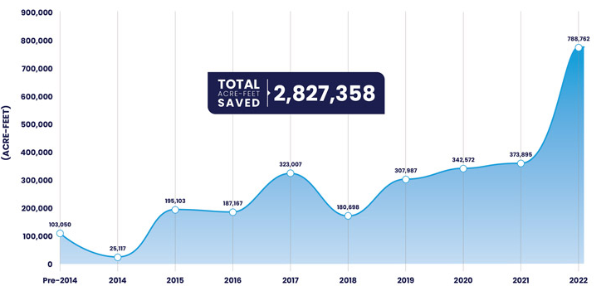
Arizona Conservation & DCP Contributions

Slide 13
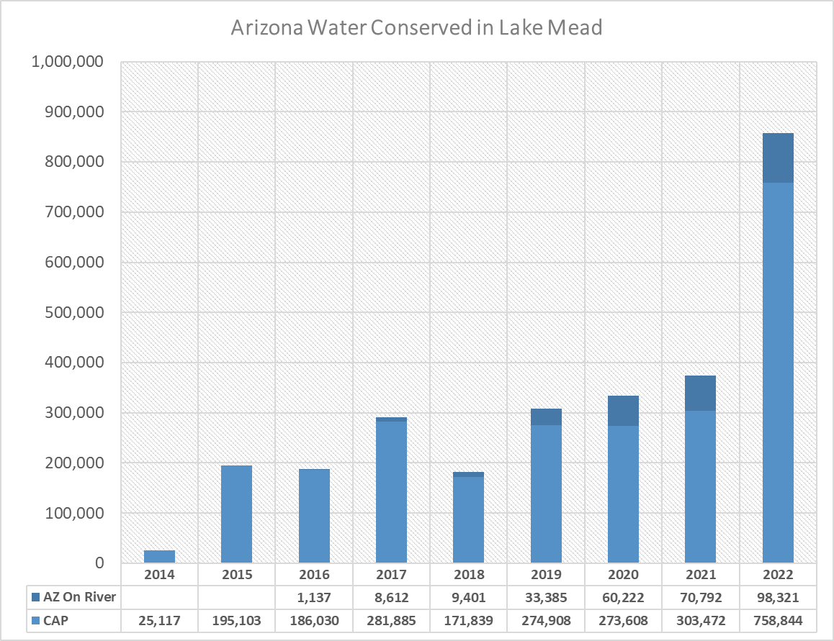
Arizona Colorado River Water Conserved in Lake Mead
DCP Contribution = 192 KAF
Shortage Reduction and DCP Contribution = 512 KAF
Includes
2007 Guidelines
DCP Contributions
ICS Creation
Voluntary System Conservation Programs

Slide 14
Arizona’s 2023 Reductions & Contributions
Tier 2a Guidelines shortage reduction | 400 KAF
Tier 2a DCP contribution | 192 KAF
Reclamation funded System Conservation | ~272 KAF
ADWR-CAWCD ICS Preservation | ~43 KAF
Total | ~907 KAF
August 8, 2023
14

Slide 15



















Arizona’s 2023 Reductions & Contributions
Arizona parties contributing water in 2023:
August 8, 2023

Slide 16
Measures to Protect the System
2007 Interim Guidelines – conjunctive management + shortage + ICS
2014 Lower Basin Memorandum of Agreement
2019 Drought Contingency Plans
2021 500+ Plan
2022 DROA and Secretarial action to protect critical elevations
2023 NEPA Supplemental Environmental Impact Statement
Bipartisan Infrastructure Law (2021)/Inflation Reduction Act (2022) funding
August 8, 2023
16

Slide 17
Supplemental EIS Purpose
DOI recognizes that operational strategies must be revisited due to critically low reservoir elevations, and potential for worsening drought which threatens critical infrastructure and public health and safety
Potential impacts of low runoff conditions in 2022 and 2023 pose unacceptable risks to operations of Glen Canyon and Hoover Dams
Development of modified operating guidelines will inform operations in 2023-24; and may also inform potential operations in 2025-26
Scoping comments were due by December 20, 2022
August 8, 2023
17

Slide 18
Lower Basin Consensus Proposal
On May 22, 2023, the Lower Colorado River Basin States announced a consensus proposal to conserve at least an additional 3 million acre-feet of Colorado River Water in the Lower Basin by the end of calendar year 2026 with at least 1.5 MAF of that total being conserved by the end of calendar year 2024.
They requested that the proposal be fully analyzed as an action alternative in the Bureau of Reclamation’s Near-Term Colorado River Operations Draft Supplemental Environmental Impact Statement published in April.
August 8, 2023
18

Slide 19
Lower Basin Consensus Proposal, cont.
Also, on May 22, the Seven Basin States submitted a letter requesting a suspension of the comment period on the Draft SEIS, which was scheduled to close on May 30, 2023, and also requested analysis of the Lower Basin Proposal.
On Friday, May 26, Reclamation published a Federal Register Notice (88 Fed. Reg. 34151) and officially withdrew the Draft SEIS.
A new Draft Supplemental Impact Statement will be issued later this year (incorporating more recent hydrology) with a new comment period.
August 8, 2023
19

Slide 20
Post-2026 Guidelines
The current Interim Guidelines sunset at the end of Calendar Year 2026.
New operating criteria, and any supporting legislation and agreements, need to be effective before January 1, 2027.
The Notice of Intent to prepare an Environmental Impact Statement was published in the Federal Register on June 16, 2023.
  60-day Scoping Period, with Scoping Comments due by August 15, 2023.
  Anticipated 6-month “alternative development” phase.
  DRAFT EIS planned for December 2024.
August 8, 2023
20

Slide 21
Arizona Reconsultation Process
Basin States Process
BOR Process
Basin States*
ROD & Federal Legislation***
Arizona Strategy Team**
AZ Technical Work Groups
AZ Technical Work Groups
Technical Work Groups
Arizona Reconsultation Committee (ARC):
Arizona Colorado River stakeholders including: cities, Tribes, agriculture, CAP users, industry, development, NGOs, and elected officials
*By invitation to support the co-Chairs
**Requires confidentiality agreement for legal advice and negotiating strategies
***Federal legislation if necessary

Slide 22
Post-2026 Process: Tribal Engagement
Reclamation is establishing a Federal-Tribes-States Group, led and facilitated by Reclamation.
The Group will include the 30 Colorado River Basin Tribes and representatives of each of the seven Colorado River Basin States, and the United States.
Inaugural meeting scheduled for August 10.
August 8, 2023
22

Slide 23
Considerations of Importance to Arizona
Account for the supply and demand imbalance.
Examine system contents.
Better enable conjunctive management of Lake Mead and Lake Powell.
The outcome must account for reduced flows through the Colorado River.
Also, the scope must anticipate a wide range of alternatives.
Seek Basin-wide solutions with burdens shared across the Basin.
Arizona tribes are a vital component within the Arizona discussion.
Collaboration with Mexico should occur simultaneously.
August 8, 2023
23

Slide 24

Questions?
Nicole Klobas
Phone: 602.771.8472
Email: ndklobas@azwater.gov
Website: new.azwater.gov w.azwater.gov
Twitter: @azwater

